Slide 1
ICS 300 – ICS For Expanding Incidents
NORTHWELL HEALTH
NASSAU COUNTY, NY
APRIL 4-6, 2017

Slide 2
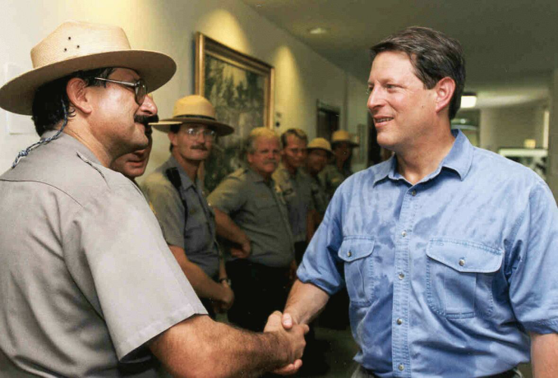
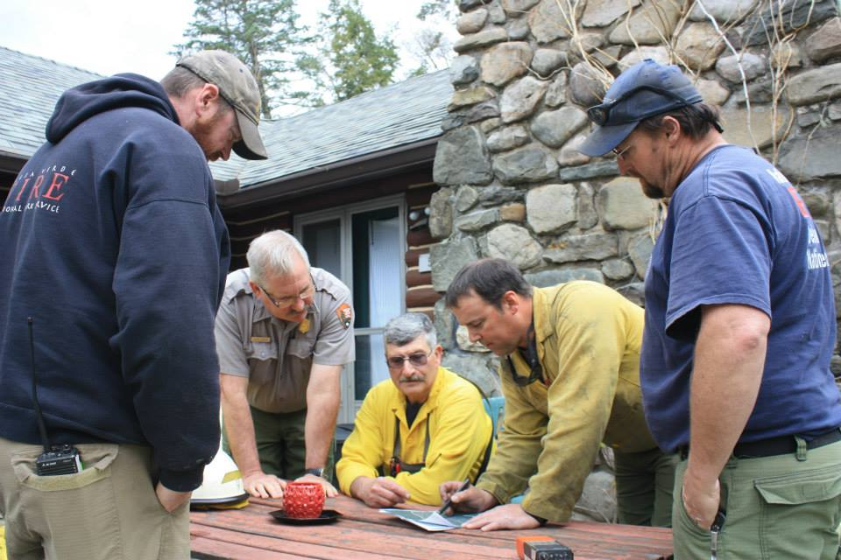
Instructor Introductions – Lead Instructor
  Bob Panko
    Retired in Nov 2007 after 36 calendar years with NPS
    USNPS Ranger / Supv Ranger / Asst Chief Ranger / District Ranger
    USNPS Fire & Aviation Man Officer Everglades NP
    Mt Rainier, Everglades, Shenandoah, Statue of Liberty / Ellis Island, Biscayne & Everglades
    ICT2 – SA IMT2 (2007-2010) & NPS Eastern All Hazard IMT 1993-2004
    Liaison Officer SA IMT1 Red Team 2011-2012, LOFR & Ops SC SA GOLD Team 2013-15.
    Presently Operations SC with NYS IMT2
    Risky Business Incident Management LLC “sole member”

Slide 3
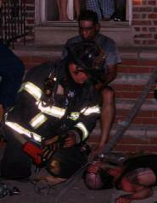
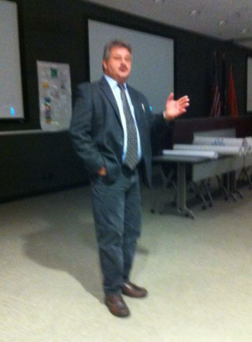
Instructor Introductions
  Jim Hay
  Captain FDNY with 30 years in the department
  Retired from FDNY 2012
  Member of FDNY National Type 2 IMT as Information Officer, Liaison Officer and Haz-Mat Specialist since the Team was formed in 2004
  Multiple out of state assignments with FDNY IMT for wildland fires, floods and hurricanes
  Presently Director of Fire & Life Safety for USTA Billie Jean King National Tennis Center
  Instructor/Coach NY DHSES
  Member NY State IMT2
  NYWIMA instructor/ICS coach

Slide 4
Student Questions
1-I have experience on multiple incidents/events managed using ICS and worked on these assignments as a member of the Command & General Staff
2-I have been on incidents/events managed under ICS, but always worked as a Unit Leader or Single Resource
3-I have had I100 & I200 training, but have had no real life experience in using ICS in real life incidents or events.
4-I have many years of emergency management experience, but have had very little involvement with incidents managed under ICS

Slide 5
Student Introductions
Name
Day Job / Who you work or volunteer for
Your past experience in emergency & incident management – ICS positions you performed in the past
Expectations from attending this course

Slide 6
Operational Period Briefing
Current Situation
Objectives
Predictive Information
Assignments
Safety
Logistics
Finance
Planning
Information
Liaison
Agency Reps / Agency Administrator
Close Out

Slide 7
Instructor Expectations
  This course is about teaching you the ICS processes of managing multi-day incidents/events
  It is predicated that you are functioning as a Type 3 Incident Management Team on scene and in command of an incident/event (NOT in an EOC, though principles may be applicable to EOC operations)
  Exhibit mutual cooperation with the group.
  Be open minded to new ideas.
  Use what is presented in the course to perform effectively within an ICS organization.
  Participate actively in all of the training activities and exercises.
  Return to class at stated time.

Slide 8
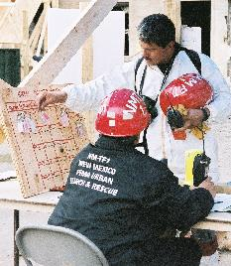
I-300 Course Objectives (1 of 2)
  Describe how the National Incident Management System (NIMS) Command and Management component supports the management of expanding incidents.
  Describe the incident/event management process for supervisors and expanding incidents as prescribed by the ICS.

Slide 9
I-300 Course Objectives (2 of 2)
  Implement the incident management process on a simulated Type 3 incident.
  Develop an Incident Action Plan for a simulated incident.
This course is designed to enable personnel to operate efficiently during an incident or event within the Incident Command System. This course focuses on management of expanding incidents.

Slide 10
Course Structure
Unit 1:
Course
Overview
Unit 2:
ICS Fundamentals Review
Unit 4:
Incident/Event Assessment & Incident ObjectivesUnified
Unit 3:
Unified Command
Unit 6:
Incident Resource Management
Unit 5:
Planning Process
Unit 7:
Demobilization, Transfer of Command, & Closeout
Unit 8:
Course Summary

Slide 11

Successful Course Completion
  Participate in unit activities/exercises (these instructors consider that part of passing grade)
  Achieve 70% or higher on the final exam
  Complete the course evaluation

Slide 12
Activity: Student Expectations
Instructions:
Meet in your assigned team to:
  Introduce yourselves and state how you can contribute to the team.
  In practical exercises what role might you fill for the team (IC, PIO, Safety, Liaison, Operations, Plans, Logistics or Finance/Admin Section Chief)
  As a team, record any additional expectations for this course on chart paper.
Be prepared to report in 15 minutes.

Slide 13
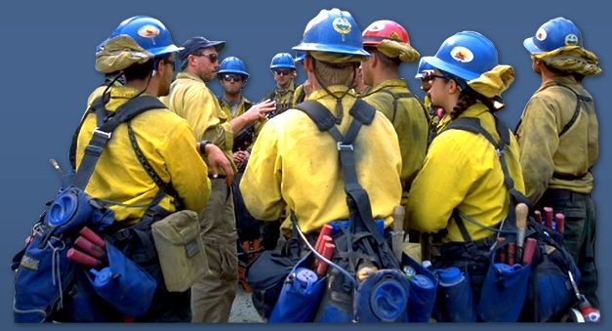
Summary
Are you now able to:
  Describe the course objectives?

