Slide 1
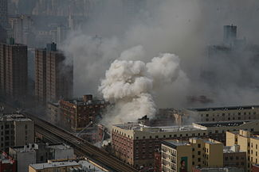
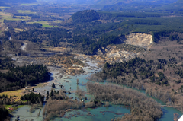
NIMS/ICS Working Nationwide
Response to 2 Similar Incidents
Across the Nation
March 2014

Slide 2
Both major collapses with buried victims
Very Different Environments / Both ICS managed
Oso, Washington Mudslide
March 22, 2014 1037 hours:41 fatalities/4 serious injuries/2 missing
Harlem Building Collapse, NY, NY, March 12, 2014 0931 hours
8 fatalities/70+ injuries
Initial Response
CIMS – FDNY Single Command Incident
FDNY IMT3 – 5 Operational Periods active – 24 hour OP’s with shift changes.
Assumption that eventual transfer of command to normal responsible municipal agencies after 5 OP’s.
Densely urban. Huge volume of response resources immediately available
Initial Response
Washington State IMT3 – four operational periods
Transfer of command to Washington State IMT2 (Team 4) – 14 Operational Periods - 24 hour OP’s with minimally staffed overnight shift.
Transfer of command to Washington State IMT2 (Team 3) – 11 OP’s
Transfer of command back to Washington State IMT3
Extremely Rural, IA resources limited. Tactical resources had to come from long distance away.

