Slide 1

Meet & Greet Buffet Dinner – May 3, 2018
Presentation Goals
1-Introduce Friends of Pachaug Forest to the attendees
2-Discuss the Environmental Impact Evaluation Process used by the State of Connecticut (including SCOPING)

Slide 2

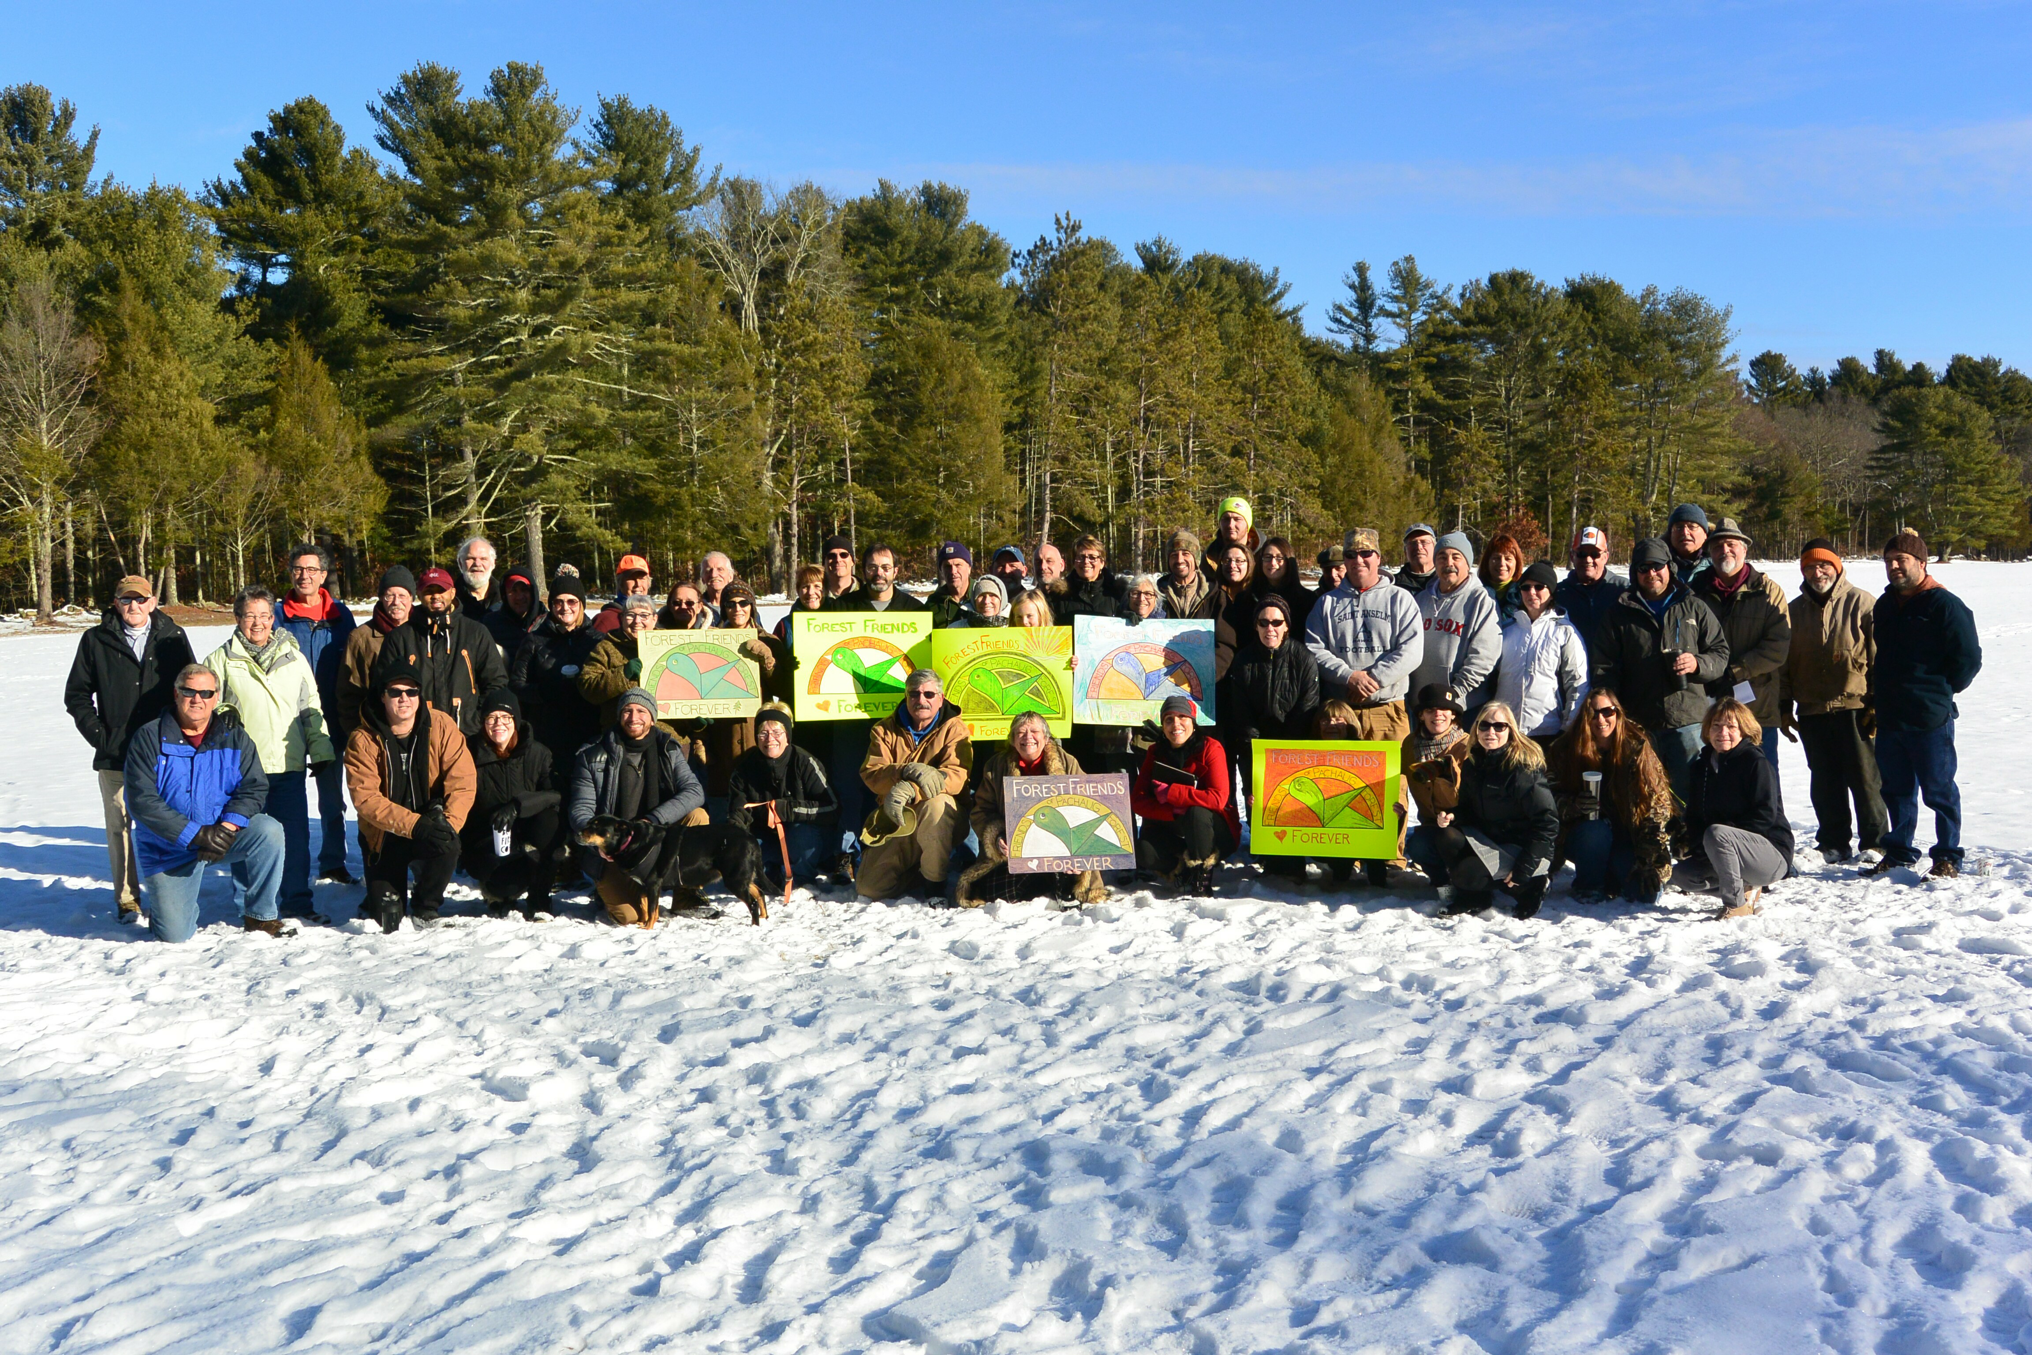
WHO WE ARE
WHY WE ARE
WHAT WE ARE
WHERE WE ARE
WHERE ARE WE GOING?

Slide 3
WHO WE ARE
About a dozen folks that were all involved in different grass roots groups that stood against the State Range project
Recognized that the Range was a Regional not “Town by Town” issue which is how the State has been treating it
Started meeting in early November 2017 discussing forming a non-profit corporation
WHEN WE MET WE DISCOVERED
We all had deep common interests in Pachaug Forest:
  Applied Conservation
  Recreational Use
  Educational Access and Use
  Cultural / Historic preservation
  Volunteerism to Assist the Forest

Slide 4
Mission Statement:
Friends of Pachaug Forest, Inc. is a group of volunteers whose mission is to sponsor, and/or participate in events and activities that promote educational opportunities about Pachaug Forests resources; and to preserve and protect the unique quality and character of Pachaug Forest.
WHO WE ARE
So we set about forming a non-profit corporation.
Corporation established mid December 2017
Application submitted to IRS mid January and 501 (c) (3) status granted by IRS in mid February 2018

Slide 5
We are not organized as an “anti State Range” group; but the potential Range Project in the midst of Pachaug State Forest is the biggest conservation “elephant in the room” issue and we are proactive about it.
WHY WE ARE:
Networking with other environmental & conservation organizations.
Obtain grants to support Forest activities & land purchases to add to Pachaug State Forest or provide protected easements.

Slide 6
New friends in our communities
Opportunities to do stuff in the Forest together that is FUN
WHY WE ARE:
In our individual “grass roots” backgrounds that led us here together we discovered something else:

Slide 7
WHY WE ARE: Guiding Principles
Support the implementation of approved Conservation and Development Plans with Griswold, Voluntown, Preston, Plainfield, Sterling, and North Stonington.
As a stakeholder of the Pachaug Forest, assist CT Department of Energy and Environmental Protection (DEEP) in their Forest management activities by providing both scrutiny and advocacy of proposed actions of CT DEEP in their management of the Forest. This includes current and future DEEP Forest Resource Management Plans and other Forest management policies and practices.
To provide opportunities for the public and students of all ages to engage in agricultural, aquatic, forestry management, conservation, recreational, and wildlife use and education;
To sponsor, host and/or participate in events and activities that promote educational opportunities about Pachaug Forest’s resources and to preserve the forest for future generations;
Involve a focus on sustainable development, ecotourism, native American culture, conservation biology, community health, land use planning, and social justice

Slide 8
WHY WE ARE
Our programs are to include, but not limited to, raising social consciousness about the Forest and it’s conservation on a local and state level, and to hold fundraising events in order to provide immediate protection to the forest. To maximize our impact on current efforts, we may seek to collaborate with other non-profit organizations which fall under the 501 (C)(3) section of the internal revenue code and are operated exclusively for educational and charitable purposes. At times, per the discretion of the board of directors, we may provide internships or volunteer opportunities which shall provide involvement in leadership, activities, and programs in order to have a greater impact for change.
To purchase, accept, exchange, inherit, lease, transfer/ sale and otherwise acquire real and personal property/ assets for the purposes of furthering the mission of Friends of Pachaug Forest, Inc.
To identify and survey the needs for community support, and develop better coordination between other stakeholders to promote ingenuity/creative solutions to conserve the forest.

Slide 10
WHAT HAVE WE BEEN DOING?
Lets start this with the observation it is now May 3.
Friends of Pachaug Forest, Inc. has only been an approved Non-Profit since mid February (10 weeks ago)
We feel we have accomplished a lot in a very short period of time

Slide 11
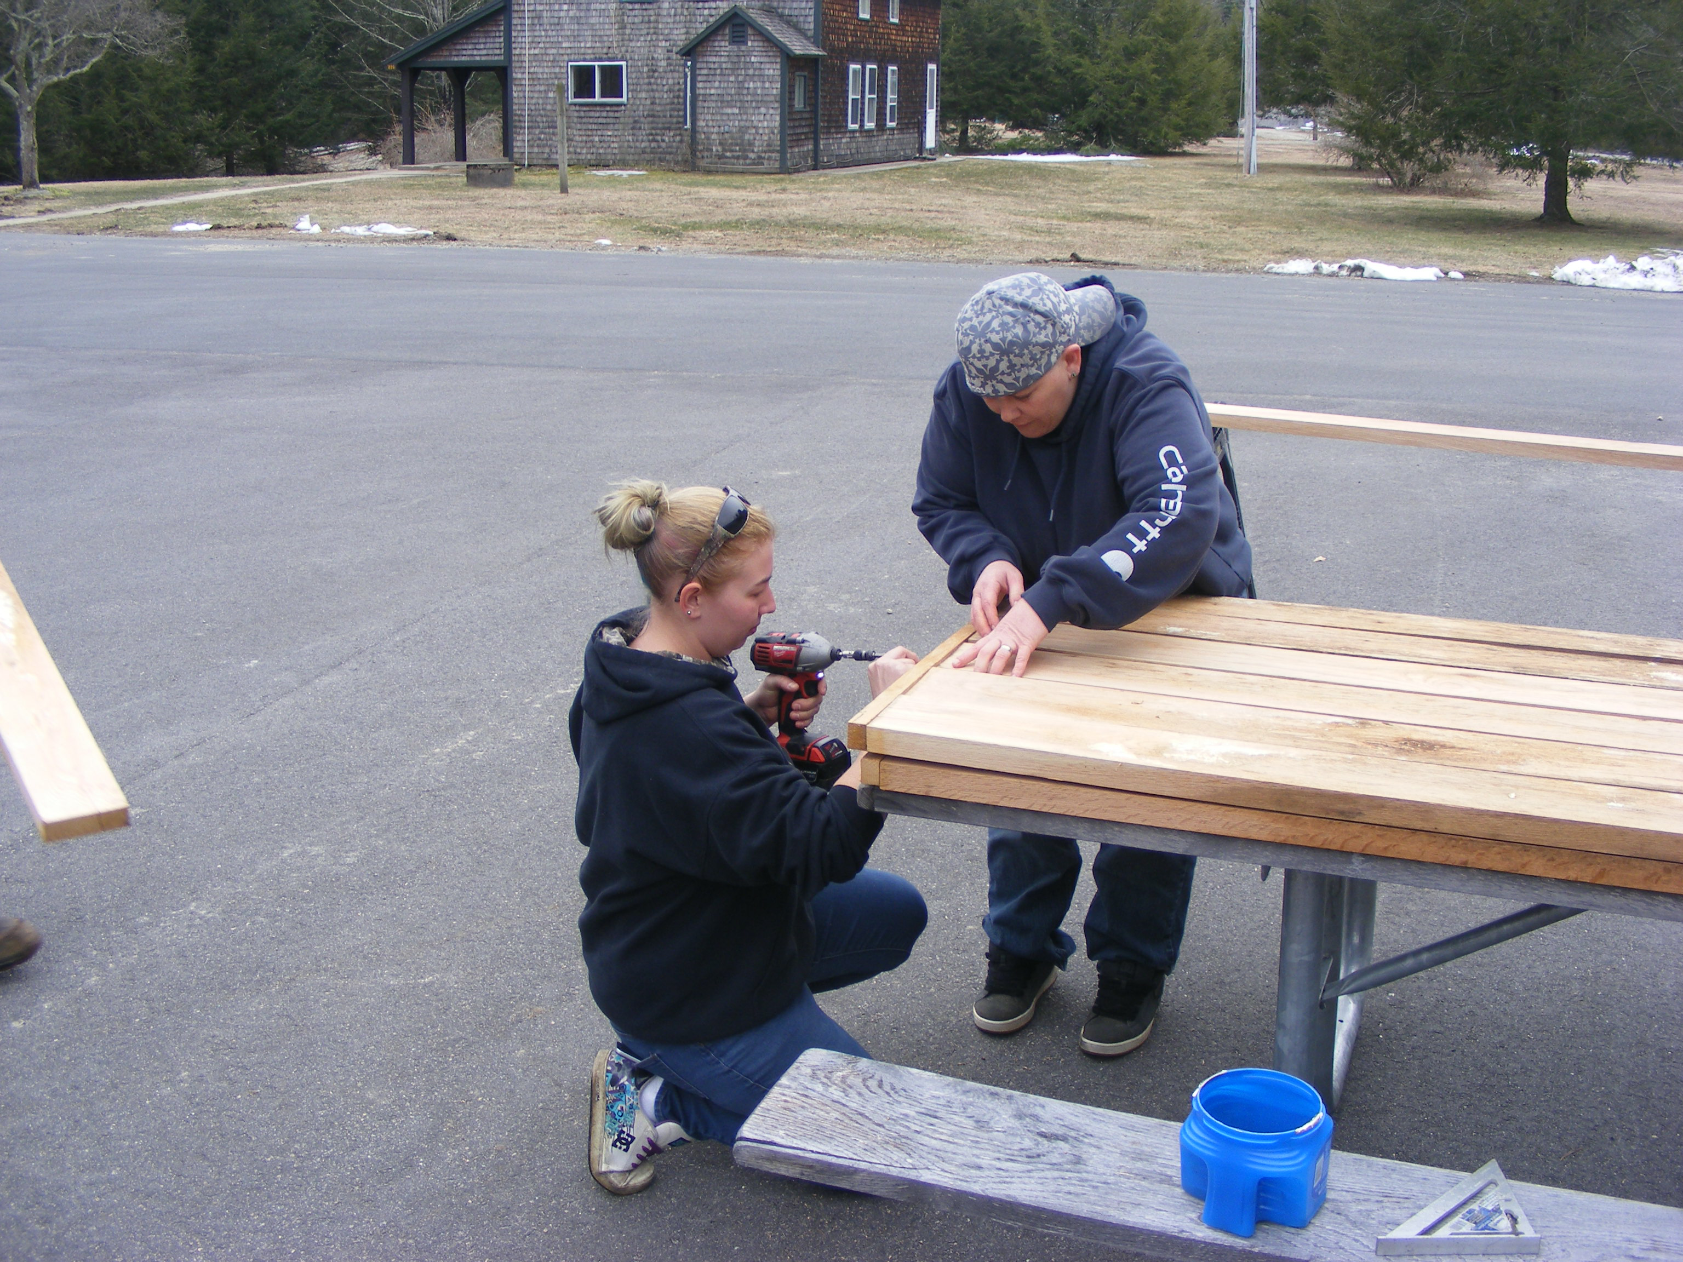
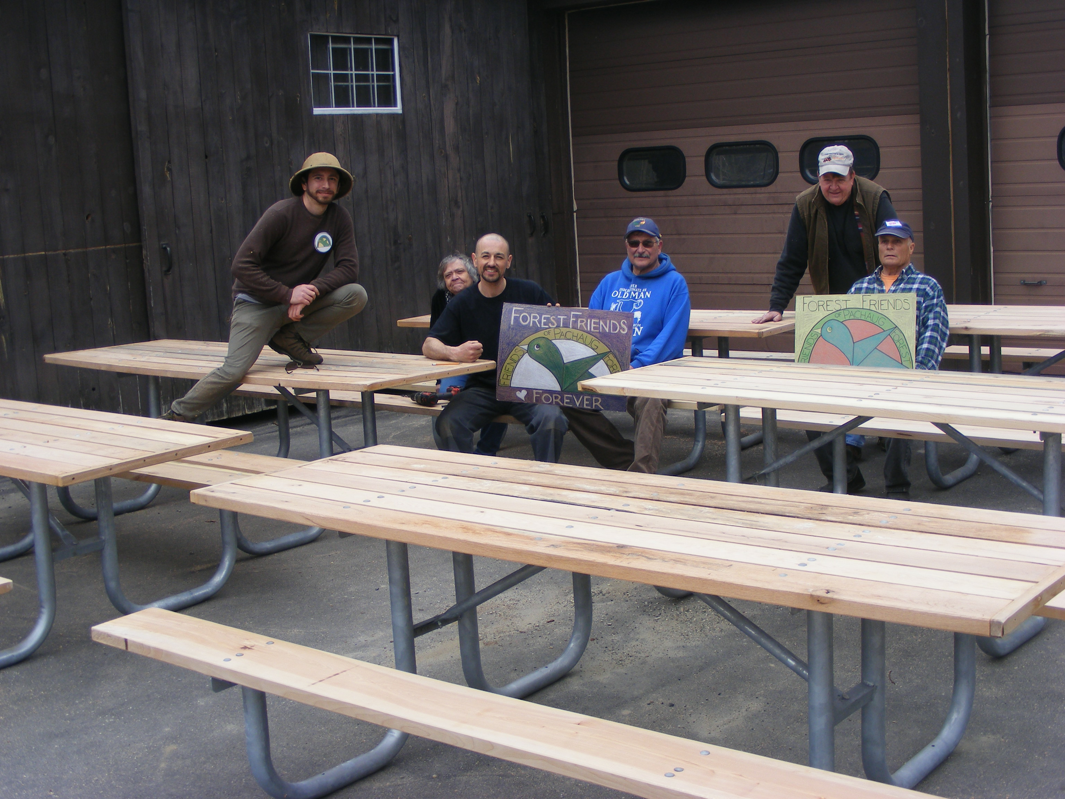
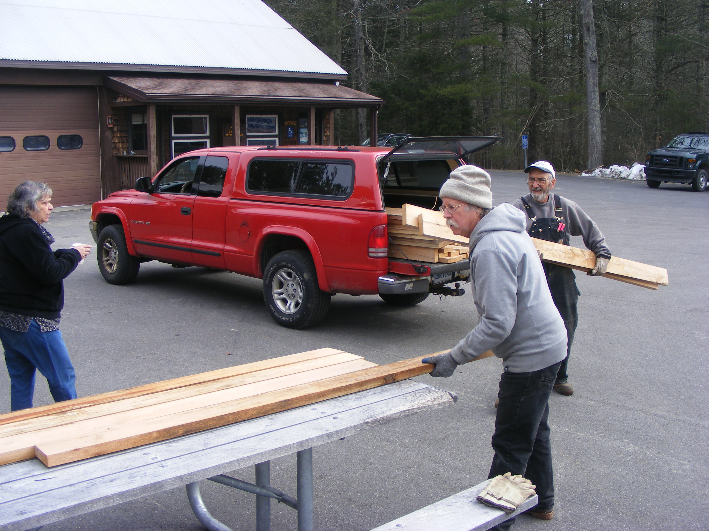
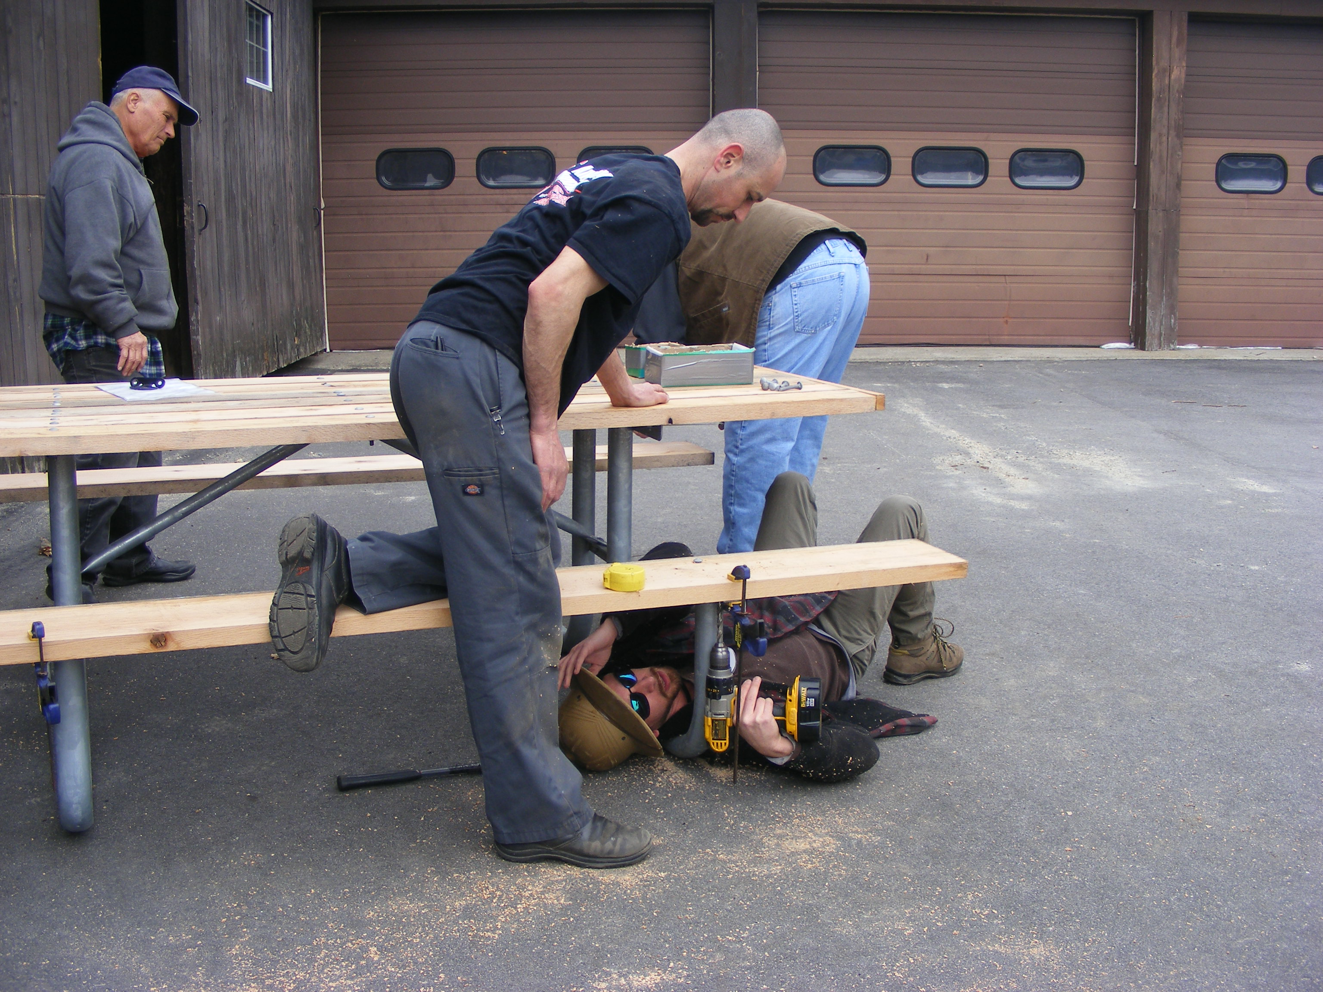
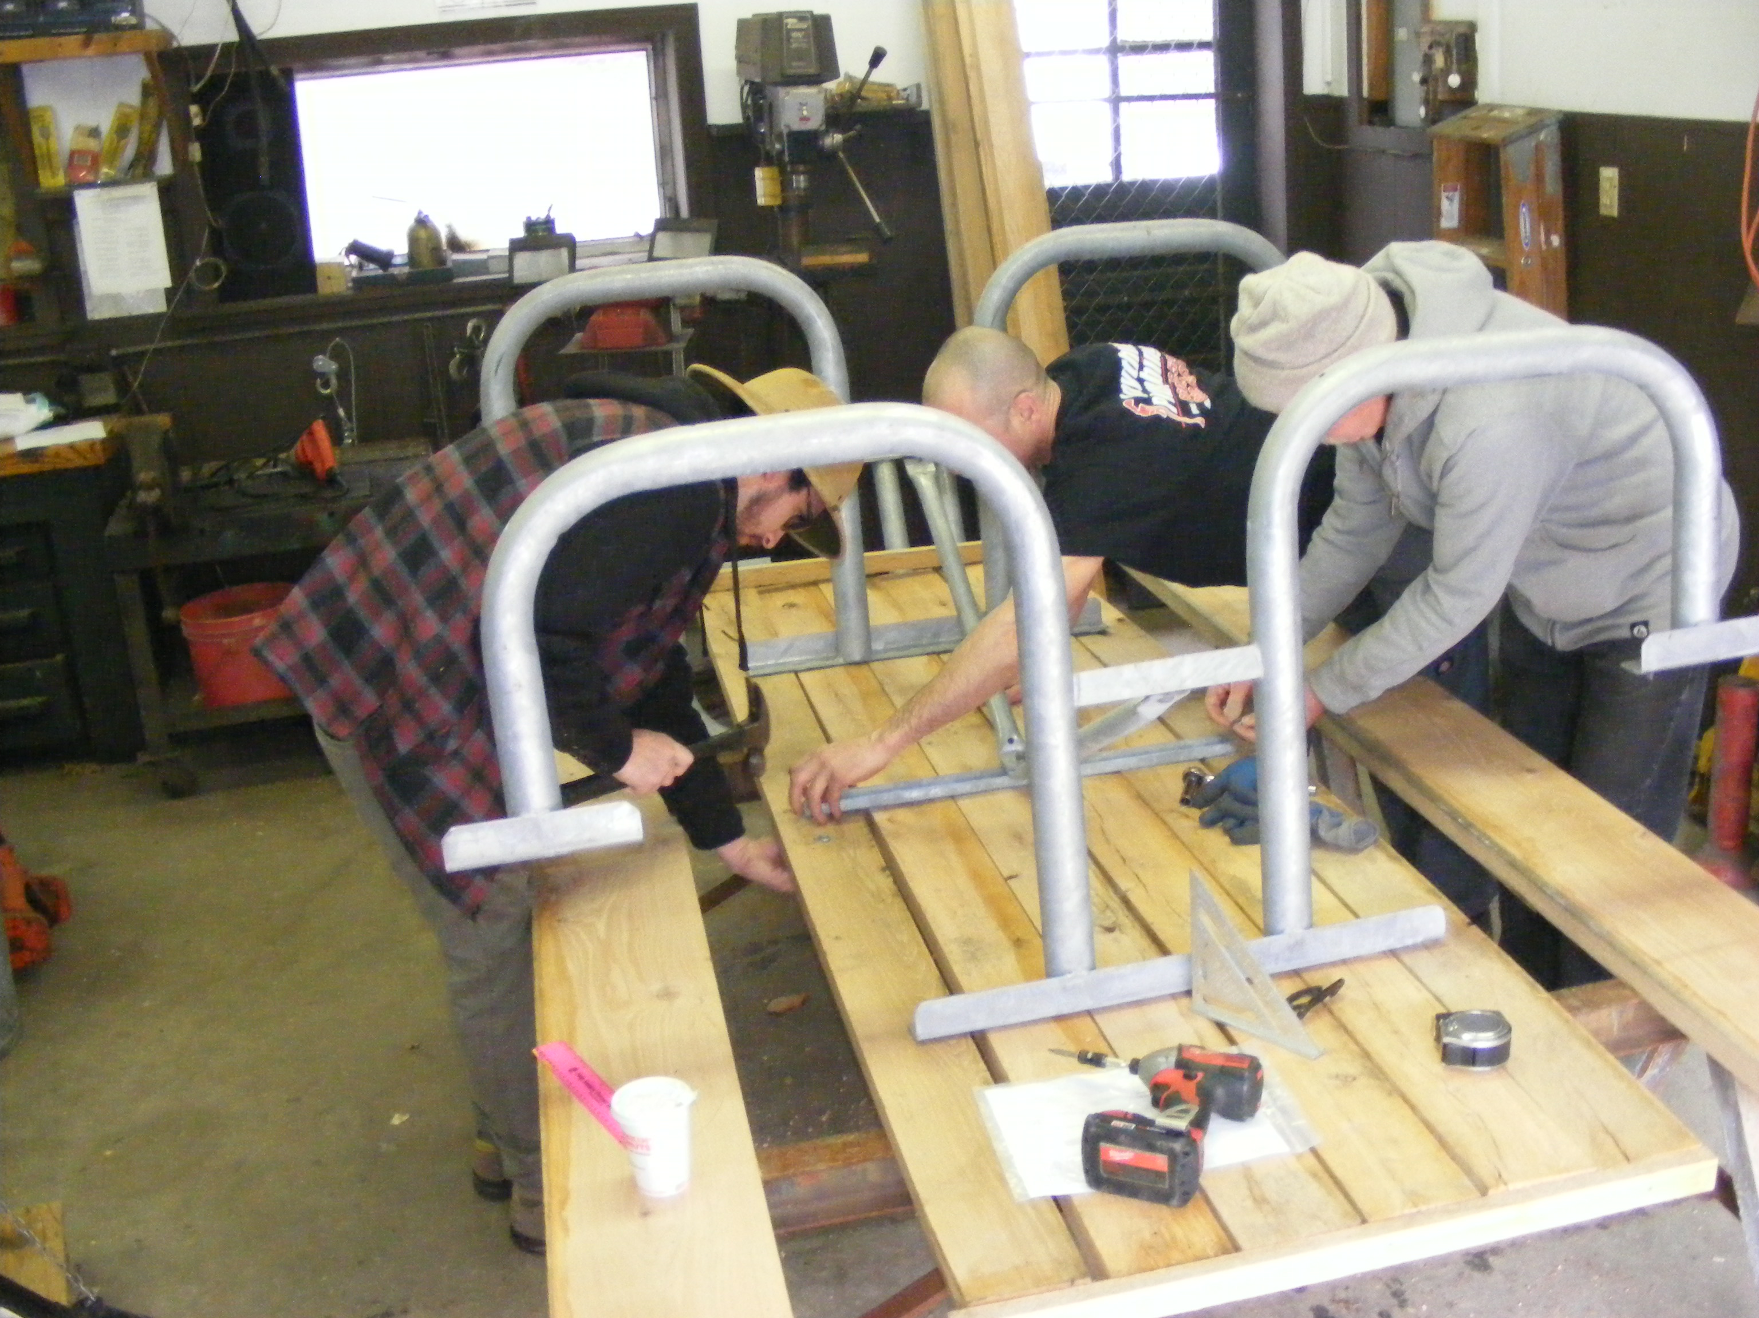
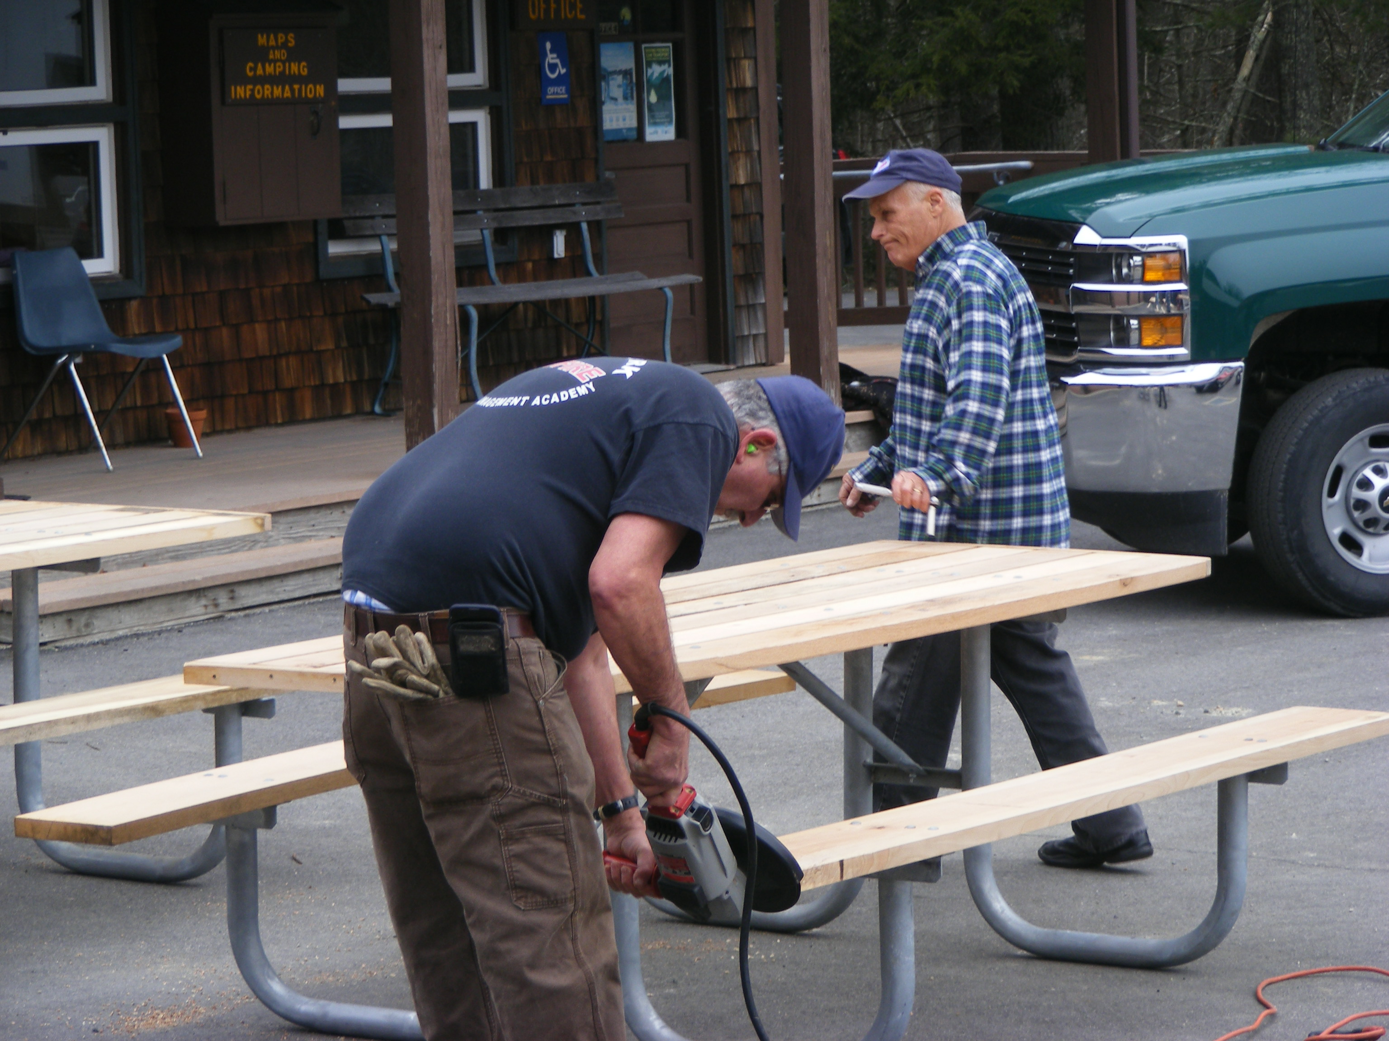
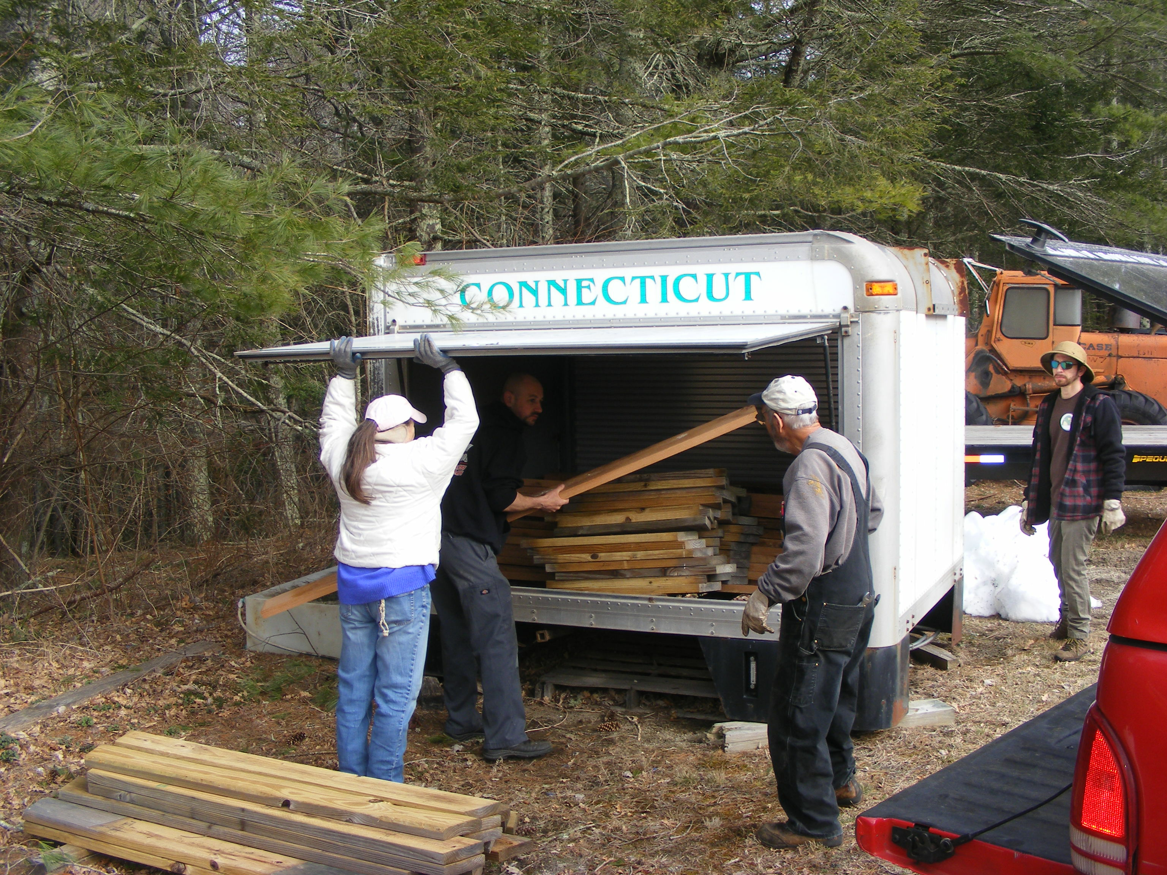
WHAT HAVE WE BEEN DOING?
PROJECTS COMPLETED SO FAR
Picnic Table Assembly

Slide 12
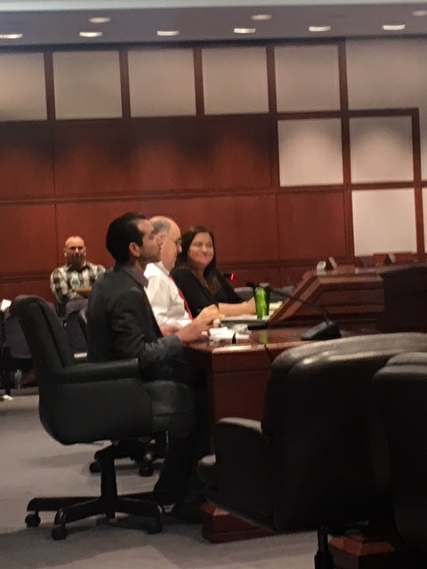
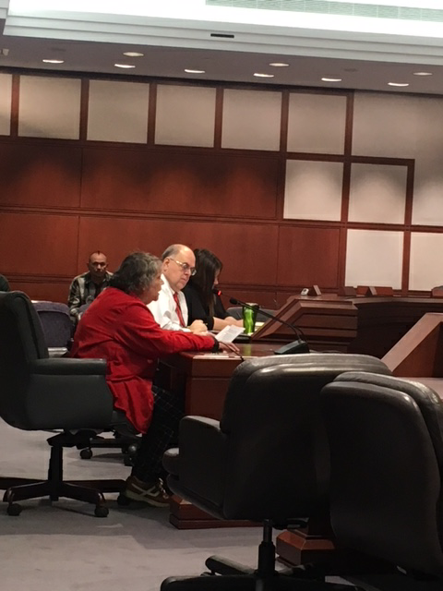
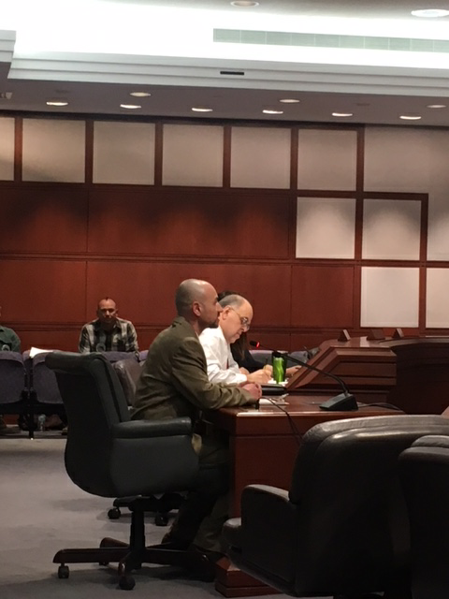
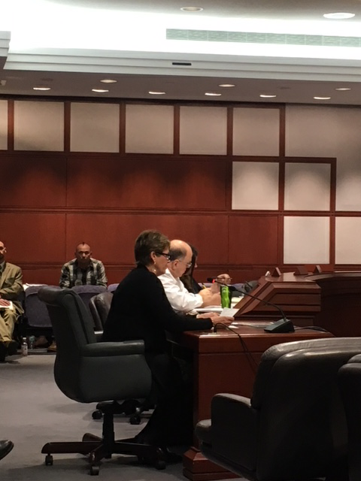
Testifying at State Capitol
Senate Bill 424
  Deed Lee Site to DEEP: Originally to authorize additional bonding for trails, greenways and bikeways.
House Bill 5304
  Require DESPP to prepare report on actual training needs & alternative existing ranges
SJ 35
  Amendment to State Constitution to Protect State Properties from Sale / Trade without legislative approval

Slide 13
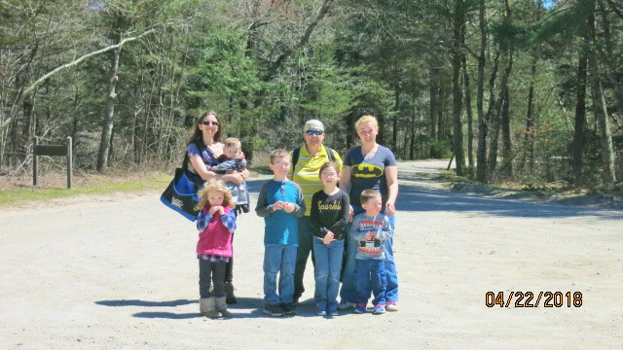
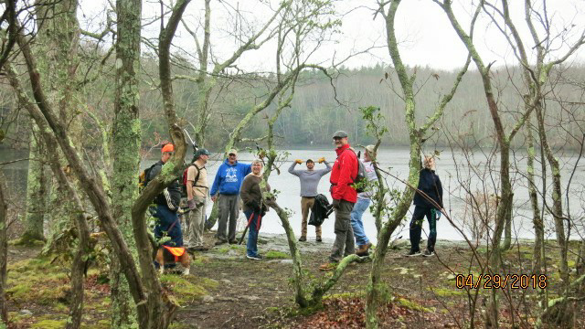
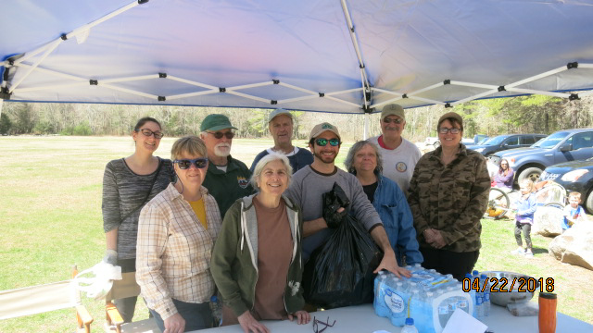
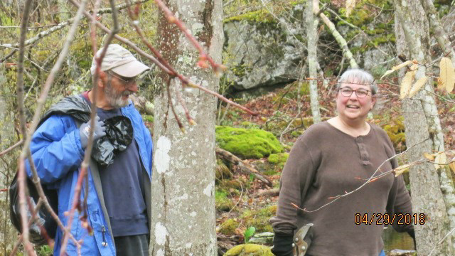
Earth Day Cleanups & Trail Maintenance April 22 & 29
Jointly funded by a grant from The Last Green Valley
Jointly done with Ct. Forest and Park’s Association (who maintains the Blue Blazed Trails Statewide)
  Chapman Field visitor use areas, Trails near Mt. Misery, Hell Hollow
  Green Falls Pond

Slide 14
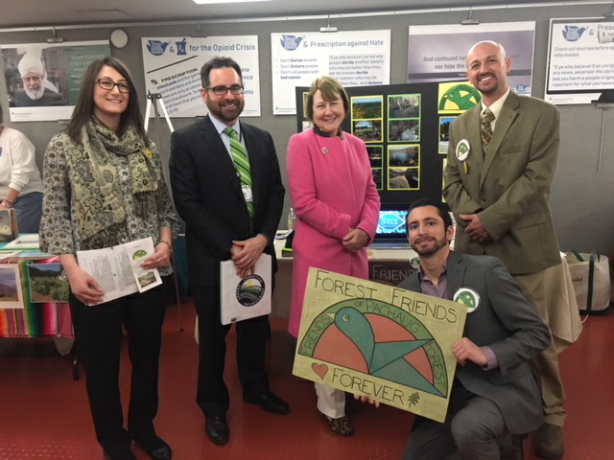
Friends of Connecticut State Parks Day
Legislative Office Building, Hartford
Staffed booth & met with elected officials and state managers to discuss our organization and endorse passage of key legislations.
President Snide, Liaison Director Joslyn & Logistics Director Gay Seen here with Ct DEEP Commissioner Robert Klee & Deputy Commissioner Susan Whalen

Slide 15
Presentation to Ct. Council on Evironmental Quality
VP Panko did an awareness presentation about environmental issues and Scoping concerns regarding the State Range project to the Connecticut Council on Environmental Quality on March 28, 2018
Presentation Objectives
Create CEQ Awareness of the scope and potential impacts of this Project.
Provide a heads up to CEQ that citizens are extremely concerned that DAS/DESPP may “cut corners” on the EIE and fail to be transparent as indicated by the lack of transparency thus far by and public statements by the Governor.
We request CEQ remain a vigilant watchdog on the Scoping & EIE process being conducted by the State Dept. of Administrative Services and Dept of Emergency Services and Public Protection

Slide 16
And all this doesn’t count the other stuff
Liaison Director Allison Josylyn making a huge amount of contacts with stakeholder organizations.
Establishing corporate and non-profit bank account.
Producing fliers, handouts and custom art works (Secretary Susan Lane, Lauren Churchill, Mike Lane and others)
Establishing website and social media
Countless other details / meetings

Slide 17
What’s on our Calendar?
May 5 – 10 am: Hike from Hopeville Pond State Park to Lee Road
May 27- 10 am: Kayaking Hopeville Pond SP
Connecticut Trails Day Events
  June 2 – Hike around Green Falls Pond
  June 3 – Hike to Mt. Misery / Picnic / Hike Rhododendron Sanctuary
June 10 – Yoga in the Forest
Please visit our events calendar at:
http://www.friendsofpachaugforest.org

Slide 18
WHERE WE ARE & WHERE ARE WE GOING?
Maintain close working relationship with DEEP staff
Continue to develop and improve our website & expand social media outreach
Recruit membership from the 6 towns surrounding Pachaug SF
Fill roles on various Committees
Establish cooperation with local business’s / membership benefits
Expand & maintain networking with other Friends & Conservation Groups
Meet with elected officials in 6 surrounding towns
Research & apply for conservation / education / recreation / cultural grants
Continue to sponsor project work events & outings
Establish Regional/Statewide presence in the State Range Scoping & EIE Process

Slide 19
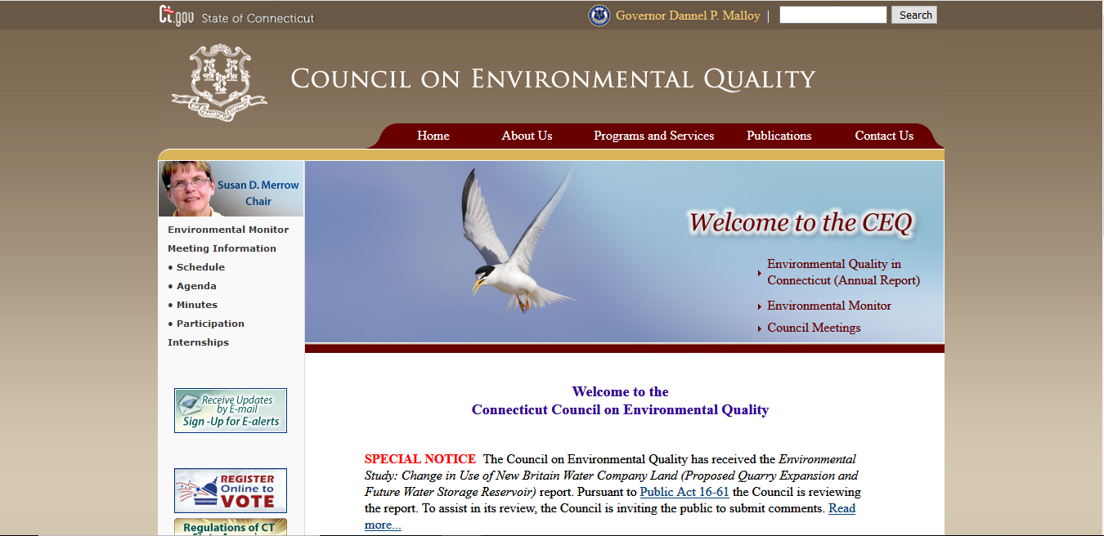
Connecticut Scoping and Environmental Impact Evaluations

Slide 20
Connecticut Environmental Impact Evaluation Basics from the Connecticut Environmental Policy Act (CEPA)
(1) Each sponsoring agency shall, prior to a decision to prepare an environmental impact evaluation pursuant to subsection (c) of this section for an action which may significantly affect the environment, conduct an early public scoping process.
(2) To initiate an early public scoping process the Agency must have their Scoping Announcement published in the CEQ’s Environmental Monitor publication.
(3) Members of the public and any interested state agency representatives have 30 days to submit comments following the publication of the Scoping in the Environmental Monitor.
Sec 22a-1b Evaluation by state agencies of actions affecting the environment. Public scoping process. Environmental monitor.

Slide 21
Connecticut Environmental Impact Evaluation Basics from the Connecticut Environmental Policy Act (CEPA)
Sec 22a-1b Evaluation by state agencies of actions affecting the environment. Public scoping process. Environmental monitor.
(4) A public scoping meeting shall be held at the discretion of the sponsoring agency or if twenty-five persons or an association having not less than twenty-five persons requests such a meeting within ten days of the publication of the notice in the Environmental Monitor. A public scoping meeting shall be held not less than ten days following the notice of the proposed action in the Environmental Monitor. The public comment period shall remain open for at least five days following the meeting.

Slide 22
Connecticut Environmental Impact Evaluation Basics from the Connecticut Environmental Policy Act (CEPA)
Sec 22a-1b Evaluation by state agencies of actions affecting the environment. Public scoping process. Environmental monitor.
(7) The sponsoring agency shall consider any comments received pursuant to this section or any information obtained during the public scoping meeting in selecting the proposed actions to be addressed in the environmental impact evaluation and shall evaluate in its environmental impact evaluation any substantive issues raised during the early public scoping process that pertain to a proposed action or site or alternative actions or sites.

Slide 23
Connecticut Environmental Impact Evaluation Basics from the Connecticut Environmental Policy Act (CEPA)
Sec 22a-1b Evaluation by state agencies of actions affecting the environment. Public scoping process. Environmental monitor.
(c) Agencies are basically required to produce a detailed written evaluation of its environmental impact before deciding to undertake or approve such action.
In documents obtained by the Town of Griswold under FOI (and researched by FOPF at Griswold Town Hall) it is apparent the DAS/DESPP have already prepared that evaluation but have come to some surprising conclusions.

Slide 24
Connecticut Environmental Impact Evaluation Basics from the Connecticut Environmental Policy Act (CEPA)
Excerpt from DAS/DESPP report regarding States “detailed impact evaluation” obtained by FOI request

Slide 25
Connecticut Environmental Impact Evaluation Basics from the Connecticut Environmental Policy Act (CEPA)
Sec. 22a-1d. Review of environmental impact evaluations. Notification to municipalities and agencies.
(a) Environmental impact evaluations and a summary thereof, including any negative findings shall be submitted for comment and review to the Council on Environmental Quality, the Department of Energy and Environmental Protection, the Connecticut Commission on Culture and Tourism, the Office of Policy and Management, the Department of Economic and Community Development in the case of a proposed action that affects existing housing, and other appropriate agencies, and to the town clerk of each municipality affected thereby, and shall be made available to the public for inspection and comment at the same time. The sponsoring agency shall publish forthwith a notice of the availability of its environmental impact evaluation and summary in a newspaper of general circulation in the municipality at least once a week for three consecutive weeks and in the Environmental Monitor. The sponsoring agency preparing an environmental impact evaluation shall hold a public hearing on the evaluation if twenty-five persons or an association having not less than twenty-five persons requests such a hearing within ten days of the publication of the notice in the Environmental Monitor.

Slide 26
Scoping Issues
DAS & DESPP have made it clear they intend to host a single Scoping Meeting on this project in Griswold in Mid May 2018.
Due to the Regional/Statewide nature of this project it can be expected that 400 or more people will attend making it unlikely concerns of the citizens will be able to be heard in the allotted time.
Griswold location will be inconvenient for people from other towns surrounding the Forest to attend. Will also make it hard for statewide Stakeholder groups to attend. Perhaps this is what DAS/DESPP desires in this process?
A single meeting may preclude a wide variety of Stakeholders from attending on that specific date due to schedule conflicts.
It is the intent of Friends of Pachaug Forest Inc. to coordinate petitions from 25 residents of the 6 Towns surrounding Pachaug SF to request Scoping Meetings in their Town as well as file a request for a Scoping Meeting to be held in Hartford to enable cooperating organizations Statewide to participate in a Scoping Meeting.
In Spring of 2016 DAS & DESPP held a series of public meetings in towns under consideration for hosting this Range.
Each meeting was attended by about 200 local citizens.
Citizens were given 2-3 minutes to talk and even on a “town by town” basis many voices could not be heard about their concerns for this Project due to the volume of participants.

