Slide 1
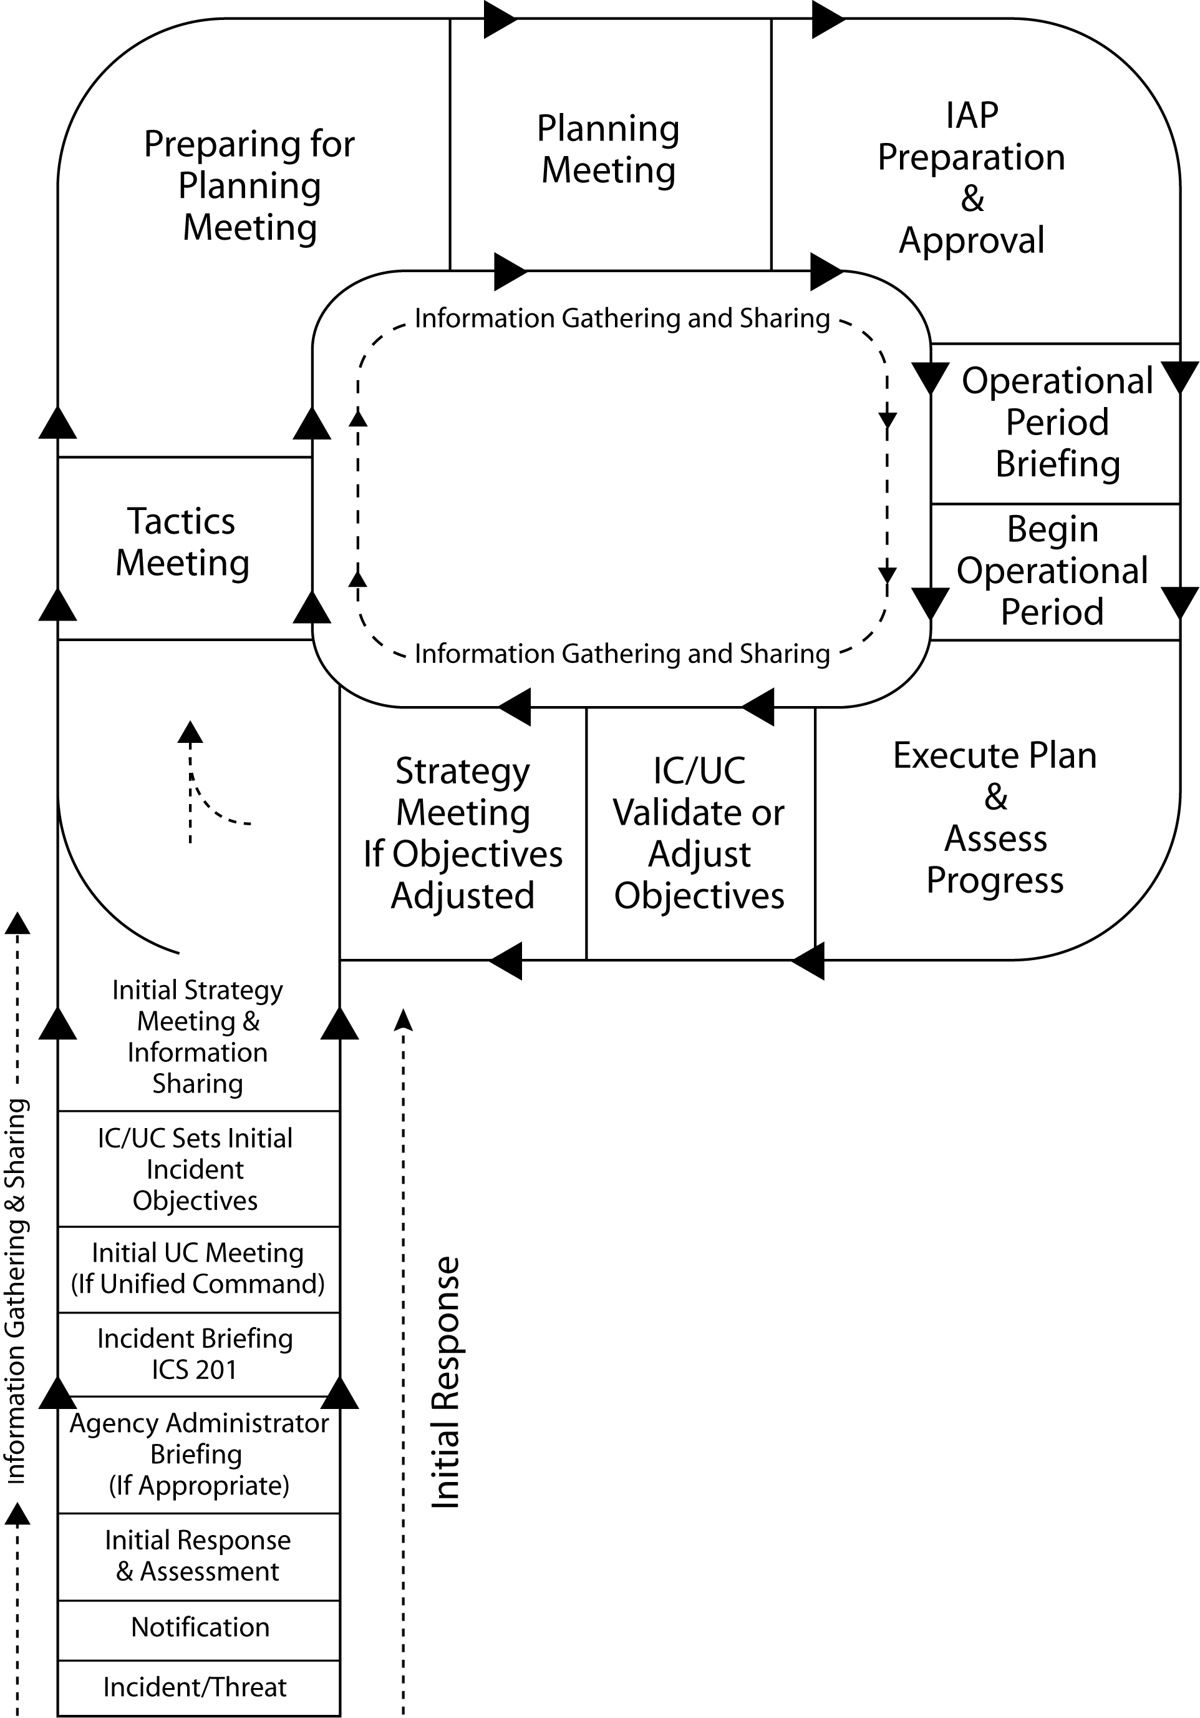

ICS Fundamentals & Process
1

Slide 2
Instructor Introductions
Work Group Breakdowns
Student Introductions
Student background signs:
I’ve had I200 training but no experience in real ICS managed incidents
I have been on multiple incidents run under ICS as a single resource, and took the I100 class on line.
I have had I300 and/or other higher level training in ICS and experience on numerous ICS managed incidents
I have been involved in emergency incidents, but have had no ICS training

Slide 3
Module 1 Objectives
At the conclusion of this module, students will be able to:
Saturday March 26, 2011
  0730 Check-In
Describe how the “Planning P” is the foundation of the ICS management process.
Describe the ICS positions that comprise the Command & General Staff (C&G)
Describe the overall roles, responsibilities and authorities of the Incident Commander and C&G positions
Describe how Incident Commanders obtain a Delegation of Authority to perform their duties
Describe the role of C&G members in each step of the Planning P process
3

Slide 4
Module 1 Objectives Cont.
Be able to discuss the importance of ICS common principles (span of control, chain of command, unity of command, delegation of authority, unified command, use of incident specific facilities)
Be able to apply fundamental principles of incident operational organization (geographic, functional, combination) in order to build an incident organization for a practical exercise.
Describe why the ICS 201 Incident Briefing form is used.
Demonstrate use of the ICS 201 Incident Briefing form during a practical exercise.
Describe multiple methods for ordering additional resources to be used on an incident
Describe the common steps performed in transferring command of an incident

Slide 5
The Five Fingers of ICS
Beauties of ICS include it’s simplicity, it’s ability to utilize the same organizational structure yet expand or contract, and it’s applicability to all types and kinds of incidents and events:
Five organizational elements that are always present; Command, Operations, Planning, Logistics and Finance/Administration
These 5 areas are always covered under the responsibilities of the IC
On very small incidents the IC may retain performing all of these elements
As the incident response grows the IC will delegate supervision of these elements to subordinate staff as deemed necessary to maintain span of control
The planning process for ICS follows a distinct orderly process, regardless of whether “the plan” is in the head of the Incident Commander and verbally relayed to a few troops or is published in a formal Incident Action Plan used by thousands of people.
5

Slide 6
OBJECTIVES, STRATEGIES, TACTICS
ICS is rooted in the development of specific objectives for each period of action (the “Operational Period”) . These objectives address the overall goals, and lend themselves to the development of strategic alternatives that can be achieved through specific work assignments (called tactics):
Objectives are broad goals that describe desirable outcomes for the incident.
  Objective 1- Reduce the level of the reservior to 30’ MSL by 1800 hrs March 25.
Strategies describe various alternatives that can be taken to achieve the objectives
  Strategy A – Prevent additional water from entering the reservior by diverting water delivery from the upstream watershed.
  Strategy B – Reduce the volume of water in the reservior by removing water from it.
Tactics are the specific work actions that need to be taken to meet the selected strategic alternative(s)
  Tactics for Strategy B:
    Pump water out of the reservior into the existing spillway. 4 4000 gpm pumps will be needed to run for 12 hours
    Create an emergency drainage ditch to remove water from the reservior
6

Slide 7
Common Fundamentals
span of control
chain of command
unity of command
delegation of authority
unified command
use of incident specific facilities

Slide 8
Operations Section
Operations – is the reason we are here!
Perform the work activities (tactics) that mitigate the incident.
The Operations SC is the “quarterback” of the incident and calls and implements the plays.
OSC and subordinate supervisors (DIVS, TFLD, STL, SRB) are the real tactical planners of incident activities. They most directly see what needs to be done, what is working and what isn’t and why, and directly and indirectly supervise actions. The OSC is the focal point to use these inputs & their own experience to plan tactical work for each operational period.
The OS is responsible for establishing and maintaining Staging Areas, Helibases and Helispots.
The OSC participates in almost every step of the Planning P process
Notes:
During the initial action phase of an incident, the IC is often the OSC as well. If the incident remains small and time duration is anticipated to be short that may be fine. Often however, the separation of IC / OSC roles is one of the first expansions of the IMT. The IC cannot remain tactically engaged. If replaced by a more experienced or more highly qualified IC, the IA IC is often a good choice to become the OSC. It is also a good point in time to consider the need to establish a Unified Command with multiple IC’s. As the Operations Section expands the OSC will also likely need subordinate supervisors to maintain span of control or supervise specific functional actions. Hence the Operations Section is one of the first to expand as an incident becomes larger or to reflect expected duration of the incident.

Slide 9
Incident Commander
There is always an IC for an incident
If operating under Unified Command the multiple IC’s act as one & one UIC acts as spokesperson.
If the IC does not have pre-designated authority to manage the incident (e.g. position description, legal mandate, they are outside their own jurisdiction, etc.) they must obtain a delegation of authority from the responsible Agency Administrator (AA). This DOA is basically the IC’s contract or scope of work and defines what the IC is responsible for & grants authority to direct the incident.

Slide 10
Incident Commander
The IC works for the AA.
The IC is responsible for forming the incident objectives. The DOA, AA or other guiding documents may provide considerable input for the objectives.
Responsibility in ICS is like a deck of cards. During IA the IC holds the entire deck. As the incident grows, the IC “hands out the cards” to their subordinate staff who then assume responsibility for their function.
The IC can be looked upon as the “Head Coach” of the IMT
The IC participates in every step of the Planning P process with the exception of the Tactics Meeting

Slide 11
Logistics Section
The Logistics Section is responsible for providing all incident support and services.
After Operations it is usually the next section of the ICS organization that needs to expand.
Expansion is based on need and span of control. If the IC still remains under 7 in span of control they may only need logistics Unit Leaders (e.g. Facilities UL, Ground Support UL) to work directly for them. If span of control is exceeded a LS Chief position should be designated.

Slide 12
Logistics Section
Once established, the LS is responsible for ordering of all resources for an incident (e.g. people, equipment, supplies)
Ordering of resources may be accomplished thru agency procedures, interagency agreements, a single point dispatching system or multi-point dispatching systems.
The LS is responsible for establishing and maintaining the ICP, Incident Base and Incident Camps.
Without Logistics “it’s just a dream”
The LSC participates in almost every step of the Planning P process.

Slide 13
Planning Section
The Planning Section is responsible for facilitating the planning process. The PS also is responsible for duplicating the IAP, for maintaining all incident documentation, for tracking the status of all incident resources, for production of maps and predictive information and to manage the demobilization process.
As an incident grows the PS is generally the third ICS organizational element that expands to meet the needs of incident management.

Slide 14
Planning Section
PS may not initially need a PSC but may consist of Unit Leaders (e.g. Resource UL, Situation UL) dependent upon span of control of the IC.
The PS does not “write the plan” independently. They are facilitators of the planning process (e.g. the PS doesn’t tell OS what to do, they document and display the OS ideas & provide info as to what resources are or will be available).
The PSC participates in almost every step of the Planning P process and is responsible to facilitate most of them.
It is critical to IMT success that the PSC establish the schedule of times of all steps of the Planning P during the “Initial Strategy and Info Sharing” meeting
The PSC is one of the key leadership roles in ICS

Slide 15
Finance / Administrative Section
The Finance/Admin Section is responsible for tracking (and predicting) costs, to perform personnel & equipment timekeeping, to pay for incident expenditures (including contracting) and to process compensation & claims.
In this day and age of govt / private financial concern COST of incident activities is a high priority item for AA’s
Better to have the right staffing soon so you don’t get behind the power curve.

Slide 16
Finance / Administrative Section
Cost sharing agreements require accurate records to fulfill
Establishing F/A Section allows for the proper experts to establish incident / local agency contracting processes.
Contracts may outlive the incident itself (often do) and best to have the proper expertise on hand to ensure proper processes and future transfer of responsibilities of contract oversite and eventual close out.
The FSC participates in very few of the steps in the P; primarily in the stem, the Planning Meeting and the Operational Period Briefing

Slide 17
Command Staff
The Command Staff is made up of the “Officers” of the IMT… Safety, Public Information and Liaison.
The CS are not “line officers” in ICS management; they are more like “specialty coaches” of the IMT

Slide 18
Command Staff
The PIO is not only responsible for Public information, but also plays key roles in providing information to those assigned to the incident as well as other agency(s) officials.
In this day and age of instant media attention and social networking adding a PIO early on as the incident grows can be extremely valuable.
Regarding PIO functions, it is usually not the role of an Incident to establish a Joint Information Center (JIC), but is more a responsibility of the AA external to the incident. If a JIC is established, PIO will work closely with them and may coordinate release of all incident info through the JIC.

Slide 19
Command Staff
The Liaison Officer is not a “tactical” role. It is their job to coordinate with cooperating agencies and NGO’s. If there is no LOFR assigned, this coordination is a “card” still held by the IC.
Participation of the Public Information Officer and Liaison Officer are only required at specific steps in the Planning P.

Slide 20
Command Staff
SAFETY OFFICER
Adding a Safety Officer early in incident management process is a good idea
SO is not “tactically engaged” so can be a good set of eyes and ears
While SO can “stop” any ongoing activity due to safety concerns, every resource on an incident must be a SO too (nobody should do anything that is unsafe & should raise concerns to immediate supervisor)
SO is responsible for watch-dogging all safety related aspects of the incident (not just OS!)
The Safety Officer is a key player in almost every step of the Planning P process

Slide 21
The Planning P is the Core of the ICS Planning Process
Implementing the Planning P does not interfere with ongoing Initial Actions. IA continues until the new IMT gets its feet on the ground. We are just starting to organize where we will go in the next operational period and beginning to build for future OP’s
It is the first step in “bringing order to chaos”
21

Slide 22
The Planning P is the Core of the ICS Planning Process
If we fail to start organizing and planning we are just caught in a continuing loop of initial action
  Failure to establish / address Objectives
  Failure to address work/rest needs of responders
  Failure to maintain span of control
  Failure to account for incident resources that are assigned or ordered
  Failure to begin stepping back and looking at the big picture
  Failure to build a comprehensive geographic or functional organization
  Failure of SAFELY managing the incident
22

Slide 23
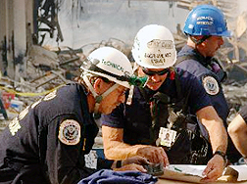
  The “stem” of the P focuses on two main themes –
  1. The Initial Response is on-going and will continue until relieved
  2. The IMT is concurrently doing “Information Gathering & Sharing” and may or may not yet have “operational control” of the incident
Following the “stem” represents the beginning of the “Extended Action” phase of an incident
The process is the same whether it is a new IMT arriving to take over management of the incident or if the existing organization has expanded in place and is now commencing the EA phase of the incident.
23

Slide 24
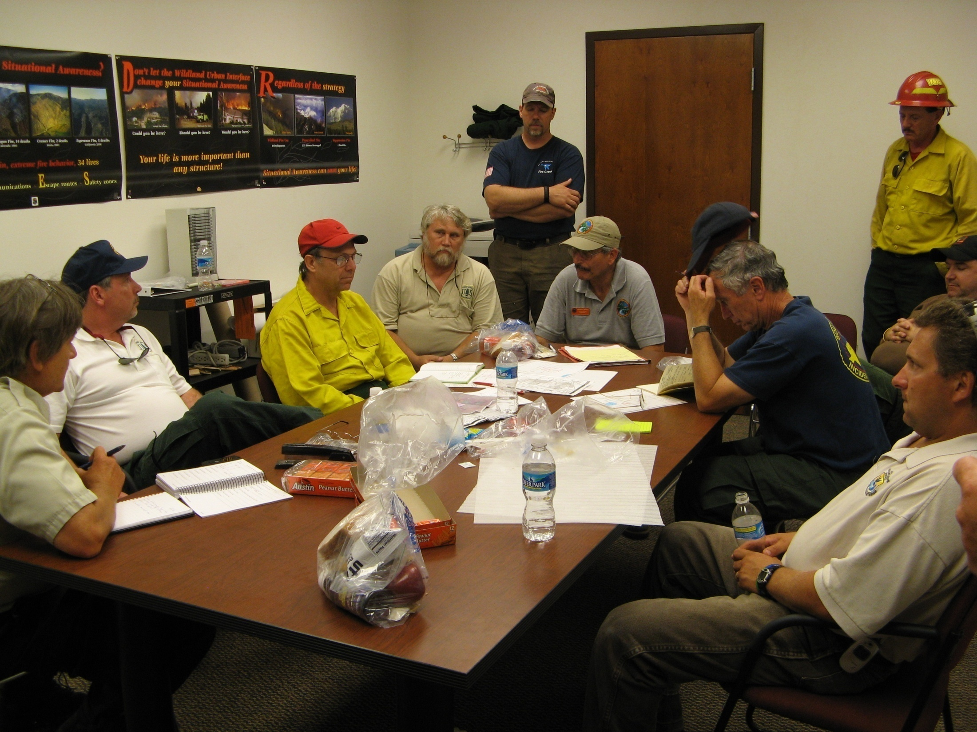
  The “stem” of the P focuses on two main themes –
  The Initial Action IC will need to take a few minutes to prepare the ICS 201 – Incident Briefing form.
  If appropriate the Agency Administrator (& their staff) will meet with the IMT and brief them regarding the overall situation, their goals, authorities (DOA) and constraints, provide guiding documents
  The IA IC will use the 201 form as a tool to brief the IMT about the past and current situation
  After briefings the IC(s) will take a few minutes to pen some incident objectives while the rest of the C&G goes out fact finding about all their particular functions
24

Slide 25
5 Steps of Transfer of Command
Assess the situation with the current Incident Commander.
Receive a briefing from the current Incident Commander and if a large incident the responsible Agency Administrator(s).
Determine an appropriate time for the transfer of command and document the transfer (ICS Form 201).
Notify others of the change in incident command.
Assign the current Incident Commander to another position in the incident organization or release from the incident.

Slide 26
Incident Briefing Form
ICS-201
Can be separated for easy use by IC and incoming Plans Section Chief or Resource UL
Place for sketch map
Summary of current actions
Current Organization
Resources Summary

Slide 27
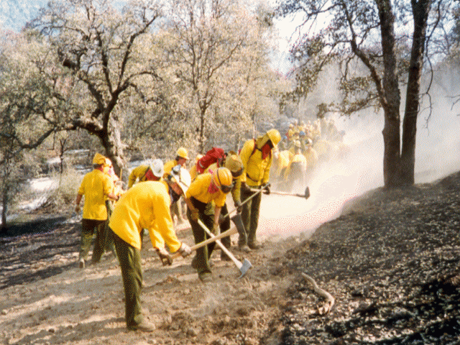
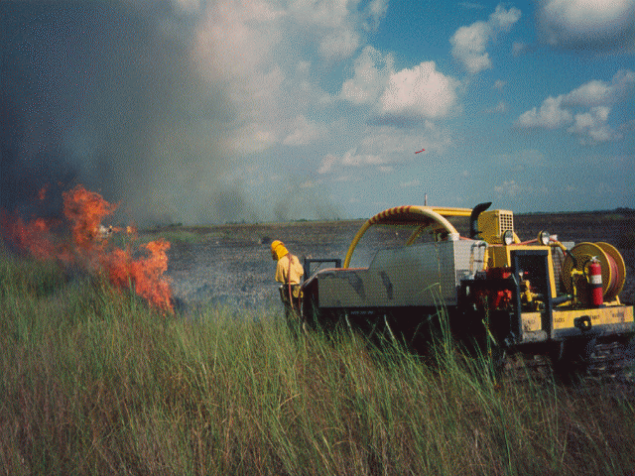
Use of the Incident Briefing-ICS Form 201 vs. IAP
Initial Action Operational Period
First & Subsequent Extended Action Operational Periods
Incident Action Plan for Each Operational Period
Original
Incident Briefing
ICS Form 201
Updated
Incident Briefing
ICS Form 201

Slide 28
Let’s Do an Exercise Applying What We Have Discussed So Far
Begin Exercise Simulation:
Initial Action, Sea Turtle Stranding
-Begin initial response
-Document on ICS 201
-Assignment:
  Receive Agency Administrator In-briefing
  Use ICS 201 to brief players in new roles
  Formulate Incident Objectives (Unified Objectives)
28

Slide 29
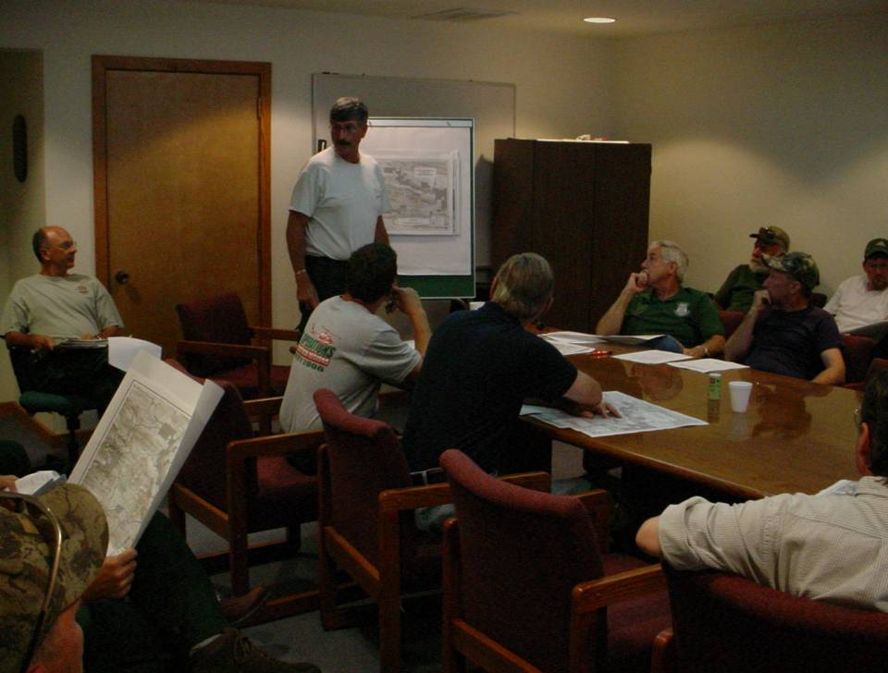
  The new IC(s) will then pull the IMT together to perform the final step on the stem of the P
  The Initial Strategy & Information Sharing step is often a brief meeting of the entire IMT
    The IC(s) will state the incident objectives to all the IMT members and pass on to the IMT important direction from the DOA, agency policies or guidance, or special concerns of the AA.
    OSC will brief the team on the current status of the incident, the current and anticipated operations organization structure, the anticipated duration of the incident
29

Slide 30
  The new IC(s) will then pull the IMT together to perform the final step on the stem of the P
  The Initial Strategy & Information Sharing step is often a brief meeting of the entire IMT
    Other C&G members will share information about the current or anticipated issues or needs of their functions (e.g. LSC may share information gathered about communications, housing arrangements, location or re-location of the ICP / Incident Base, etc.)
    The PSC will propose the schedule for all the steps of the P for at least the next operational period
30

Slide 31
Example Planning Cycle for Incident Running a “Day Shift” only
Operational Period: 0700 –> 1900
Tactics Meeting – 1500
Planning Meeting – 1700
All IAP products submitted to PSC – 1900
IAP reviewed and approved by IC – 1930
IAP duplicated – 1930 – 2130
Operational Period Briefing – 0630
C&G informal meeting - 1200

Slide 32
1700
1530-1645
1730-2130
0630
1500
0700
1230 - 1330

Slide 33
Example Planning Cycle for Incident Running both Day & Night Shifts
Day Operational Period: 0700 –> 1900 Night Operational Period: 1900 -> 0700
Day Operational Period Briefing - 0700
Night Tactics Meeting – 1000
Night Planning Meeting - 1130
C&G informal meeting – 1200
All Night IAP products submitted to PSC - 1300
Night IAP reviewed and approved by IC – 1330
Night IAP duplicated – 1330 - 1430
Day Tactics Meeting – 1500
Day Planning Meeting – 1700
Night Operational Period Briefing - 1830
All Day IAP products submitted to PSC – 1900
Day IAP reviewed and approved by IC – 1930
Day IAP duplicated – 1930 – 2130

Slide 34
What is our next step in the Planning P Process ?
34

Slide 35
Operations Is the Driver
Operations has some heavy lifting to do before we can move ahead together as a team to the Tactics Meeting
Operations SC will develop strategies to meet the objectives (IC may play a big role in this with OSC during first OP)
At this phase of the incident the Operations SC will need to create a clear picture as to how the incident is going to be organized:
    Geographically (?)
    Functionally (?)
    Combination (?)
35

Slide 36
Operations Section Organization
Geographic & Function Combo
Basic ICS OPS Org. Terminology
Incident Commander
Operations Section Chief
Turtle Stabilization Group
Division A
Division D
Division F
Turtle Evac Group
Beachview Staging
Planning Section
Logistics Section
Finance/Admin Sectio
Most incidents are basically geographic in nature and ICS uses Divisions for geographic distinctions
Often it is useful to establish functional Groups to perform special work anywhere on the incident
Staging areas are established by OSC to hold available resources until they are needed

Slide 37
Other ICS Functions will also expand to meet the needs of the size of the incident, usually driven by the size of the Operations Section (more OPS = greater support & service needs)
Planning Section
Logistics Section
Resource Unit Leader
  Status / Check In Recorder
Situation Unit Leader
  Display Processor / GISS / GIST
  Field Observers
  IMET
Facilities Unit
Ground Support Unit
Supply Unit

Slide 38
Incident Commander
Public Info Officer
Operations Section Chief
Planning Section Chief
Finance/Admin Section Chief
Turtle Stabilization Group
Division A
Division D
Division F
Turtle Evac Group
Facilities Unit
Ground Support Unit
Supply Unit
Safety Officer
Resource Unit
Logistics Section Chief
Situation Unit
Beachview Staging Area
38

Slide 39
Tactics Meeting Basics
The Tactics Meeting is where:
Operations SC describes the Operations organization (divisions, groups, branches, staging areas)
The Operations SC describes the work assignments that will be performed in each component of the organization during the next operational period
The Operations SC describes the kinds and types of resources needed to perform the work in each component of the organization during the next operational period
This is a very informal meeting
Saying all that, OPS needs to come into this meeting prepared; often the first organizational approach may last for many operational periods with additions and modifications
39

Slide 40
Review – Tactics are the Work Actions
Strategies describe various alternatives that can be taken to achieve the objectives
  Strategy A – Prevent additional water from entering the reservior by diverting water delivery from the upstream watershed.
  Strategy B – Reduce the volume of water in the reservior by removing water from it.
Tactics are the specific work actions that need to be taken to meet the selected strategic alternative(s)
  Tactics for Strategy B:
    Pump water out of the reservior into the existing spillway. 4 4000 gpm pumps will be needed to run for 12 hours
    Create an emergency drainage ditch to remove water from the reservior

Slide 41
Tactics Meeting Basics
Who Else is at the Tactics Meeting?
Plans Section Chief and/or Resource Unit Leader
Logistics Section Chief
Safety Officer
What are their roles?

Slide 42
Tactics Meeting Basics
Planning Section
The RESL or PSC will record the OSC’s information on the wall chart ICS 215
The RESL or PSC need to bring comprehensive resource status info to the meeting
Logistics Section
There to get information about what kind / type resources may need to be ordered for the next OP so OSC has them for the work to be performed
There to provide “reality check” about possible resource orders & about services / support present or needed
Safety Officer
There to review work assignments proposed by OSC and work with OSC on mitigating safety issues perceived
There to document safety issues, risks and mitigations using the ICS 215A wall form
42

Slide 43
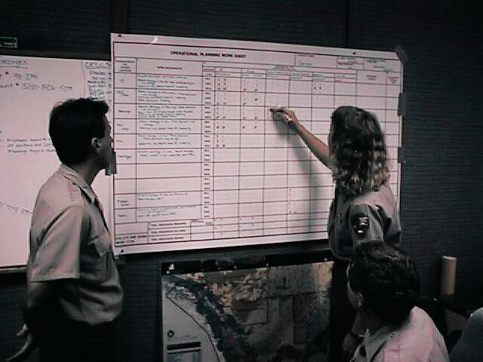
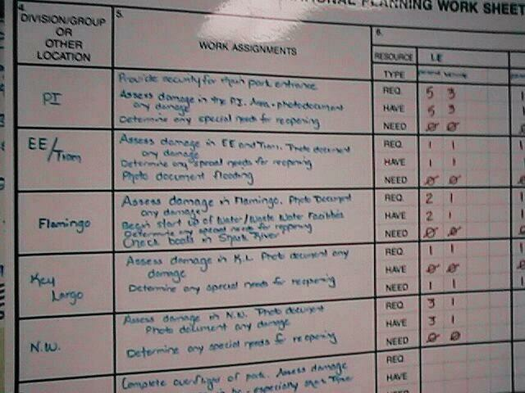
Use of the ICS 215 = “Hey it’s just a spreadsheet!”
43

Slide 44
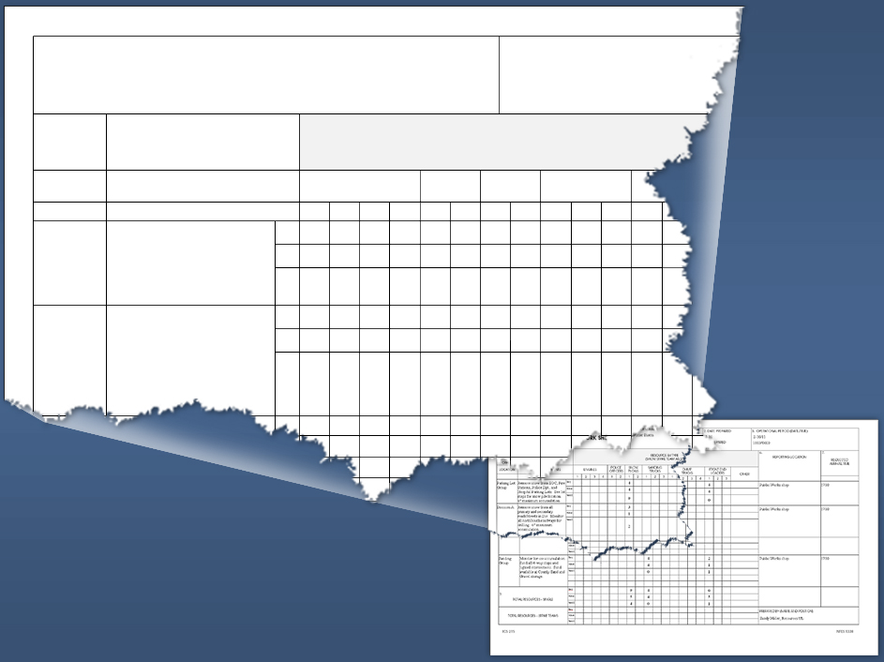
1. INCIDENT NAME
Winter Storm
OPERATIONAL PLANNING WORKSHEET
4. DIVISION/ GROUP OR OTHER
5.
RESOURCE BY TYPE (SHOW STRIKE TEAM AS ST)
POLICE OFFICERS
SNOW PLOWS
SANDING TRUCKS
Kind/Type Resources
LOCATION
WORK ASSIGNMENTS
ENGINES
1 2 3 4 1 2 1 2 1 2 3 1
Parking
Lot Group
Remove snow from EOC,
Fire Stations, Police Dpt.,
and Hospital Parking Lots.
See maps for snow pile location. 6” max. accumulation.
Req
Have
Need
4
4
0
Division A
Remove snow from all
primary and secondary roads/streets in Div. Monitor all north/south roadways for drilling. 6” maximum accumulation.
Req
Have
Need
3
1
2
Req
Resources Needed Next
Operational Period
Visual 5.44
Notes:
Refer the participants to the chart in Figure 6 (page 29) of the National Response Plan. Explain that this chart shows a sample JFO organization during natural disasters. Note if you are not planning to hand out complete copies of the plan, it is recommended that you provide a copy of this page.
Ask the participants to familiarize themselves with the chart. Point out that the next visuals cover selected JFO functions.
Tell the participants that the National Response Plan includes possible JFO organizational structures for various types of threat scenarios and incidents.
The Infrastructure Liaison Position under the Chief of Staff coordinates with critical infrastructure elements, in both the public and private sectors.
Pages 29 - 32

Slide 45
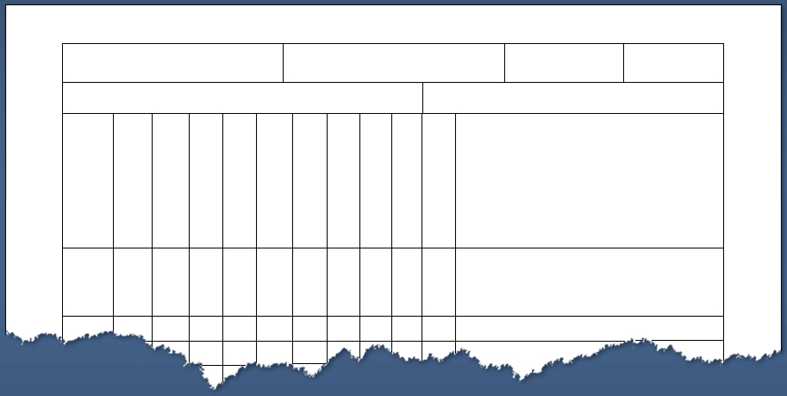
ICS Form 215A, Incident Safety Analysis
The Safety Officer or Incident Commander completes ICS Form 215A for each operational period.
1. INCIDENT NAME Winter Storm
2. DATE 2-10
INCIDENT ACTION PLAN SAFETY &
RISK ANALYSIS
3. TIME 1100
LCES* and Risk Analysis (Lookouts, Communications, Escape Routes, Safety Zones)
RISK MITIGATIONS
Impacted Organizational Element
Communications
Extreme Weather
Bio-Hazard
Hazmat
Driving
Other
Other
Other
Other
Other
Div A
X
X
Drive with lights on, chain up before leaving for assignment. Maintain safe speed for conditions. Wear gloves, hat when operating out of vehicle.
Organizational Element at Risk
Mitigation Strategies
Hazards
Notes:
Refer the participants to the chart in Figure 6 (page 29) of the National Response Plan. Explain that this chart shows a sample JFO organization during natural disasters. Note if you are not planning to hand out complete copies of the plan, it is recommended that you provide a copy of this page.
Ask the participants to familiarize themselves with the chart. Point out that the next visuals cover selected JFO functions.
Tell the participants that the National Response Plan includes possible JFO organizational structures for various types of threat scenarios and incidents.
The Infrastructure Liaison Position under the Chief of Staff coordinates with critical infrastructure elements, in both the public and private sectors.
Pages 29 - 32

Slide 46
PREPARING FOR THE PLANNING MEETING
Wrap up loose ends from Tactics Meeting (place orders; confirm resources; fill in IC or other C&G members about Tactics Meeting decisions / info that might be critical to “no surprises” and full C&G support of the Plan that will be presented at Planning Meeting
46

Slide 47
Planning Meeting
Formal meeting
All C&G and certain Unit Leaders; AREPs; Agency Admin
Out of way to reduce interference
Facilitated by PSC
Purpose of the Planning Meeting is to obtain concensus from all other C&G members in supporting Operations SC’s plan for next operational period
47

Slide 48
Planning Meeting Agenda:
  Current Situation (OSC)
  Objectives (IC or PSC)
  Predictive Info – Weather, Modeling outputs(PSC &/or Tech Specs)
  Next OP Work Assignments – ground & air (OSC& AOBD)
  Safety Mitigations – SOF
  Logistics info – Communications, Facilities, etc. (LSC & or Unit Leaders)
  Finance/Admin info – Cost to date, spec. info (FSC)
  Information update/info – (PIO)
  Cooperator info – (Liaison Officer &/or Agency Reps)
  Confirmation of supporting the Plan
  Management comments – (Agency Administrator)
  Final words – (IC)

Slide 49
IAP Preparation & Approval
Based on “support of the plan” by all C&G members during the Planning Meeting we can now go ahead and write the Incident Action Plan (IAP) for the next operational period
Planning Section and Logistics Section have the most work to do in writing plan components
Always good to have Operations SC review the ICS 204 Assignment Lists before the IAP is sent to IC for final approval.
Once the IAP is approved, the Planning Section will make sufficient copies for all incident supervisors for distribution prior to the next Operational Period Briefing
49

Slide 50
Purpose of a Written IAP
  A written IAP provides:
  A clear statement of objectives and actions.
  A basis for measuring work effectiveness and cost effectiveness.
  A basis for measuring work progress and providing accountability.
  Documentation for post-incident fiscal and legal activities.

Slide 51
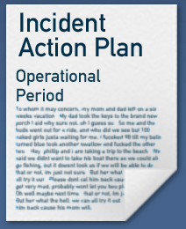
Forms and Supporting Documents: Overview
ICS 203
ICS 204
Assignment
List
Organization Assignment
List
ICS 205
ICS 202
Incident Comm.
Plan
ICS 206
Incident
Objectives
IAP Cover Sheet
Incident Medical Plan
Safety
Safety
Messages,
Messages,
Maps,
Maps,
Forecasts
Forecasts

Slide 52
Are All Forms Used?
The Incident Commander determines which ICS forms and attachments are included in the IAP.
For less complex incidents, the Incident Commander may only require these ICS forms:
ICS 202
ICS 203
ICS 204
Safety
Messages
&
Maps
Incident
Objectives
Organization Assignment
List
Assignment
List

Slide 53

Operational Period
Incident Objectives
1. INCIDENT NAME Winter Storm
2. DATE
PREPARED
2-10
3. TIME PREPARED 1300
INCIDENT OBJECTIVES
4. OPERATIONAL PERIOD (DATE/TIME) 2-10 1800 to 0600 2-11
5. GENERAL CONTROL OBJECTIVES FOR THE INCIDENT (INCLUDE ALTERNATIVES)
1. Provide for safety of responders and public (see safety message).
2. Keep parking lots of critical facilities plowed.
3. Keep primary routes open (see map).
4. Sand parking lots and lighted intersections.
Incident Objectives, ICS Form 202 (1 of 2)
Notes:
Refer the participants to the chart in Figure 6 (page 29) of the National Response Plan. Explain that this chart shows a sample JFO organization during natural disasters. Note if you are not planning to hand out complete copies of the plan, it is recommended that you provide a copy of this page.
Ask the participants to familiarize themselves with the chart. Point out that the next visuals cover selected JFO functions.
Tell the participants that the National Response Plan includes possible JFO organizational structures for various types of threat scenarios and incidents.
The Infrastructure Liaison Position under the Chief of Staff coordinates with critical infrastructure elements, in both the public and private sectors.
Pages 29 - 32

Slide 54
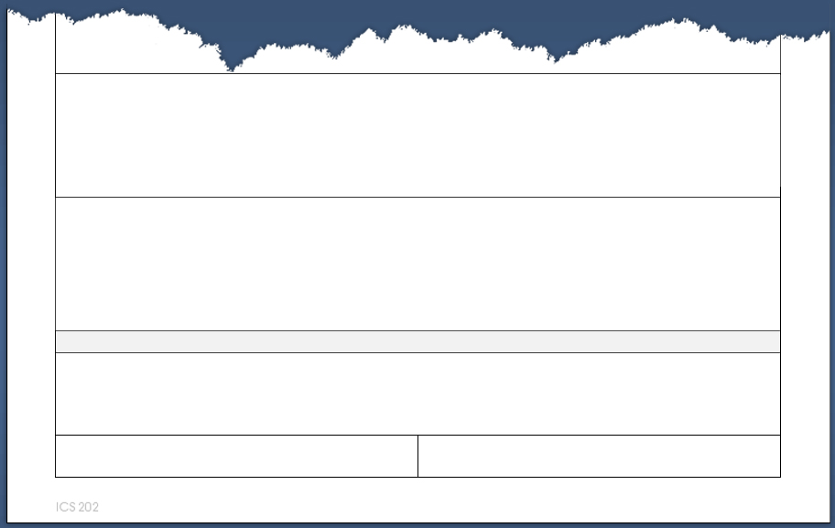
Attachments
6. WEATHER FORECAST FOR OPERATIONAL PERIOD Winter storm warning continues. Snow level at sea level, 10-12" accumulations possible, accompanied by high winds and drifting. See attached forecast.
7. GENERAL SAFETY MESSAGE Driving extremely hazardous. Lights on and chains required. Wear high visibility clothing, hat and gloves when outside vehicle.
9. PREPARED BY (PLANNING SECTION CHIEF) 10. APPROVED BY (INCIDENT COMMANDER) Alice Walker Dan Franklin
General Safety Message
Planning Section Chief Prepares
Incident Commander Approves By Signature
ICS Form 202, Incident Objectives (2 of 2)
Notes:
Refer the participants to the chart in Figure 6 (page 29) of the National Response Plan. Explain that this chart shows a sample JFO organization during natural disasters. Note if you are not planning to hand out complete copies of the plan, it is recommended that you provide a copy of this page.
Ask the participants to familiarize themselves with the chart. Point out that the next visuals cover selected JFO functions.
Tell the participants that the National Response Plan includes possible JFO organizational structures for various types of threat scenarios and incidents.
The Infrastructure Liaison Position under the Chief of Staff coordinates with critical infrastructure elements, in both the public and private sectors.
Pages 29 - 32

Slide 55
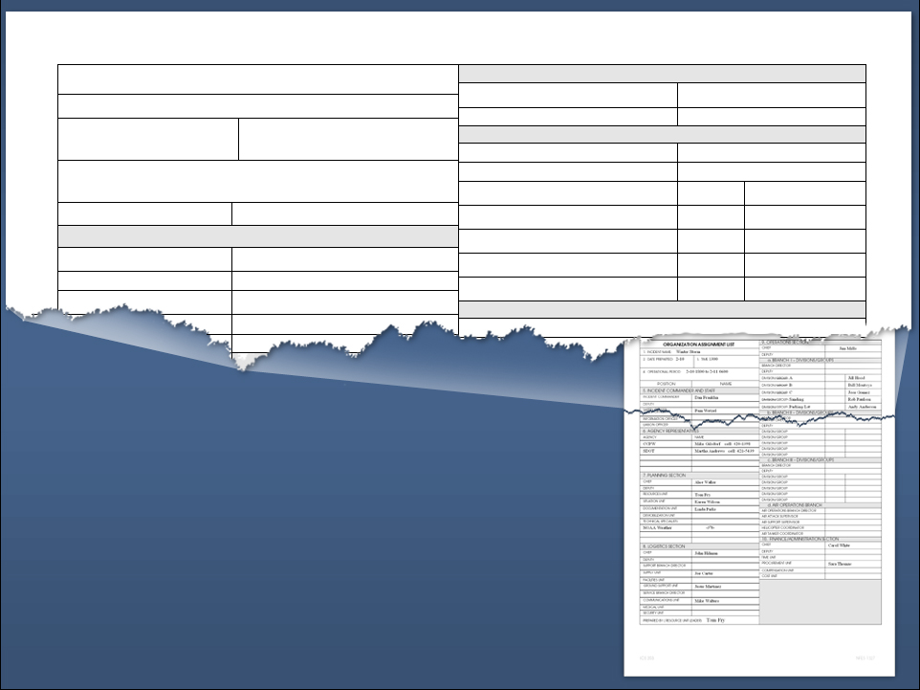
ORGANIZATION ASSIGNMENT LIST
9. OPERATIONS SECTION
1. INCIDENT NAME Winter Storm
CHIEF
Jim Mills
2. DATE PREPARED 2-10
3. TIME 1300
DEPUTY
a. BRANCH I - DIVISIONS/GROUPS
BRANCH DIRECTOR
4. OPERATIONAL PERIOD (DATE/TIME)
2-10 1800 to 2-11 0600
DIVISION/GROUP A
Jill Hood
POSITION
NAME
DIVISION/GROUP B
Bill Montoya
5. INCIDENT COMMANDER AND STAFF
DIVISION/GROUP C
Jose Gomez
INCIDENT COMMANDER
Dan Franklin
DIVISION/GROUP- Sanding
Rob Paulson
DEPUTY
DIVISION/GROUP- Parking Lot
Andy Anderson
SAFETY OFFICER
Pam Wetzel
b. BRANCH II - DIVISIONS/GROUPS
BRANCH DIRECTOR
Command and
General Staff
Operations
Supervisors to
Division/Group
Level
Organization Assignment List,
ICS Form 203
Notes:
Refer the participants to the chart in Figure 6 (page 29) of the National Response Plan. Explain that this chart shows a sample JFO organization during natural disasters. Note if you are not planning to hand out complete copies of the plan, it is recommended that you provide a copy of this page.
Ask the participants to familiarize themselves with the chart. Point out that the next visuals cover selected JFO functions.
Tell the participants that the National Response Plan includes possible JFO organizational structures for various types of threat scenarios and incidents.
The Infrastructure Liaison Position under the Chief of Staff coordinates with critical infrastructure elements, in both the public and private sectors.
Pages 29 - 32

Slide 56
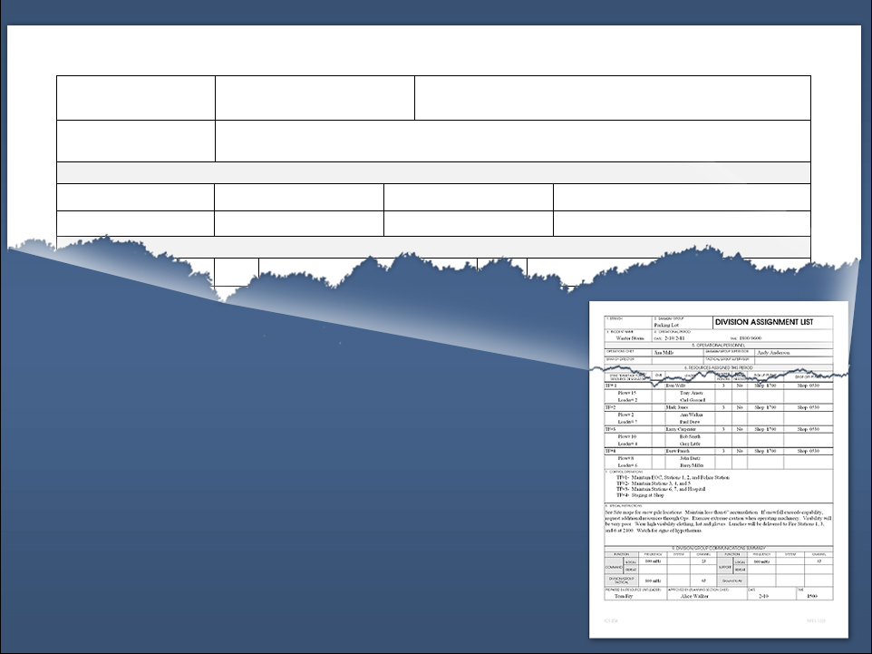
1. BRANCH
2. DIVISION/GROUP
Parking Lot
ASSIGNMENT LIST
3. INCIDENT NAME Winter Storm
4. OPERATIONAL PERIOD DATE: 2-10/2-11
5. OPERATIONAL PERSONNEL
OPERATIONS CHIEF
Jim Mills
DIVISION/GROUP SUPERVISOR
Andy Anderson
BRANCH DIRECTOR
TACTICAL GROUP SUPERVISOR
6. RESOURCES ASSIGNED THIS PERIOD
LEADER
EMT
PICK
Organizational
Elements
Operations Section Chief
Supervisor of this Assignment
Assignment List, ICS Form 204
(1 of 4)
Notes:
Refer the participants to the chart in Figure 6 (page 29) of the National Response Plan. Explain that this chart shows a sample JFO organization during natural disasters. Note if you are not planning to hand out complete copies of the plan, it is recommended that you provide a copy of this page.
Ask the participants to familiarize themselves with the chart. Point out that the next visuals cover selected JFO functions.
Tell the participants that the National Response Plan includes possible JFO organizational structures for various types of threat scenarios and incidents.
The Infrastructure Liaison Position under the Chief of Staff coordinates with critical infrastructure elements, in both the public and private sectors.
Pages 29 - 32

Slide 57
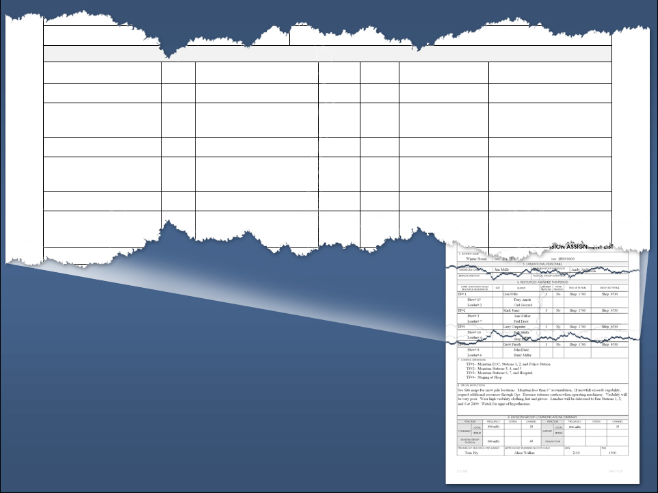
6. RESOURCES ASSIGNED THIS PERIOD
STRIKE TEAM/TASK FORCE/ RESOURCE DESIGNATOR
EMT
NUMBER PERSONS
TRANS NEEDED
LEADER
PICK UP PT/TIME
DROP OFF PT/TIME
TF #1
Don Wells
3 No Shop 1700 Shop 0530
Plow #15
Loader #2
Tony Anioti
Carl Gossard
TF #2
Mark Jones
3 No Shop 1700 Shop 0530
Plow #2
Loader #7
Ann Walker
Paul Drew
TF #3
Larry Carpenter
3 No Shop 1700 Shop 0530
Plow #10
Loader #4
Bob Smith
Gr ittle
Resources Assigned
Assignment List, ICS Form 204
(2 of 4)
Notes:
Refer the participants to the chart in Figure 6 (page 29) of the National Response Plan. Explain that this chart shows a sample JFO organization during natural disasters. Note if you are not planning to hand out complete copies of the plan, it is recommended that you provide a copy of this page.
Ask the participants to familiarize themselves with the chart. Point out that the next visuals cover selected JFO functions.
Tell the participants that the National Response Plan includes possible JFO organizational structures for various types of threat scenarios and incidents.
The Infrastructure Liaison Position under the Chief of Staff coordinates with critical infrastructure elements, in both the public and private sectors.
Pages 29 - 32

Slide 58
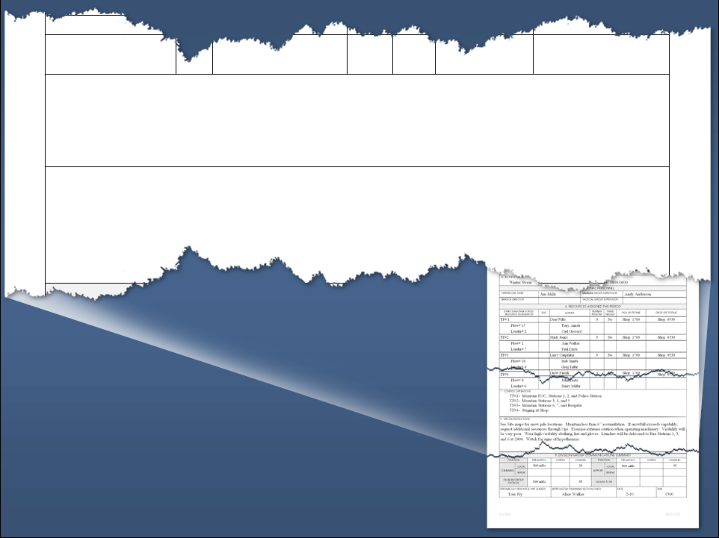
TF #3
Shop
Plow #8
Loader #6
John Dietz
Barry Miller
7. CONTROL OPERATIONS
TF #1- Maintain EOC, Stations 1, 2, and Police Station TF #2- Maintain Stations 3, 4, and 5 TF #3- Maintain Stations 6, 7, and Hospital TF #4- Staging at Shop
8. SPECIAL INSTRUCTIONS
See site maps for snow pile locations. Maintain less than 6 inches accumulation. If snowfall exceeds capability, request additional resources through Ops. Exercise extreme caution when operating machinery. Visibility will be very poor. Wear high visibility clothing, hat and gloves. Lunches will be delivered to Fire Stations 1, 3, and 6 at 2400. Watch for signs of hypothermia.
Assignment and Special Instructions
Assignment List, ICS Form 204
(3 of 4)
Notes:
Refer the participants to the chart in Figure 6 (page 29) of the National Response Plan. Explain that this chart shows a sample JFO organization during natural disasters. Note if you are not planning to hand out complete copies of the plan, it is recommended that you provide a copy of this page.
Ask the participants to familiarize themselves with the chart. Point out that the next visuals cover selected JFO functions.
Tell the participants that the National Response Plan includes possible JFO organizational structures for various types of threat scenarios and incidents.
The Infrastructure Liaison Position under the Chief of Staff coordinates with critical infrastructure elements, in both the public and private sectors.
Pages 29 - 32

Slide 59
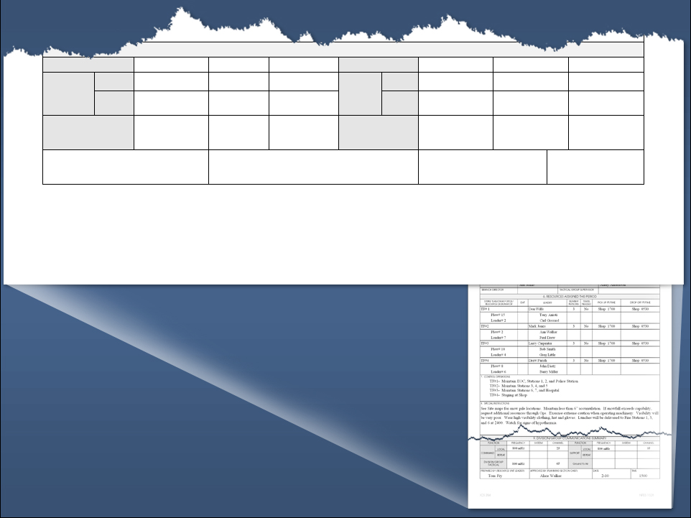
9. DIVISION/GROUP COMMUNICATIONS SUMMARY
FUNCTION
FREQUENCY
SYSTEM
CHANNEL
FUNCTION
FREQUENCY
SYSTEM
CHANNEL
LOCAL
800 mHz 2J
800 mHz 3J
COMMAND
LOCAL
SUPPORT
REPEAT
REPEAT
DIV/GROUND TACTICAL
800 mHz 6J
GROUND TO AIR
PREPARED BY (RESOURCE UNIT LEADER)
APPROVED BY (PLANNING SECTION)
DATE
TIME
Tom Fry Alice Walker
2-10
1500
ICS 204
Approved by Planning Section Chief
Communications for this Assignment
Prepared by Resources Unit Lead
Assignment List, ICS Form 204
(4 of 4)
Notes:
Refer the participants to the chart in Figure 6 (page 29) of the National Response Plan. Explain that this chart shows a sample JFO organization during natural disasters. Note if you are not planning to hand out complete copies of the plan, it is recommended that you provide a copy of this page.
Ask the participants to familiarize themselves with the chart. Point out that the next visuals cover selected JFO functions.
Tell the participants that the National Response Plan includes possible JFO organizational structures for various types of threat scenarios and incidents.
The Infrastructure Liaison Position under the Chief of Staff coordinates with critical infrastructure elements, in both the public and private sectors.
Pages 29 - 32

Slide 60
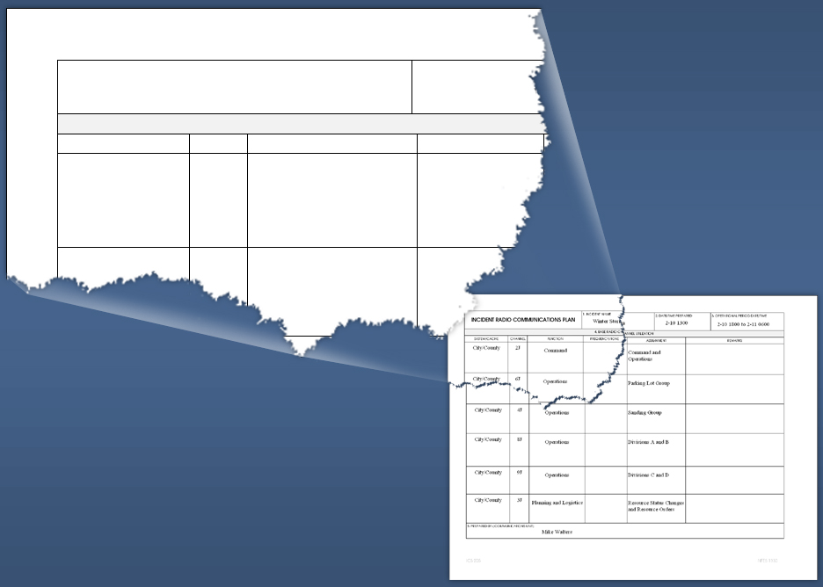
INCIDENT RADIO COMMUNICATIONS PLAN
1. INCIDENT NAME Winter Storm
4. BASE RADIO CHA
SYSTEM/CACHE
CHANNEL
FUNCTION
FREQUENCY/TONE
City/County 2J Command
City/County 6J Operations
Priority 1 Command to Ops
Priority 2 Tactical
Assignments
Incident Radio Communications Plan,
ICS Form 205
Notes:
Refer the participants to the chart in Figure 6 (page 29) of the National Response Plan. Explain that this chart shows a sample JFO organization during natural disasters. Note if you are not planning to hand out complete copies of the plan, it is recommended that you provide a copy of this page.
Ask the participants to familiarize themselves with the chart. Point out that the next visuals cover selected JFO functions.
Tell the participants that the National Response Plan includes possible JFO organizational structures for various types of threat scenarios and incidents.
The Infrastructure Liaison Position under the Chief of Staff coordinates with critical infrastructure elements, in both the public and private sectors.
Pages 29 - 32

Slide 61
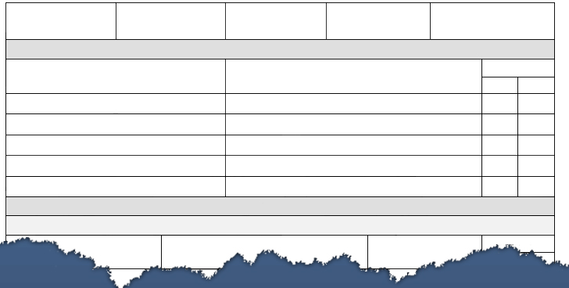
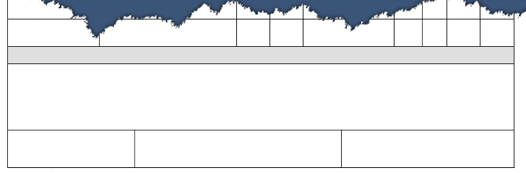
1. INCIDENT NAME Winter Storm
2. DATE PREPARED
2-10
3. TIME PREPARED
1530
4. OPERATIONAL PERIOD
2-10 1800 to 0600 2-11
MEDICAL PLAN
Aid Stations and Level of Service
5. INCIDENT MEDICAL AID STATIONS
MEDICAL AID STATIONS
LOCATION
PARAMEDICS
YES
NO
Fire Station 1
1171 S. 5th Ave.
Fire Station 2
950 Bellingham Way
Fire Station 4
2100 Main
Fire Station 6
4700 N. 12th Ave.
Fire Station 7
170 West Oakdale
6. TRANSPORTATION
A. AMBULANCE SERVICES
ADDRESS
PHONE
MEDICS
Instructions,
if required
Minor injuries will be treated at closest Medical Aid/Fire Station.
Major injuries call 911 for assistance.
Any injury received on the job requires notification to immediate incident supervisor, Operations Section Chief, IC and Safety Officer and completion of Accident/Injury Form 104 A & B.
9.PREPARED BY (MEDICAL UNIT LEADER) LSC
_{John Hilman}
10. REVIEWED BY (SAFETY OFFICER)
_{Pam Wetzel}
_{206 ICS 8/78}
Medical Plan, ICS Form 206
Notes:
Refer the participants to the chart in Figure 6 (page 29) of the National Response Plan. Explain that this chart shows a sample JFO organization during natural disasters. Note if you are not planning to hand out complete copies of the plan, it is recommended that you provide a copy of this page.
Ask the participants to familiarize themselves with the chart. Point out that the next visuals cover selected JFO functions.
Tell the participants that the National Response Plan includes possible JFO organizational structures for various types of threat scenarios and incidents.
The Infrastructure Liaison Position under the Chief of Staff coordinates with critical infrastructure elements, in both the public and private sectors.
Pages 29 - 32

Slide 62
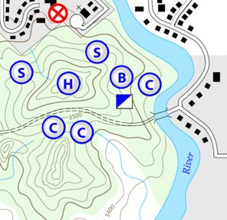
Additional Supporting Documents
  Maps and incident facility plot plans
  Safety messages
  Detailed weather forecasts
  Human Resource message
  Financial message
  Other important information for operational supervisors

Slide 63
Operational Period Briefing
Meeting directed at the Operations Section supervisors who will be directing work on scene
This is a “stand up” meeting and kept to 20 minutes
Facilitated by PSC and follows the same basic agenda as the Planning Meeting – critical difference is who is attending and why they are attending
63

Slide 64
Operational Period Briefing
Attendees will have copy of IAP for reference during OP Briefing
OSC will identify primary supervisors (DIVS, Group Supv, etc.) and general work activities
  Specific work activities are discussed in Division or Group breakouts following the formal Briefing
Pen & ink changes to IAP need to be addressed
Good place to gather additional resources not currently assigned, assure check-in and give additional assignments
64

Slide 65
Operational Period Briefing
Operational Period Briefing Agenda:
  Current Situation (OSC)
  Objectives (IC or PSC)
  Predictive Info – Weather, Modeling outputs(PSC &/or Tech Specs)
  OP Work Assignments – ground & air (OSC& AOBD)
  Safety Mitigations – SOF
  Logistics info – Communications, Facilities, etc. (LSC)
  Finance/Admin info – Cost to date, spec. info (FSC)
  Information update/info – (PIO)
  Cooperator info – (Liaison Officer &/or Agency Reps)
  Management comments – (Agency Administrator)
  Final words – (IC)
65

Slide 66
Execute The IAP
Resources go to work implementing the plan for this OP
Throughout the OP there is a great deal of communication going on:
  OSC is in contact with supervisors out in the field or may visit on-site to discuss with supervisors how things are going, make adjustments to current actions and begin gathering information for the next OP plan
  All C&G are communicating formally and informally with needs and adjustments
There may be an informal C&G staff meeting during this phase for a pulse check &/or to discuss long term issues.
66

Slide 67
Execute The IAP
What other things may happen during this long period of time in the planning cycle?
67

Slide 68
Beginning Planning for Next OP
As the OP winds down OSC will be in close contact with IC/UC
OCS will give direct input to IC/UC as to success/failure of tactical work
IC/UC will also be talking with the AA to report progress and to address any new issues / concerns / priorities
68

Slide 69
Validate or Adjust Objectives
Armed with current information about success/failure of actions the IC/UC may need to adjust the Objectives
If given new direction or guidance from the AA the IC/UC may have to adjust the Objectives
69

Slide 70
Adjust Strategies
New or changed Objectives will force the OSC to re-evalute or expand existing strategies. IC/UC may want to participate if an entirely new strategic approach is needed.
Even if no changes to Objectives this is the time when OSC wants to review the primary and alternative strategies.
  Remember it is the strategy or strategies being actively pursued that drive what tactical actions and resources will be needed during the next operational period.
70

Slide 71
ICS Groundhog Day
Next OP Around the Loop Again
Once needed changes are made to Objectives and Strategies we commence the next Planning Cycle
This process continues until the incident is done
Span of Control is a big driver of how large the organization may grow or how small it can remain or return to during the life of the incident
71

Slide 72
Module 1 Objectives
At the conclusion of this module, students will be able to:
Saturday March 26, 2011
  0730 Check-In
Describe how the “Planning P” is the foundation of the ICS management process.
Describe the ICS positions that comprise the Command & General Staff (C&G)
Describe the overall roles, responsibilities and authorities of the Incident Commander and C&G positions
Describe how Incident Commanders obtain a Delegation of Authority to perform their duties
Describe the role of C&G members in each step of the Planning P process
72

Slide 73
Module 1 Objectives Cont.
Be able to discuss the importance of ICS common principles (span of control, chain of command, unity of command, delegation of authority, unified command, use of incident specific facilities)
Be able to apply fundamental principles of incident operational organization (geographic, functional, combination) in order to build an incident organization for a practical exercise.
Describe why the ICS 201 Incident Briefing form is used.
Demonstrate use of the ICS 201 Incident Briefing form during a practical exercise.
Describe multiple methods for ordering additional resources to be used on an incident
Describe the common steps performed in transferring command of an incident

