Slide 1

Unit 4:
Area Command

Slide 2
Unit Objectives
  Define Area Command.
  List the principal advantages of using Area Command.
  Describe how, when, and where Area Command would be established.
  Describe the Area Command organization.
  Identify six primary functional responsibilities of Area Command.
  Given a scenario, develop an Area Command organization.

Slide 3
Definition of Area Command
Area Command is used to oversee the management of:
  Multiple incidents that are each being handled by an Incident Command System organization; or
  A very large incident that has multiple Incident Management Teams assigned to it.
Area Commander
Incident 1
Incident Commander
Incident 2
Incident Commander
Incident 3
Incident Commander

Slide 4
Area Command: Primary Functions
  Provide agency or jurisdictional authority for assigned incidents.
  Ensure a clear understanding of agency expectations, intentions, and constraints.
  Establish critical resource use priorities between various incidents.
  Ensure that Incident Management Team personnel assignments and organizations are appropriate.
  Maintain contact with officials in charge, and other agencies and groups.
  Coordinate the demobilization or reassignment of resources between assigned incidents.

Slide 5
Key Terms Review
Emergency
Ops Center
(EOC)
Emergency Operations Center: Coordinates information and resources to support local incident management activities.
Area
Command
Area Command: Oversees the management of multiple incidents. Area Command may be Unified, and works directly with Incident Commanders.
Incident
Commander
1
Incident
Commander
2
Incident
Commander
3
Incident Commander: Performs primary tactical-level, on-scene incident command functions. The Incident Commander is located at an Incident Command Post at the incident scene.

Slide 6
Unified Command vs. Area Command
What is the difference between Unified Command and Area Command?

Slide 7
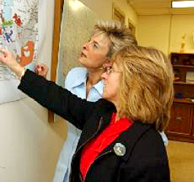
Advantages of Area Command
Handout Page 2, Area Command Strategic Goals
  Area Command:
  Assists in inter incident coordination.
  Ensures efficient resource use.
  Ensures that agency policies,
  priorities, constraints, and
  guidance are being made
  known and implemented
  consistently across incidents.
  Reduces workload for
  agency officials.

Slide 8
Chain of Command & Reporting Relationships
Agency
Administrator(s)
Area
Commander/
Unified Command
Incident
Commander 1
Incident
Commander 2
Incident
Commander 3

Slide 9
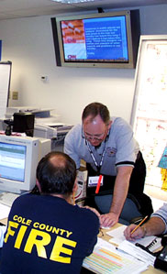
Area Command: Best Practices
  Area Command should:
  Receive its authority through a written delegation of authority.
  Notify Incident Commanders
  of its authorities and roles.
  Be staffed with qualified and experienced personnel.
  Operate under standard ICS principles.
  Be kept small.

Slide 10
Katrina Area Command Scenario
  Review the case-study Katrina Area Command scenario in your Student Manuals.
  Working as a team, answer the following questions:
    Why did the Coast Guard choose to use Area Command?
    How did the Coast Guard adapt the Area Command structure? Why?
    What are the lessons learned for your agency or jurisdiction?
  Select a spokesperson and be prepared to present your analysis to the entire group.

Slide 11
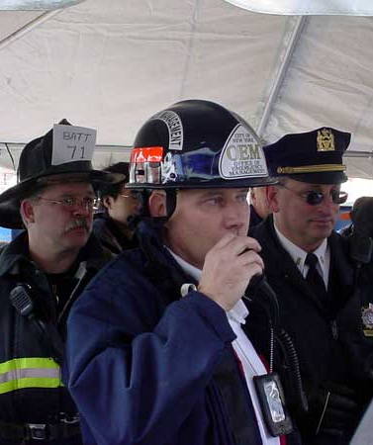
When Should Area Command Be Established?
As soon as possible when:
  Several active incidents are in close proximity.
  Critical life saving or property values are at risk due to incidents.
  Incidents will continue into the next operational period.
  Incidents are using similar and limited critical resources.
  Difficulties are encountered with interincident resource allocation and coordination.

Slide 12
Area Command Organization
Handout: P7 “SW Montana Area Command Organization”
Area Commander
Assistant Area Commander
Planning
Area Command
Public Information Officer
Area Command
Situation Unit Leader
Area Command
Critical Resources Unit Leader
Area Command
Liaison Officer
Assistant Area Commander
Logistics
Incident 1
Commander
Incident 2
Commander
Incident 3
Commander
NOTE: THERE IS A MISPRINT IN SRG PAGE 4.13- CRITICAL RESL WORKS FOR AAC PLANNING!!!!!!!

Slide 13
Area Command: Storm
Liberty County
Unified Area Command
Public Works/County Sheriff/Fire/EMS
Area Command
Public Information Officer
Area Command
Liaison Officer
Assistant Area Commander
Planning
Assistant Area Commander
Logistics
Area Command
Critical Resources Unit Leader
Area Command
Situation Unit Leader
Traffic Engineer
Weather Specialists
GIS Mapping Specialist
Springfield Unified Command Law Enforcement/
Fire/EMS/
Public Works
Dayton Unified Command Law Enforcement/
Fire/EMS/
Public Works
River Bend Unified Command Law Enforcement/
Fire/EMS/
Public Works
NOTE: THERE IS A MISPRINT IN SRG PAGE 4.14- CRITICAL RESL WORKS FOR AAC PLANNING!!!!!!!

Slide 14
Area Command: July 4th Celebrations/Terrorist Threat
July 4th Unified Area Command Law Enforcement
Fire/EMS/Public Health
Area Command
Investigation/Intel Officer
Area Command
Liaison Officer
Area Command
Public Information Officer
Assistant Area Commander
Planning
Assistant Area Commander
Logistics
Area Command
Situation Unit Leader
Area Command
Critical Resources Unit Leader
Terrorist Specialists
Central City July 4th Unified Command
Law Enforcement/
Fire/EMS/
Public Health
River Bend July 4th Unified Command
Law Enforcement/
Fire/EMS/
Public Health
Liberty Co. July 4th Unified Command
Law Enforcement/
Fire/EMS/
Public Health
NOTE: THERE IS A MISPRINT IN SRG PAGE 4.15- CRITICAL RESL WORKS FOR AAC PLANNING!!!!!!!

Slide 15
Area Commander: Overall Responsibilities
Handout: P3 Roles & responsibilities of Area Command
  Set overall objectives.
  Ensure incident objectives are
  met and do not conflict with each
  other or agency policy.
  Establish incident-related priorities.
  Allocate/reallocate critical resources.
  Ensure that personnel are qualified and incidents are properly managed.
  Coordinate demobilization of assigned resources.
  Coordinate with Agency Administrator, EOC, other
  entities, and the media.
Area
Commander
Area Command
Public Information
Officer
Area Command
Liaison Officer
Assistant Area
Commander Planning
Assistant
Area Commander
Logistics
Area Command
Situation
Unit Leader
Area Command
Critical Resources
Unit Leader
NOTE: THERE IS A MISPRINT IN SRG PAGE 4.16- CRITICAL RESL WORKS FOR AAC PLANNING!!!!!!!

Slide 16
Area Commander: Critical Activities
Assess
Establish Priorities
Allocate Resources
Rapidly assess each incident.
Communicate priorities to Commanders.
Ensure plans support priorities and policies.
Allocate/reallocate critical resources.
Plan resource demobilization.

Slide 17
Panko’s Little Area Command Additional Slides

Slide 19
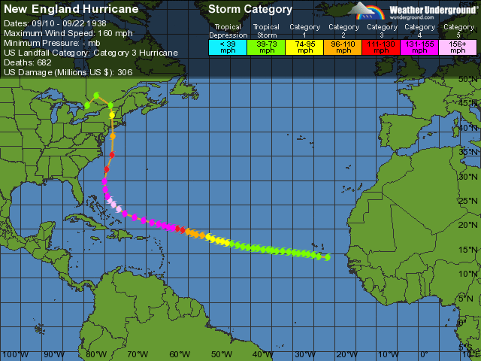

Slide 20
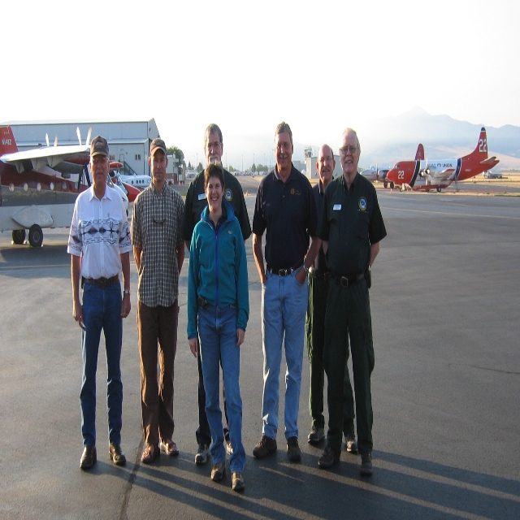
Area Command Team One

Slide 21

Area Command: Location Considerations
  Close to incidents
  Not collocated with an ICP
  Sufficient size
  Capable of continuous operation
  Adequate communications
  capabilities
  Backup power
  Adequate and secure parking
  Near commercial food and
  lodging
Hint: This is
kinda like “it”

Slide 22
Katrina Area Command Team 1
Daily Team Schedule – AC Zimmerman
Area Command Team Schedule
Time Activity Participants Call Number
0700 JOC Senior Staff Meeting JOC/AC 800.320.4330
0800 Area Command Staff mtg ACT#1
0900 Region-AC-IC Conference Call AC-ICs-Region 866.769.2334
1100 Finance Conference Call IBA 877.710.5722
1200 Logistics Conference Call AC & IMT’S 866.769.2334
1300 Area Command Staff mtg AC
1600 FEMA Planning meeting
1600 Information Officer conference Call AC/IMT IOF 866.769.2334
1700 AC-AC-SACC AC’S -SACC 877.972.6038
1800 AC/IC Conference Call AC/ICs 866.769.2334
1800 IBA Conference Call IBAs
1830 Area Command Planning mtg AC
Handout Page 4 “Area Command Daily Schedule”

Slide 23
Area Command Officers
Area
Commander
  Public Information Officer
  Provides public information coordination between incidents. Serves as the contact point for media requests.
  Liaison Officer
  Maintains off-incident interagency contacts and coordination.
Area Command
Public Information
Officer
Area Command
Liaison Officer
Assistant Area
Commander Planning
Assistant
Area Commander
Logistics
Area Command
Situation
Unit Leader
Area Command
Critical Resources
Unit Leader
NOTE: THERE IS A MISPRINT IN SRG PAGE 4.21- CRITICAL RESL WORKS FOR AAC PLANNING!!!!!!!

Slide 24
Assistant Area Commander – Planning
Handout: P3 Area Command Management Philosophies
  Assembles information on individual incident objectives.
  Recommends resource allocation priorities.
  Maintains critical resources status.
  Ensures advance planning is accomplished.
  Ensures demobilization plans are coordinated.
  Prepares Area Command briefings.
  Reviews Incident Action Plans and completed ICS 209 forms from assigned incidents.
Area
Commander
Area Command
Public Information
Officer
Area Command
Liaison Officer
Assistant Area
Commander Planning
Assistant
Area Commander
Logistics
Area Command
Situation
Unit Leader
Area Command
Critical Resources
Unit Leader
NOTE: THERE IS A MISPRINT IN SRG PAGE 4.22- CRITICAL RESL WORKS FOR AAC PLANNING!!!!!!!

Slide 25
Assistant Area Commander – Logistics
  Obtains briefings from Area Commander.
  Provides facilities, services, and materials for Area Command.
  Designates and coordinates ordering process.
  Ensures communications are coordinated.
  Assists in Area Command decisionmaking.
  Ensures that critical resources are used.
Area
Commander
Area Command
Public Information
Officer
Area Command
Liaison Officer
Assistant Area
Commander Planning
Assistant
Area Commander
Logistics
Area Command
Situation
Unit Leader
Area Command
Critical Resources
Unit Leader
NOTE: THERE IS A MISPRINT IN SRG PAGE 4.23- CRITICAL RESL WORKS FOR AAC PLANNING!!!!!!!

Slide 26
Student Reference Guide Correction
On page 4.25 there is a Job Aid table.
Make a correction to the Area Command Critical Resource Unit Leader. Scratch out Logistics and replace it with Planning. The Critical Resource Unit Leader works for Planning in AC just as the Resource Unit is a component of the Planning Section of an Incident Management Team.

Slide 27
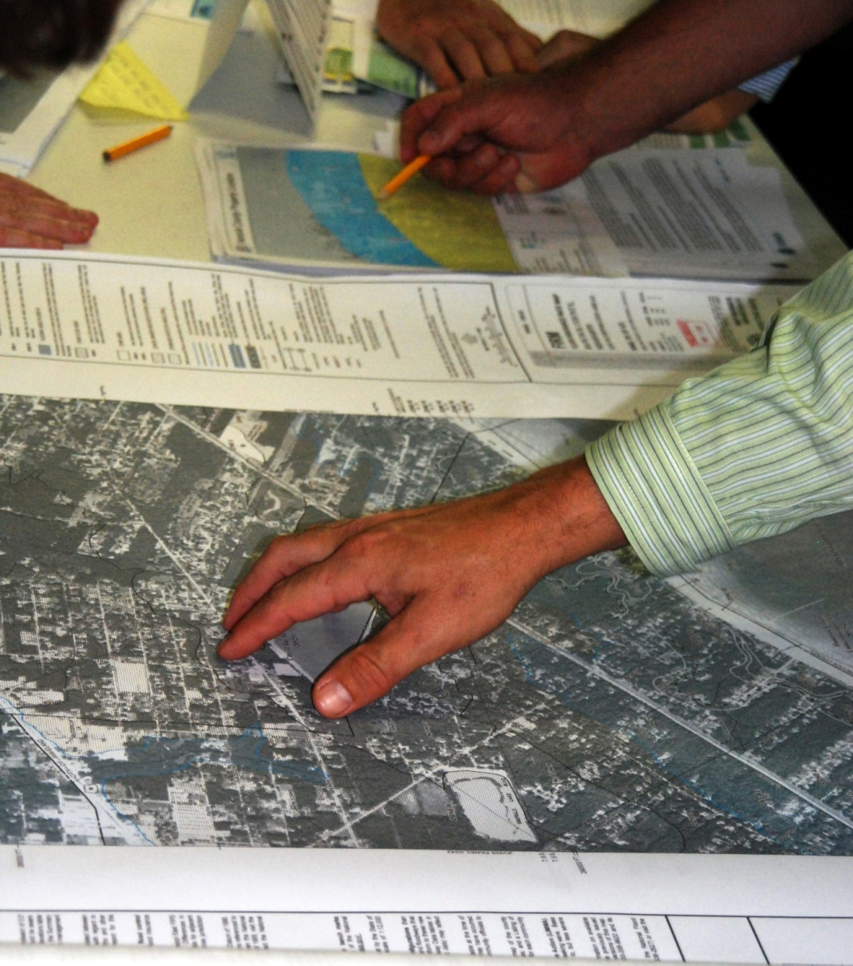
Area Command Technical Specialists
  Aviation Specialist
  Hazardous Materials
  Specialist
  Environmental
  Specialist
  Communications
  Specialist

Slide 28
Agency Administrator In-Briefing
  General situation and incidents assigned
  Jurisdictional delegation of authority
  Assumption of command timing and notifications procedure
  Names and qualifications of Incident Commanders (indicating those under Unified Command)
  Limitations on the Area Commander's authority
  Current IAPs
  Policies, political factors, or other constraints
  Agency advisor
  Area Command facility
  Status of communications systems
  Critical resource designations
  Policy and expectations for interaction with the media
  Area Command reporting responsibility to agency
  Briefing and contact schedules

Slide 29
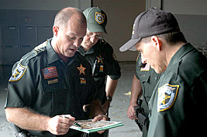
Area Commander In-Briefing With ICs
  Concise incident briefings (including IAPs and other documentation).
  Area Command roles and responsibilities.
  Policy, direction, and priorities.
  Conflict resolution procedures.
  Communication procedures,
  meeting schedules, etc.
  Resource ordering process.
  Critical resource needs.

Slide 30
Incident Commanders & Critical Priorities
Why must Incident Commanders accept the need for Area Command to establish critical priorities?

Slide 31
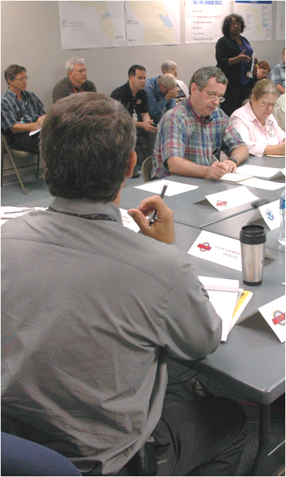
Area Command Meeting Agenda
  Incident situation reports
  Technical specialist reports
  Identification of critical resource needs
  Allocation and reallocation of resources
  Public Information Officer report
  Liaison Officer report
  Demobilization of resources
  Unified Area Command wrap-up

Slide 32

Demobilization Procedures
Handout: P13 Demobilization Strategy
  Establish procedures with incidents and EOCs/multiagency coordination centers on demobilization.
  Determine demobilization priorities and procedures for handling critical resources.
  Provide incidents with a list of critical resources and instructions for clearing releases with Area Command.
  Incidents must provide
  Area Command with
  copies of demobilization
  schedules.

Slide 33
The Murkey River flows south through the Granite Mountain foothills and then through Prosperous Valley. Severe weather followed by flooding caused by the emergency release of water at a weakened upstream dam has caused several major incidents along the east bank of the river in Jackson County. More rain and wind is expected during the next several days.
The county jail and juvenile detention facility has suffered extensive damage. All electrical power and water are out. Population is 450 adult males, 175 females, and 250 male juveniles. Relocation may be required. Only cold meals and limited water are available. A county sheriff's captain is the Incident Commander.
A 10-block area of Baytown has had extensive flooding. Search and rescue and evacuations are underway. There is no electrical power and the water and sewer systems have been damaged. An incident complex has been established to cover several incidents in this area. The Baytown Police Department has designated an Incident Commander from the department.
A southbound train was derailed over the Murkey River due to a section of track being undermined. Several cars are overturned. A tank car with an unknown chemical is on its side in the river and leaking. This incident is operating under a Unified Command consisting now of the county fire and sheriff.
In Fryville, a gas leak ignited, causing a fire in a major grocery chain warehouse. Several people have been injured and there is a danger of fire spreading to adjacent buildings. Water pressure is low. The Fryville Volunteer Fire Department Chief is the Incident Commander.

Slide 34
There is currently a major problem with allocating limited resources among these incidents. Many volunteers have come forward, and the Incident Commanders and the County EOC are looking for ways to organize and use them effectively. Several news media representatives are on the scene at the various incidents.

Slide 35
Activity: Establishing Area Command
Instructions:
Working as a team, review the scenario and map in your Student Manuals.
Complete the following steps:
  Develop an Area Command organizational chart and staffing requirements.
  Describe Area Command facility and support needs.
  Develop procedures to be given to Incident Commanders.
  Establish resource priorities.
  Develop a list of questions you would like to ask
  agency officials at the next briefing.
Select a spokesperson and be prepared to present your work in 60 minutes.

Slide 36
Summary
You should now be able to:
  Define Area Command.
  List the principal advantages of using Area Command.
  Describe how, when, and where Area Command would be established.
  Describe the Area Command organization.
  Identify six primary functional responsibilities of Area Command.
  Given a scenario, develop an Area Command organization.

