Slide 1

Unit 3:
Major and/or
Complex Incident/Event
Management

Slide 2
Unit Objectives
  List the principal factors often found in or related to major and/or complex incidents/
  events.
  List the four expansion options for incident/
  event organization and describe the conditions under which they would be applied.
  Demonstrate, through an activity, how to apply the various options related to major or complex incident management.

Slide 3
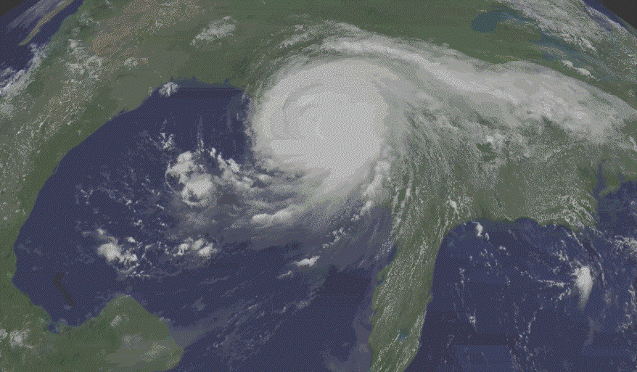
Complex Incident Management
What are the characteristics of a complex incident?
How does major or complex incident management differ?

Slide 4
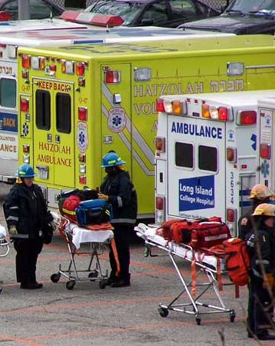
What Are Major/Complex Incidents? (1 of 2)
Major/complex incidents:
  Involve more than one agency and/or political jurisdiction.
  Involve complex management and communication issues.
  Require experienced, highly qualified supervisory personnel.
  Require numerous tactical and support resources.
  May involve multiple victims with injuries, fatalities, or illnesses.

Slide 5

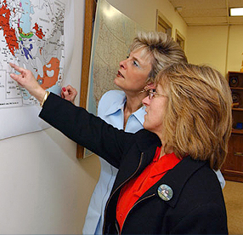
What Are Major/Complex Incidents? (2 of 2)
Major/complex incidents:
  Include widespread damage to property/environment/economy.
  Result in psychological threat/trauma.
  Span multiple operational periods (weeks, months, years).
  Are costly to control and mitigate.
  Require extensive post-incident recovery efforts.
  Draw national media interest.
  May require a coordinated Federal response.

Slide 6
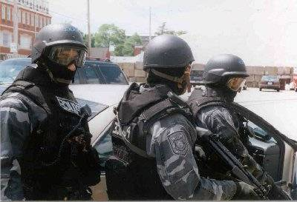
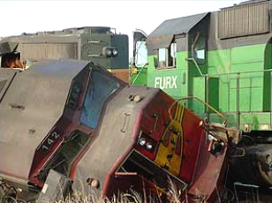
Factors for Determining Size & Structure
  Administrative and jurisdictional complexity
  Geographic area involved
  Consideration of the span of control
  Functional specialties required
  Logistics, planning, and other support needs
  Potential for growth

Slide 7
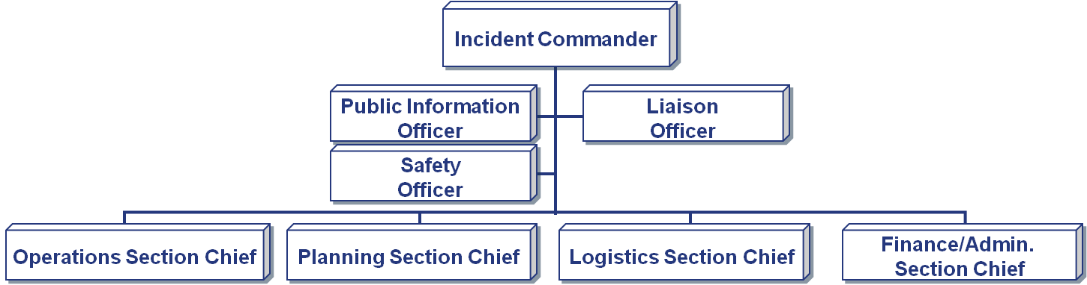
Characteristics: Organization (1 of 3)
Most Command and General Staff positions are filled.

Slide 8
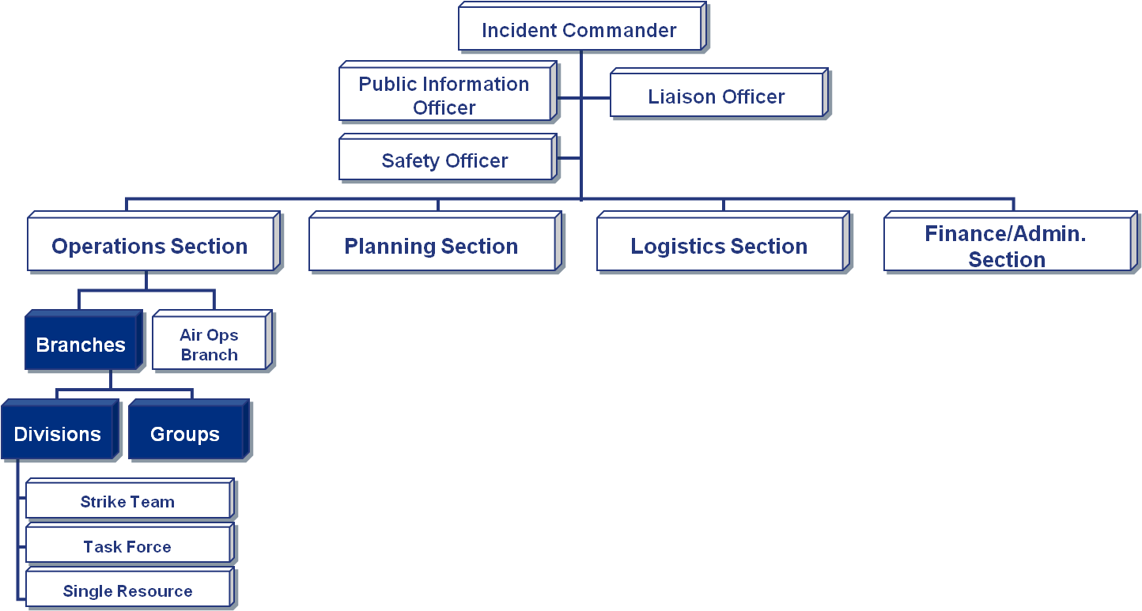
Characteristics: Organization (2 of 3)
Divisions and Groups are used to organize tactical resources. Branches may be required to reduce span of control.

Slide 9
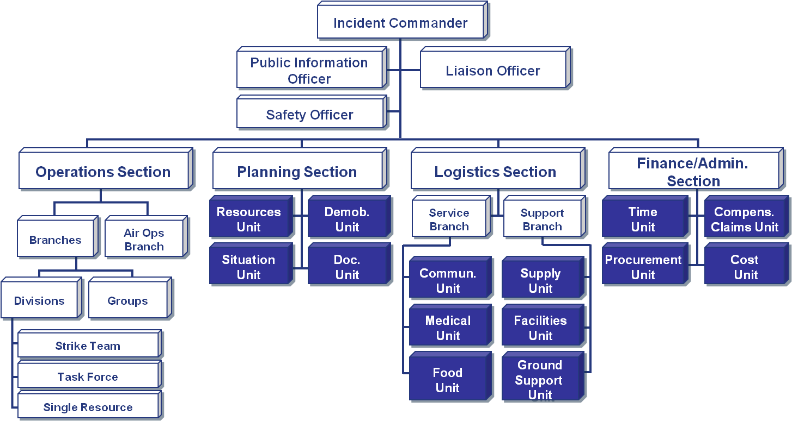
Characteristics: Organization (3 of 3)
Most support units are needed.

Slide 10
Characteristics: Resources & Planning
  Large number of tactical and support resources will need to be ordered, tracked, and managed.
  Multiple operational periods are required.
  Written Incident Action Plans are produced.
  Transfer of command is likely.
  The use of an Incident Management Team may be required.
County Line Flood
Incident Action Plan
August 21, XXXX
Operational Period

Slide 11
ICS Organizational Options
Combine Several Incidents Into an Incident Complex
Divide an Incident Into Two or More Single Incidents
Expand the Planning Capability
Add a Second Operations or Logistics Section

Slide 12

Incident Complex: Definition
An Incident Complex is two or more individual incidents located in the same general proximity that are assigned to a single Incident Commander or Unified Command to facilitate management.

Slide 13
Discussion Question
What are some
examples of when it might be advantageous to establish an Incident Complex?

Slide 14
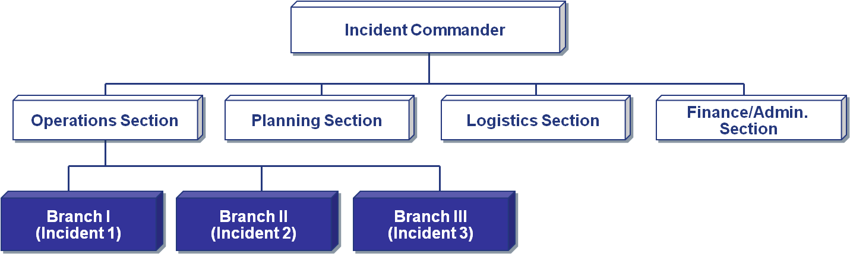
Incident Complex: Structure
Typically, each separate incident is organized as a Branch, allowing for future expansion if required.

Slide 15
ICS Organizational Options
Combine Several Incidents Into an Incident Complex
Divide an Incident Into Two or More Single Incidents
Expand the Planning Capability
Add a Second Operations or Logistics Section

Slide 16
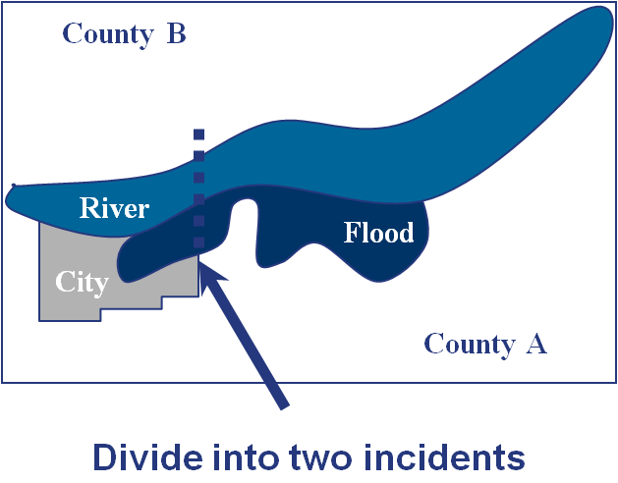
Dividing a Single Incident (1 of 2)
A single incident may be divided when it:
  Spreads into other jurisdiction(s) and Unified Command is not feasible.
  Is difficult to manage from one location due to terrain and access.
  Has objectives that are naturally separating into two operations.

Slide 17
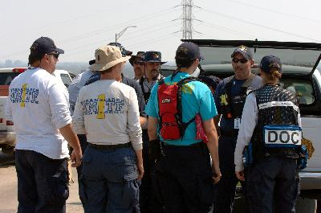
Dividing a Single Incident (2 of 2)
Incidents may be divided when:
  The Planning and/or Logistics Section can no longer adequately provide support services.
  The Operations Section cannot manage
  the number of resources
  required without
  exceeding span of control.

Slide 18
Dividing an Incident
  Step 1: Determine how best to divide the incident.
  Step 2: Assign Incident Commanders and Command and General Staffs for each incident.
  Step 3: Designate additional supporting organizational facilities, locations, etc.
  Step 4: Designate an appropriate time for establishing two separate incidents (each with a unique name).
  Step 5: Coordinate planning strategies and use of critical resources for at least the next operational period.
  Step 6: Consider the need for Area Command. (Area Command is covered in the next unit.)

Slide 19
ICS Organizational Options
Combine Several Incidents Into an Incident Complex
Divide an Incident Into Two or More Single Incidents
Expand the Planning Capability
Add a Second Operations or Logistics Section

Slide 20
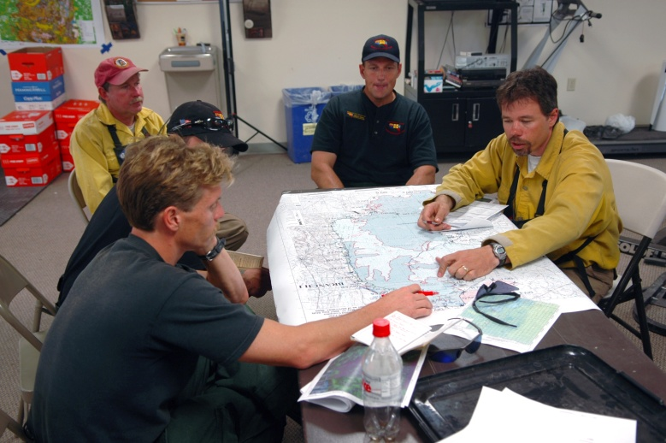
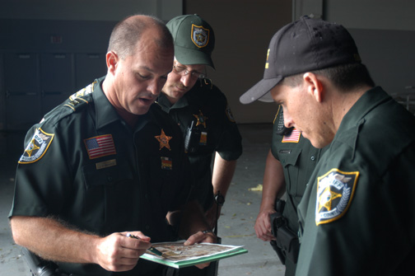
Branch Tactical Planning
Branch Tactical Planning means that:
  Detailed action plans are developed within the Operations Section at the Branch level.
  The Planning Section provides support.

Slide 21
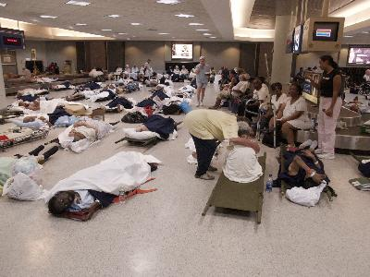
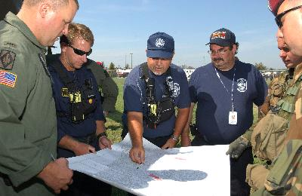
Branch Tactical Planning: Examples
  In a mass fatalities incident, the Medical Examiner/Morgue Operations Branch may be best suited to establish its own incident tactical plans.
  In a structural collapse, the Search and Rescue Branch typically will include its own planning component.

Slide 22
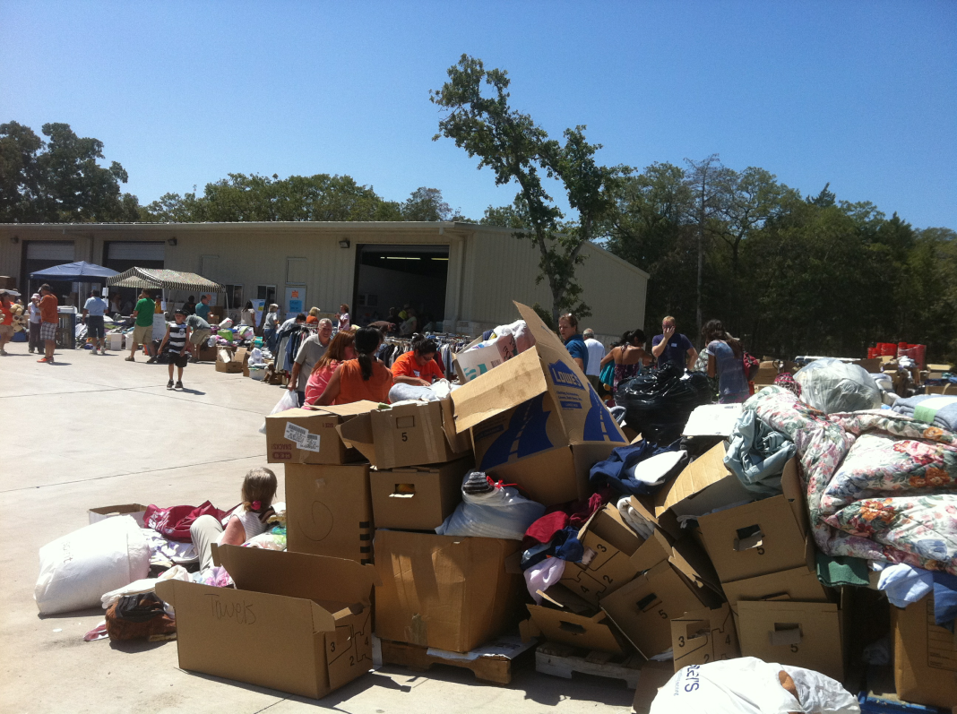
Bastrop County Complex Sept 2011
Branch Tactical Planning Used in Two Ways
Bastrop County Office of Emergency Management began Recovery Branch by about day 5

Slide 23
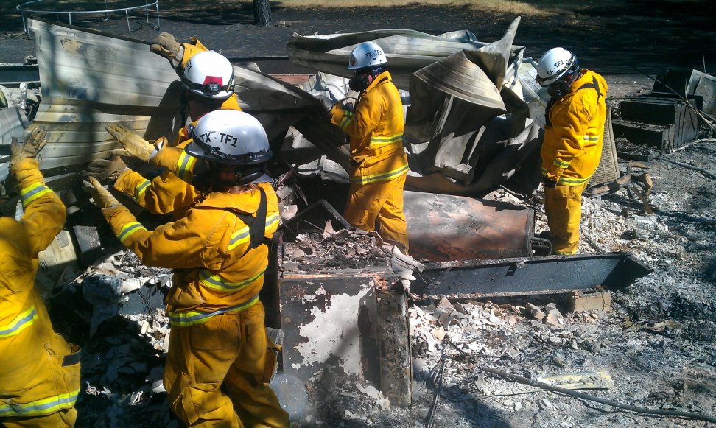
Bastrop County Complex Sept 2011
Branch Tactical Planning Used in Two Ways
USAR Group (Texas TF1) used Branch Tactical Planning for their detailed work assignments

Slide 24
Accomplishing Branch Planning
When Branch Tactical Planning is used, the Planning Section provides:
  General incident objectives.
  Strategy for the Branch for the next operational period.
  Branch resource summary for the next operational period.
  Weather and safety information.
  Changes to logistical support.
  Personnel to support planning.

Slide 25
Discussion Questions
Why is advanced planning critical during a complex incident?
What are the challenges to ensuring that advanced planning occurs?

Slide 26
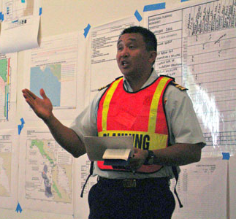
Separate Advanced Incident Planning
To ensure that advanced planning occurs, the Planning Section Chief may:
  Assign a Deputy Planning Section Chief to manage advanced planning.
  Assign technical specialists to perform advanced planning.
  Establish a special unit within
  the Planning Section.

Slide 27
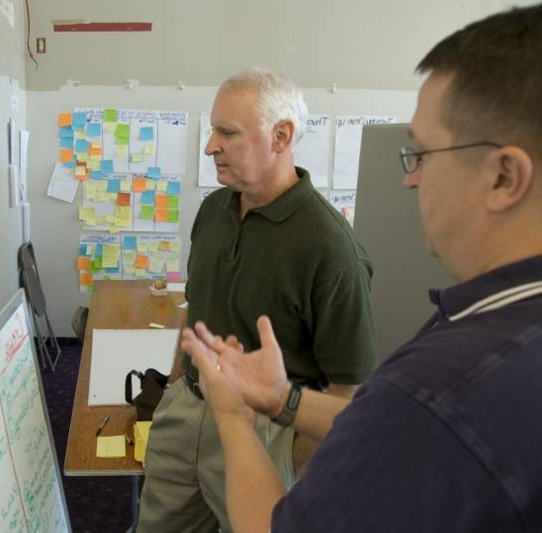
Advanced Planning Considerations
Advanced planning should project ahead at least 36 to 72 hours, and consider:
  Overall goal and incident objectives.
  Adequacy of previous and present plans.
  Future resource availability.
  Strategy assessment and alternatives.
  Environmental factors.
  Organizational assessment and alternatives.
  Political and economic issues.
  Long-term recovery needs.

Slide 28
ICS Organizational Options
Combine Several Incidents Into an Incident Complex
Divide an Incident Into Two or More Single Incidents
Expand the Planning Capability
Add a Second Operations or Logistics Section

Slide 29
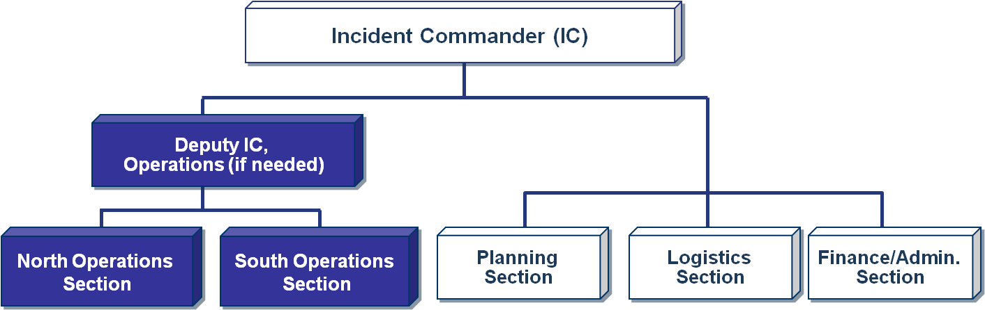
Adding an Operations Section
Adding an Ops Section is designed to address issues related to span of control and geography, not function. This is an extremely rare occurrence.

Slide 30
Adding Operations Section: Considerations
  Ensure that Command and General Staffs can support the expansion.
  Ensure adequate incident action planning.
  Ensure adequate logistics support.
  Establish the second Operations Section at the beginning of an operational period.
  Ensure that all incident supervisory personnel are aware of the expanded organization.
  Add a Deputy Incident Commander for Operations, if necessary.

Slide 31
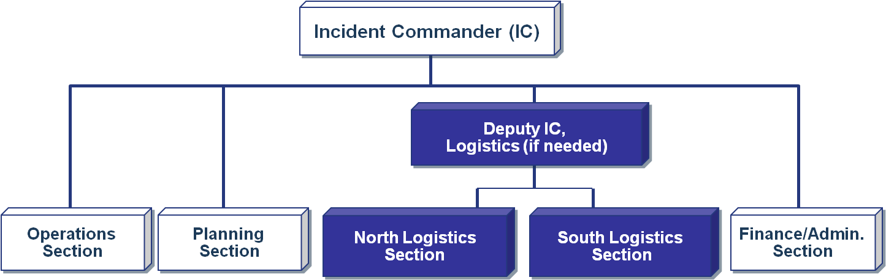
Adding a Logistics Section
If an incident is so geographically dispersed that it is not feasible for the Incident Base to support the incident logistical needs, it may be necessary to establish another Logistics Section. This is an extremely rare occurrence.

Slide 32
Adding Logistics Section: Considerations
  Ensure that Command and General Staffs can support the expansion.
  Ensure adequate incident action planning.
  Establish the second Logistics Section at the beginning of an operational period.
  Ensure that all incident supervisory personnel are aware of the expanded organization.
  Add a Deputy Incident Commander for Logistics, if necessary.

Slide 33
Activity: The Expanding Incident
Scenario: A major portion of the county has been affected by sudden severe weather. Three incidents are reported within a 10-square-mile area. Initially, each of these was designated as an individual incident and resources were separately assigned to each by separate response groups.
  Incident 1: Damage to a hospital requiring evacuation, search and rescue, and relocation of 50 patients.
  Incident 2: Severe damage to a 50 unit mobile home park. Six residents are reported trapped inside two overturned mobile homes; other residents are unaccounted for.
  Incident C: Partial collapse of a roof in an open supermarket. Persons trapped and injured inside. Numerous volunteers are rushing to the scene to help.

Slide 34
Summary
You should now be able to:
  List the principal factors often found in or related to major and/or complex incidents/
  events.
  List the four expansion options for incident/
  event organization and describe the conditions under which they would be applied.
  Demonstrate, through an activity, how to apply the various options related to major or complex incident management.

