Slide 1

ICS 400
Advanced ICS for Command and General Staff and Complex Incidents
June 19-20, 2019
RIVERHEAD, NY
RBIM LLC

Slide 2

Unit 1:
Course Overview
Advanced ICS for Command and General Staff, Complex Incidents, and MACS

Slide 3

Instructor Introductions
Bob Panko
    Bob and ICS grew up together starting in 1982
    Retired in Nov 2007 after 36 calendar years with NPS
    USNPS Ranger / Supv Ranger / Asst Chief Ranger
    USNPS Fire & Aviation Man Officer Everglades NP
    Mt Rainier, Everglades, Shenandoah, Statue of Liberty / Ellis Island, Biscayne & Everglades
    ICT2 – Southern Area IMT2 & NPS All Hazard 1993-2010
    Southern Area Type 1 & 2 IMT’s 2004-2015 (IC / OSC / LOFR)
    2016- Current Operations SC NY State IMT2
    Risky Business Incident Management LLC “sole member”
Photo courtesy TIME Magazine, June 1986

Slide 4
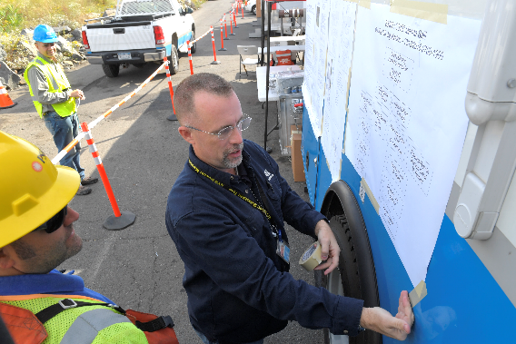
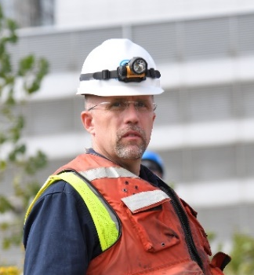
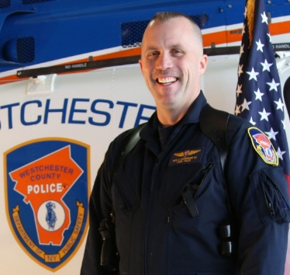
Instructor Introductions
Chris Lieberman
  Project Specialist at Con Edison Emergency Preparedness since 2012
    Deployed to Florida and Puerto Rico in response to Hurricanes Irma and Maria
    Command & General Staff for incidents and events in NYC, Westchester, Orange and Rockland Counties
  Retired Detective/Chief Pilot from Westchester County after 23 year career in 2012
  Instructor/Facilitator for NYS DHSES OEM
  Planning Section Chief on NY State IMT
    Multiple assignments with NYS IMT for wildland fires, floods, and hurricanes

Slide 5
Student Questions
I have experience on multiple incidents/events managed using ICS and worked on these assignments as a member of the Command & General Staff
I am a member of a Type 3 or 4 Incident Management Team (regionally or within your own organization)
I have been on multiple incidents/events managed using ICS but have usually worked as a single resource (part of a crew, as an EMT, etc.) or worked as a Unit Leader
I have had I300 training, but have had no real life experience in using ICS

Slide 6
Student Introductions
Name
Day Job / Who you work or volunteer for
Your past experience in emergency & incident management – ICS positions you performed in the past
Expectations from attending this course

Slide 7
Operational Period Briefing
Current Situation
Objectives
Predictive Information
Assignments
Safety
Logistics
Finance
Planning
Information
Liaison
Agency Reps / Agency Administrator
Close Out

Slide 8
ICS-400 Course Goals
  Explain how major incidents engender special management challenges.
  Describe the circumstances in which an Area Command is established.
  Describe the circumstances in which multiagency coordination systems are established.
This course is designed for senior personnel who are expected to perform as a Command & General Staff member of a T2 or T1 IMT or in an Area Command or multiagency coordination system.

Slide 9
Instructor Expectations
  Cooperate with the group.
  Be open minded to new ideas.
  Participate actively in all of the training activities and exercises.
  Return to class at the stated time.
  Use what you learn in the course to perform effectively within an ICS organization.

Slide 10
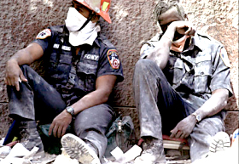
ICS Challenges in Complex Incidents
What challenges do you face in managing complex incidents?

Slide 11
Course Structure
Unit 1:
Course Overview
Unit 2:
Fundamentals Review
Unit 3:
Major and/or Complex Incident/
Event Management
Unit 4:
Area Command
Unit 5:
Multiagency Coordination
Unit 6:
Course Summary

Slide 12

Successful Course Completion
  Participate in unit activities/exercises.
  Achieve 70% or higher on the final exam.
  Complete the end-of-course evaluation.

