Slide 1
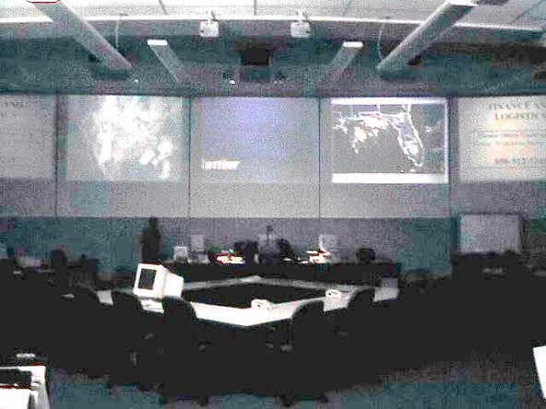


Unit 5:
Multiagency
Coordination
Florida State EOC
(State), Tallahassee, Fl
Expanded Dispatch (Federal), Florida State Coordination Center, Tallahassee, Fl
National Hurricane Center, (MAC Entity)
Miami, Fl

Slide 2
Unit Objectives (1 of 2)
  Describe the kinds of incident/event management problems that can occur due to a lack of multiagency coordination.
  Define essential terms related to multiagency coordination.
  Identify the major guidelines for establishing and using Multiagency Coordination Groups and Systems.
  Provide examples of the different levels at which multiagency coordination is commonly accomplished.
  Identify the primary components of a Multiagency Coordination System.

Slide 3
Unit Objectives (2 of 2)
  Describe examples of organizations that may provide multiagency coordination.
  List the responsibilities of multiagency coordination organizations.
  Identify principal positions within a Multiagency Coordination System.
  Identify differences between Area Command, Unified Command, and multiagency coordination organizations.

Slide 4
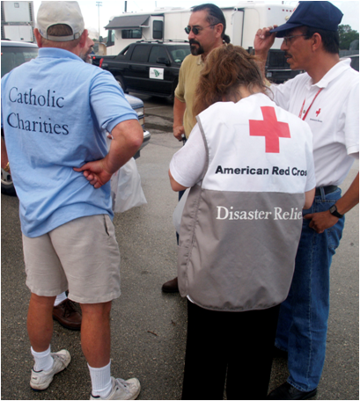
Response Coordination Challenges
  Increasing incident complexity
  Complex and confusing legal
  authorities
  Increasing litigation
  Increasing response costs
  High property and economic losses
  Life, health, safety issues
  Deteriorating public view of government
  Intense media and public scrutiny
  Political, legislative, and budgetary ramifications

Slide 5
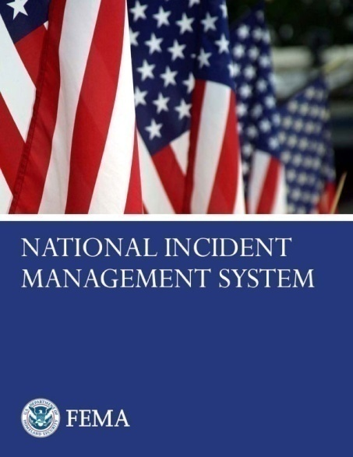
NIMS Components Review
Preparedness
Communications and
Information Management
Incident Command System
Resource Management
Multiagency Coordination Systems
Command and Management
Ongoing Management
and Maintenance
Public Information
Additional Information: www.fema.gov/emergency/nims

Slide 6

What Is a Multiagency Coordination System?
NIMS Element: Command and Management
Multiagency Coordination (MAC) Systems
MAC Systems provide the architecture to support coordination for:
  Incident prioritization.
  Critical resource allocation.
  Communications systems integration.
  Information coordination.

Slide 7
Multiagency Support and Coordination
Provide support and coordination to incident command by:
  Making policy decisions.
  Establishing priorities.
  Resolving critical resource issues.
  Facilitating logistics
  support and resource tracking.
  Collecting, analyzing,
  and disseminating
  information.
Local
Multiagency Coordination
(MAC)
State
Multiagency Coordination
(MAC)
Federal
Multiagency Coordination
(MAC)
Unified Command

Slide 8
Command vs. Coordination
What is the difference between command and coordination?

Slide 9
NIMS: Command
Command: The act of directing, ordering, or controlling by virtue of explicit statutory, regulatory, or delegated authority.
Who has the explicit authority for the management of all incident operations?

Slide 10
NIMS: Coordination
Multiagency coordination is a process that allows all levels of government and all disciplines to work together more efficiently and effectively.
An entity/individual may have “command and control” over resources and policies without being in command of the incident scene.

Slide 11
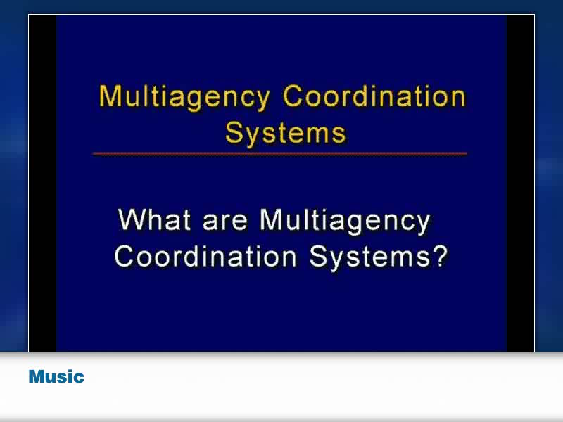
MAC Systems Overview

Slide 12
Terminology Review
How does Area Command differ from
a Multiagency Coordination System?
Where is Unified Command applied?

Slide 13
Unity of Command & Unity of Effort
Local
Emergency
Ops Center
(EOC)
State
Emergency
Ops Center
(EOC)
Federal Emergency Ops Center (EOC)
Unity of
Effort
Policy, Coordination, and Support
Command
Unity of
Command
Area
Command
Incident
Commander
1
Incident
Commander
2
Incident
Commander
3
Multiagency Coordination System

Slide 14
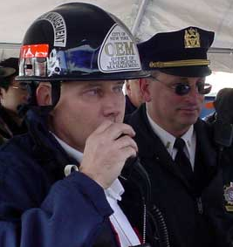


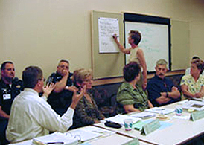
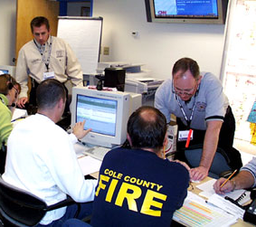
A System . . . Not a Facility
On-Scene
Command
Dispatch
Coordination
Resource Centers
Multiagency Coordination System
Coordination
Organizations/
Groups
Emergency
Operations Centers
Visual 5.14

Slide 15

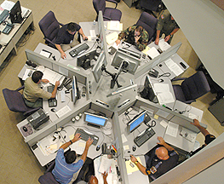
Multiagency Coordination System
A MAC System:
  May be as simple as a teleconference, or
  May require an assembled group and associated support systems.

Slide 16
MAC System Components: Elements
Consists of agency representatives with decisionmaking authority.
Prioritizes critical resource allocations.
Provides policy direction.
Policy-Level Group
(MAC Organization)
Implementation Staff
Coordination Center
Consists of agency representatives with functional or jurisdictional authority.
Implements multiagency coordination organization decisions.
Serves as a location from which to operate.
May consist of permanent or temporary facilities including dispatch center, EOCs, etc.

Slide 17
Common Coordination Organizations
  Multiagency Coordination (MAC) Group
  Crisis Action Teams
  Policy Committees
  Agency Executives
  Dispatch Centers
  Emergency Operations Centers (EOCs)
  Department Operations Center (DOCs)
  National Operations Center
Decisionmakers
Facilities/Ops Support

Slide 18
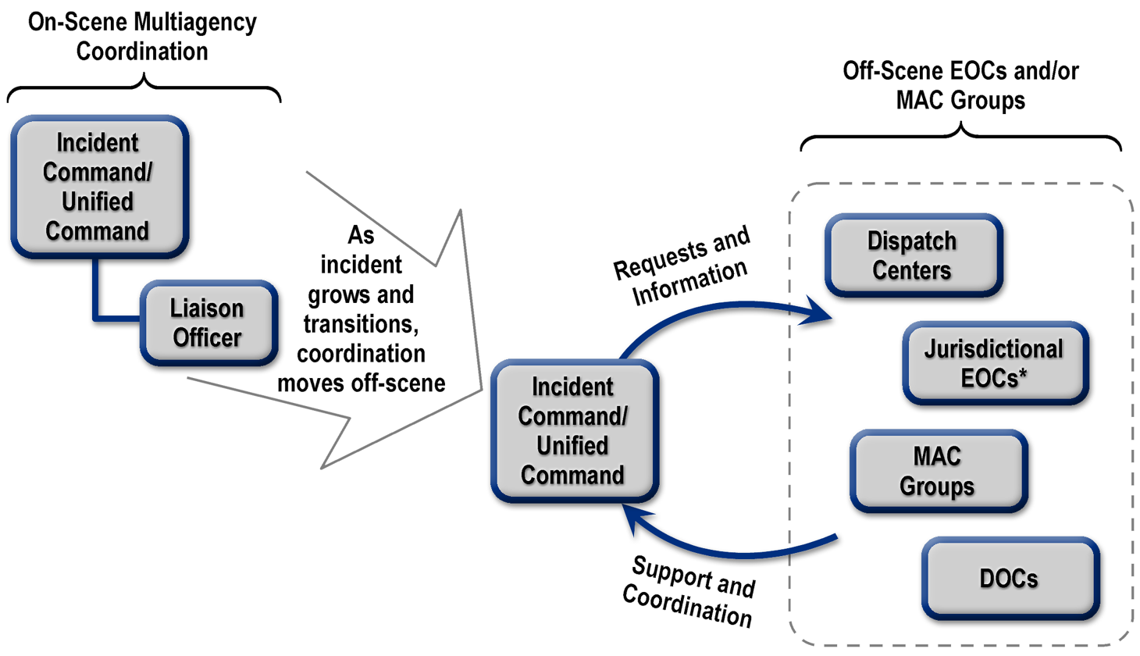
MAC System Components: Relationships
*Includes State−level EOCs.

Slide 19
Multiagency Coordination Centers
  Organizational structures may be based on:
  Incident Command System principles.
  Management functions.
  Emergency support functions.

Slide 20
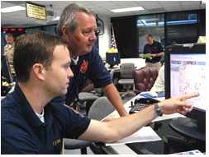
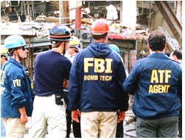
Multiagency Coordination System Activation
  Activated when . . .
  An emergency situation threatens, significantly impacts, or involves multiple agencies and/or political subdivisions.
  Preestablished threat levels are reached.

Slide 21
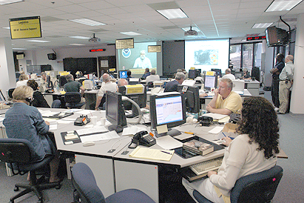

Primary Coordination Functions
  Situation assessment
  Incident policy/priorities
  Critical resource acquisition and allocation
  Support of incident management policies and interagency activities
  Coordination with other ops
  centers/MAC organizations
  Coordination with elected
  and appointed officials
  Support maintenance of a common operating picture

Slide 22
Common Operating Picture
Common Operating Picture = A single, identical summary/presentation of critical incident information that is shared by all responders and organizations
What are the potential challenges in maintaining a common operating picture?
What can an EOC do to address those challenges?

Slide 23

NIMS Components: Public Information
NIMS Element: Command and Management
Public Information
The Public Information Officer supports the Incident Command.
Public information functions must be coordinated and integrated across all levels of government and with the private sector and NGOs.
Organizations participating in incident management retain their independence.

Slide 24
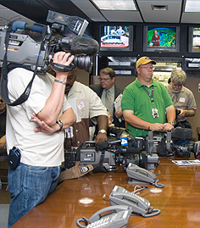
Joint Information Center (JIC)
The Joint Information Center (JIC):
  Is a physical location used to coordinate crisis communications, critical emergency information, and public affairs functions.
  May be established at each level of incident management, as required.
  Must include representatives
  of all stakeholders.

Slide 25
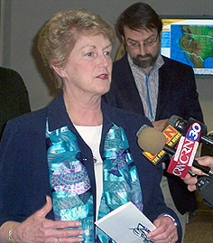
Speaking With One Voice
The Joint Information System (JIS):
  Is the framework for organizing, integrating, and coordinating the delivery of understandable, timely, accurate, and consistent public information.
  Encompasses all public information operations
  (i.e., local, tribal, State, Federal, and private sector) related to an incident.

Slide 26
Discussion Question
What can the policymakers within a multiagency coordination organization do to facilitate their decisionmaking process?

Slide 27
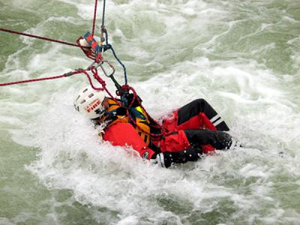
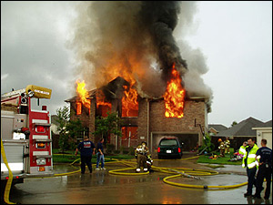
Criteria for Determining Priorities
Life Safety
  Threat to responders
  Threat to public
  Incident Stabilization
  High damage potential
  Incident complexity
  Infrastructure protection
  Property Conservation
  Real property threatened
  Environmental impact
  Economic impact

Slide 28

Role of the MAC Group
Interagency decisionmaking related to:
  Incident management policies and priorities.
  Logistics support and critical resource tracking.
  Resource allocation.
  Coordinating incident-related information.
  Coordinating interagency and intergovernmental issues regarding incident management policies, priorities, and strategies.

Slide 29
MAC Group Organization
MAC Group
Agency
Representatives
MAC Group
Coordinator
MAC Group
Situation
Assessment
Unit
MAC Group Resource Status Information
Unit
Joint Information Center
(JIC)

Slide 30
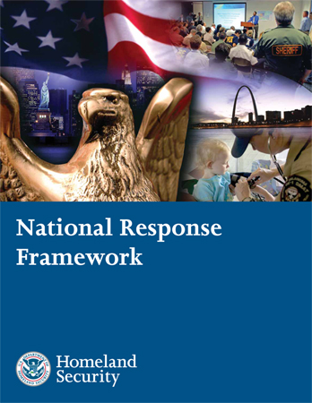
National Response Framework
  Establishes a comprehensive, national, all-hazards approach to domestic incident response.
  Defines principles, roles, and structures.

Slide 31
NRF Emphasizes Partnerships
Federal Government Last Resort!
State Government Provides Support
Local Government First Response!
Individuals and Households
Private
Sector
Nongovernmental Organizations

Slide 32

Resource Request and Delivery Flow
Joint Field Office
Federal Agencies
and Departments
Funding
Assistance
Resources and Equipment
Expertise
Intrastate Mutual Aid
Interstate Mutual Aid
Private Sector/NGOs
State
EOC
Local-to-Local
Mutual Aid
Private Sector/NGO
s
Requests
Local EOCs
Coordination
Command
Incident Command/Unified Command
Visual 5.32
Multiagency Coordination
Version 2.0

Slide 33
Mutual Aid and Assistance Agreements
Allow one jurisdiction to provide resources, facilities, services, and other needed support to another jurisdiction during an incident.
Intrastate Mutual Aid
Interstate Mutual Aid (EMAC)
Local-to-Local Mutual Aid

Slide 34

National Operations Center (NOC)
Watch
Multiagency operations 24/7.
Monitors national picture.
Puts incident in national context.
Planning Element
Provides national-level planning recommendations to the Secretary.
Provides staff support to the Domestic Readiness Group.
DHS
Secretary
NOC Components
Watch
Intel & Analysis
Provides threat information, analysis, and intelligence.
Monitors national intel picture.
Intel & Analysis
Planning Element
NICC
Monitors critical infrastructure and key resources.
Supports government and industry partners.
NICC
NRCC

Slide 35
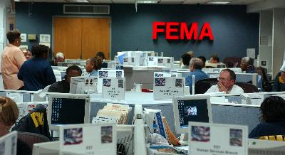
National Response Coordination Center (NRCC)
  Coordinates resource deployment.
  Provides operational support
  to regional and field structures.
  Develops strategic plans.
  Serves as an information conduit.
DHS
Secretary
NOC Components
Watch
Intel & Analysis
Planning Element
NICC
NRCC

Slide 36
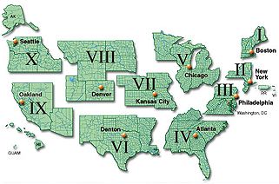
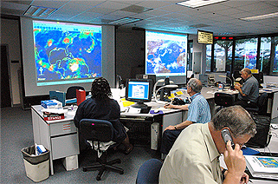
Regional Response Coordination Centers (RRCCs)
Coordinate regional response efforts, including:
  Establishing initial Federal objectives.
  Providing Federal support to the affected States.
  Deploying teams to establish the Joint Field Office that will assume these functions.

Slide 37
Joint Field Office (JFO)
Multiagency Coordination
JFO Unified
Coordination Group
Federal Coordinating Officer (FCO)
State Coordinating Officer (SCO)
Senior Federal Officials (SFOs)
Chief of Staff
External Affairs
Safety Officer
Defense Coordinating
Element
Operations Section
Planning
Section
Logistics
Section
Finance/Admin Section
Emergency Support Functions

Slide 38
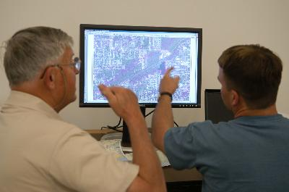
Emergency Support Functions (ESFs)
  Primary Federal-level mechanism to provide assistance.
  Organized around functional capabilities (e.g., public health, search and rescue, etc.).
  Composed of primary and supporting agencies.

Slide 39
Activity: Unit 5
Objective: Demonstrate the ability to utilize the full range of ICS command, control, and coordination options to organize a disaster.
Instructions:
For this exercise our class teams are assigned as follows:
Team #1: Central City Complex IMT
Team #2: Turtle River Area Command
Team #3: Liberty County EOC (MAC Group)
Team #4: Columbia State EOC (MAC Group)
Review the overall scenario in your student workbook & problem statements.
Develop strategies for dealing with each problem statement.
Instructors will facilitate discussions between the teams to resolve some of the problem statements asking the following:
-what are the issues for each Team created by the problem statement?
-which Team do you talk to about your issue created by the problem?
-which Team ultimately “owns” the problem/issue?
-how do decisions made about the issue flow between the Teams?

Slide 40
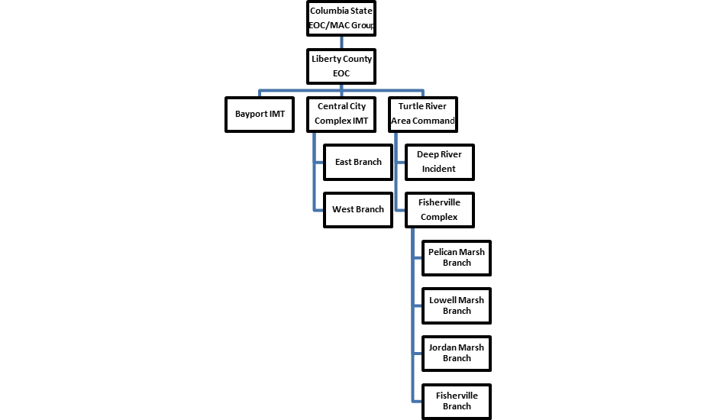

Slide 41
Summary (1 of 2)
You should now be able to:
  Describe the kinds of incident/event management problems that can occur due to a lack of multiagency coordination.
  Define essential terms related to multiagency coordination.
  Identify the major guidelines for establishing and using Multiagency Coordination Groups and Systems.
  Provide examples of the different levels at which multiagency coordination is commonly accomplished.
  Identify the primary components of a Multiagency Coordination System.

Slide 42
Summary (2 of 2)
You should now be able to:
  Describe examples of organizations that may provide multiagency coordination.
  List the responsibilities of multiagency coordination organizations.
  Identify the principal positions within a Multiagency Coordination System.
  Identify differences between Area Command, Unified Command, and multiagency coordination organizations.

