Slide 1

Unit 2:
Fundamentals Review for Command and General Staff

Slide 2
Unit Objectives (1 of 2)
  Describe types of agency(ies) policies, guidelines, and agreements that influence management of incident or event activities.
  Describe issues that influence incident complexity and the tools available to analyze complexity.
  Describe the process for transfer of command.
  Describe the primary guidelines and responsibilities of the Command and General Staff positions.
  List the major steps in the planning process.
Notes:
Introduce the Unit objectives by telling participants that the National Wildfire Coordinating Council (NWCG) and U.S. Department of Homeland Security (DHS) jointly revised the ICS-300 objectives in 2005.
Explain that the Fundamentals Review unit is a review of basic ICS principles learned in previous training. Some participants may taken the pre-requisite ICS training months or years prior to this course; others may have recently taken the pre-requisite ICS-100 and ICS-200 training.
Briefly review the objectives on the visuals. Note that this lesson includes a brief review of ICS concepts followed by an exercise where participants can practice applying these concepts.

Slide 3
Unit Objectives (2 of 2)
  Describe the purposes and responsibilities of Agency Representatives or technical specialists, reporting relationships, and how they can be used effectively within the incident organization.
  Define the advantages of Unified Command and list the kinds of situations that may call for a Unified Command organization.
  Describe how Unified Command functions on a multijurisdiction or multiagency incident.
Notes:
Introduce the Unit objectives by telling participants that the National Wildfire Coordinating Council (NWCG) and U.S. Department of Homeland Security (DHS) jointly revised the ICS-300 objectives in 2005.
Explain that the Fundamentals Review unit is a review of basic ICS principles learned in previous training. Some participants may taken the pre-requisite ICS training months or years prior to this course; others may have recently taken the pre-requisite ICS-100 and ICS-200 training.
Briefly review the objectives on the visuals. Note that this lesson includes a brief review of ICS concepts followed by an exercise where participants can practice applying these concepts.

Slide 4
Activity: ICS Features Review
Instructions:
  This course builds on what you learned in
  ICS-100/200/300 about ICS features. Let’s see how much you remember!
  Your team will have 3 minutes to try to list as many ICS features as you can remember. Hint: There are 14 features.
  Start writing when your instructor says “go.”
  Stop when the instructor calls time.

Slide 5
ICS Features: Review
  Standardization
    Common terminology
  Command
    Establishment and transfer of command
    Chain of command and unity of command
    Unified command
  Planning/Organizational Structure
    Management by objectives
    Incident Action Plan (IAP)
    Modular organization
    Manageable span of control
  Facilities and Resources
    Comprehensive resource management
    Incident locations and facilities
  Communications/Information Management
    Integrated communications
    Information and intelligence management
  Professionalism
    Accountability
    Dispatch/Deployment

Slide 6
Review Activity: Introduction
Your team is part of a group preparing to manage a 4th of July celebration that includes the following:
  July 3rd - July 5th: The Fire Department’s annual 3-day carnival will begin each day at 10:00 a.m. and end each evening with a concert and fireworks. In conjunction with the carnival, the 4-H Club is sponsoring a craft fair and livestock show.
  July 4th: A parade honoring a returning war hero is scheduled to begin at 9:30 a.m., ending in a noon rally. The rally will include speeches from your U.S. Senator, the Governor, and Department of Defense officials. Press reports have indicated that the Senator is about to announce her intent to run for President in the fall primaries.
The carnival and rally will be held on the County Fairgrounds. The mile-long parade route begins at the County Courthouse. The county is in the middle of a heat wave that is forecasted to continue. Large crowds are projected. National media outlets are beginning to arrive. The FBI has issued a general advisory warning of possible terrorism directed at disrupting holiday celebrations.

Slide 7
Review Activity: Instructions
1. Your team will be assigned one or more of the topic questions to answer. Each team will select a leader.
2. Each team will be given an assigned area. During the time allotted by the instructor, each team will develop a presentation that:
  Is based on the scenario.
  Addresses all assigned questions.
  Uses chart paper to create visual displays and bullet items summarizing key points.
  Allows ALL team members to have a role during the presentation.
3. Use the review materials in your Student Manuals to help formulate your presentations!

Slide 8
Group 1: Complexity & Transfer of Command
  Based on the incident type complexity levels (1–5), identify the anticipated complexity level type for this event. Present a review of all five complexity types and then state the reasons why the team chose the selected incident type.
  What are the three most likely factors/scenarios that might cause the incident type to increase in complexity?
  Select one of the above “what-if” scenarios. Now assume that this scenario has occurred and that a transfer of command is needed. What are the five important steps for effectively assuming command of an incident?
Be ready to present in 75 minutes.

Slide 9
Group 2: Command Staff
  How might the role of command be defined in this scenario? Should it be limited to public safety and security only, or should it also include the management of all activities associated with a 3 day event? What are the issues associated with either choice?
  What are the primary responsibilities of the Safety Officer for this event?
  What are the primary responsibilities of the Liaison Officer for this event? What agency representatives may be present? What are the roles of the agency representatives?
  What are the primary responsibilities of the Public Information Officer for this event?
Be ready to present in 75 minutes.

Slide 10
Group 3: General Staff—Tactical Resources
  What are the primary responsibilities of the Operations Section Chief for this event?
  What tactical resources are likely to be needed to manage this event?
  How will span of control be managed? Will Branches, Divisions, and/or Groups be added?
  What is a possible organizational structure for the Operations Section? (Draw a chart.)
Be ready to present in 75 minutes.

Slide 11
Group 4: General Staff—Support Resources
  Planning: What are the primary responsibilities of the Planning Section Chief for this event? What are the greatest challenges facing the Planning Section? What types of technical specialists may be included in the Planning Section?
  Logistics: What are the primary responsibilities of the Logistics Section Chief for this event? What are the greatest challenges facing the Logistics Section?
  Finance/Admin: What are the primary responsibilities of the Finance/Administration Section Chief for this event? What are the greatest challenges facing the Finance/Admin Section?
Be ready to present in 75 minutes.

Slide 12
Group 5: Planning Process
  Who is responsible for the planning process?
  What types of policies, guidelines, or agreements must be considered in managing this event?
  How long will the first operational period be?
  What are the initial objectives for the event’s first operational period? (Write SMART objectives!)
  Once the formal planning process begins, what are the major steps/meetings conducted?
  What ICS forms will be completed? What are the purposes of each form?
Be ready to present in 75 minutes.

Slide 13
Group 6: Unified Command
  What are the advantages of using Unified Command for this event?
  Which jurisdictions/agencies will be included in the Unified Command structure?
  What are the essential elements of Unified Command and how will they be used to manage this event?
  What are the top three challenges associated with using Unified Command for this event? What strategies will be used to address these challenges?
Be ready to present in 75 minutes.

Slide 14
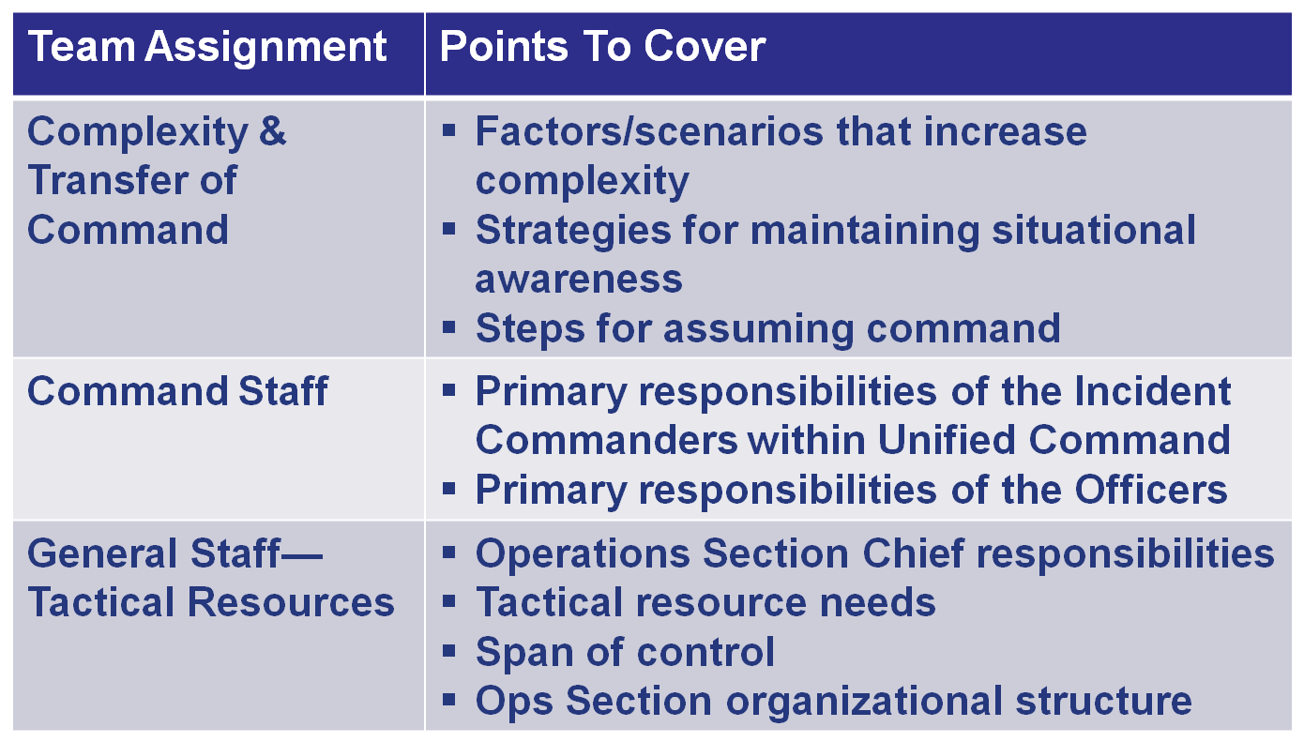
Activity Debrief (1 of 2)

Slide 15
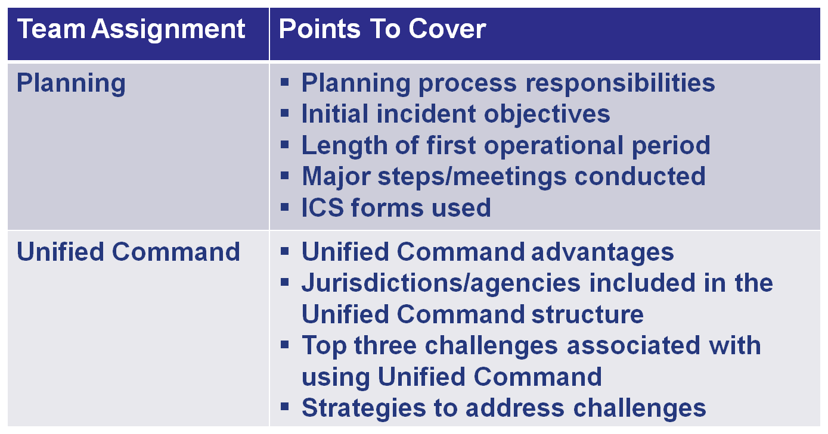
Activity Debrief (2 of 2)

