Slide 1
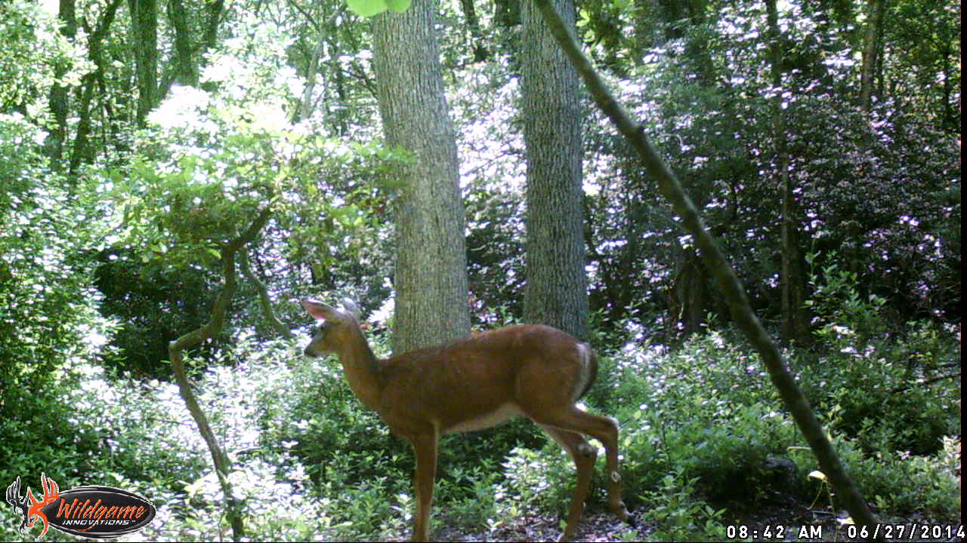
Retired USNPS Park Ranger Life

