Slide 1
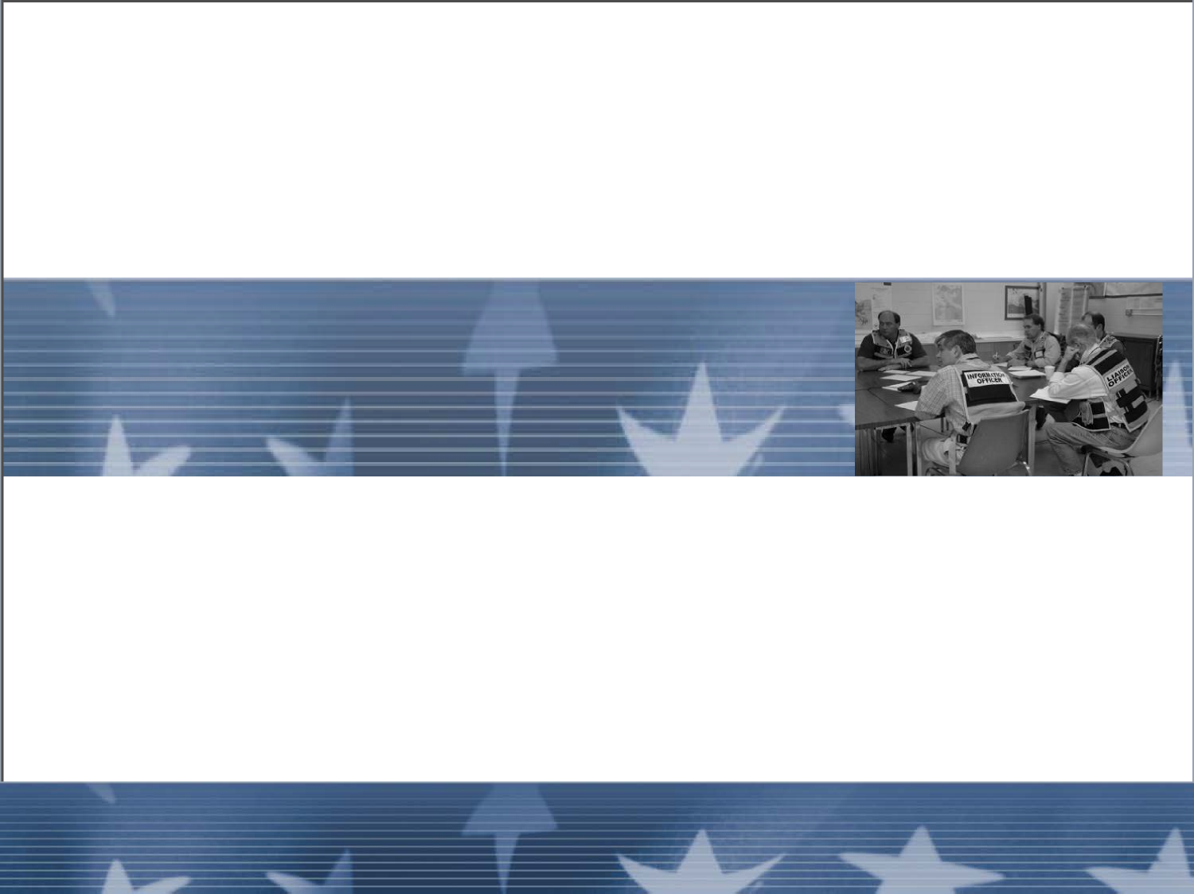
Unit 8
Coordination

Slide 2
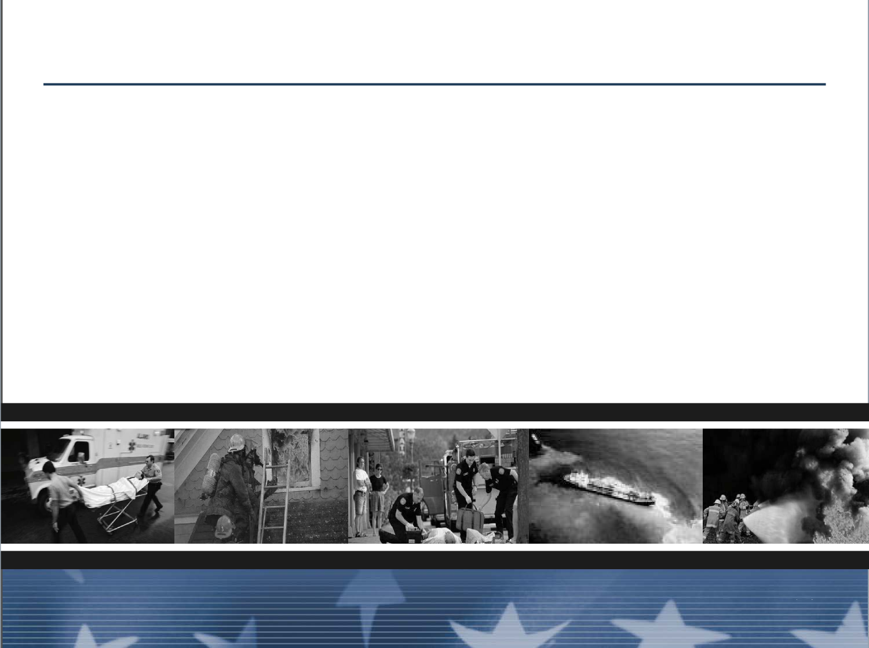
Unit Terminal Objective
Describe the interactions with the Command and
General staff and other ICS functional areas that are
required to perform the Division/Group Supervisor’s
job.
Unit 8: Coordination
Visual 8-2

Slide 3
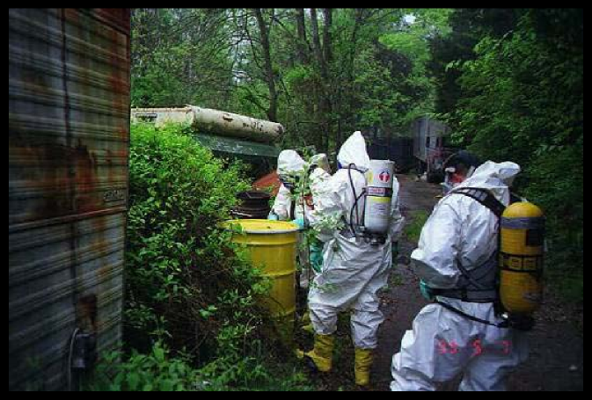
Information Communication
The early organization and establishment of lines of
communication with resources assigned to the
Division or Group is critical.
Unit 8: Coordination
Unit 8: Coordination
Visual 8-27
Visual 8-27

Slide 4
Information Communication (cont.)
Sharing:
■ From you to your assigned resources
■ From your assigned resources to you
■ From you to adjoining Divisions, Groups, and
resources
Unit 8: Coordination
Visual 8-4
Unit 8: Coordination
Visual 8-27

Slide 5
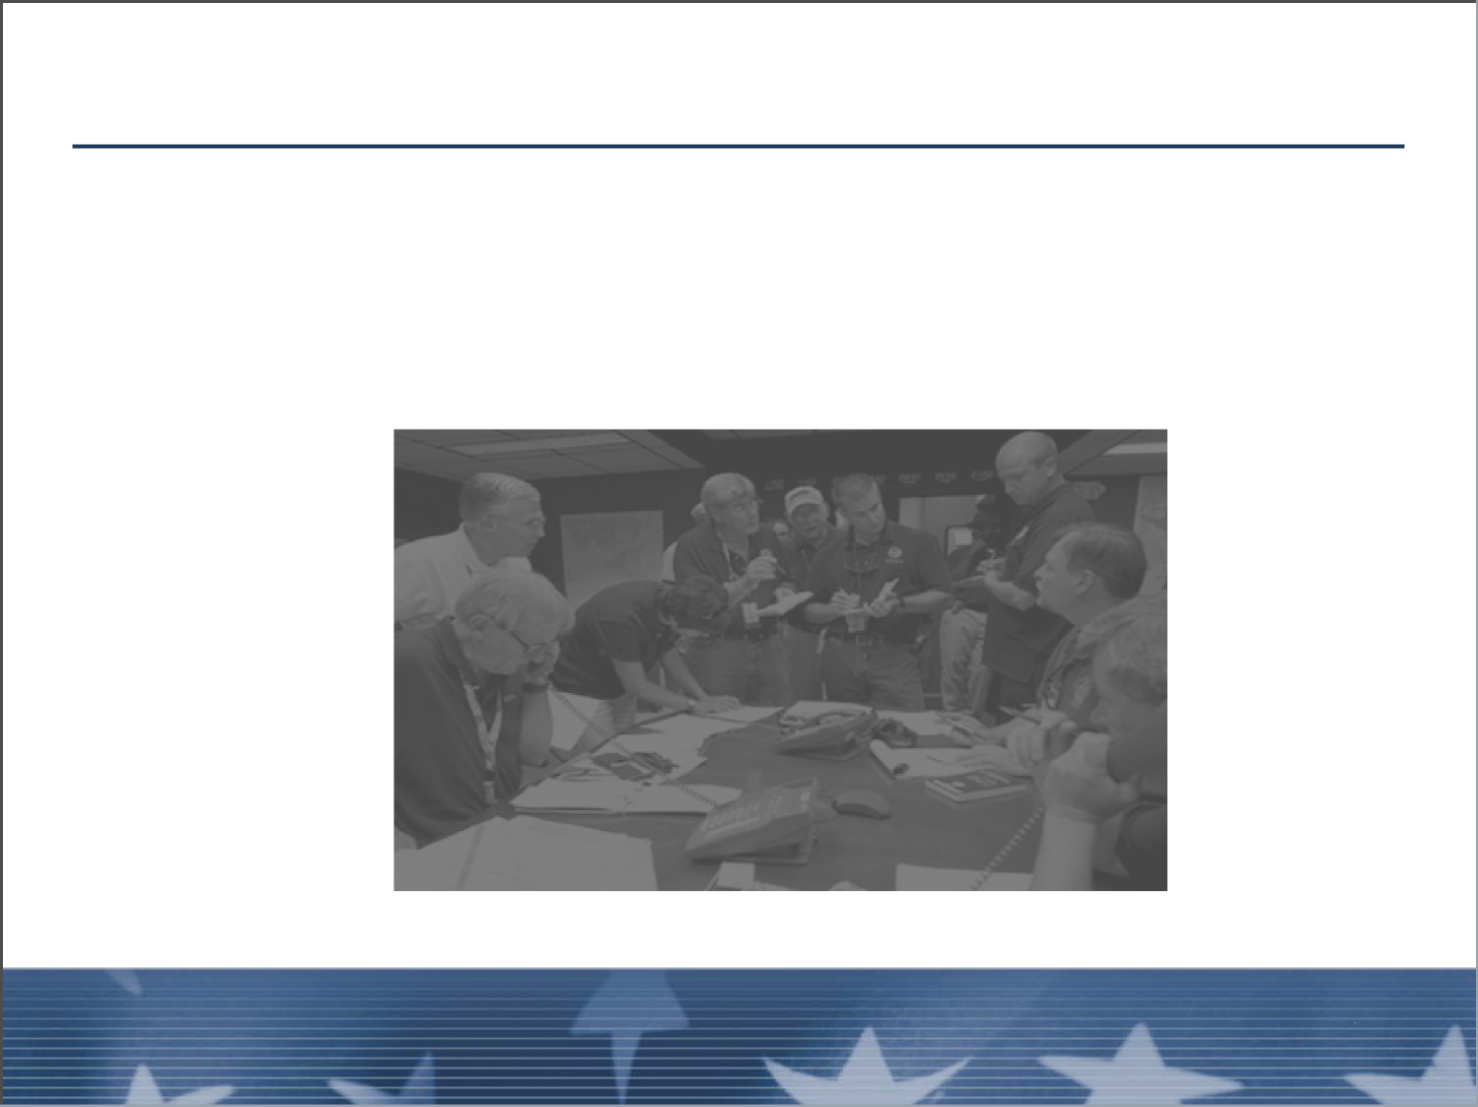
Interactions with Command and General Staff
■ Inherent to the tasks of the Division/Group Supervisor
■ The ability to do this effectively will determine your
success as a Division/Group Supervisor
Unit 8: Coordination
Visual 8-27

Slide 6
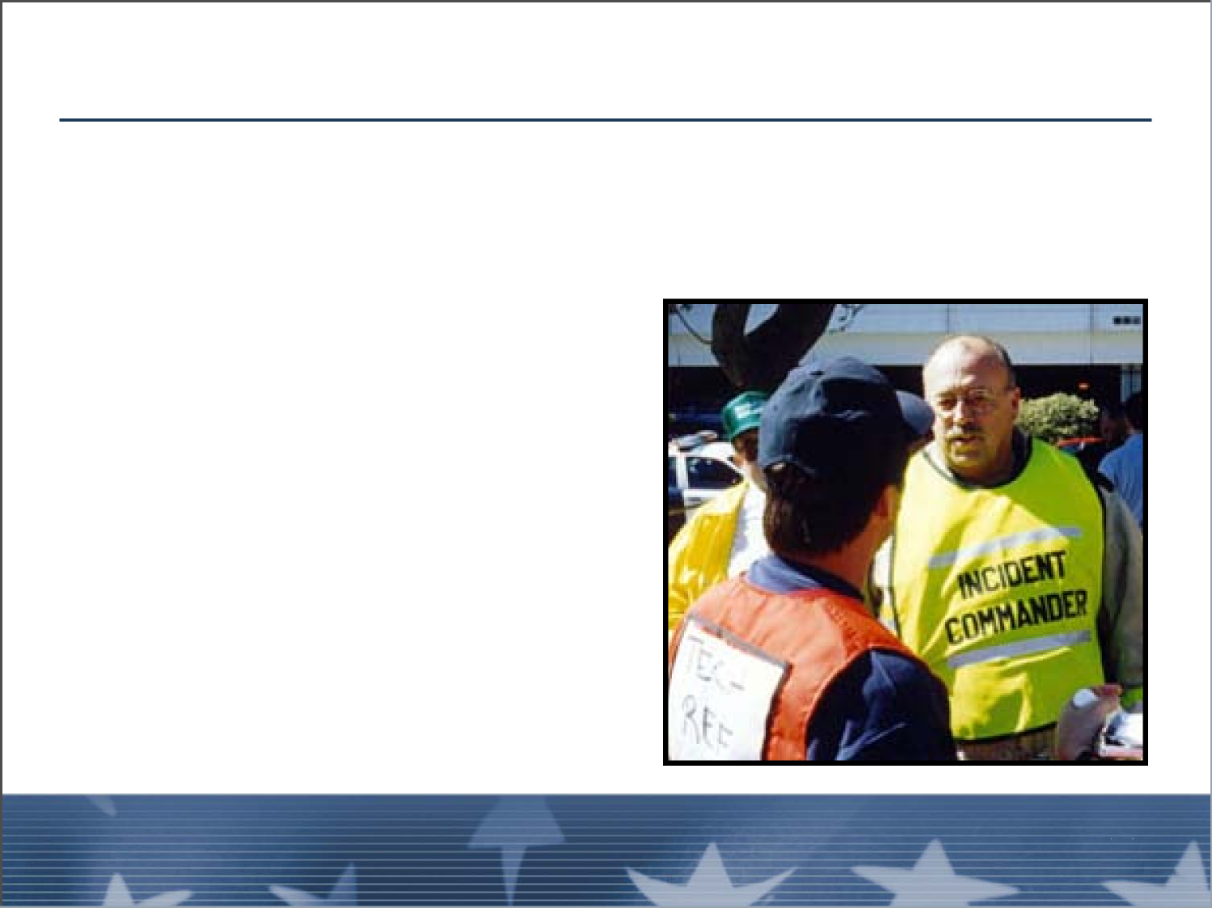
Interactions with Command and General Staff
Division/Group Supervisor and Incident Commander:
The Incident Commander provides:
■ Broad direction
■ Policy interpretation
Unit 8: Coordination
Unit 8:
Visual 8-27
Coordination
Visual 8-6

Slide 7
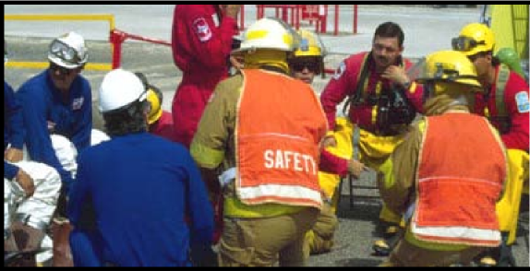
Interactions with Command and General Staff
Division/Group Supervisor, Safety Officer, and
assistants:
■ Risk assessment and mitigation
■ Accident or incident investigations
■ May act as a second set of eyes and ears for the
Division/Group Supervisor
Unit 8: Coordination
Visual 8-27

Slide 8
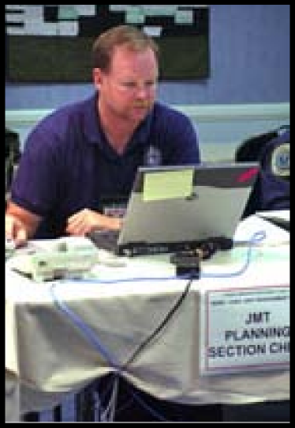
Interactions with Command and General Staff
Division/Group Supervisor and Planning:
Most of the interactions will be with subordinate staff
rather than the Planning Section Chief.
Unit 8: Coordination
Unit 8: Coordination
Visual 8-27
Visual 8-8

Slide 9
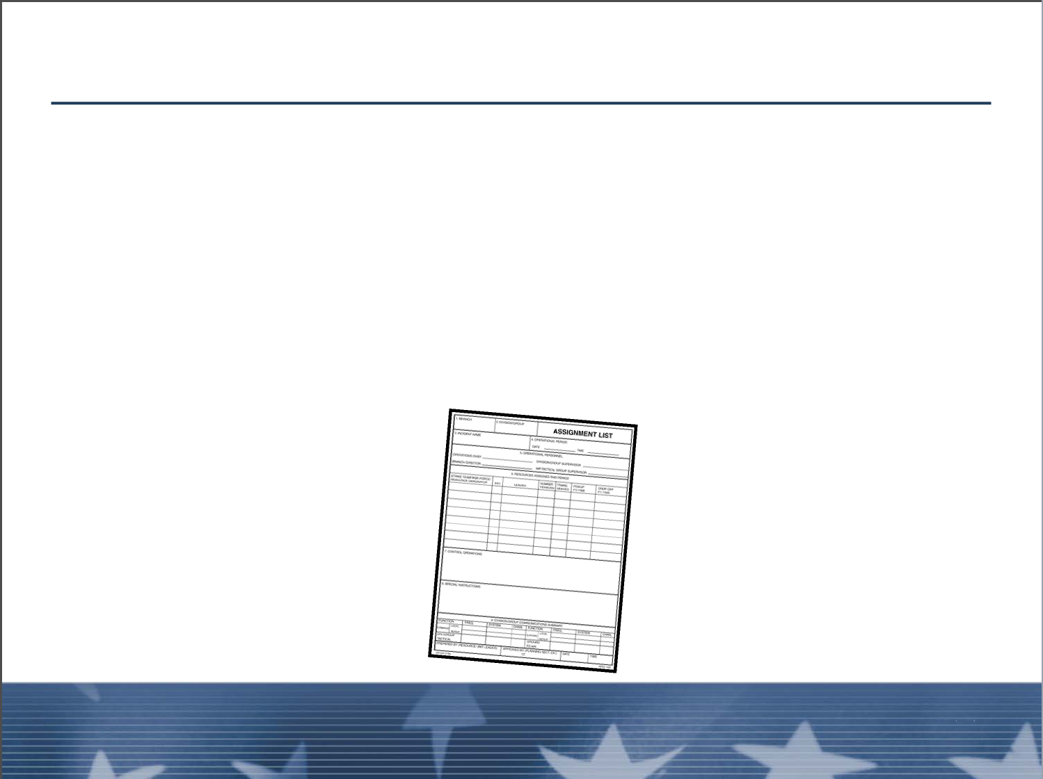
Interactions with Command and General Staff
Division/Group Supervisor and Planning (cont.):
Resources Unit Leader (RESL):
■ Maintains current incident resource status
■ Assembles Task Forces and Strike Teams
■ Prepares the ICS Form 204 - Assignment List
Unit 8: Coordination
Visual 8-27

Slide 10
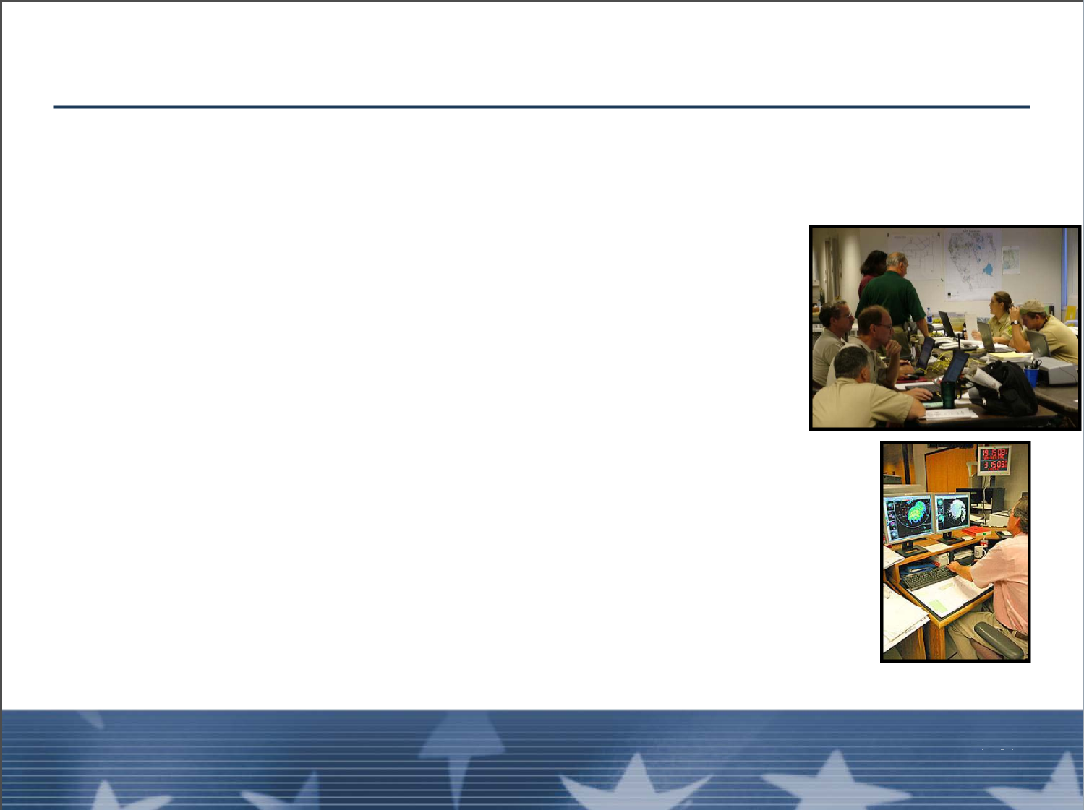
Interactions with Command and General Staff
Division/Group Supervisor and Planning (cont.):
Situation Unit Leader (SITL):
■ Incident prediction and probabilities
■ Maps and photo services
■ Incident perimeter
■ Situation status
■ Weather
■ Summary and status of accomplishments
Unit 8: Coordination
Unit 8:
Coordination
Visual 8-27
Visual 8-10

Slide 11
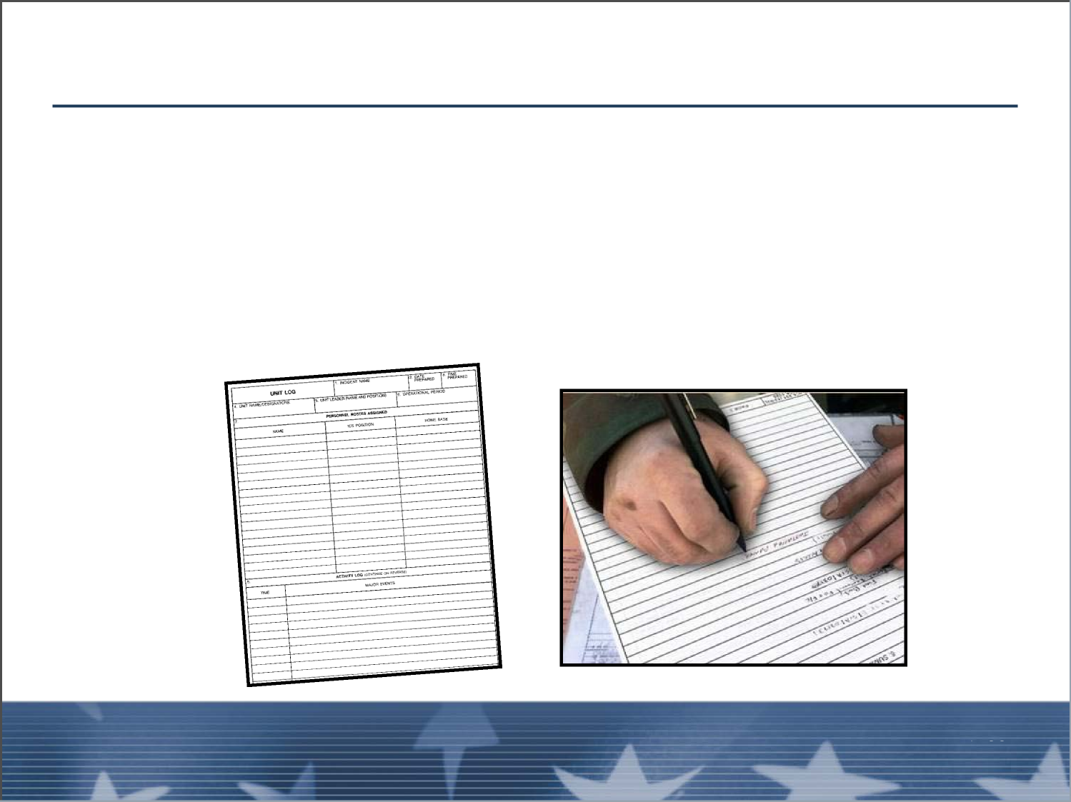
Interactions with Command and General Staff
Division/Group Supervisor and Planning (cont.):
Documentation Unit Leader (DOCL):
■ Copying and duplication services
■ Files narratives, ICS Form 204, and others
Unit 8: Coordination
Visual 8-27

Slide 12
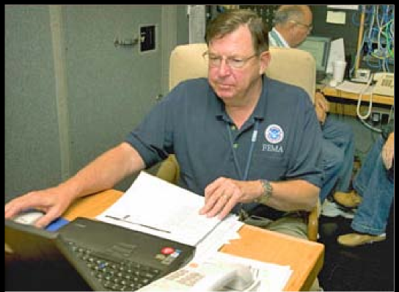
Interactions with Command and General Staff
Division/Group Supervisor and Planning (cont.):
Demobilization Unit Leader (DMOB):
■ Preparation of Demobilization Plan
■ Check-out procedures
Unit 8: Coordination
Unit 8: Coordination
Visual 8-27
Visual 8-12

Slide 13
Interactions with Command and General Staff
Division/Group Supervisor and Planning (cont.):
Technical Specialists:
■ Meteorologist
■ Training Specialist
■ Rehabilitation Specialist
■ USAR
■ Hazardous materials specialist
■ Seismologist
Unit 8: Coordination
Visual 8-27

Slide 14
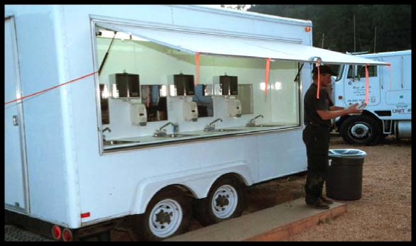
Interactions with Command and General Staff
Division/Group Supervisor and Logistics:
■ Interaction is critical for accomplishment of the job
■ Most interactions will take place with subordinate staff
rather than the Logistics Section Chief
Coordination
Visual 8-14
Unit 8:
Unit 8: Coordination
Visual 8-27

Slide 15
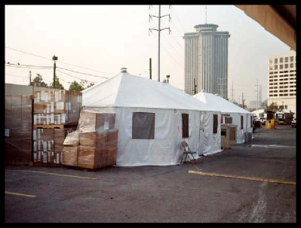
Interactions with Command and General Staff
Division/Group Supervisor and Logistics (cont.):
Supply Unit Leader (SPUL):
■ Establishes times, methods by, and locations
where supplies are to be delivered and returned
■ Tactical items
■ Logistical items (including rations)
Unit 8: Coordination
Visual 8-27

Slide 16
Interactions with Command and General Staff
Division/Group Supervisor and Logistics (cont.)
Ground Support Unit Leader (GSUL):
■ Support and transportation vehicles
■ Crew transports
■ Tactical vehicles and support
■ Fueling, maintenance, and repairs
■ Transportation Plan
Unit 8: Coordination
Unit 8: Coordination
Visual 8-27
Visual 8-16

Slide 17
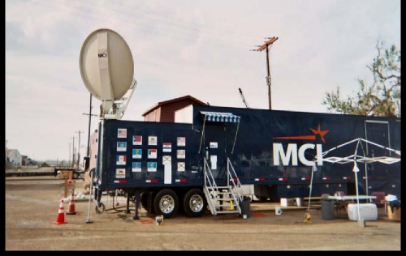
Interactions with Command and General Staff
Division/Group Supervisor and Logistics (cont.)
Communications Unit Leader (COML):
■ Resolves communications problems
■ Maintains, repairs, and replaces radios
■ Coordinates message center operations
Unit 8: Coordination
Visual 8-27

Slide 18
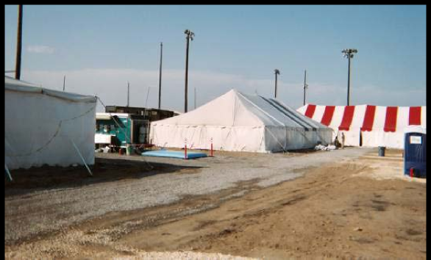
Interactions with Command and General Staff
Division/Group Supervisor and Logistics (cont.)
Facilities Unit Leader (FACL):
■ Base and Camp establishment, maintenance, and
organization
■ Site location and layout
■ Security
Unit 8: Coordination
Unit 8: Coordination
Visual 8-27
Visual 8-18

Slide 19
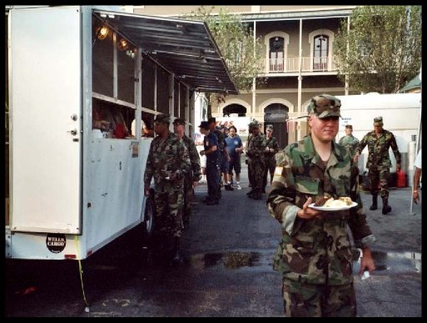
Interactions with Command and General Staff
Division/Group Supervisor and Logistics (cont.)
Food Unit Leader (FDUL):
■ Meals
■ Caterer (contract administration)
■ Kitchen
■ Potable water
Unit 8: Coordination
Visual 8-27

Slide 20
Interactions with Command and General Staff
Division/Group Supervisor and Logistics (cont.)
Medical Unit Leader (MEDL):
■ Paramedics, EMTs, and other medical staff
■ Preventative care
■ First aid treatment
■ Evacuations
■ Comp-for-injury documentation
Unit 8: Coordination
Unit 8: Coordination
Visual 8-27
Visual 8-20

Slide 21
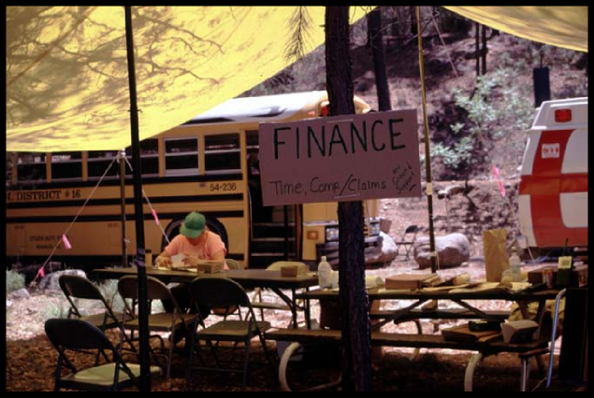
Interactions with Command and General Staff
Division/Group Supervisor and Finance/Administration
Most interactions will take place with subordinate staff
rather than the Finance/Administration Section Chief.
Unit 8: Coordination
Visual 8-27
Coordination

Slide 22
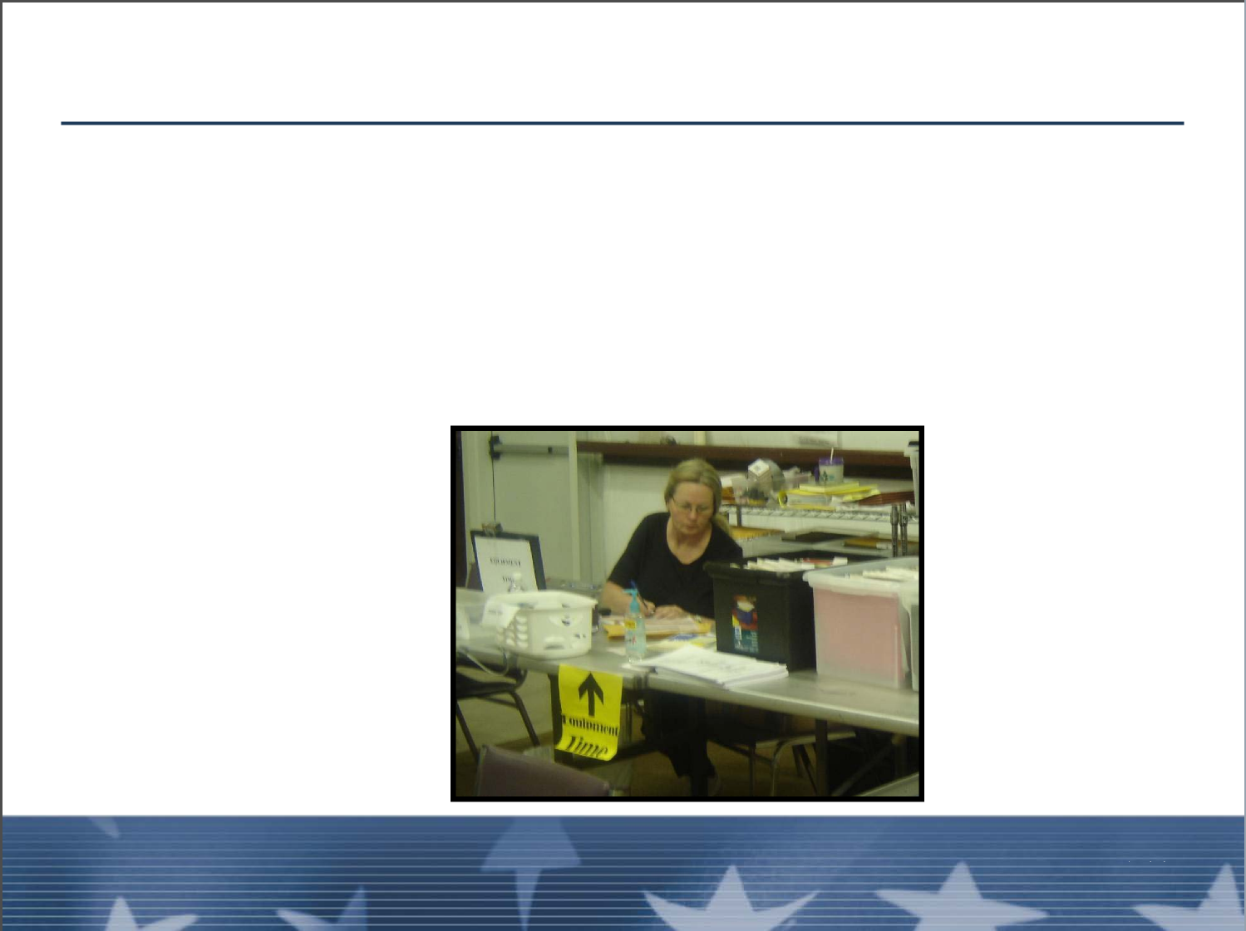
Interactions with Command and General Staff
Division/Group Supervisor and Finance/Administration
Time Unit Leader (TIME):
■ Personnel time recording
■ Commissary
Unit 8: Coordination
Unit 8:
Visual 8-27
Coordination
Visual 8-22

Slide 23
Interactions with Command and General Staff
Division/Group Supervisor and Finance/Administration
(cont.)
Procurement Unit Leader (PROC):
■ Procurement and contract administration
■ Information on contracts and agreements
■ Payment documents
Unit 8: Coordination
Visual 8-27

Slide 24
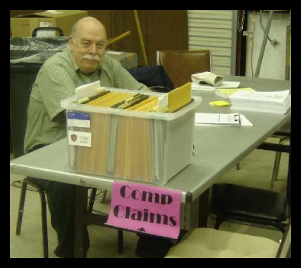
Interactions with Command and General Staff
Division/Group Supervisor and Finance/Administration
(cont.)
Compensation/Claims Unit Leader (COMP):
■ Comp-for-injury documentation processing
■ Written authority for persons requiring medical
treatment
Unit 8: Coordination
Unit 8:
Visual 8-27
Coordination
Visual 8-24

Slide 25
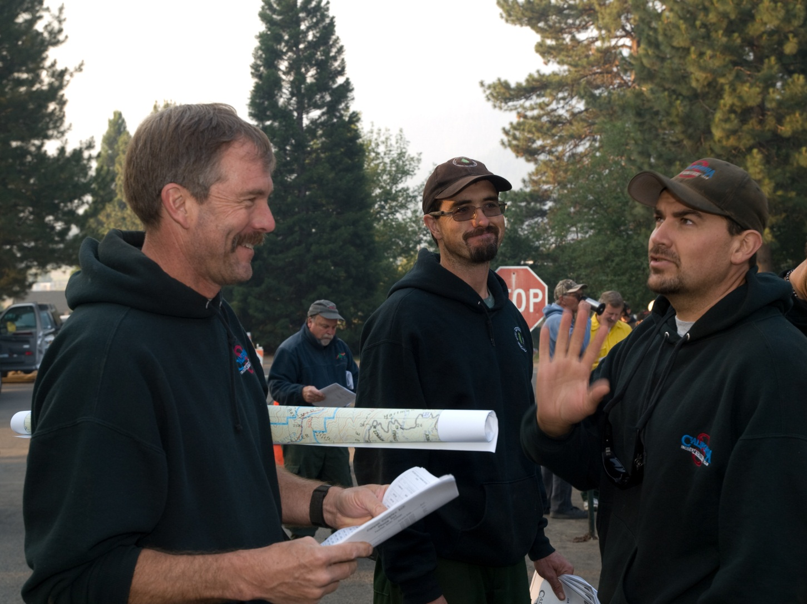
Unit 5
Interaction
DIVISION/GROUP SUPERVISOR
Unit 2 – Interactions
Slide 5-25

Slide 26
Unit 5 Objective
Discuss the interactions with the command and general staff and other ICS functional areas that are required to perform the DIVS’s job.

Slide 27
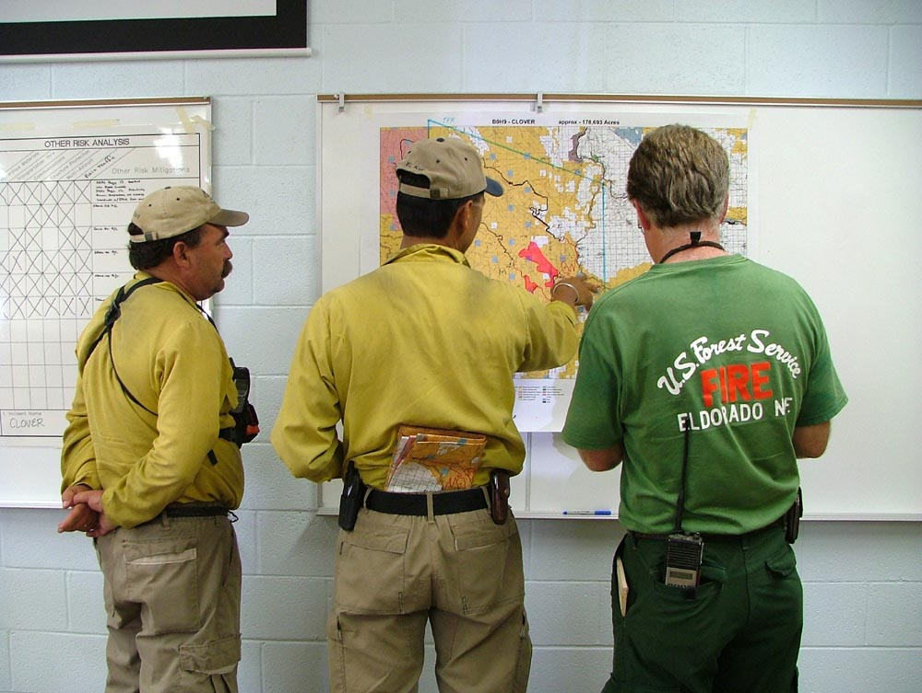
An important task of the DIVS is interaction with:
Other positions within the operations section
Other sections in the incident organization
The command staff

Slide 28
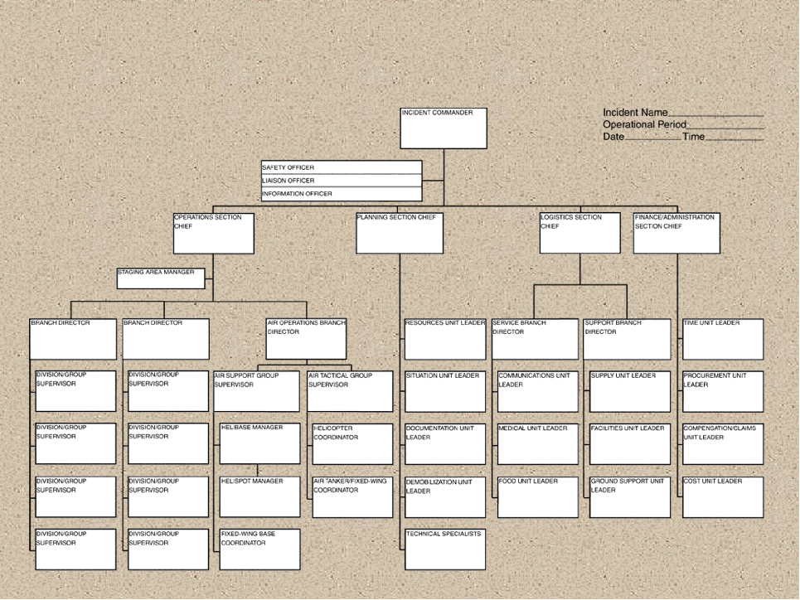
Panel Introductions
DIVISION/GROUP SUPERVISOR
Unit 2 – Interactions
Slide 5-28

Slide 29
NWCG Unit 5 Exercise
Discuss the scenarios in the General Message handouts and answer the questions.

Slide 30
Review Unit 5 Objective
Discuss the interactions with the command and general staff and other ICS functional areas that are required to perform the Division/Group Supervisor’s job.

Slide 31
Objectives Review
1. What support would you seek from:
■ The Planning Section?
■ The Logistics Section?
■ The Finance/Administration Section?
Unit 8: Coordination
Visual 8-27

Slide 32
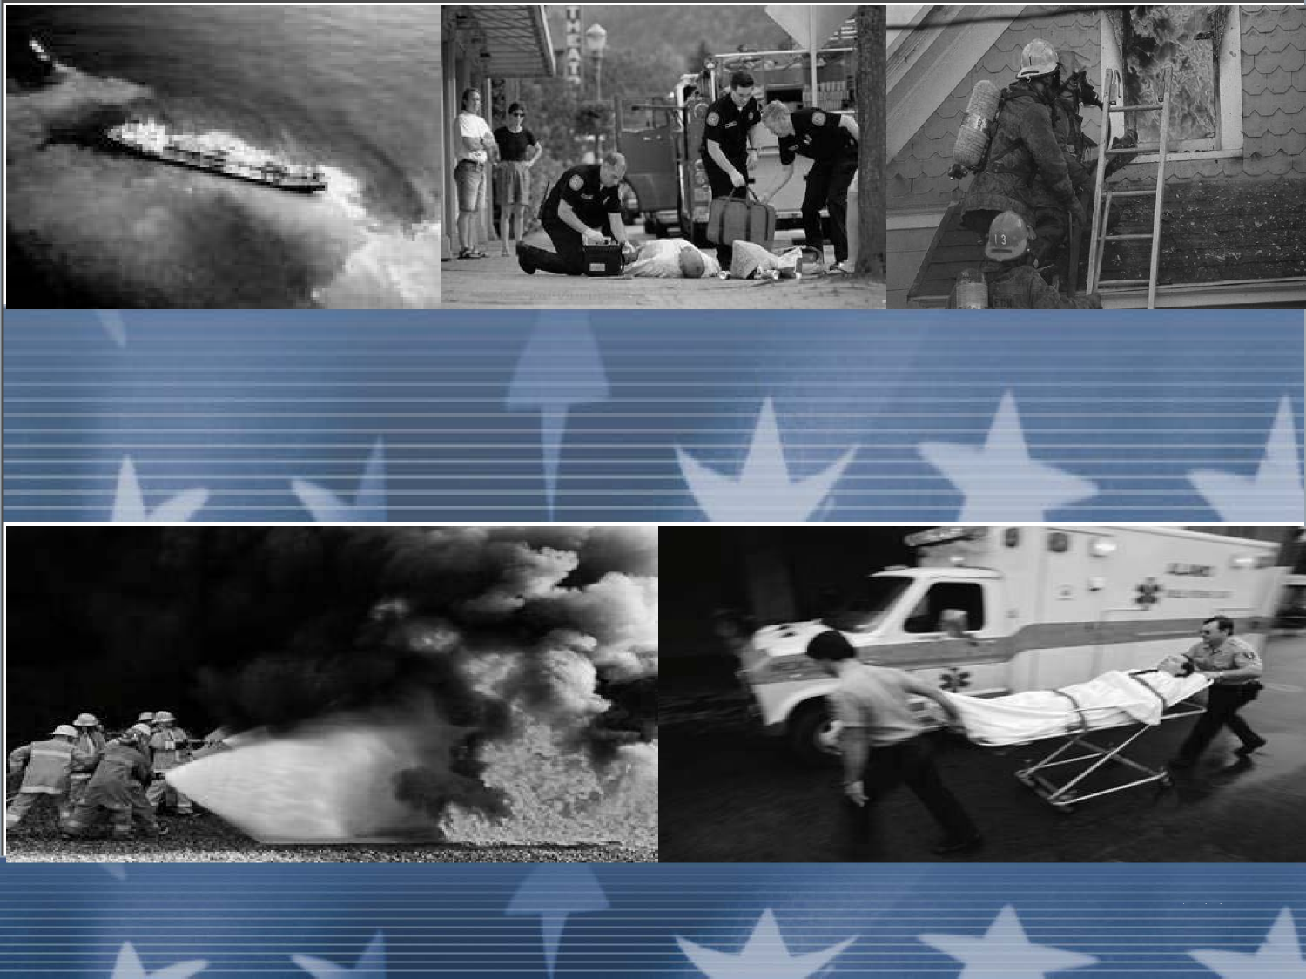
Review Course Expectations
Unit 8: Coordination
Unit 8: Coordination
Visual 8-27
Visual 8-26

Slide 33
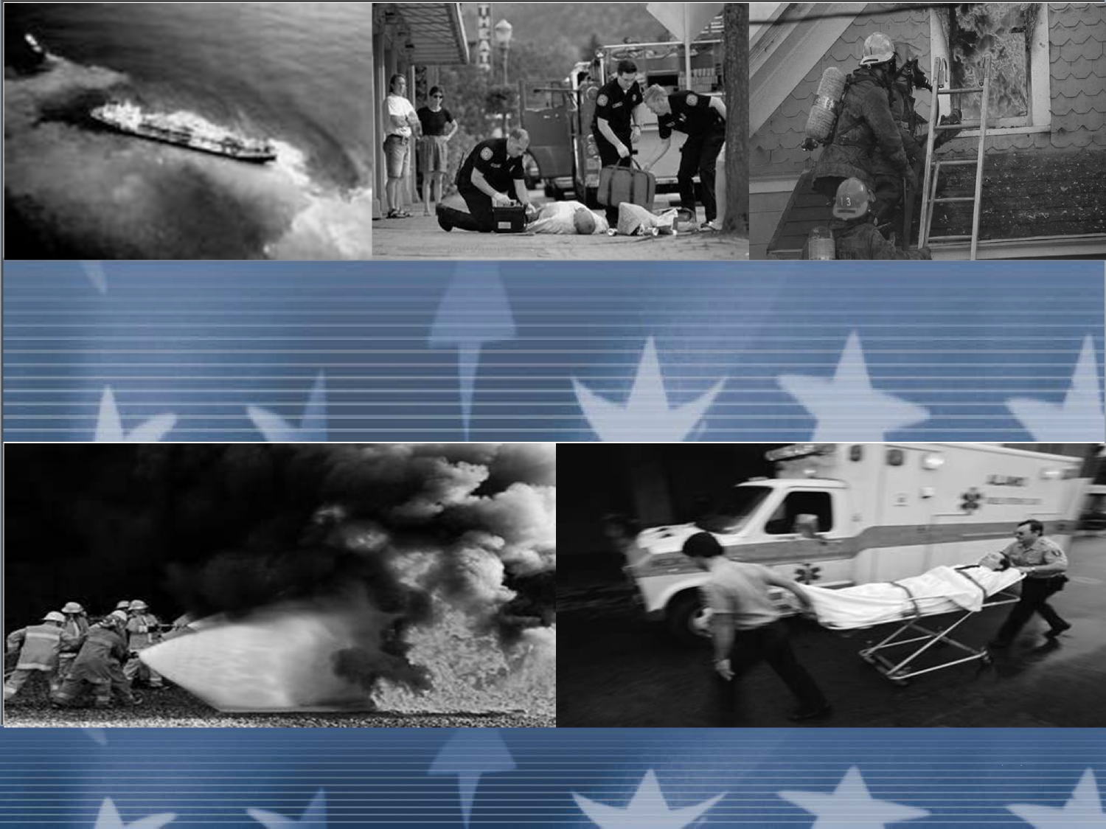
Course Final
Unit 8: Coordination
Visual 8-27

