Slide 1

Unit 6
Role in the Planning Process

Slide 2
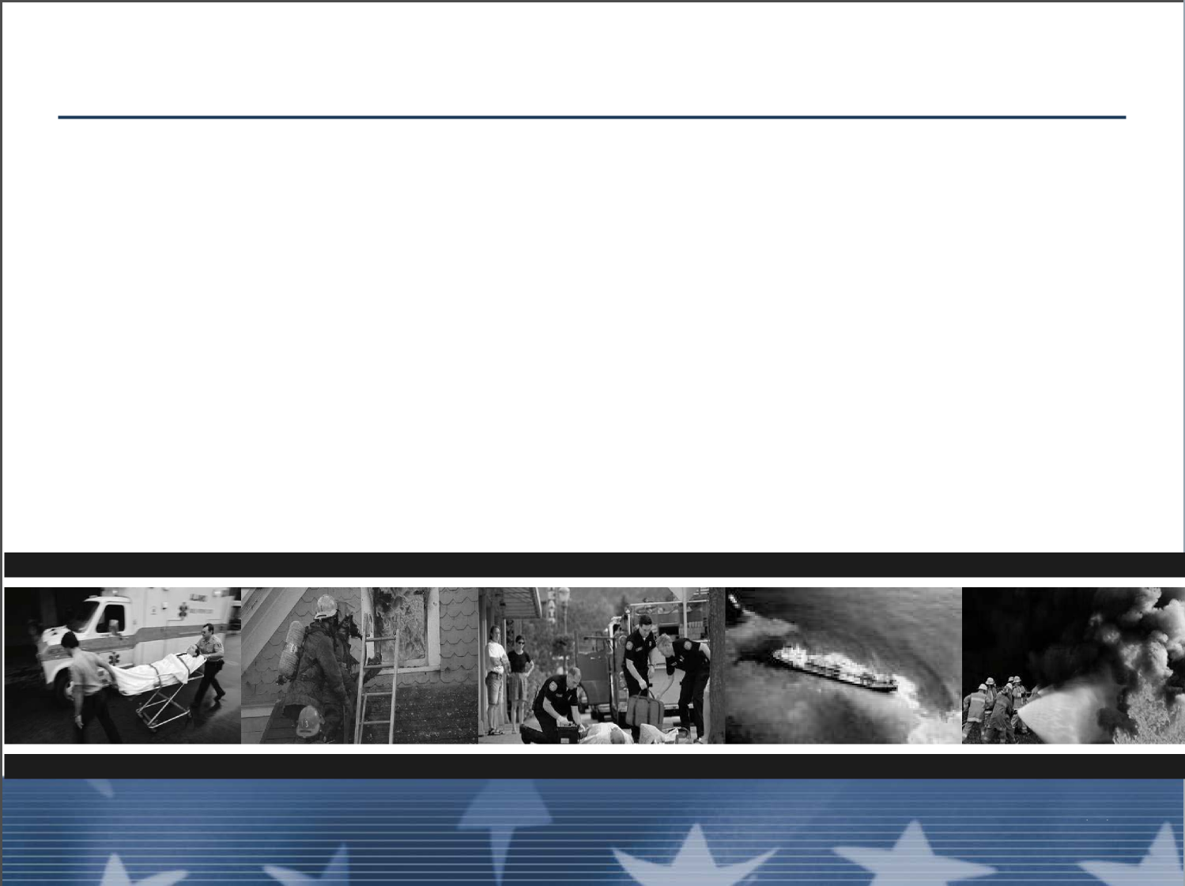
Unit Terminal Objective
Describe the role of the Division/Group Supervisor
in the Planning Process.
Unit 6:
Role in the Planning Process
Visual 6-2

Slide 3
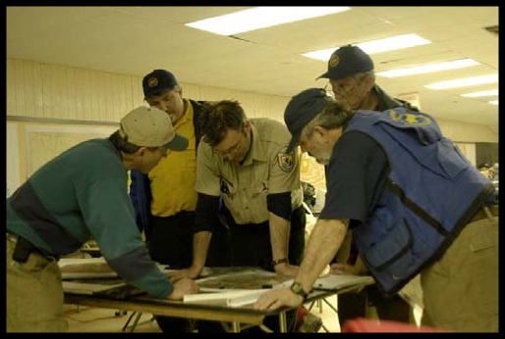
Value of the Information Reported to the OSC
■ The information the Division/Group Supervisor
gathers is critical to the entire incident
■ The planning process in ICS begins with the
Operations Section and the information provided by
the Division/Group Supervisor
Unit 6:
Unit 6:
Visual 6-13
Role in the Planning Process
Visual 6-13
Role in the Planning Process

Slide 4
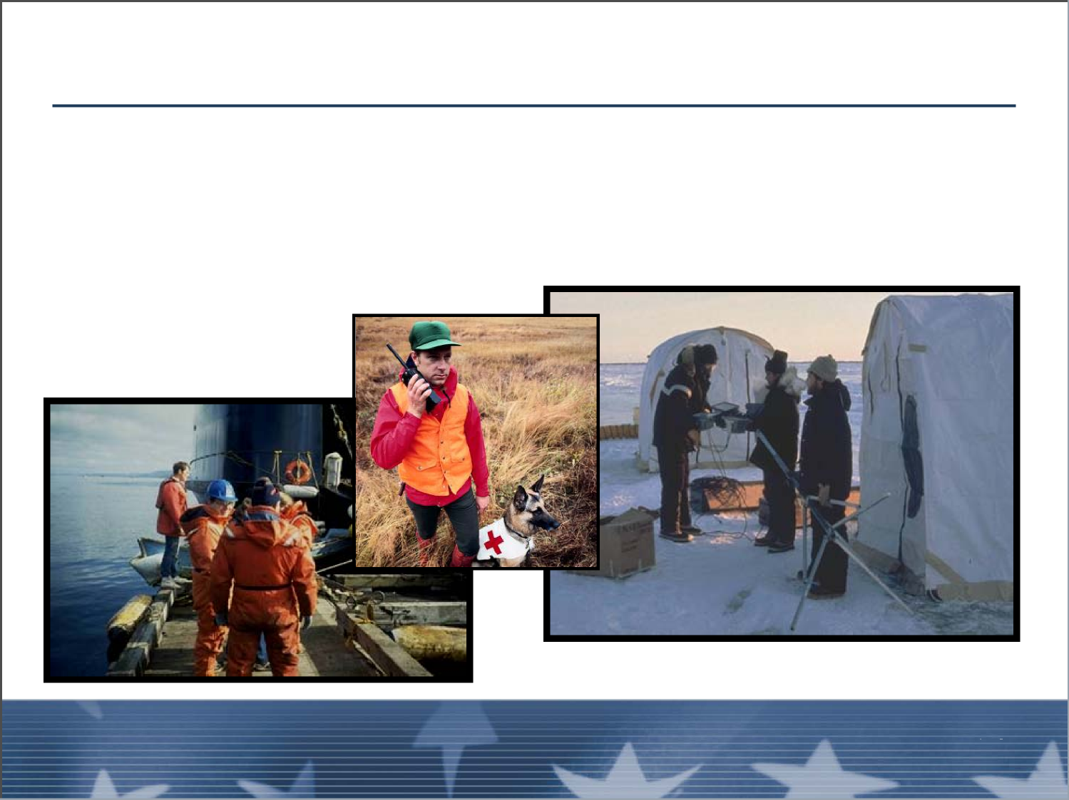
Division/Group Supervisor’s Role in Planning Process
Primary role:
Validation of Current Work Assignment
Unit 6:
Unit 6:
Visual 6-13
Role in the Planning Process
Visual 6-4
Role in the Planning Process

Slide 5
Input for Next Operational Period
■ Work accomplished
■ Remaining unfinished tasks
■ A written projection of resource needs
■ Projected completion time of your primary objectives
■ Any unusual logistical needs
■ Resources required
Unit 6:
Role in the Planning Process
Visual 6-13

Slide 6
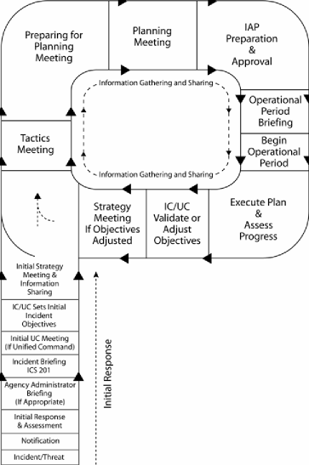
The Operational Planning Cycle: Planning P
■ The Operational Planning Cycle: The Planning P
■ Handout 6-1: The Planning P
Unit 6:
Unit 6:
Visual 6-13
Role in the Planning Process
Visual 6-6
Role in the Planning Process

Slide 7
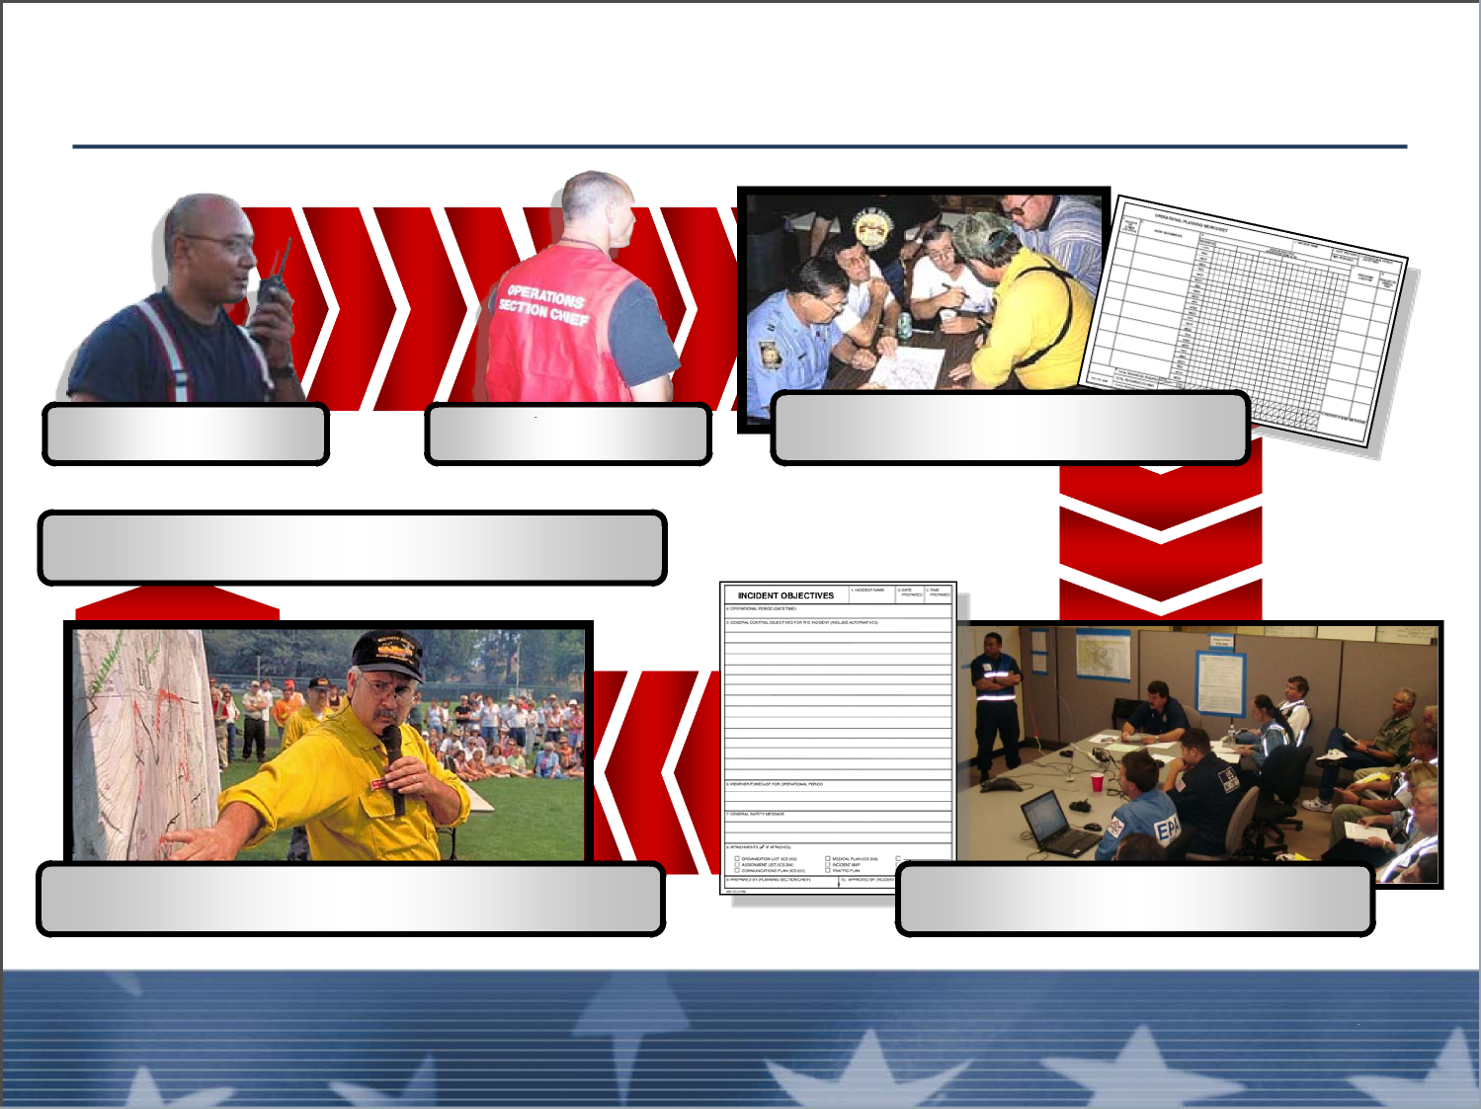
Planning Process Information Flow
DIVS
OSC
Tactics Meeting
Resource Briefing
Operational Period Briefi
Planning Meeting
Unit 6:
Role in the Planning Process
Visual 6-13

Slide 8
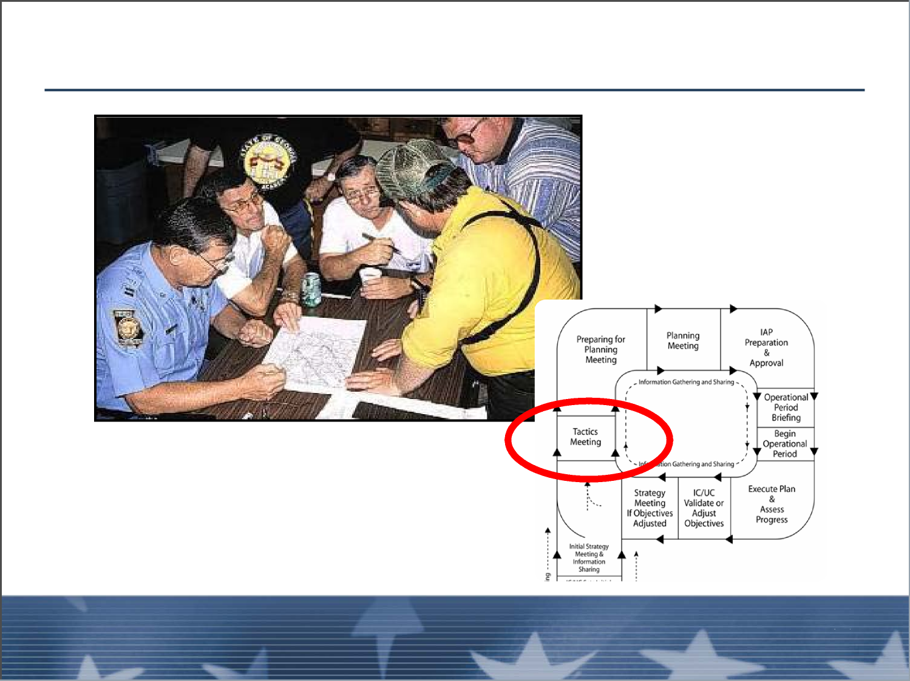
Tactics Meeting
Unit 6:
Unit 6:
Visual 6-13
Role in the Planning Process
Visual 6-8
Role in the Planning Process

Slide 9
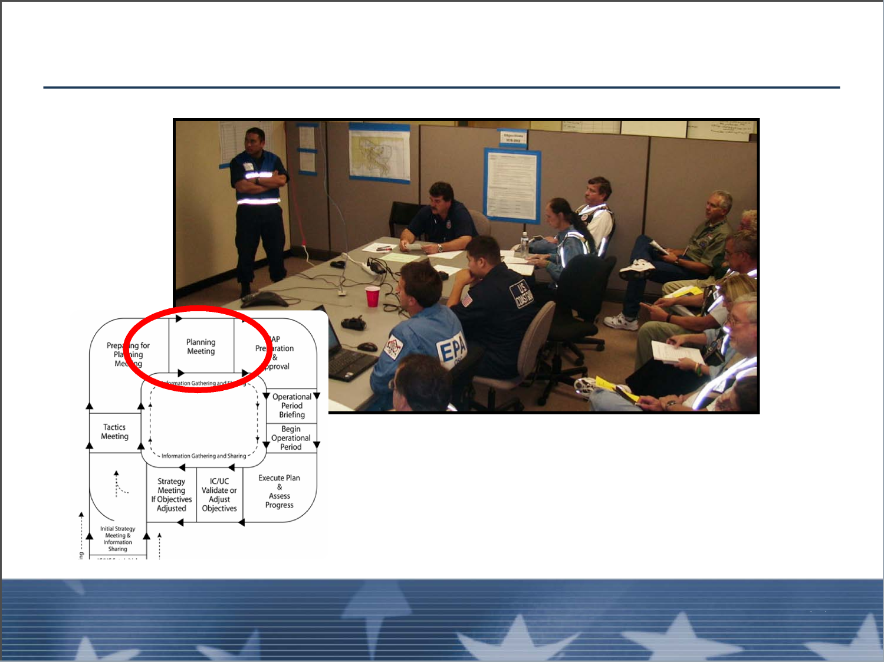
Planning Meeting
Unit 6:
Role in the Planning Process
Visual 6-13

Slide 10
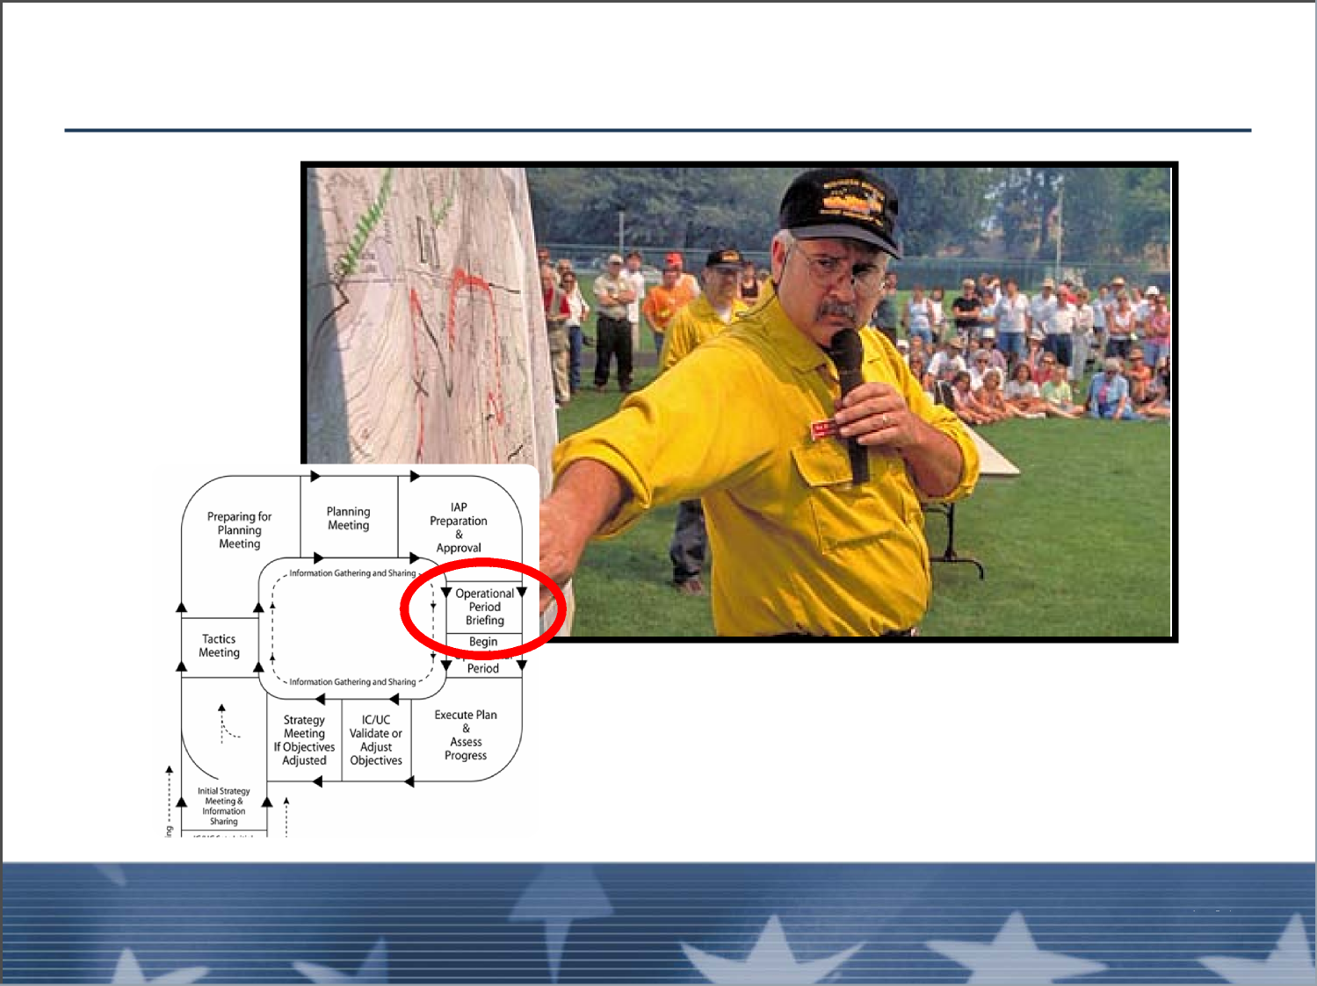
Operational Period Briefing
Unit 6:
Unit 6:
Visual 6-10
Role in the Planning Process
Visual 6-13
Role in the Planning Process

Slide 11
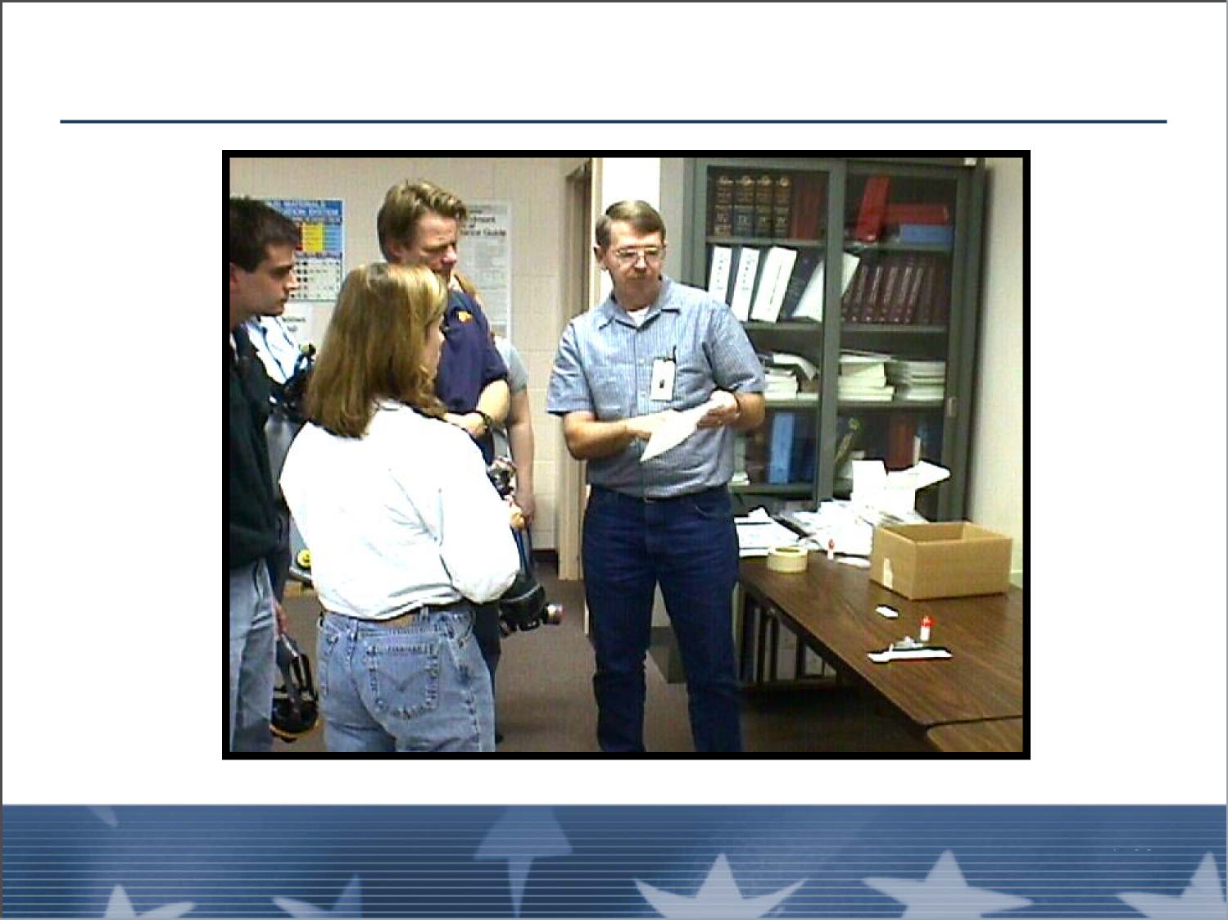

Resource Briefing
Unit 6:
Role in the Planning Process
Visual 6-13

Slide 12
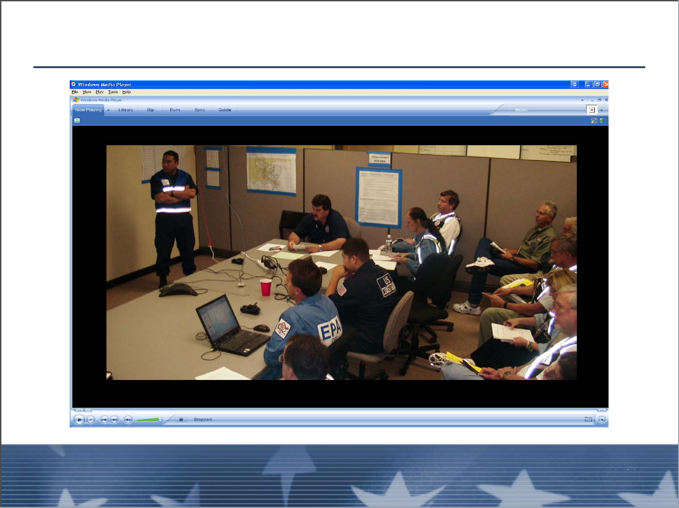
Planning Meeting Video
Unit 6:
Unit 6:
Visual 6-12
Role in the Planning Process
Visual 6-13
Role in the Planning Process

Slide 13
Objectives Review
What is the value of the information that the
Division/Group Supervisor reports to the Operations
Section Chief?
What information will the Operations Section Chief
want for preparation of the next Operational Period
IAP?
Unit 6:
Role in the Planning Process
Visual 6-13

