Slide 1
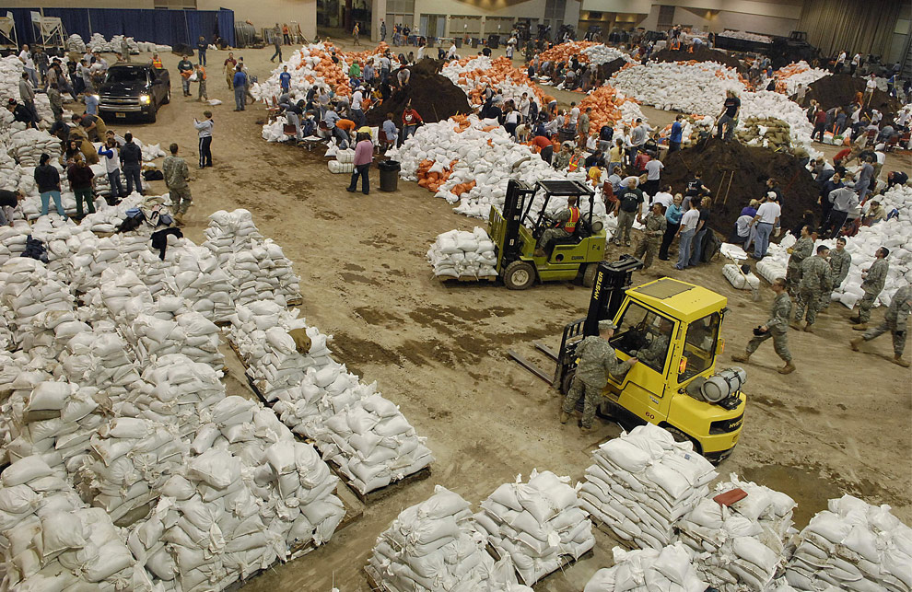
Unit 3
All Hazard
DIVISION/GROUP SUPERVISOR
Unit 3 – All Hazard
Slide 3-1

Slide 2
Unit 3 Objectives
Distinguish the different types of
all-hazard incidents.
Identify the Division/Group Supervisor roles and responsibilities in regards to All Hazard Incidents and working with All Hazard teams.
Discuss the preparation process for All Hazard Incidents.

Slide 3
Unit 3 Objectives
Identify assignment diversion (mission creep) during all hazard assignments and discuss the impacts.
Identify critical stress indicators and how to respond.

Slide 4
All Hazard Duties and Responsibilities
Your role as a Division/Group Supervisor
  Provide supervisory and administrative support.
The responsibilities, processes, and procedures are similar to a wildfire
  Recognize that hazards, risks, and mitigations are usually different and may require assistance from technical specialist.

Slide 5
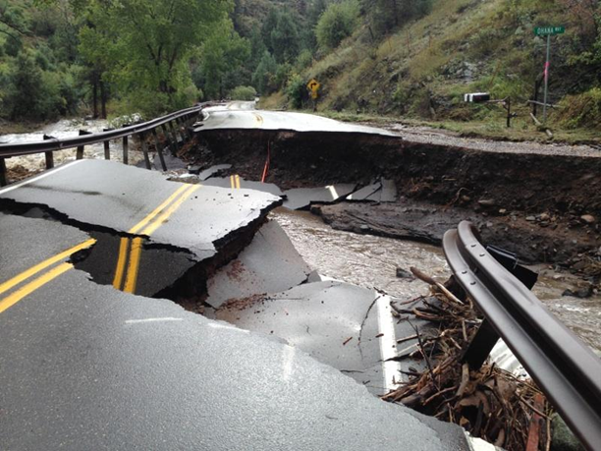
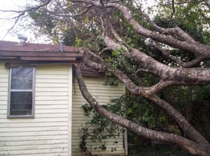
Types of All Hazard Assignments
  Natural disasters
  Law enforcement
  Disaster Response
  (e.g., shuttle recovery)
  Terrorism
  Planned events
  Others?

Slide 6
Gulf Islands NS Hurricane Ivan

Slide 7
All Hazard Duties and Responsibilities
Examples of assigned tasks:
  Logistical distribution centers
  Staging areas
  Base camps for emergency responders
  Clearing roadways and debris
  Support for wildfire or structural fire suppression
  Search and rescue operations/recovery operations

Slide 8
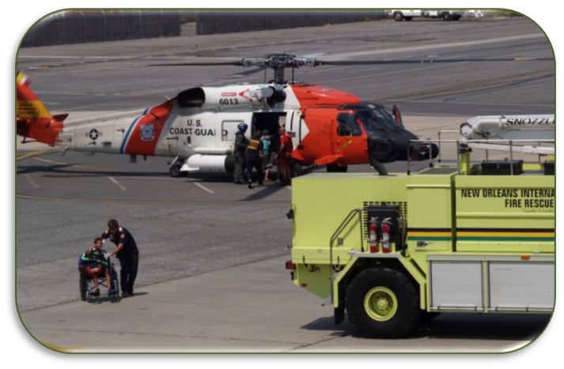
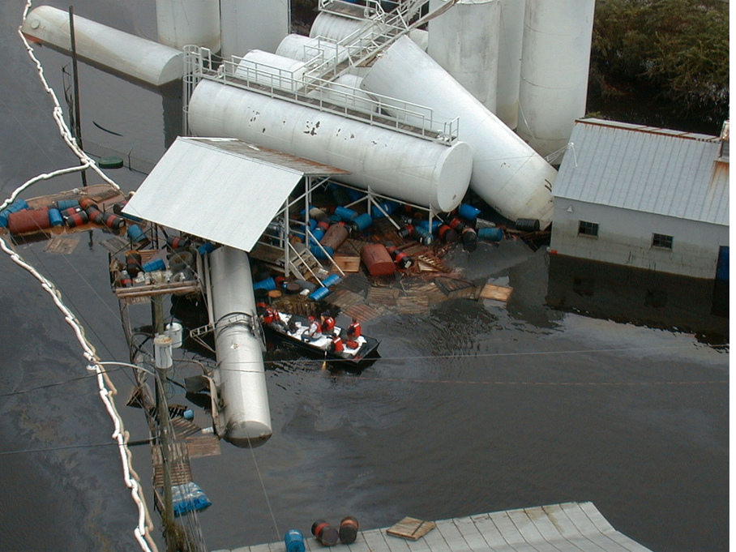
Working with All Hazard Teams
Working with All Hazard Teams typically includes
  Working with an expanded interagency team.
  Various all hazard response agencies
  Technical specialist which you may be unfamiliar.
  Different interpretation of ICS.

Slide 9
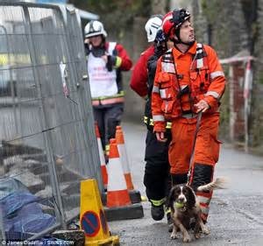
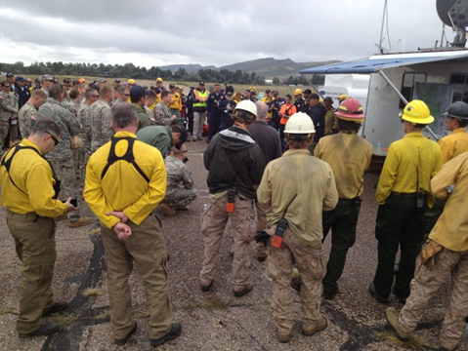
Working with All Hazard Teams
Stress levels
  Elevated
  Emotions are high and can be inconsistent.
  Many of these assignments involve life or death scenarios.

Slide 10
Working with All Hazard Teams
Communication
  The ability to understand cultural differences, language and terminology is an essential part of communication.

Slide 11
Working with All Hazard Teams
Communication
  Radio use
    You may be communicating with various outside agencies that are unfamiliar with wildfire radio protocol.
    They may use their own terminology
      It is vital to use clear text and do not use acronyms.

Slide 12

Working with All Hazard Teams
Communication
  Radio use
    Follow the communication plan and ensure that personnel assigned to you are familiar with frequency management and emergency communication procedures.

Slide 13
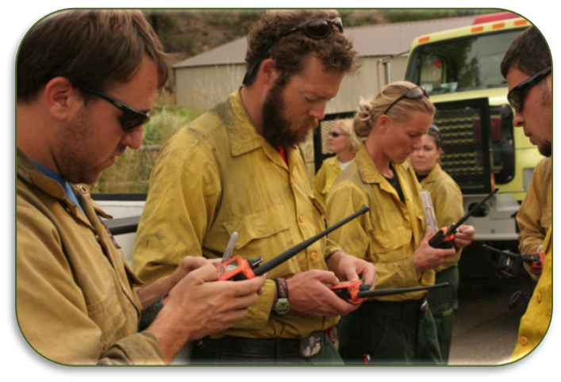
Working with All Hazard Teams
Communication
  Responding agencies may have different roles, responsibilities, policies and procedures.
  It is crucial to start a dialog with All Hazard teams to ensure common understanding.

Slide 14
Working with All Hazard Teams
Information Requests:
  DIVS may be requested to provide specific information for statistical purposes.
  Be sure to have a clear understanding of the type of information being requested and who is requesting it.
  Check the assignment list, ICS 204 for specifics.

Slide 15
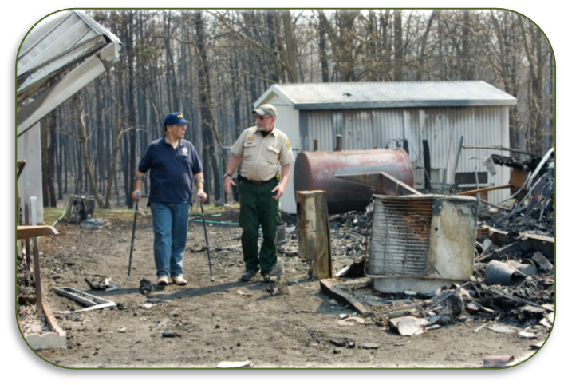
Preparing for an All Hazard Assignment
Preplanning for an all hazard assignment is essential.
All hazard response presents some of the most complex management challenges that our agencies face.

Slide 16
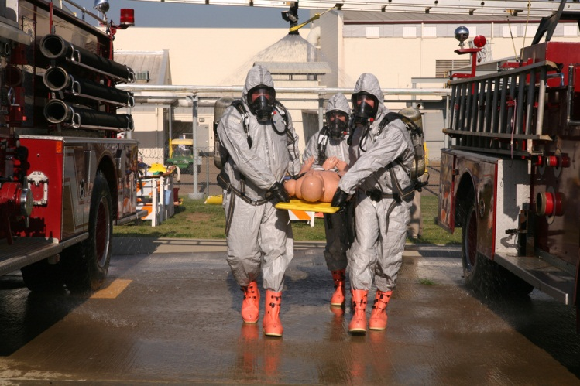
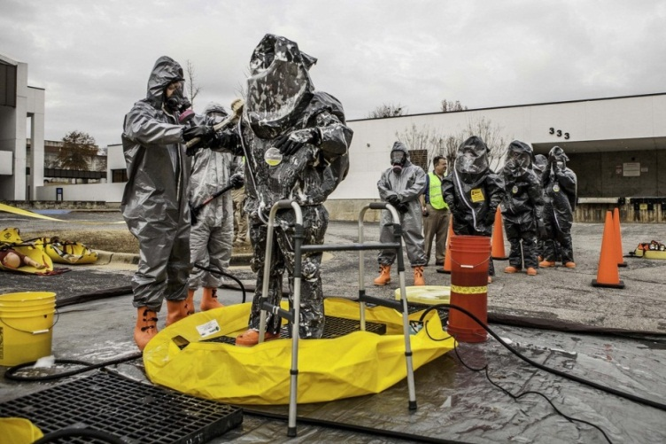
Preparing for an All Hazard Assignment
Work with your agency to ensure you have the required training for the assignment.
In some cases training may be provided at the incident and may include HazMat Awareness Procedures.

Slide 17
Preparing for an All Hazard Assignment
Length of Assignments
  May last up to 30 days.
  Work/rest ratio (2:1) guidelines are the same as on a wildland fire incident.
  When assigned to an all hazard incident discuss with your supervisor or Liaison Officer the need for a set 2-1 work/rest ratio.

Slide 18

Preparing for an All Hazard Assignment
If you are willing to accept all hazard assignments long range preparations may include:
  Passports
  Vaccinations
  Research

Slide 19
Preparing for an All Hazard Assignment
Geographic Area
  Where am I going?
  What am I going to do?
  How am I going to operate in that environment?
  Have safety concerns been identified?
  Are you prepared for the types of resources a DIVS might manage?
  Can I opt out of the assignment?

Slide 20
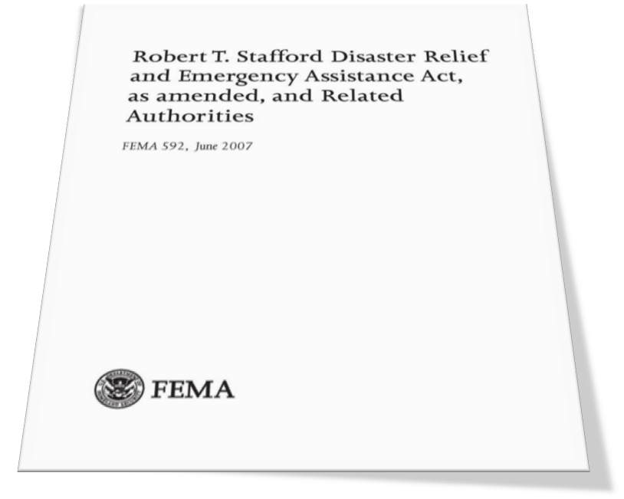
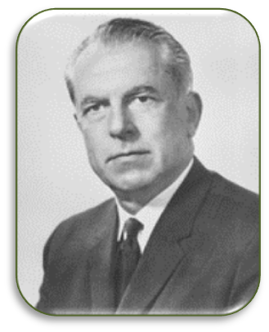
Stafford Act
Federal support to States and local jurisdictions takes many forms.
The most widely known authority under which assistance is provided for major incidents is the Stafford Act.

Slide 21
Stafford Act
When an incident occurs that exceeds or is anticipated to exceed local, tribal, or State resources, the Governor can request Federal assistance under the Stafford Act.
  The Stafford Act authorizes the President to provide financial and other assistance.

Slide 22

The National Response Framework
The NRF presents the guiding principles that enable all response partners to prepare for and provide a unified national response.

Slide 23

The National Response Framework
Mission Assignment
  FEMA may issue mission assignments to other Federal agencies.

Slide 24
The National Response Framework
Mission Assignment
  A mission assignment is very similar to a Resource Order.
  The difference being, a mission assignment gives you a scope of tasks to do, whereas a resource order assigns you to an overall incident in a qualified position. A FEMA liaison will assign specific duties upon your arrival/check in.

Slide 25


Mission Creep
Assignment Diversion (Mission Creep)
  Common in all hazard assignments.
  Can have an unforeseen or hazardous effect on the overall mission.

Slide 26
Mission Creep
Example of mission creep:
  Assigned to support the local fire department at a hurricane. All infrastructures ceased, including sanitation services.
  Your assigned personnel are requested to “help out” with trash disposal.

Slide 27
Mission Creep
Safety related issues:
  Trash could contain toxic or hazardous material.
  Has your initial assignment gone beyond the scope of its intent? Is it still safe?
  Is your personnel trained or equipped to do this job?
  Who exactly is requesting this and have they followed their chain of command?

Slide 28

Stress Management
Critical stress can have serious short-term and long-term effects.

Slide 29
Stress Management
Taking Care of Yourself
Placing yourself into a disaster situation that includes property destruction, and suffering on a mass scale is outside the scope of normal stress management.

Slide 30
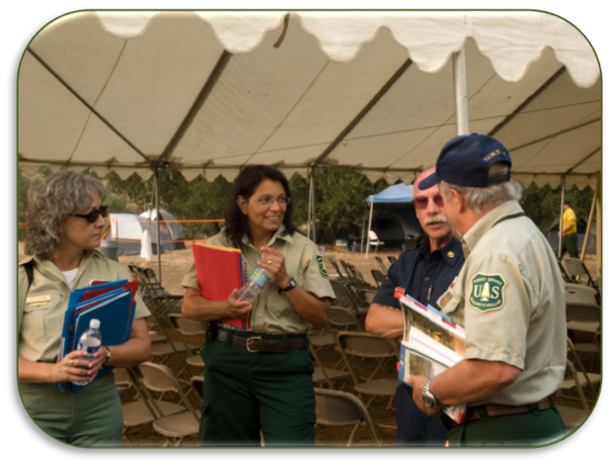
Stress Management
Taking Care of the Team
  Evaluate yourself and your team.
  Note any unusual behaviors.

Slide 31
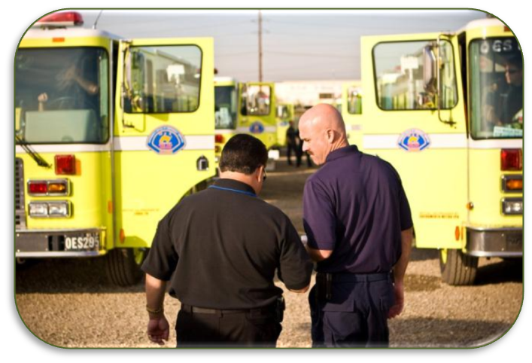
Stress Management
Taking Care of the Team
  Notify your supervisor if things are seemingly out of the ordinary.
  Follow-up
  accordingly.

Slide 32
Situational Awareness
All hazard assignments can pose many threats, hazards, and dangerous situations.
Cultural
  Local customs
  Language
  Religious beliefs
  Perceptions
  Urban versus rural environment

Slide 33
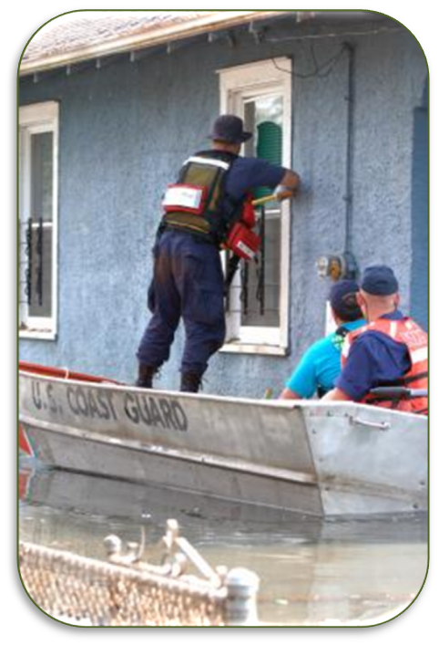
Situational Awareness
Hazards
  Environmental
  Infrastructure
  Biological
  Chemical
  Radiological
  Explosive
  Human

Slide 34

Situational Awareness
Personal Safety and Security
  Anti-government
  Gang/criminal
  activity
  Looting
  Evacuation plan
  Site safety plan
  Incident emergency plan

Slide 35
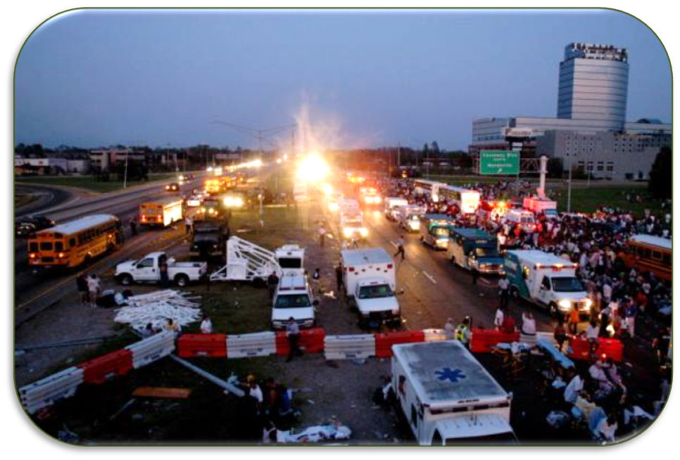
Situational Awareness
Transportation Problems
  Transportation infrastructure is one of the first things to collapse during an all-hazard incident.

Slide 36
Review Unit 3 Objectives
Discuss different types of all-hazard incidents.
Identify the DIVS/Group Supervisor roles and responsibilities in regards to All Hazard Incidents and working with All Hazard teams.
Discuss the preparation process for All Hazard Incidents.

Slide 37
Review Unit 3 Objectives
Identify assignment diversion (mission creep) during all hazard assignments and discuss the impacts.
Identify critical stress indicators and how to respond.

Slide 38
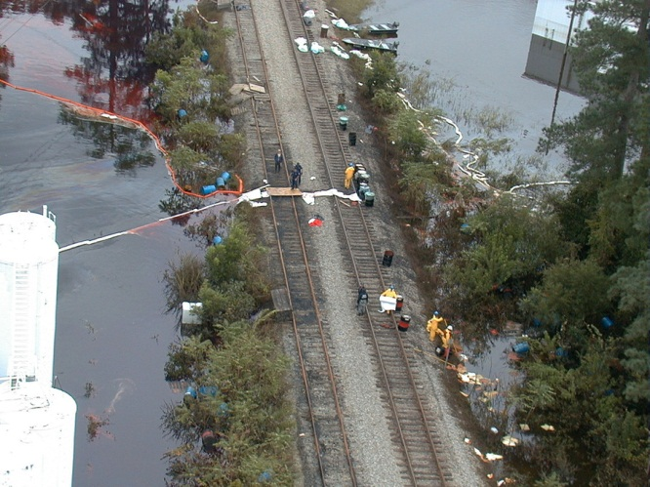
QUESTIONS?
DIVISION/GROUP SUPERVISOR
Unit 4 – All Hazard
Slide 3-38

