Slide 1

Unit 5
Information Gathering and Briefings

Slide 2
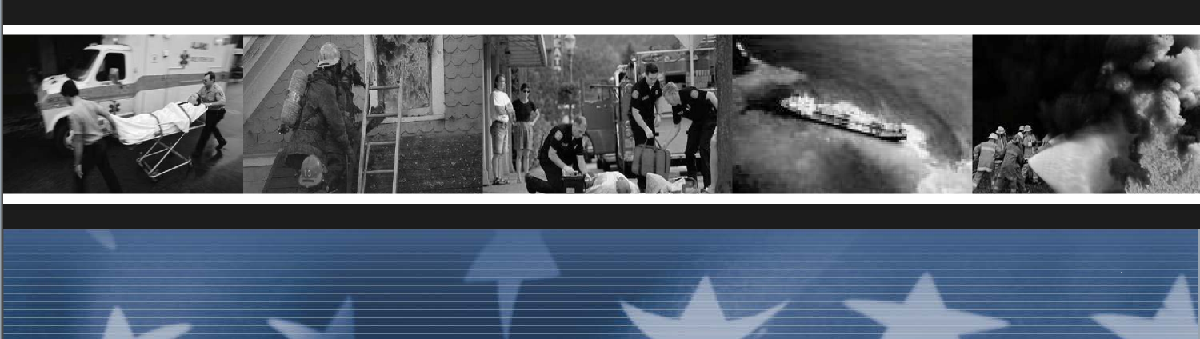
Unit Terminal Objective
Describe the information gathering and dissemination
responsibilities of the Division/Group Supervisor.
Unit 5:
Information Gathering and Briefings
Visual 5-2

Slide 3
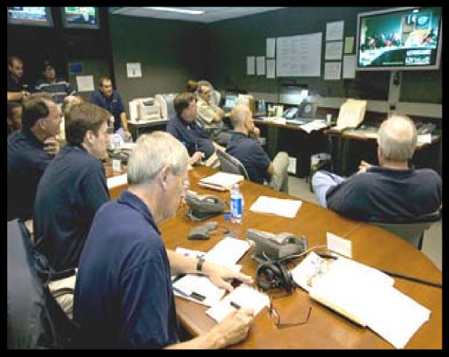
Information Gathering
■ Develop a mental picture
■ Assess current incident conditions
■ Create a plan of action
■ Consider resources
■ Plan ahead
Unit 5:
Unit 5:
Visual 5-25
Information Gathering and Briefings
Visual 5-25
Information Gathering and Briefings

Slide 4
Unit Organization
■ Pre-Incident
■ Dispatch/Mobilization
■ Arrival
■ Operational Period
Unit 5:
Unit 5:
Visual 5-25
Information Gathering and Briefings
Visual 5-4
Information Gathering and Briefings

Slide 5
Pre-Incident
■ Training
■ Incident experience appropriate to the incident
■ Division/Group Supervisor Go-Kit
Unit 5:
Information Gathering and Briefings
Visual 5-25

Slide 6

What should be
included in your
Personal Go-Kit?
Unit 5:
Unit 5:
Visual 5-25
Information Gathering and Briefings
Visual 5-6
Information Gathering and Briefings

Slide 7
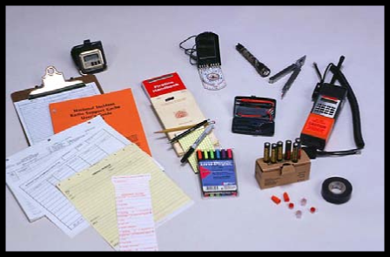
Go-Kit Contents
■ Briefing/debriefing check sheet(s)
■ Division/Group Supervisor Checklist
■ ICS Form 520-1 - FOG
■ PTB
■ Forms
■ Handout 5-1: Division/Group Supervisor Checklist
Unit 5:
Information Gathering and Briefings
Visual 5-25

Slide 8
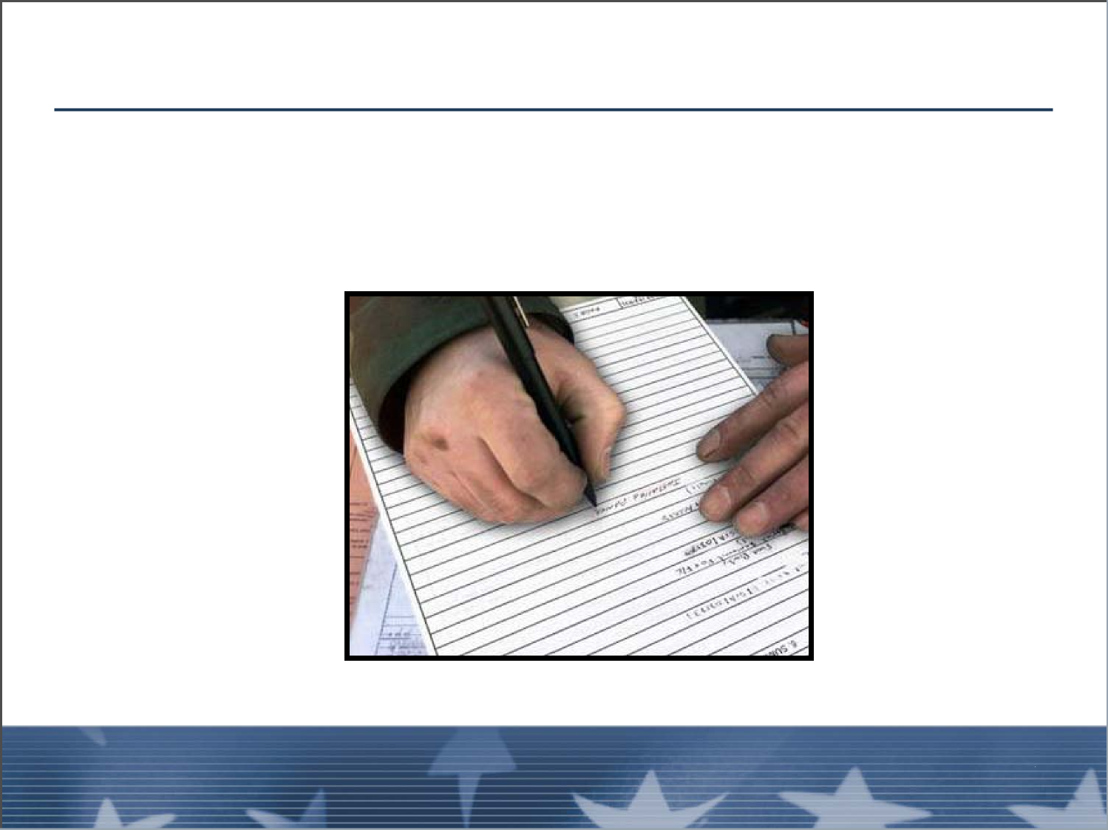
Dispatch/Mobilization
Start gathering information at the time of the request on
the Division/Group Supervisor Checklist.
Unit 5:
Unit 5:
Visual 5-25
Information Gathering and Briefings
Visual 5-8
Information Gathering and Briefings

Slide 9
Information Gathering
Information from agency dispatch:
■ Incident and order #
■ Reporting times, locations, and date
■ Radio frequencies
■ Special travel route and restrictions
■ Incident type
Unit 5:
Information Gathering and Briefings
Visual 5-25

Slide 10
Information Gathering (cont.)
Additional sources of incident pre-arrival information
include:
■ Commercial radio stations
■ Monitor incident tactical and command frequencies
■ TV news
Start the development of the Unit Log
Unit 5:
Unit 5:
Visual 5-25
Information Gathering and Briefings
Visual 5-10
Information Gathering and Briefings

Slide 11
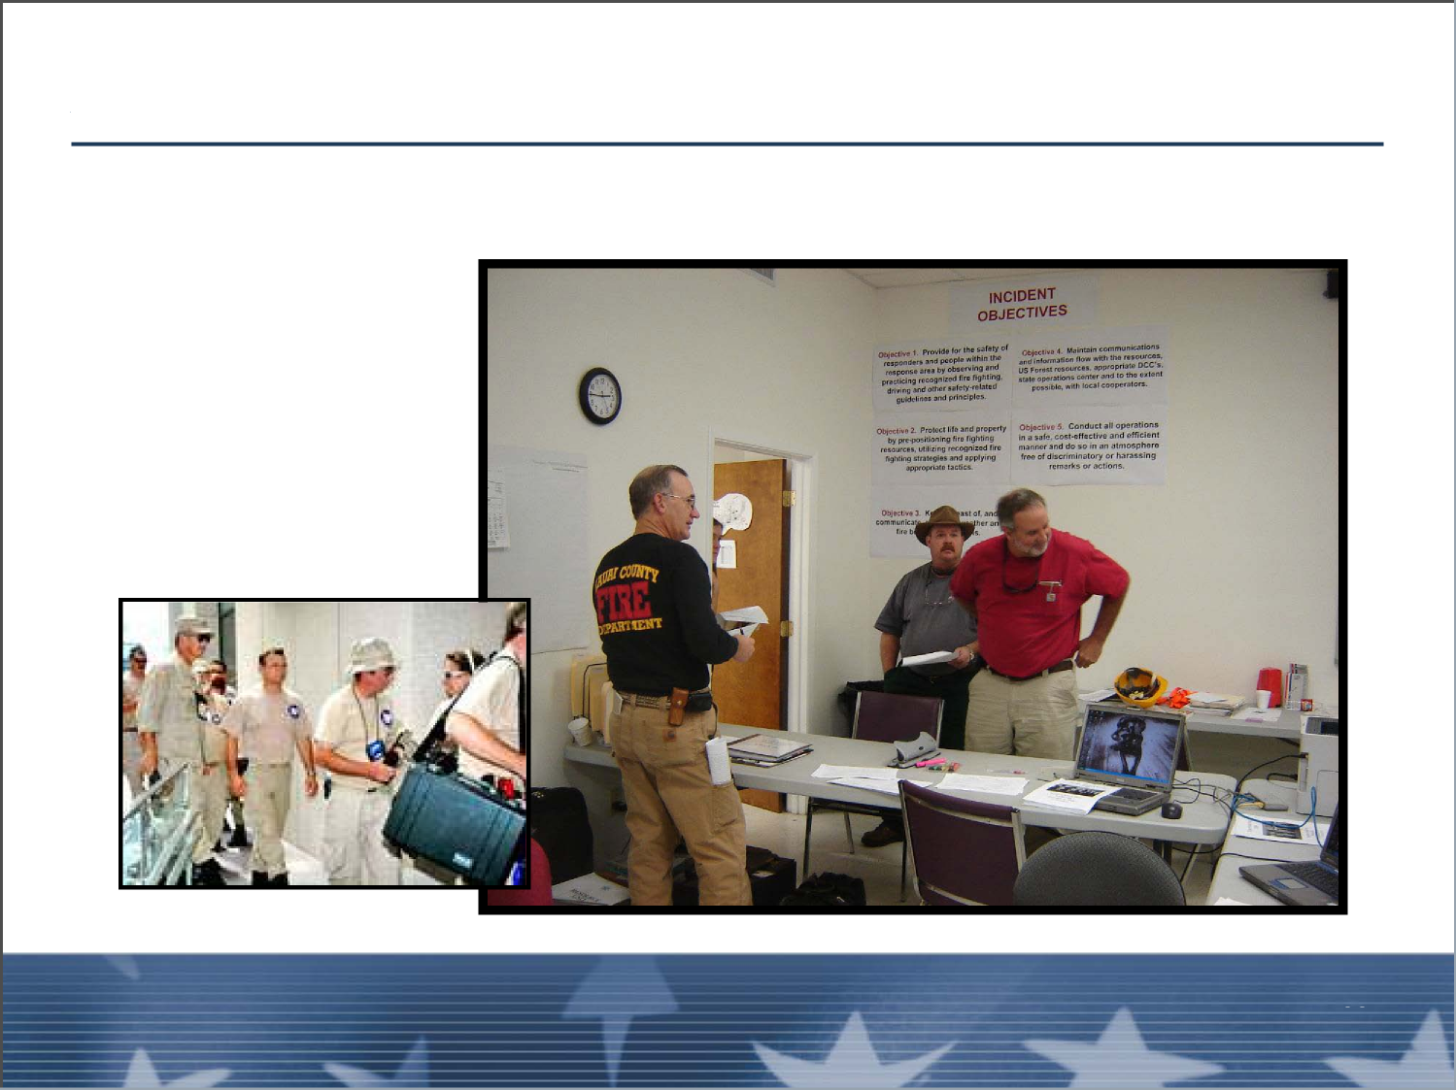
Arrival
Check-in
Unit 5:
Information Gathering and Briefings
Visual 5-25

Slide 12
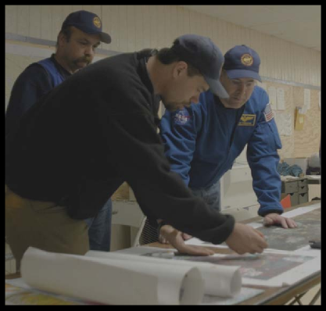
Briefing
Briefing with Operations Section Chief or Branch
Director
■ Verbal (no IAP)
■ On an individual basis as people arrive
■ Brief, only a few minutes
Unit 5:
Unit 5:
Visual 5-25
Information Gathering and Briefings
Visual 5-12
Information Gathering and Briefings

Slide 13
Briefing (cont.)
Briefing with Operations Section Chief or Branch
Director (cont.):
■ Who will you work for?
■ Who has jurisdiction?
■ What is the current incident status?
■ What type of resources will you be managing?
■ Are there any special considerations?
Unit 5:
Information Gathering and Briefings
Visual 5-25

Slide 14
Unavailable Information
Some information will not be available:
■ Transitional period
■ Incident escalation may outpace speed of information
relay
■ Previous supervisor may have been unable to
complete the task
■ Some or all of the General Staff functions may not be
up and running yet
Unit 5:
Unit 5:
Visual 5-25
Information Gathering and Briefings
Visual 5-14
Information Gathering and Briefings

Slide 15
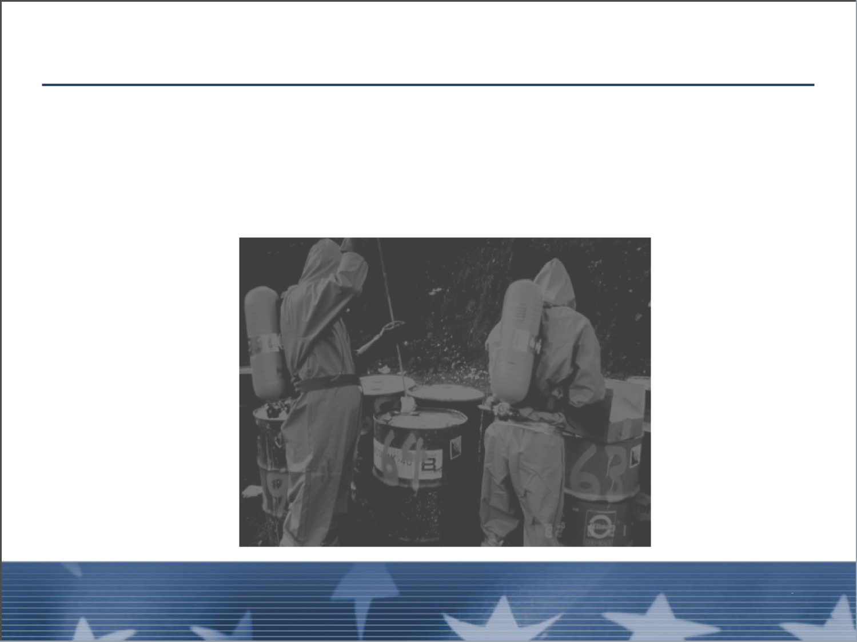
Unavailable Information (cont.)
■ This is no excuse for you to not do your job
■ In fact, if or when this happens, doing your job
becomes much more important
Unit 5:
Information Gathering and Briefings
Visual 5-25

Slide 16
Take Initiative When Gathering Information
■ Survey assignment
■ Develop inventory of assigned resources vs. needed
resources
■ Observe safety considerations and mitigating options
Unit 5:
Unit 5:
Visual 5-25
Information Gathering and Briefings
Visual 5-16
Information Gathering and Briefings

Slide 17
ICS Form 201
■ When you go out to your assignment, start observing
and gathering information
■ Utilize a blank 201 to organize the information
gathered
Unit 5:
Information Gathering and Briefings
Visual 5-25

Slide 18
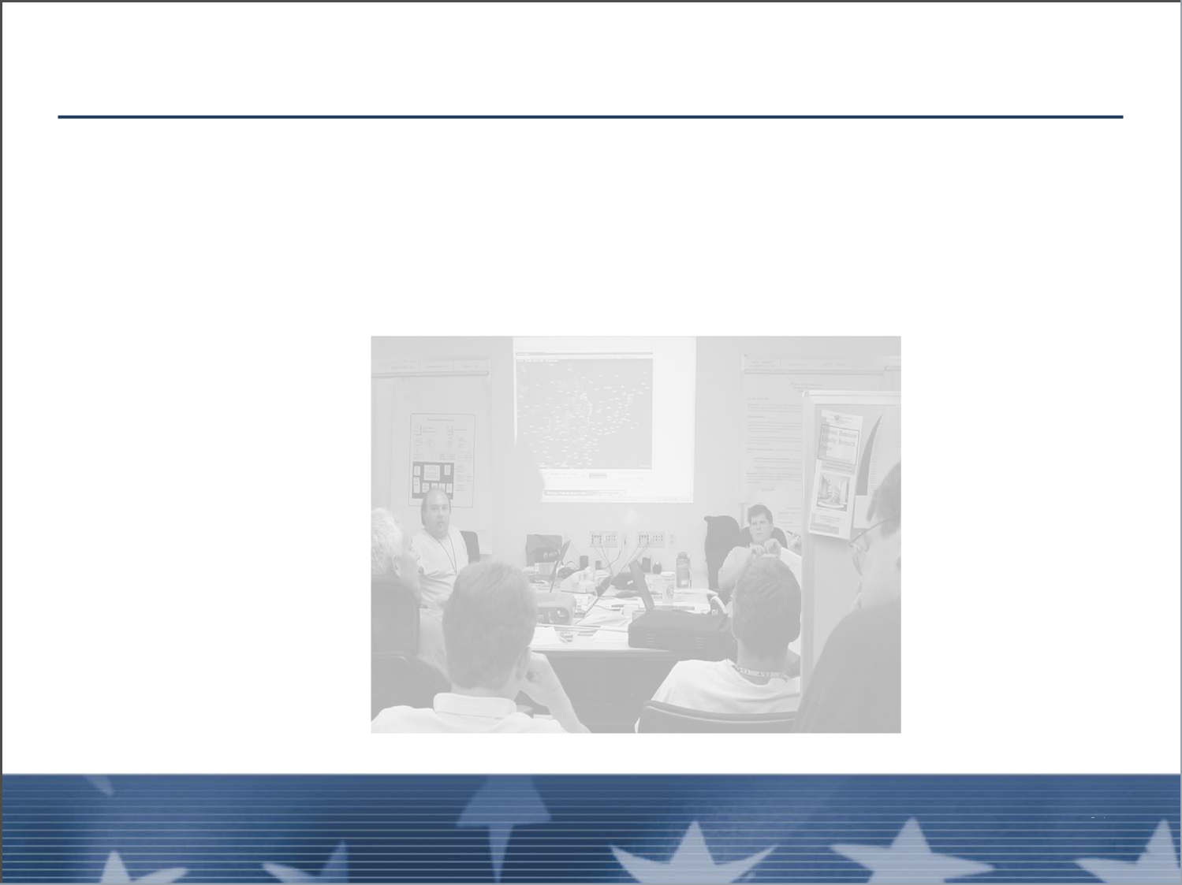
Briefing with the IAP
■ Obtain briefing from either your supervisor or attend
the Operational Period Briefing
■ Obtain copies of the current IAP
Unit 5:
Unit 5:
Visual 5-25
Information Gathering and Briefings
Visual 5-18
Information Gathering and Briefings

Slide 19
Briefing with the IAP (cont.)
■ Read and understand all the pages of the IAP
■ Ensure that you understand the current objectives,
priorities, and time frames
■ Know what, if any, contingency plans have been
developed
Unit 5:
Information Gathering and Briefings
Visual 5-25

Slide 20
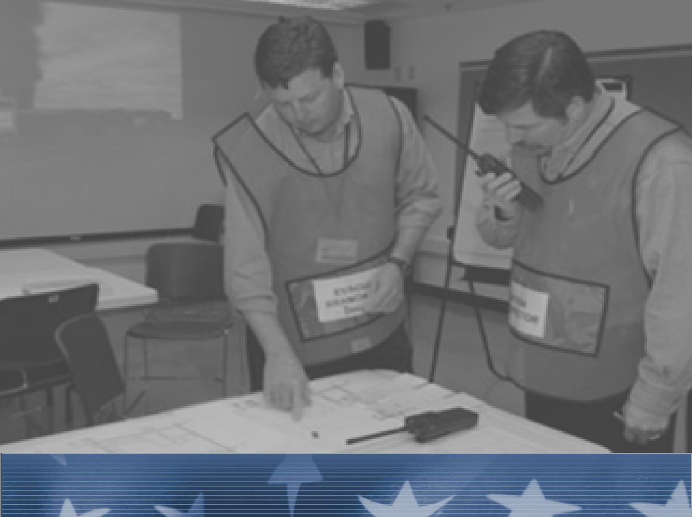
EXERCISE 4
Unit 5:
Unit 5:
Visual 5-25
Information Gathering and Briefings
Visual 5-20
Information Gathering and Briefings

Slide 22
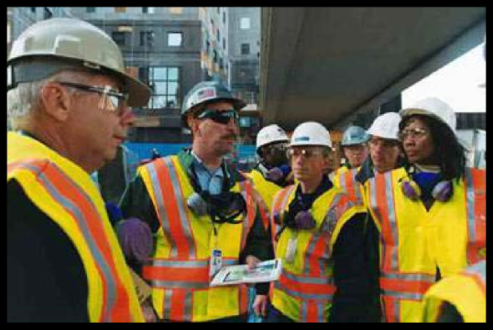
Division/Group Resource Briefing
It is your responsibility to brief all your subordinates
prior to going out to the incident.
Unit 5:
Information Gathering and Briefings
Visual 5-25

Slide 23
Division/Group Resource Briefing (cont.)
A meeting of your Division/Group assigned resource
leaders
■ Held after the operational briefing
■ Usually just a few minutes
Ensures that operational objectives and tactical
assignments are understood
Unit 5:
Unit 5:
Visual 5-25
Information Gathering and Briefings
Visual 5-22
Information Gathering and Briefings

Slide 24
Division/Group Resource Briefing (cont.)
■ Establishes open, two-way communication
■ Allows you to most effectively utilize assigned
resources to address division objectives
■ Provides an opportunity to emphasize your
commitment to safety
Unit 5:
Information Gathering and Briefings
Visual 5-25

Slide 25
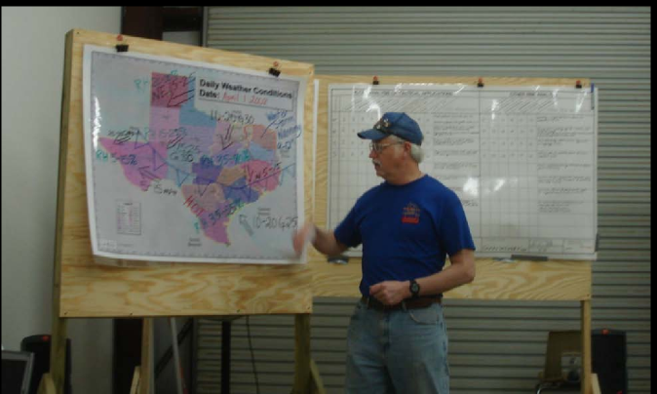
Division/Group Resource Briefing Topics
■ General
■ Safety
■ Operations
■ Handout 5-2: Division/Group Briefing Topics
Unit 5:
Unit 5:
Visual 5-25
Information Gathering and Briefings
Visual 5-24
Information Gathering and Briefings

Slide 26
Resource Briefing Topics
General:
■ What are the incident objectives?
■ What are the Division/Group priorities?
■ What are the Division/Group assignments?
Resource Briefing Topics
Unit 5:
Unit 5:
Visual 5-25
Information Gathering and Briefings
Visual 5-25
Information Gathering and Briefings

Slide 27
Resource Briefing Topics
Safety:
Obtain assessments from direct reports regarding their:
■ Crews’ state of readiness
■ Fatigue
■ Experience levels
■ Equipment
■ Physical conditions, etc.
Unit 5:
Unit 5:
Visual 5-27
Information Gathering and Briefings
Visual 5-26
Information Gathering and Briefings

Slide 28
Resource Briefing Topics
Safety (cont.):
■ Proper PPE for type of incident
■ Personnel accountability system used
■ Emergency communication procedures
Resource Briefing Topics
Unit 5:
Information Gathering and Briefings
Visual 5-27

Slide 29
Resource Briefing Topics
Safety (cont.):
■ State of weather and forecast
■ Travel to drop points or meeting places
■ Expected shift and rest requirements
Unit 5:
Unit 5:
Visual 5-27
Information Gathering and Briefings
Visual 5-28
Information Gathering and Briefings

Slide 30
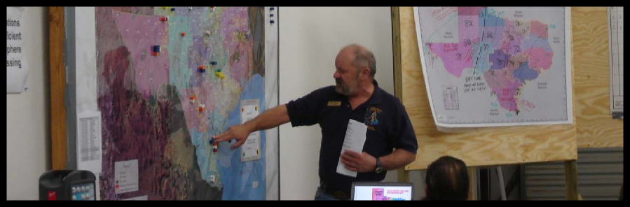
Resource Briefing Topics
Resource Briefing Topics
Operations:
■ Expectations of Division resources
■ Control
■ Significant events
Unit 5:
Unit 5:
Visual 5-42
Information Gathering and Briefings
Visual 5-29
Information Gathering and Briefings

Slide 31
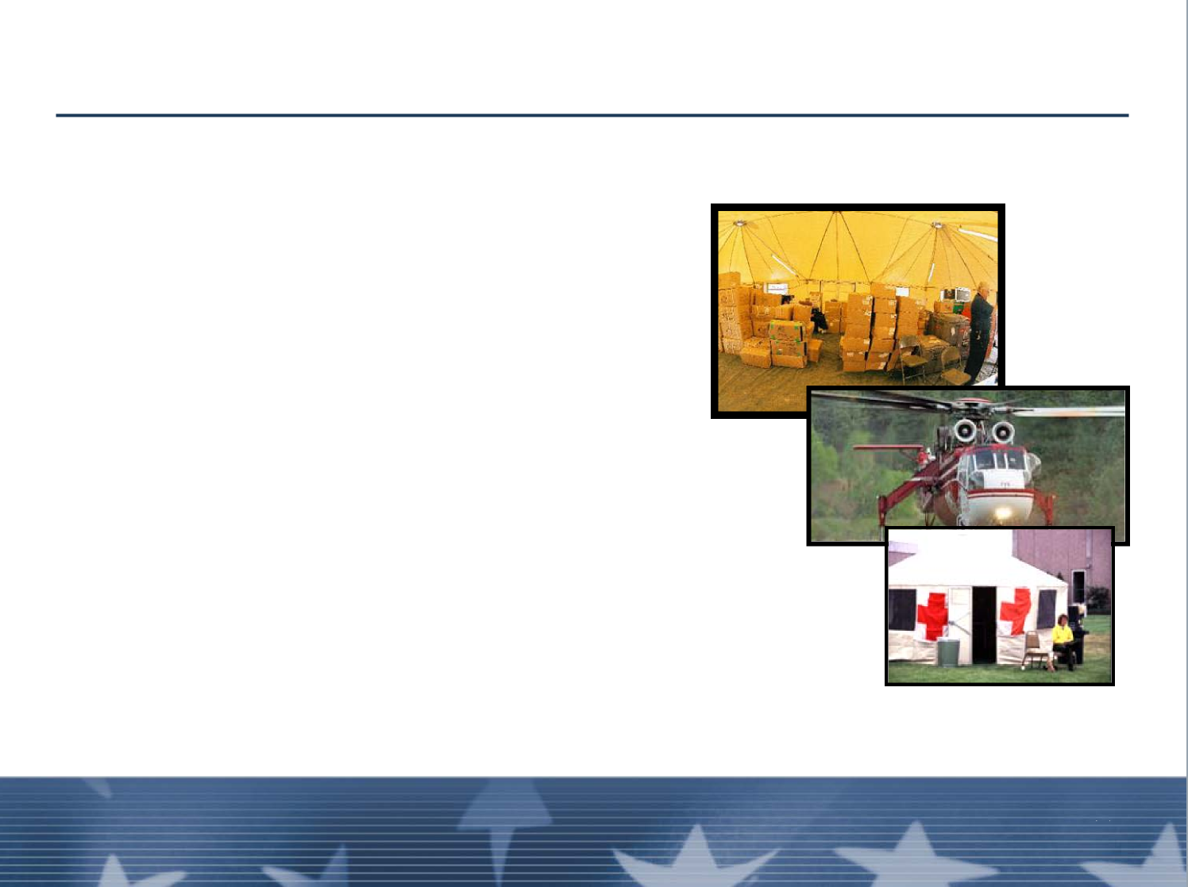
Resource Briefing Topics
Operations (cont.):
Resources should identify:
■ Additional needs
■ Air
■ Medical
■ Excess resources
■ Out-of-service equipment
Unit 5:
Information Gathering and Briefings
Visual 5-42

Slide 32
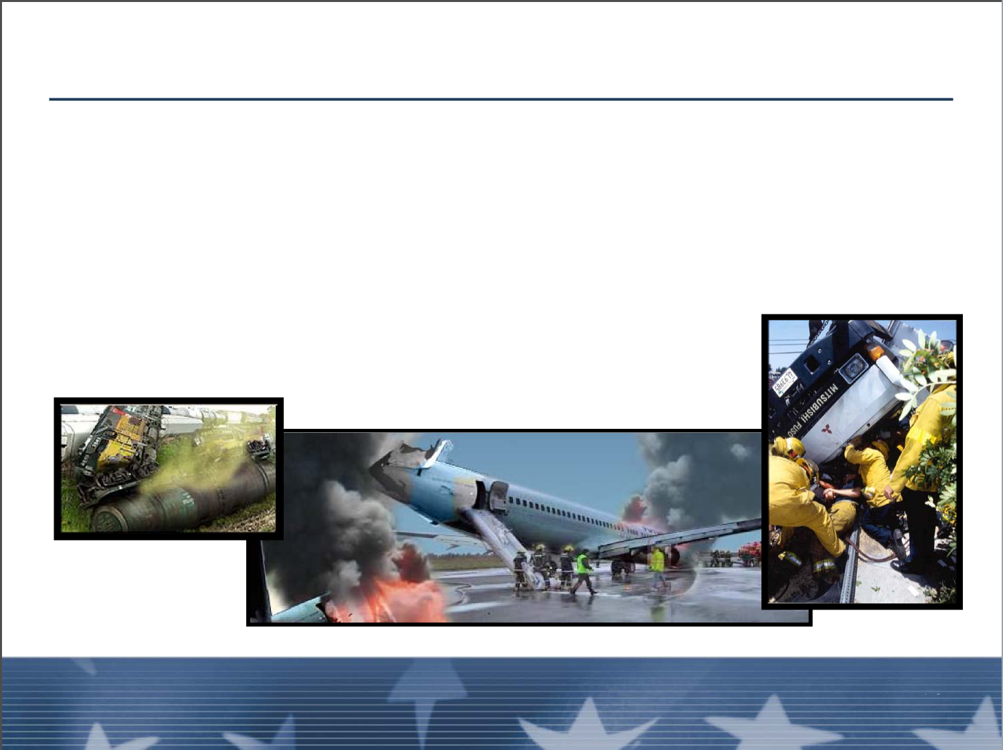
Resource Briefing Topics
Operations (cont.):
Ensure that everyone knows of any:
■ Hazard-specific concerns
■ Agency-specific concerns
Unit 5:
Unit 5:
Visual 5-42
Information Gathering and Briefings
Visual 5-31
Information Gathering and Briefings

Slide 33
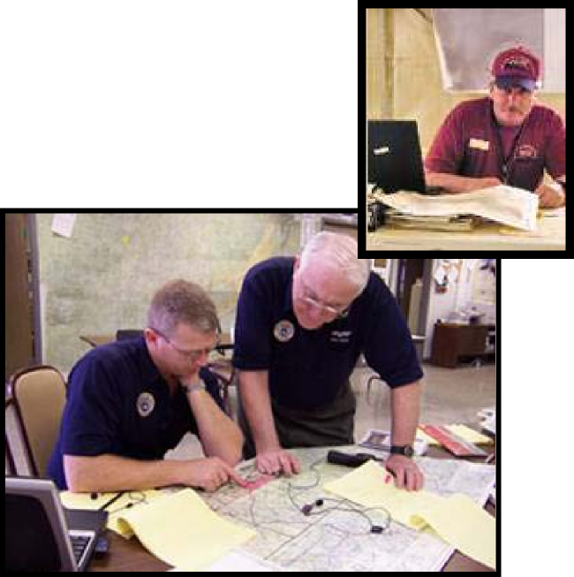
Resource Briefing Topics
Operations (cont):
■ Logistics issues
■ Finance issues
■ End-of-shift procedures
Unit 5:
Information Gathering and Briefings
Visual 5-42

Slide 34

EXERCISE 5
Information Gathering and Briefings
Visual 5-33
Unit 5:
Unit 5:
Information Gathering and Briefings
Visual 5-42

Slide 35
Operational Period
Assignment Line Briefing:
■ Once on the division, you should brief your assigned
personnel again as to specific job assignments,
safety, and time frames for completion at assignment
■ An opportunity to exchange new information gathered
from off-going Division resources
Unit 5:
Information Gathering and Briefings
Visual 5-42

Slide 36
Survey Assignment
After you have given out the assignments, survey your
assignment:
■ Check out Hazards first
■ Check Priorities, and receive input from your
subordinates
■ Make note of any changes from the IAP and report
these to your supervisor
Unit 5:
Unit 5:
Visual 5-42
Information Gathering and Briefings
Visual 5-35
Information Gathering and Briefings

Slide 37
Information for Supervisors
Be prepared to provide necessary information to your
supervisor:
■ Work accomplished
■ Remaining unfinished tasks
■ Written projection of resource needs
■ Projected completion time
■ Excess resources
■ Any unusual logistical needs
Unit 5:
Information Gathering and Briefings
Visual 5-42

Slide 38
Fiscal Accountability
The Division/Group Supervisor must maintain financial
accountability:
■ Accountable property should be located, documented,
and reported to the proper unit for recovery
■ Make sure shift tickets on any hired equipment are
signed
■ Communicate any potential claims to
Finance/Administration Section
Unit 5:
Unit 5:
Visual 5-42
Information Gathering and Briefings
Visual 5-37
Information Gathering and Briefings

Slide 39
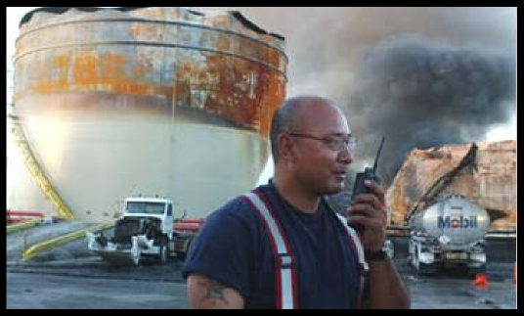
Before Going Off-Shift
■ Make sure that everyone you supervise is accounted
for
■ You should be the last person off the Division
■ Brief the on-coming supervisor
Unit 5:
Information Gathering and Briefings
Visual 5-42

Slide 40
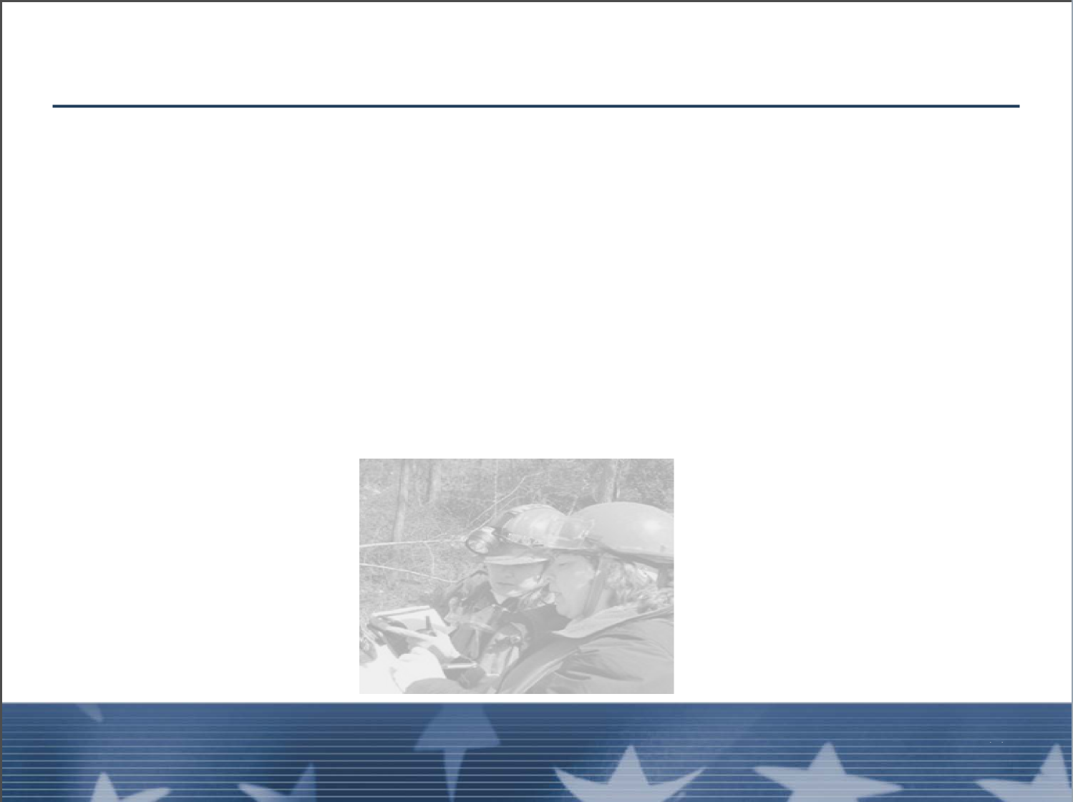
Debriefing Responsibilities
The Division/Group Supervisor must debrief the
following sections:
■ Operations Section Chief or Branch Director
■ Resource Unit
■ Situation Unit
■ Finance/Administration Section
Unit 5:
Unit 5:
Visual 5-42
Information Gathering and Briefings
Visual 5-39
Information Gathering and Briefings

Slide 41
Documentation
■ Update Operations Section Chief with info for ICS
Form 214
■ Complete Debriefing Form
■ Complete personnel evaluations
■ Handout 5-3: Division/Group Operational Debriefing
Form
Unit 5:
Information Gathering and Briefings
Visual 5-42

Slide 42
Objectives Review
What information should be gathered from time of
dispatch to arrival at incident?
What information should be gathered from an IAP?
What information should be provided at the
Division/Group Resource Briefing?
Unit 5:
Unit 5:
Visual 5-42
Information Gathering and Briefings
Visual 5-41
Information Gathering and Briefings

Slide 43
Objectives Review (cont.)
What is the purpose of an Assignment Line Briefing?
What information should be gathered for debrief and
who should receive it?
What information will the Operations Section Chief
ask from the Division/Group Supervisor?
Unit 5:
Information Gathering and Briefings
Visual 5-42

