Slide 1

Unit 4
Division/Group Management and
Personnel Management

Slide 2
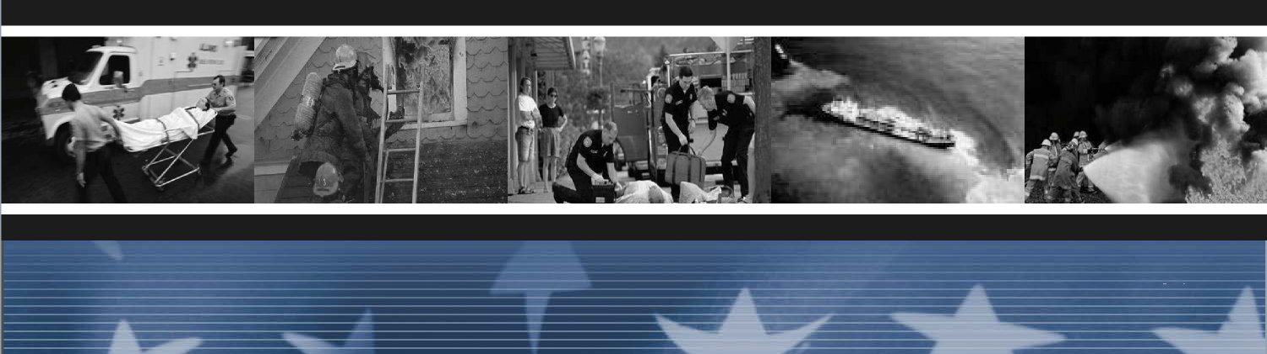
Unit Terminal Objective
Describe the supervision and
personnel management responsibilities of the
Division/Group Supervisor.
Unit 4:
Division/Group Management and Personnel Management
Visual 4-2

Slide 3
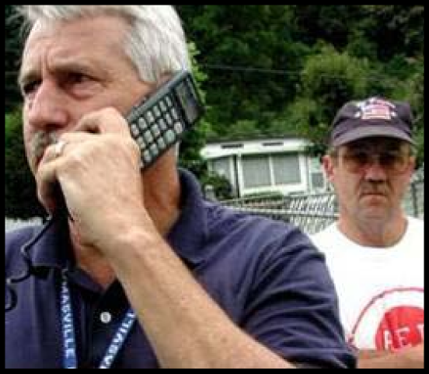
Division/Group Management
Internal Coordination with:
■ Division resources
■ Adjoining resources
Unit 4:
Unit 4:
Visual 4-13
Division/Group Management and Personnel Management
Visual 4-13
Division/Group Management and Personnel Management

Slide 4
Division/Group Relationships
■ Critical issues or operations MUST be coordinated
between divisions and groups
■ Coordination issues
■ Backfiring
■ Hazardous materials operation
■ Air operations and rescue
■ Situation that precludes you from completing your
mission
Visual 4-4
Division/Group Management and Personnel Management
Unit 4:
Unit 4:
Division/Group Management and Personnel Management
Visual 4-13

Slide 5
Division/Group Relationships (cont.)
Resource request:
■ Request from staging through the Operations
Section Chief or
■ Share resources with adjoining Divisions
Remember: Cooperation can go a long way toward
getting the job done.
Unit 4:
Division/Group Management and Personnel Management
Visual 4-13

Slide 6
Span of Control
■ The number of individuals one supervisor can
effectively manage
■ Particularly important on incidents where safety and
accountability have top priority
■ In ICS, falls within the range of 3 to 7, with 1:5 being
the standard ratio
Unit 4:
Unit 4:
Visual 4-13
Division/Group Management and Personnel Management
Visual 4-6
Division/Group Management and Personnel Management

Slide 7
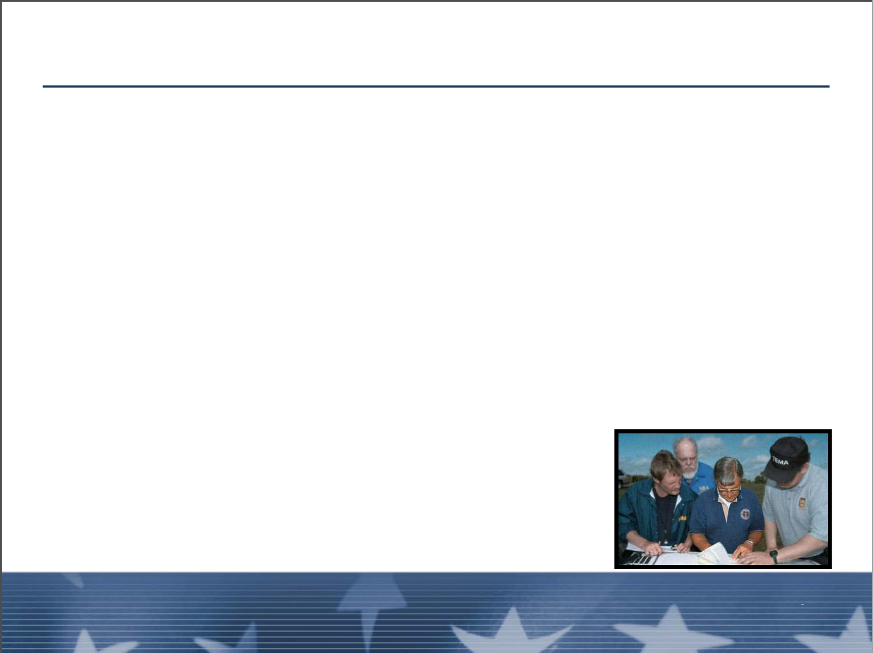
Span of Control (cont.)
■ Trip wire for expanding or contracting org chart
■ If span of control is being exceeded, consider:
■ Delegation
■ Appointing a recorder
■ Creating Task Forces
■ Recommending an additional Division/Group
■ Requests must be approved by supervisors, but
delegation is up to you
Unit 4:
Division/Group Management and Personnel Management
Visual 4-13

Slide 8
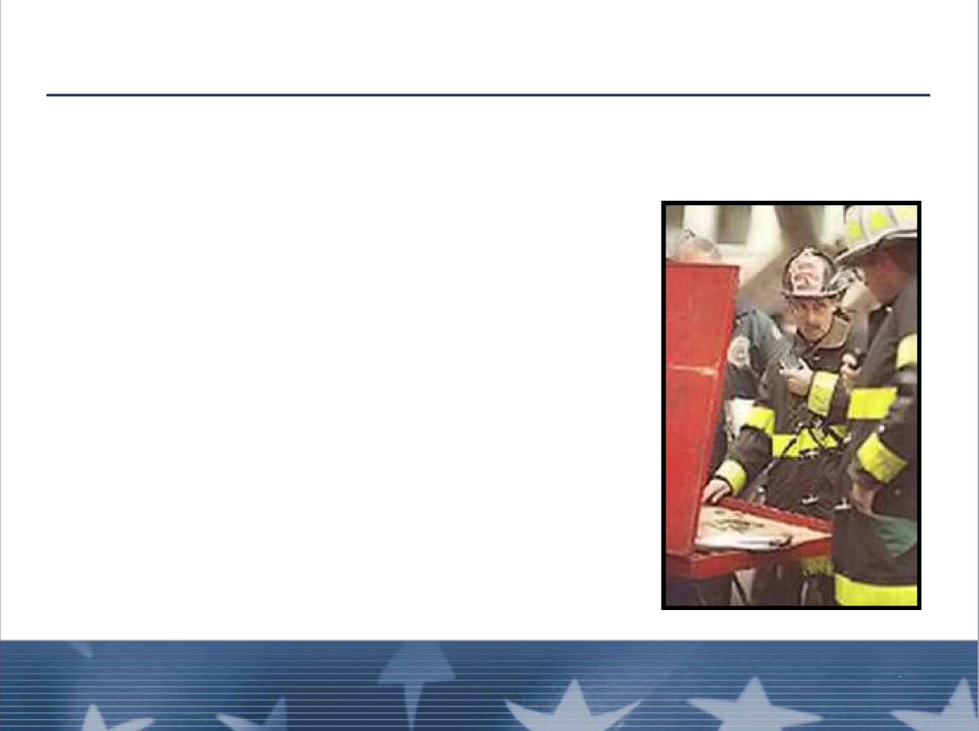
Span of Control (cont.)
Communicate the assignment with:
■ The individual assigned
■ All personnel on the
division and adjacent
division if appropriate
Unit 4:
Unit 4:
Visual 4-13
Division/Group Management and Personnel Management
Visual 4-8
Division/Group Management and Personnel Management

Slide 9

EXERCISE 3
Unit 4:
Division/Group Management and Personnel Management
Visual 4-13

Slide 11

Controls
■ A measurement of progress against time
■ Established production rates may be used initially
■ If you don’t have any find a Technical Specialist that
can provide input and adjust
Unit 4:
Unit 4:
Visual 4-13
Division/Group Management and Personnel Management
Visual 4-10
Division/Group Management and Personnel Management

Slide 12

Unity of Command
Under unity of command, personnel:
■ Report to only one supervisor
■ Receive work assignments only from their supervisors
Unit 4:
Division/Group Management and Personnel Management
Visual 4-13

Slide 13
Unity of Command (cont.)
■ Information should be shared horizontally and
vertically
■ Not meant to be taken to extremes
■ Filter information
■ Communication goes across organization,
assignments go up and down
Division/Group Management and Personnel Management
Visual 4-12
Unit 4:
Unit 4:
Division/Group Management and Personnel Management
Visual 4-13

Slide 14
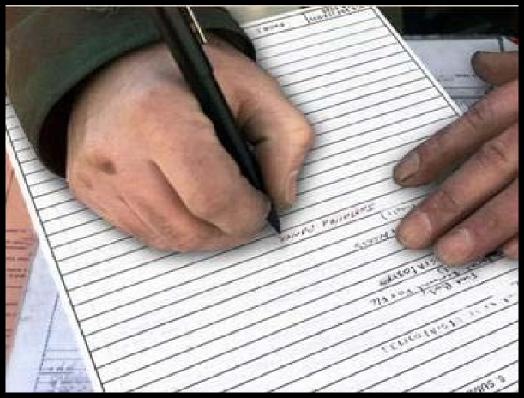
Division/Group Documentation Requirements
■ Equipment shift tickets
■ Verification of pay documents
■ Handout 4-1: Division/Group Documentation
Requirements
Unit 4:
Division/Group Management and Personnel Management
Visual 4-13

Slide 15
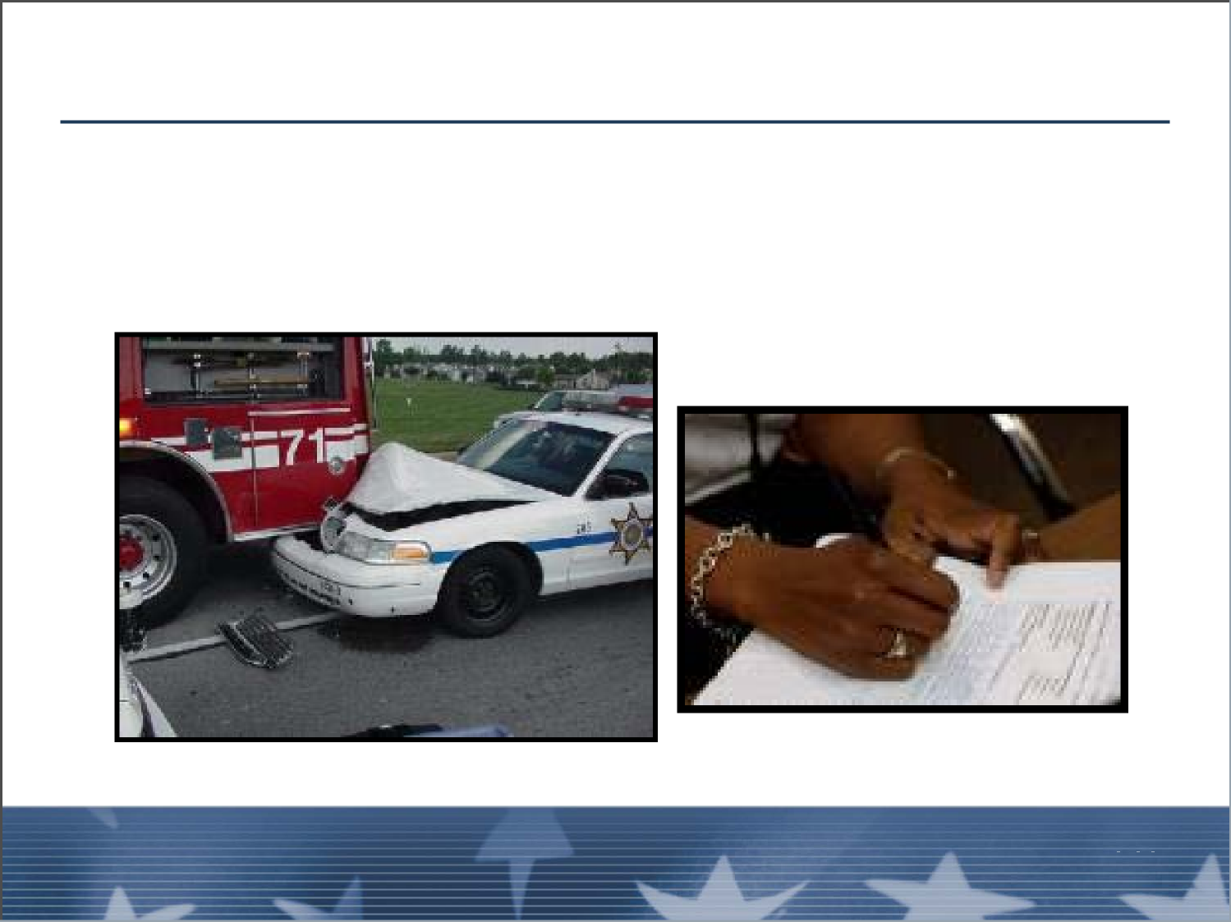
Division/Group Documentation Requirements (cont.)
■ Equipment inspection forms
■ Damage assessment and inspection documentation
Unit 4:
Unit 4:
Visual 4-15
Division/Group Management and Personnel Management
Visual 4-14
Division/Group Management and Personnel Management

Slide 16
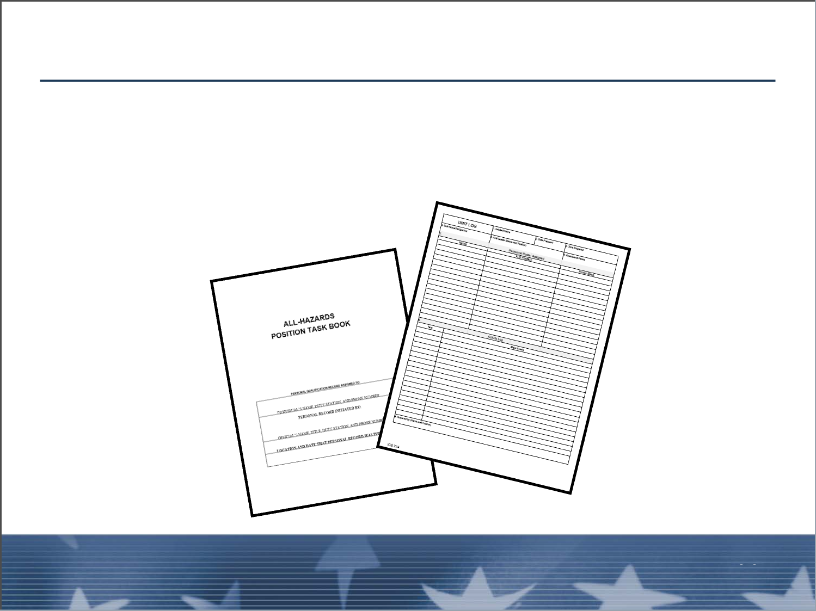
Division/Group Documentation Requirements (cont.)
■ ICS Form 214
■ Signing PTB
Unit 4:
Division/Group Management and Personnel Management
Visual 4-15

Slide 17
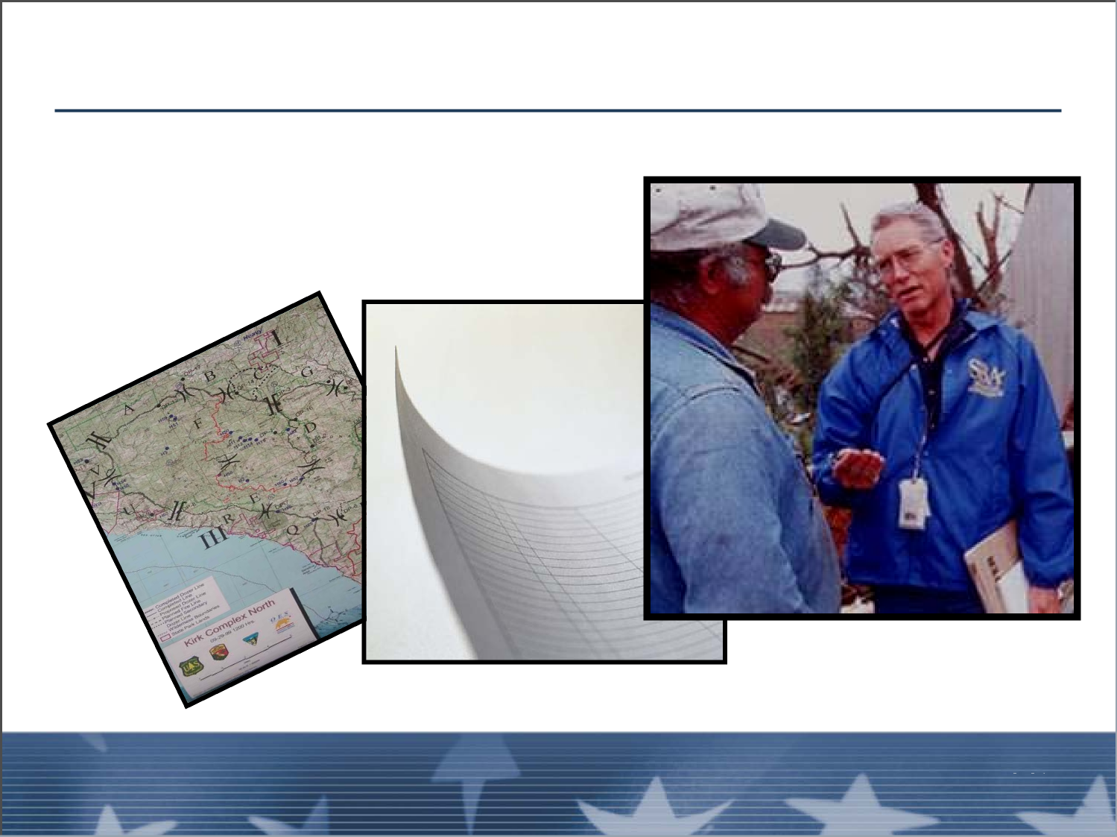
Division/Group Documentation Requirements (cont.)
■ Evaluations
■ Debriefing forms
Division/Group Management and Personnel Management
Unit 4:
Unit 4:
Visual 4-15
Division/Group Management and Personnel Management
Visual 4-16
Division/Group Documentation Requirements (cont.)

Slide 18
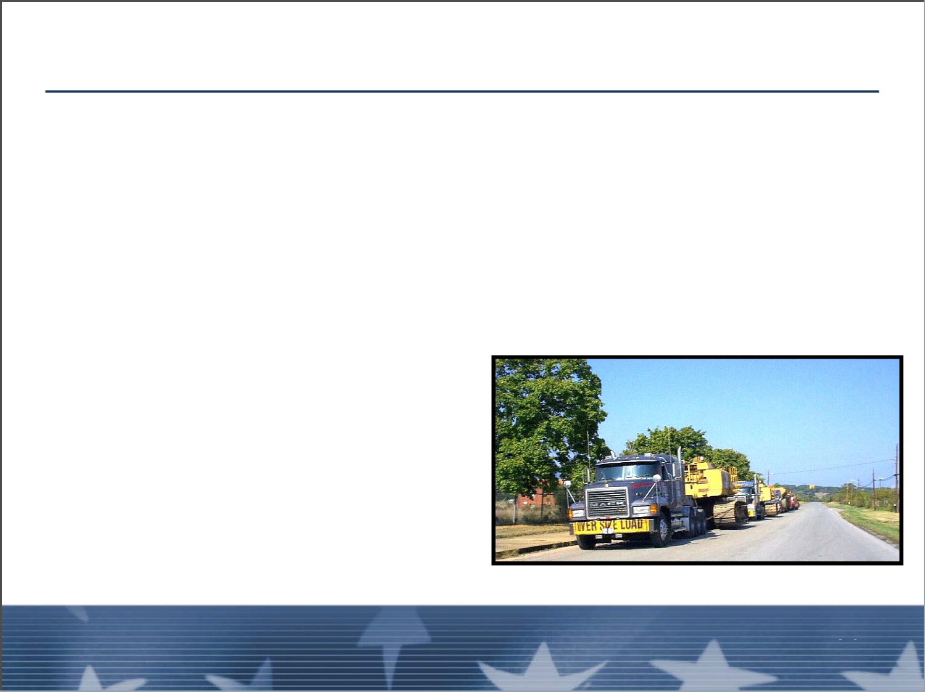
Demobilization and Close-Out Procedures
■ Coordinate operations to meet guidelines in
Demobilization Plan
■ Identify any excess resources
■ Consider cost versus effectiveness of excess
resources
■ Provide info for Glide Path
Unit 4:
Unit 4:
Visual 4-34
Division/Group Management and Personnel Management
Visual 4-17
Division/Group Management and Personnel Management

Slide 19
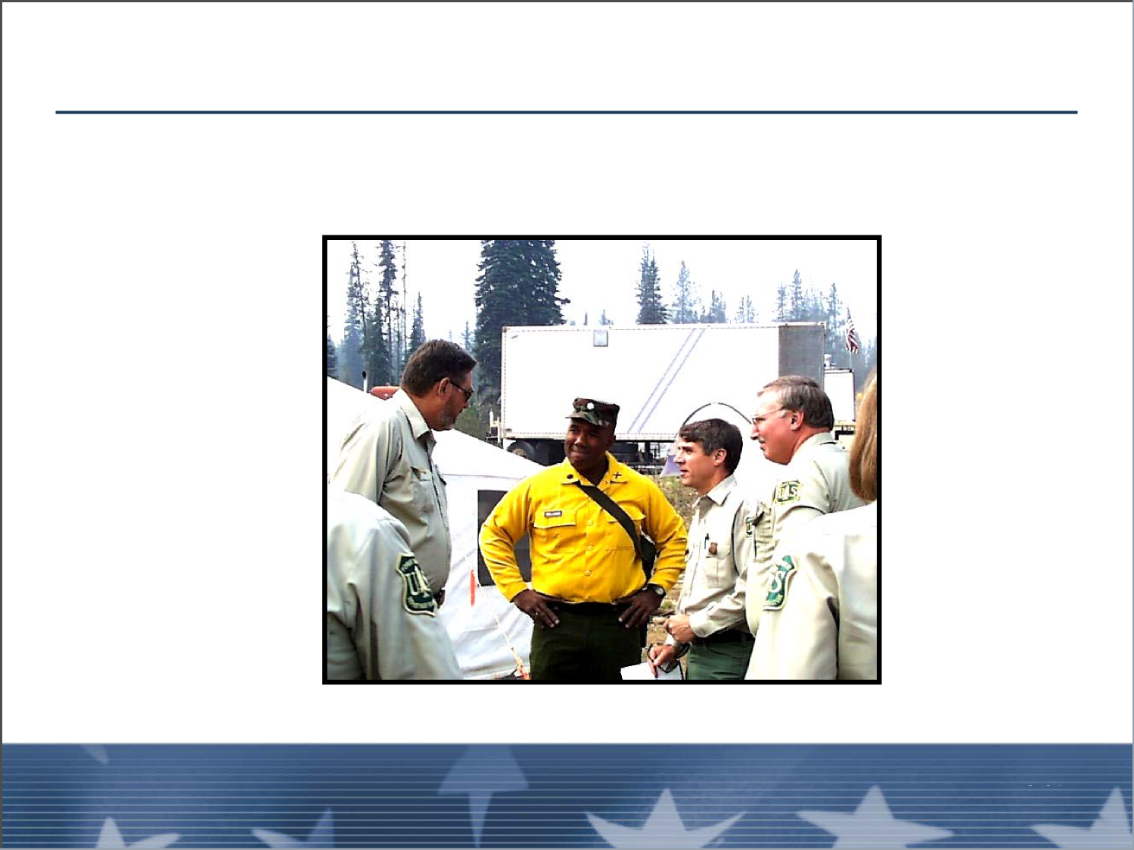
Personnel Management
The Division/Group Supervisor is a mid-level manager.
Unit 4:
Division/Group Management and Personnel Management
Visual 4-34

Slide 20
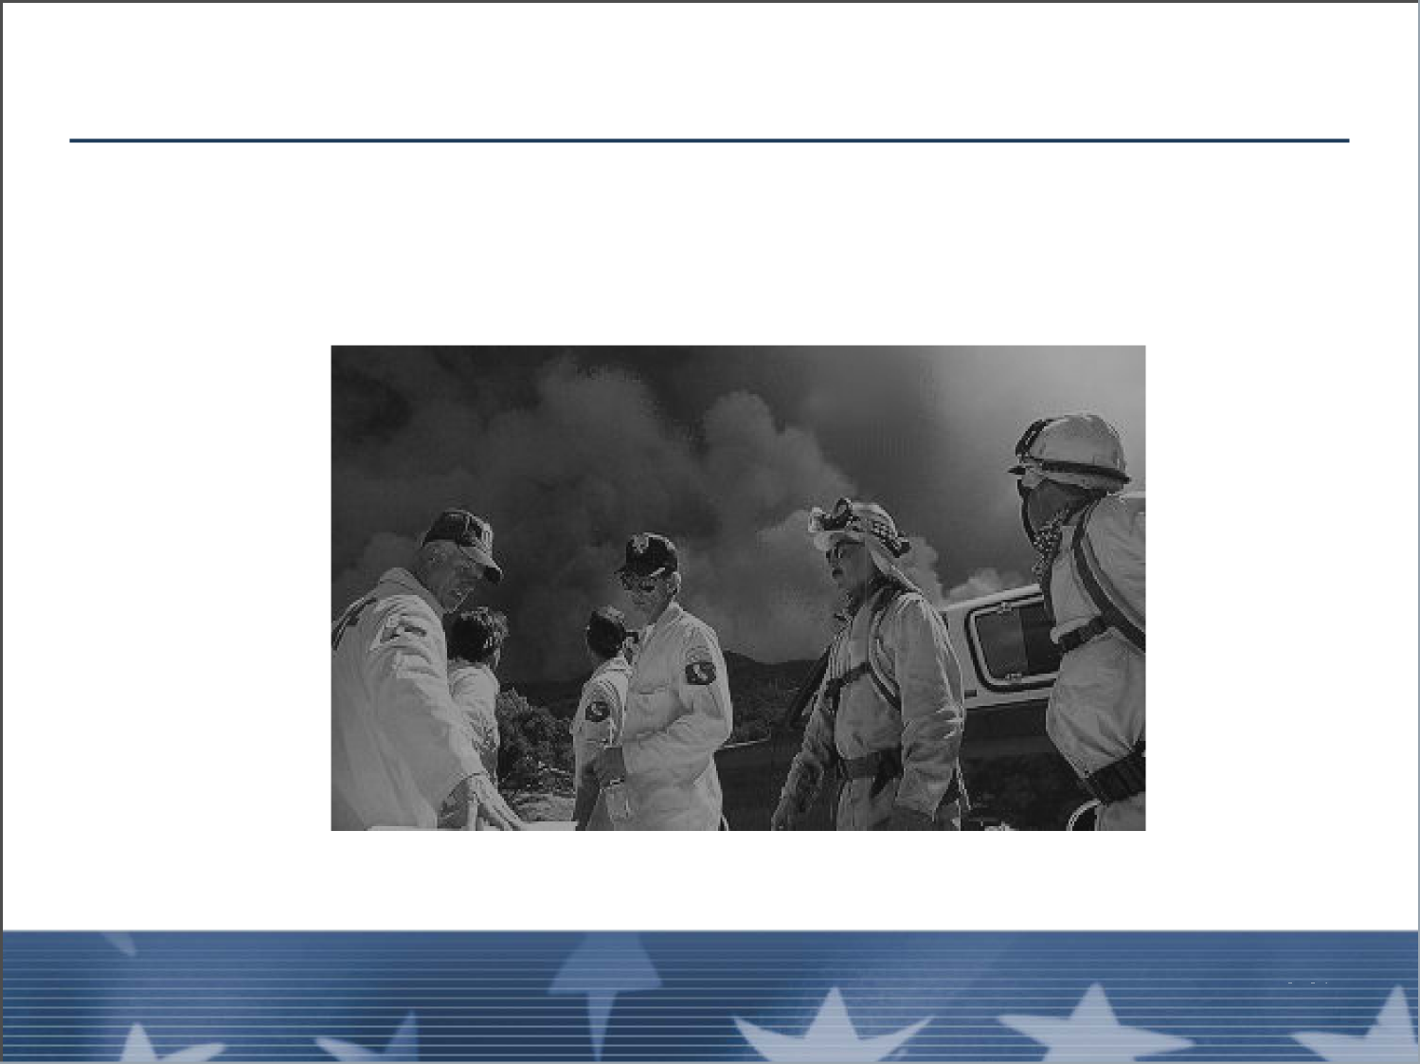
Personnel Management (cont.)
What types of personnel management issues may the
Division/Group Supervisor face?
Unit 4:
Unit 4:
Visual 4-34
Division/Group Management and Personnel Management
Visual 4-19
Division/Group Management and Personnel Management

Slide 21
Personnel Management (cont.)
A unique position that may have to contend with a
variety of personnel management issues:
■ Rank structures
■ People from different agencies
■ People without ICS experience
■ Emergency vs. non-emergency people
■ Volunteers
■ Extended operational periods
Unit 4:
Division/Group Management and Personnel Management
Visual 4-34

Slide 22
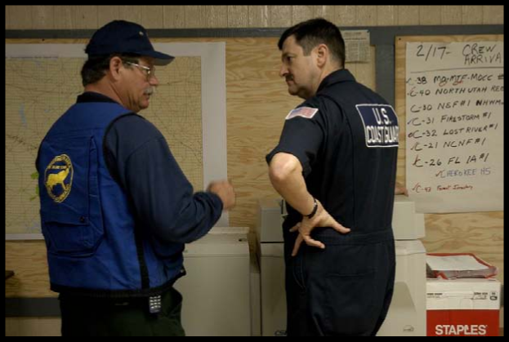
Leadership Styles
■ Autocratic
■ Laissez-faire
■ Democratic or participative management
A Division/Group Supervisor may have to play all of
these roles.
Unit 4:
Unit 4:
Visual 4-34
Division/Group Management and Personnel Management
Visual 4-21
Division/Group Management and Personnel Management

Slide 23
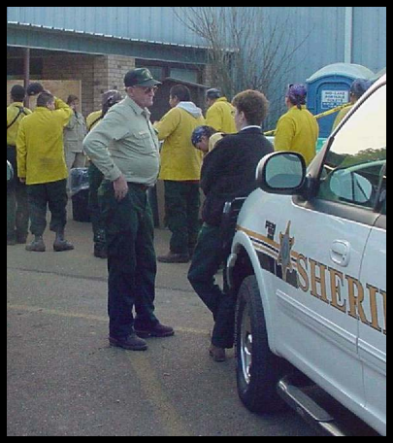
Supervision
See and be seen:
■ Monitor progress
■ Coordinate activities
■ Provide the opportunity to communicate
Unit 4:
Division/Group Management and Personnel Management
Visual 4-34

Slide 24
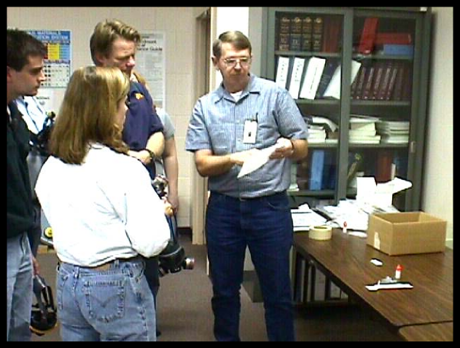
Instructions/Expectations
Must communicate instructions and expectations well:
■ In briefings
■ One-on-one
■ Request feedback
■ Clarify
■ Evaluate
Unit 4:
Unit 4:
Visual 4-34
Division/Group Management and Personnel Management
Visual 4-23
Division/Group Management and Personnel Management

Slide 25
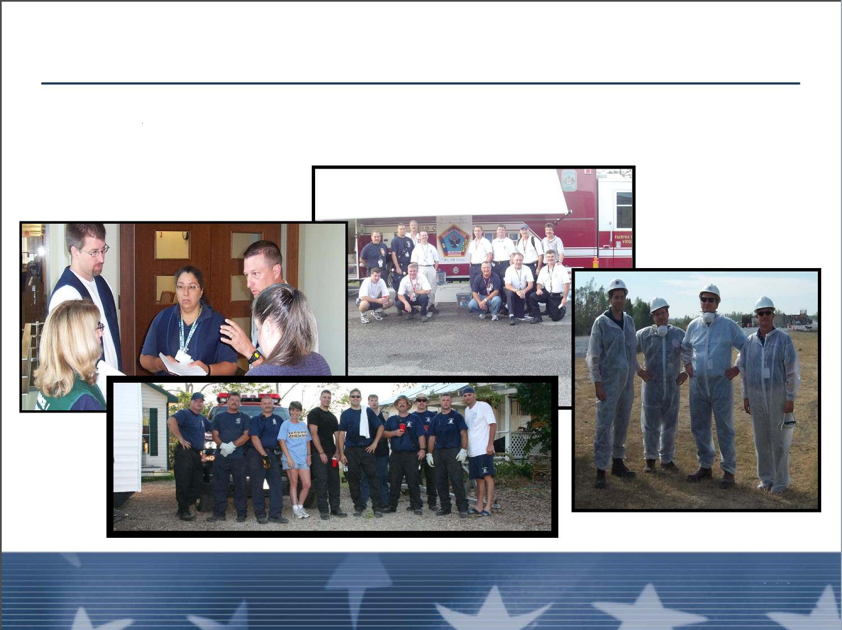
Team Building and Maintenance
Seven Practices of Highly Effective Teams
Unit 4:
Division/Group Management and Personnel Management
Visual 4-34

Slide 26
Team Building and Maintenance (cont.)
Seven Practices of Highly Effective Teams
A commitment to a clear mission
Mutual support, encouragement, and accountability
Clearly defined roles
Win-win cooperation
Continued on next slide...
Unit 4:
Unit 4:
Visual 4-34
Division/Group Management and Personnel Management
Visual 4-25
Division/Group Management and Personnel Management

Slide 27
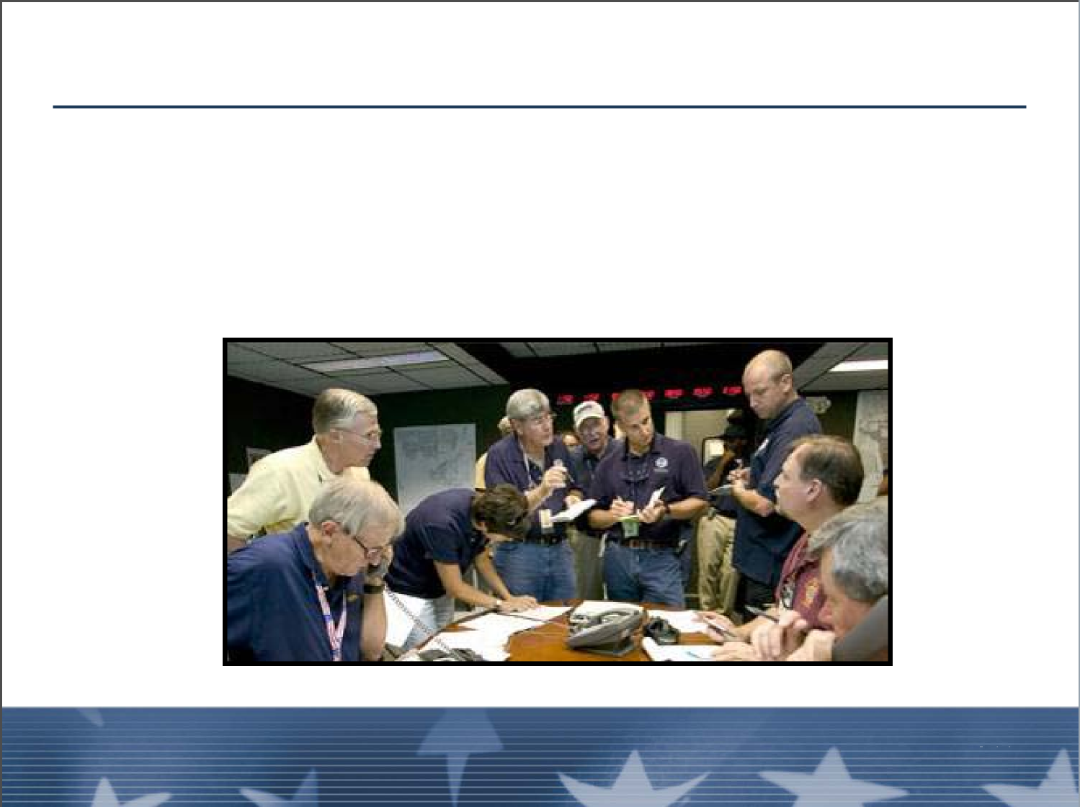
Team Building and Maintenance (cont.)
Individual competency
Empowering communication
A winning attitude
Unit 4:
Division/Group Management and Personnel Management
Visual 4-34

Slide 28
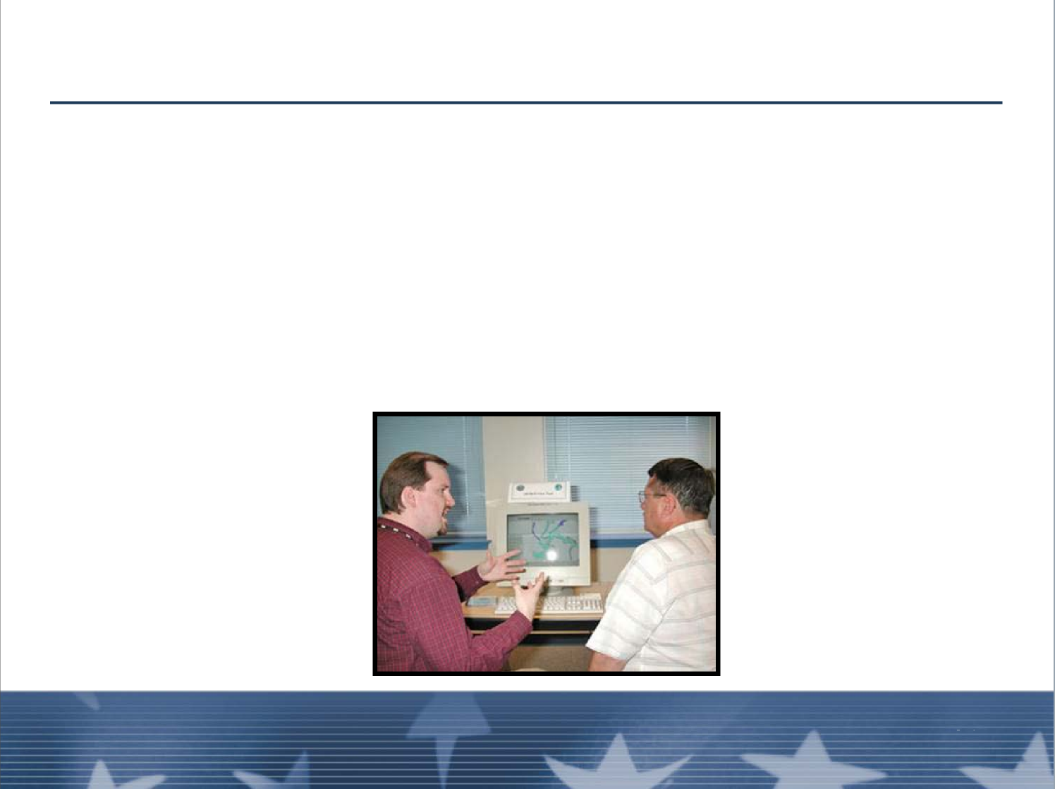
5 Steps of Coaching
Prepare the learner
Demonstrate the operation
Create a positive atmosphere
Have the learner perform the operation
Follow up
Unit 4:
Unit 4:
Visual 4-34
Division/Group Management and Personnel Management
Visual 4-27
Division/Group Management and Personnel Management

Slide 29
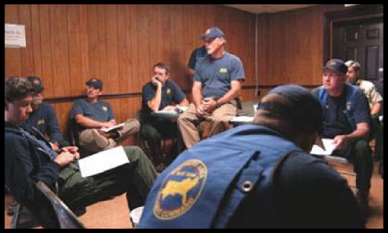
Evaluating Performance
Establish standards of performance based on:
■ Expressed expectations
■ Information from briefing
■ Production standards
■ Safety standards
Unit 4:
Division/Group Management and Personnel Management
Visual 4-34

Slide 30
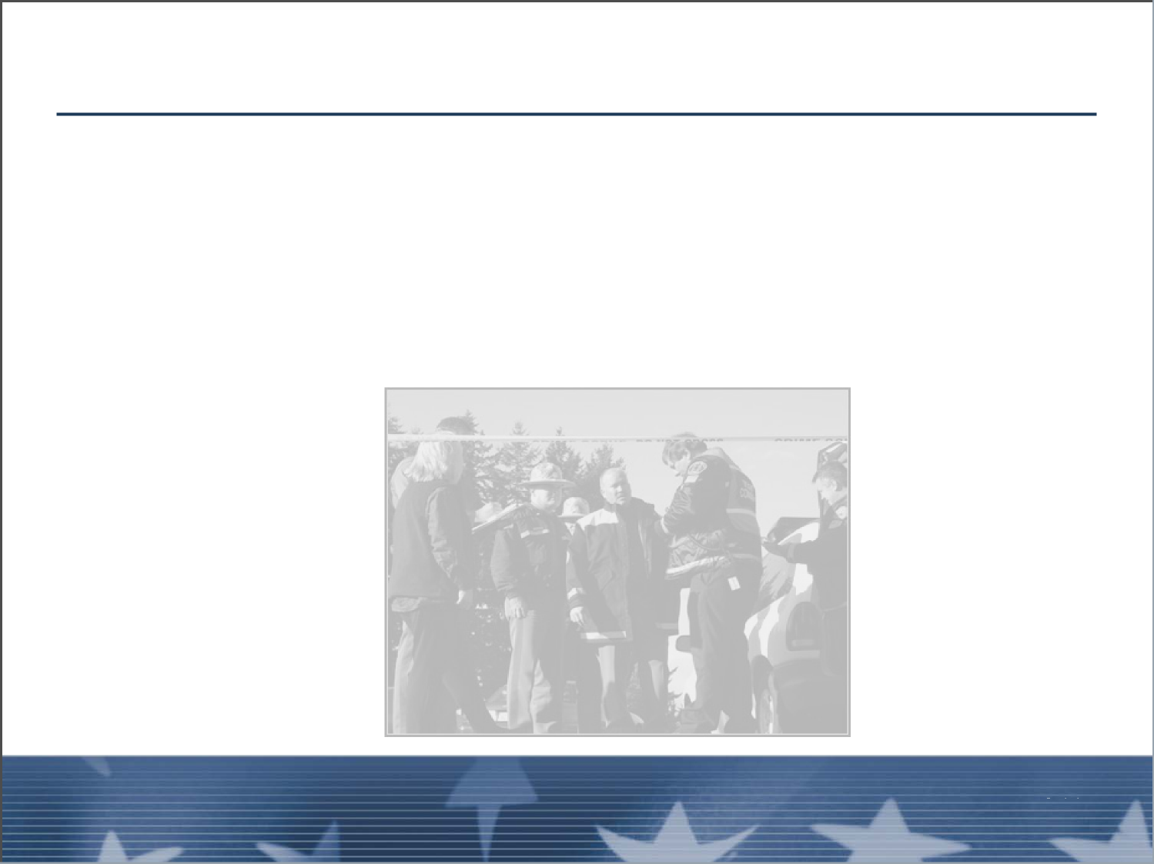
Evaluating Performance (cont.)
Compare the actual results with those established
standards:
■ Make adjustments as necessary
■ Re-evaluate after adjustment
Unit 4:
Unit 4:
Visual 4-34
Division/Group Management and Personnel Management
Visual 4-29
Division/Group Management and Personnel Management

Slide 31
Evaluating Performance (cont.)
Performance Inhibitors:
■ Fear of failure
■ Fear of the unknown
■ Fear of change
■ New and specific skills required
■ Large amounts of technical information
■ Defensiveness
■ Self doubt
Unit 4:
Division/Group Management and Personnel Management
Visual 4-34

Slide 32
Evaluating Performance (cont.)
Performance Improvement Process:
■ Tell the person
■ What is wrong
■ How to fix it
■ Reasonable timeframe
■ Document
Unit 4:
Unit 4:
Visual 4-34
Division/Group Management and Personnel Management
Visual 4-31
Division/Group Management and Personnel Management

Slide 33
Evaluating Performance (cont.)
Corrective actions to improve incident performance:
■ Training or coaching
■ Reassignment
■ Counseling
■ Release from assignment
Unit 4:
Division/Group Management and Personnel Management
Visual 4-34

Slide 34
Evaluating Performance (cont.)
Good performance:
■ Acknowledge
■ Evaluation
■ Praise
■ “Praise in public, reprimand in private”
Unit 4:
Unit 4:
Visual 4-34
Division/Group Management and Personnel Management
Visual 4-33
Division/Group Management and Personnel Management

Slide 35
Objectives Review
Why strong interpersonal skills are important to the
duties of the Division/Group Supervisor?
Why are good Division/Group relationships
important?
What is the purpose of span of control as a
management technique?
Unit 4:
Division/Group Management and Personnel Management
Visual 4-34

Slide 36
Objectives Review (cont.)
What are the Division/Group documentation
responsibilities of the Division/Group Supervisor?
How might the Division/Group Supervisor set
performance standards? How might the
Division/Group Supervisor manage the performance
of their personnel?
Unit 4:
Unit 4:
Visual 4-34
Division/Group Management and Personnel Management
Visual 4-35
Division/Group Management and Personnel Management

