Slide 1

Unit 2
Overview of the
Operations Section

Slide 2
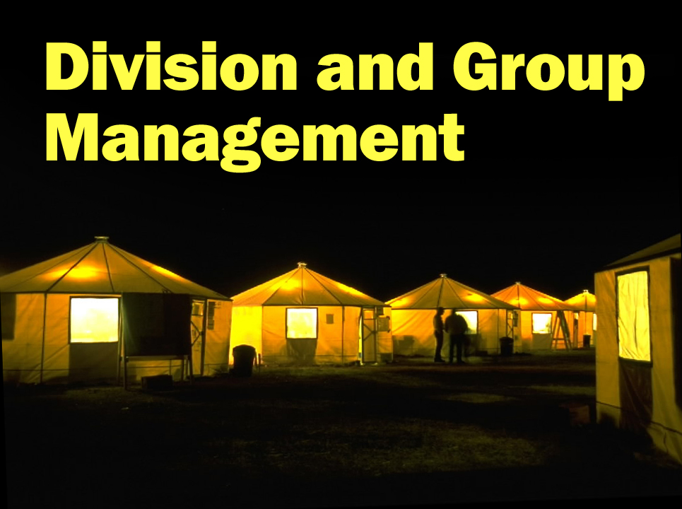
Unit 1
DIVISION/GROUP SUPERVISOR
Unit 1 – Introduction
Slide 1-2

Slide 3

Unit Terminal Objective
Describe function and components of the Operations
Section.
Unit Enabling Objectives
• Describe the purpose of the Operations Section
• Describe the responsibilities of the Operations Section Chief (OSC)
• Describe the responsibilities of the Branch Director
• Describe the key elements of the Division/Group Supervisor position
• Define Division Supervisor and Group Supervisor positions and describe the difference and similarities between the two positions
• Describe the management skill and supervision concepts relevant to the position of Division/Group Supervisor
Unit 2:
Overview of the Operations Section
Visual 2-2

Slide 4
Unit 1 Objectives
Define Division/Group Supervisor positions and describe the differences between the two positions.
Describe the differences and similarities between the Division/Group Supervisor, Strike Team/Task Force Leader, and Incident Commander Type 3.

Slide 5
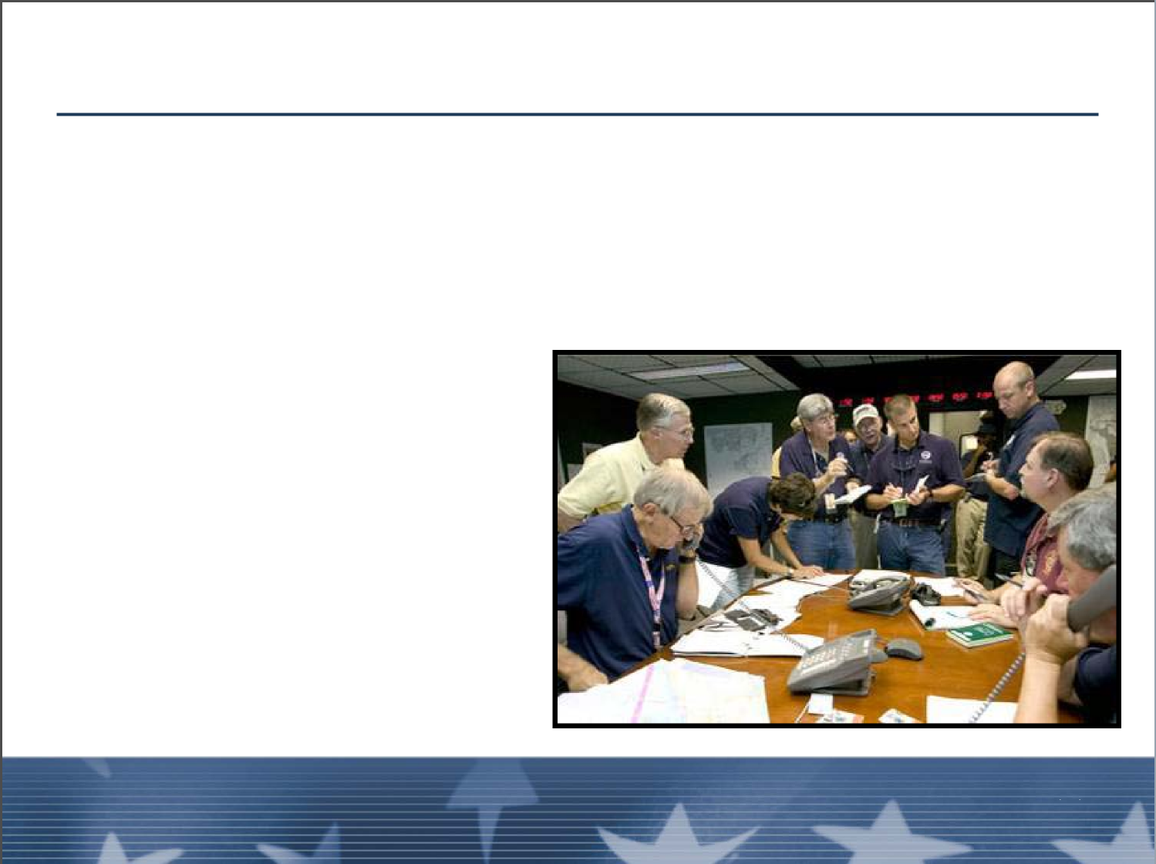
The Operations Section
Responsible for:
■ All tactical incident operations
■ IAP Implementation
Unit 2:
Unit 2:
Visual 2-27
Overview of the Operations Section
Visual 2-27
Overview of the Operations Section

Slide 6
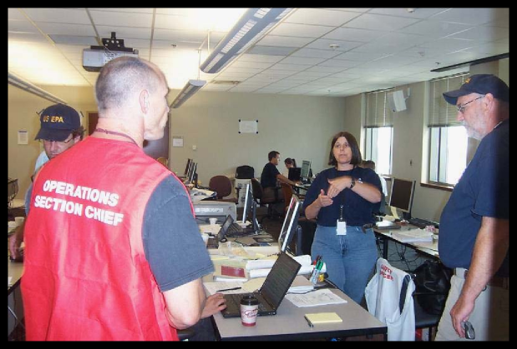
Operations Section Chief Role and Responsibilities
Responsible for:
■ Translating objectives into strategy and tactics
■ Supervising the Operations organization
Unit 2:
Overview of the Operations Section
Visual 2-27

Slide 7
Operations Section Chief Role and Responsibilities (cont.)
Responsible for coordination with: ■ Command staff ■ General staff ■ Subordinates ■ Agency Representatives ■ Resources Advisors | ■ Local Officials ■ Media ■ Public ■ Technical Specialists ■ Training Specialists
Overview of the OperationSection
Unit 2:
Visual 2-6
Unit 2:
Overview of the Operations Section
Visual 2-27

Slide 8
Operations Section Chief Role and Responsibilities (cont.)
Responsible for coordination with: ■ Command staff ■ General staff ■ Subordinates ■ Agency Representatives ■ Resources Advisors | ■ Local Officials ■ Media ■ Public ■ Technical Specialists ■ Training Specialists
Unit 2:
Unit 2:
Overview of the Operations Section
Visual 2-6

Slide 9
Organization of Operations Section Type 3 Incident

Slide 10
Organization of Operations Section
Type 2 Incident Example

Slide 11
Organization of Operations Section
Major Incident (Type 2 or Type 1)

Slide 12

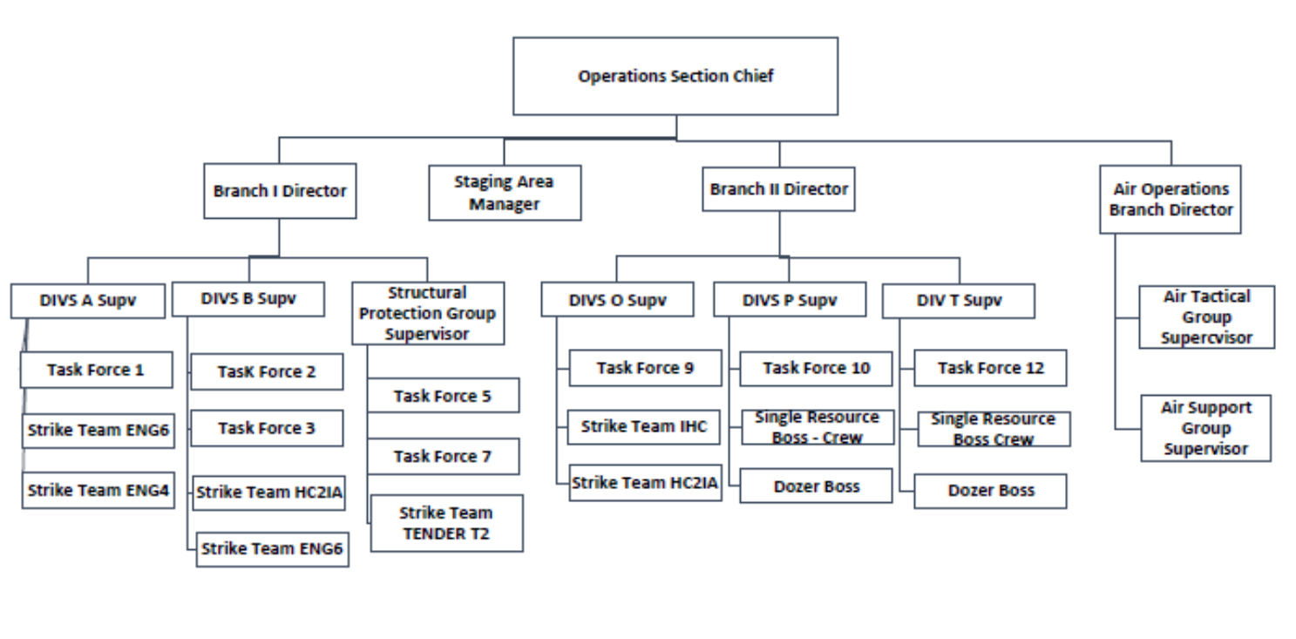
Branch Director Role and Responsibilities
Responsible for:
■ Implementation of IAP as appropriate for their Branch
■ Development of alternatives for Branch operations
■ Attendance at Planning Meetings with the Operations
Section Chief at their request
Unit 2:
Overview of the Operations Section
Visual 2-27

Slide 13
Branch Director Role and Responsibilities (cont.)
Responsible for:
■ Supervising Branch operations
■ Reviewing the ICS Form 204 - Division/Group
Assignment List for Divisions/Groups within the Branch
■ Assigning specific work tasks to DIVSs
■ Resolving logistical problems reported by subordinates
■ Reporting to Operations Section Chief as needed
■ Approving accident and medical reports
■ Maintaining the ICS Form 214 - Unit Log
Overview of the Operations Section
Visual 2-8
Unit 2:
Unit 2:
Overview of the Operations Section
Visual 2-27

Slide 14
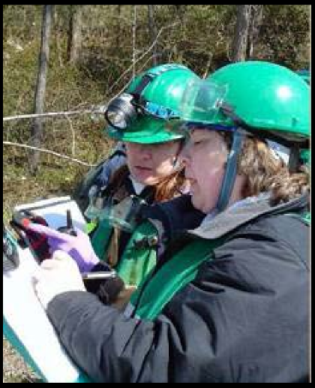
Division Supervisor vs. Group Supervisor
The Division or Group Supervisor is responsible for activities within that Division or Group:
■ Fire control operations
■ Flood control operations
■ HAZMAT control
■ Site access
■ Rescue
Visual 2-12
Unit 2:
Overview of the Operations on
Unit 2:
Overview of the Operations Section
Visual 2-27

Slide 15

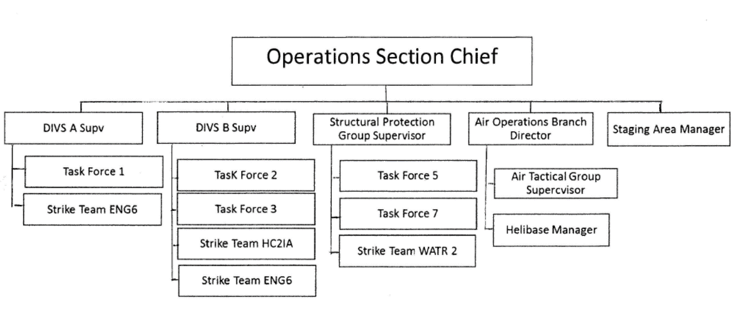
Division/Group Supervisor
Key Elements:
■ Translates direction from the Operations Section Chief
into on-the-ground tactical operations
■ Implements the IAP
■ Reviews assignments and assigns tasks
Unit 2:
Overview of the Operations Section
Visual 2-27

Slide 16
Division/Group Supervisor Key Elements (cont.)
■ Coordinates activities with adjacent Groups and
Divisions
■ Determines need for assistance
■ Resolves logistical problems within Division or Group
■ Develops Tactical plans for next Operational Period
Unit 2:
Unit 2:
Visual 2-27
Overview of the Operations Section
Visual 2-10
Overview of the Operations Section

Slide 17
Division Supervisor
The division supervisor is responsible for the implementation of the assigned portion of the IAP (ICS 204) in a specific geographical area.

Slide 18
Division Supervisor vs. Group Supervisor
The Division Supervisor:
■ Supervises, coordinates, and manages a geographic
portion of an incident
■ Under the Operations Section Chief or Branch Director
■ Implements assigned portion of IAP
DIVISIONS ARE DIRT!!!!!
Unit 2:
Overview of the Operations Section
Visual 2-27

Slide 19
Group Supervisor
A group supervisor is responsible for the implementation of the assigned portion of the IAP of a specific functional area.
Functional groups can best be used to describe areas of activity (rescue, water handling, structure protection).

Slide 20


Division Supervisor vs. Group Supervisor
The Group Supervisor:
■ Also works for the Operations Section Chief or the
Branch Director
■ Also implements assigned portion of the IAP
■ Also is responsible for the frontline supervision and
management of assigned resources
Unit 2:
Unit 2:
Visual 2-27
Overview of the Operations Section
Visual 2-14
Overview of the Operations Section

Slide 21
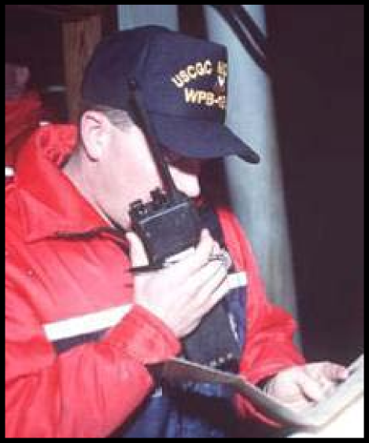
Division Supervisor vs. Group Supervisor
The Group Supervisor supervises, coordinates,
manages a function:
■ Sampling
■ Decontamination
■ Shoreline assessment
■ Disposal
■ Entry
■ Health monitoring
■ Damage assessment
Unit 2:
Overview of the Operations Section
Visual 2-27

Slide 22

Resources
DIVISION/GROUP SUPERVISOR
As a division/group supervisor, what types and kinds of resources do you manage?
Unit 1 – Introduction
Slide 1-5

Slide 23
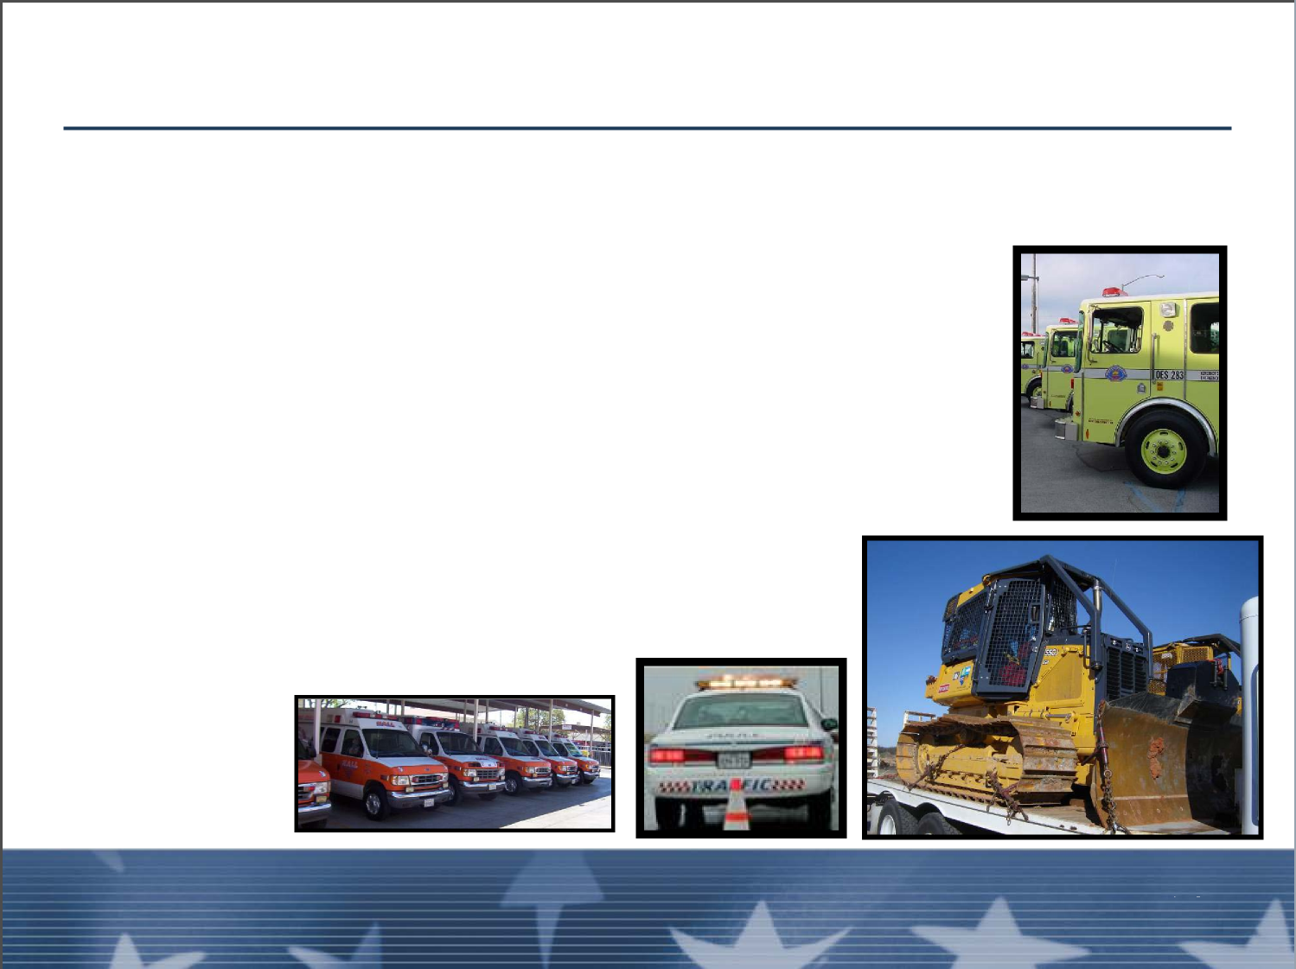
Division/Group Supervisor
Kinds of resources that may be assigned to a Division or
Group:
■ Crews
■ Heavy equipment (like excavators)
■ Engines or Strike Teams
■ Patrol vehicles
■ Confined Space Entry Teams
■ Boats
Unit 2:
Overview of the Operations Section
Visual 2-27

Slide 24
EXERCISE: Distinguishing Roles and Responsibilities
Division/Group Supervisor
Strike Team/Task Force Leader
Incident Commander Type 3

Slide 25
Exercise Questions
Group 1: Identify the differences and similarities between DIVS and task force leader.
Group 2: Identify the differences and similarities between DIVS and strike team leader.
Group 3: Identify the differences and similarities between DIVS and ICT3.

Slide 26
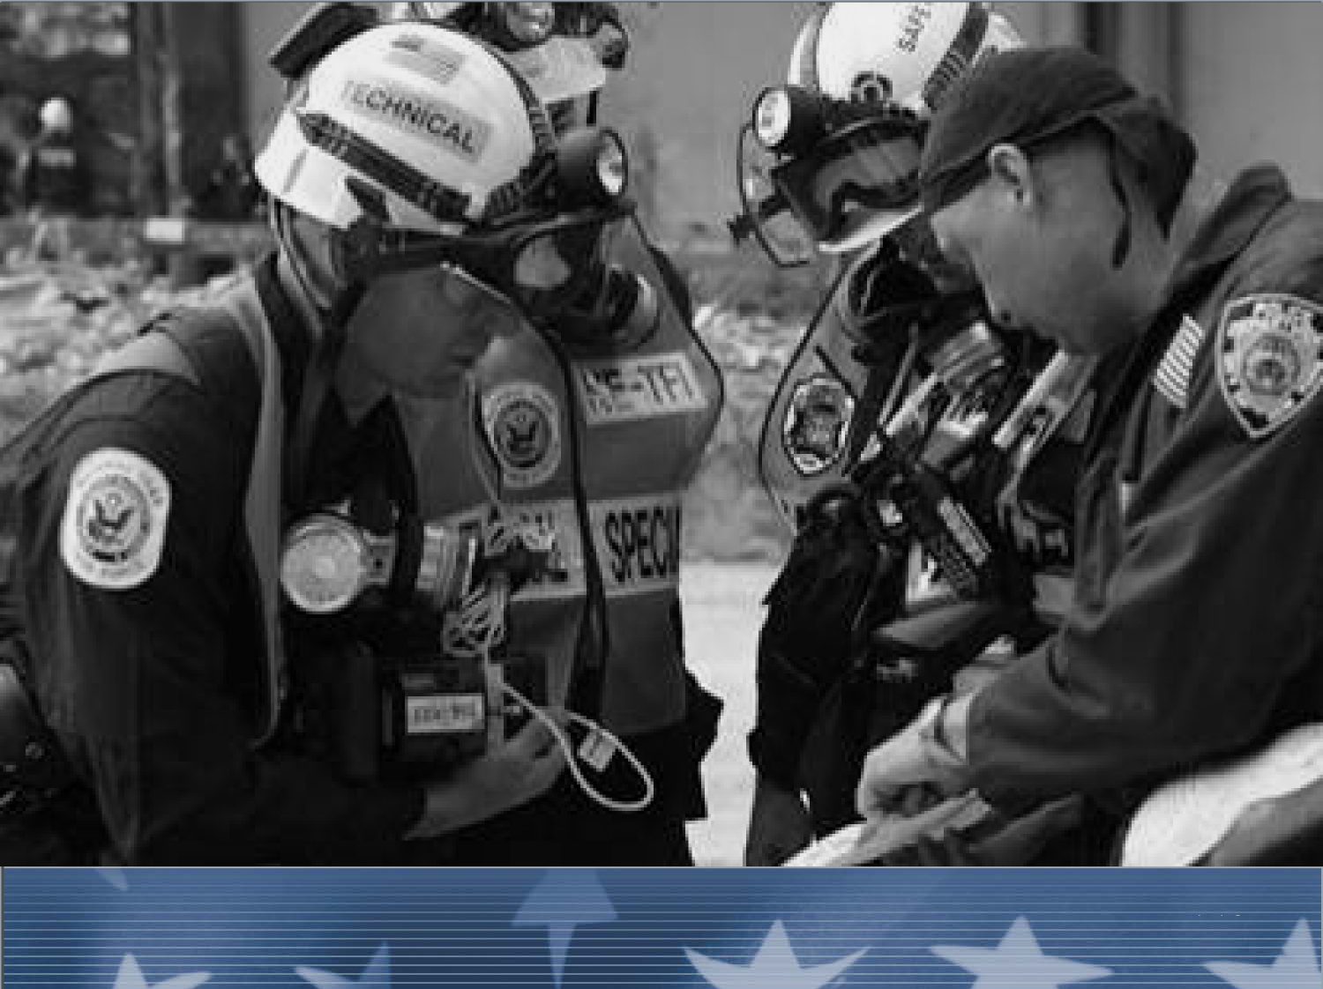
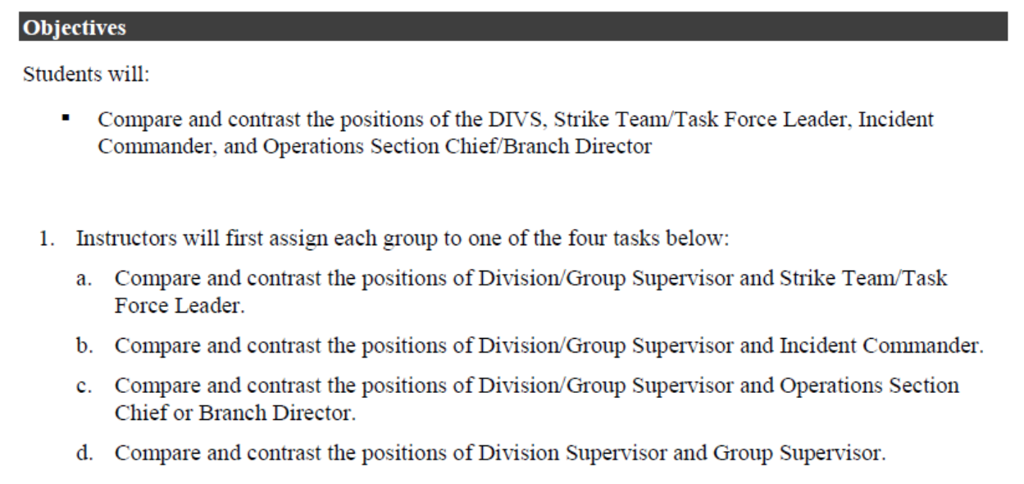
EXERCISE 2
Unit 2:
Overview of the Operations Section
Visual 2-27

Slide 27
SO FOR OUR EXERCISE, COMBINING FEMA & NWCG CURRICULUMS:
DIV A-Identify the differences and similarities between DIVS & STLD/TFLD.
DIV B- Identify the differences and similarities between DIVS and ICT3.
DIV R- Identify the differences and similarities between a Division Supervisor & a Group Supervisor
DIV S- Identify the differences and similarities between a Division Supervisor & an Operations SC
Bonus discussion: If a Group is working within a Division who supervises who?

Slide 28
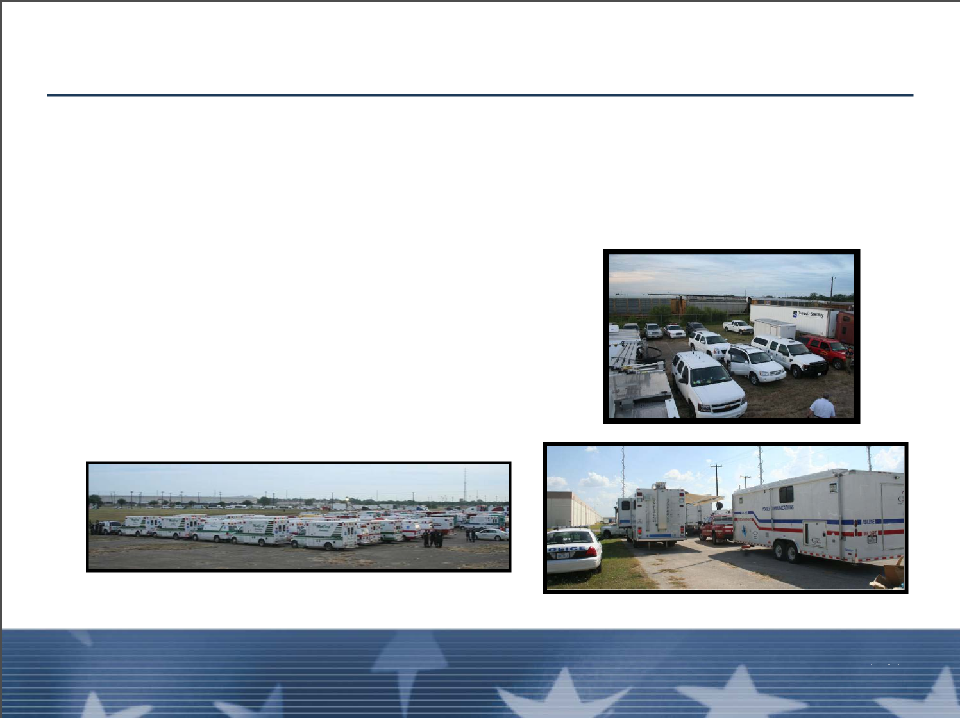
Collocation of Groups within Divisions
■ May both be used on an incident (in fact on major incidents they are both usually used)
■ Groups work where needed and may work within a
Division's area
■ Neither supervises the other
■ Coordination is key
Unit 2:
Unit 2:
Visual 2-27
Overview of the Operations Section
Visual 2-16
Overview of the Operations Section

Slide 29
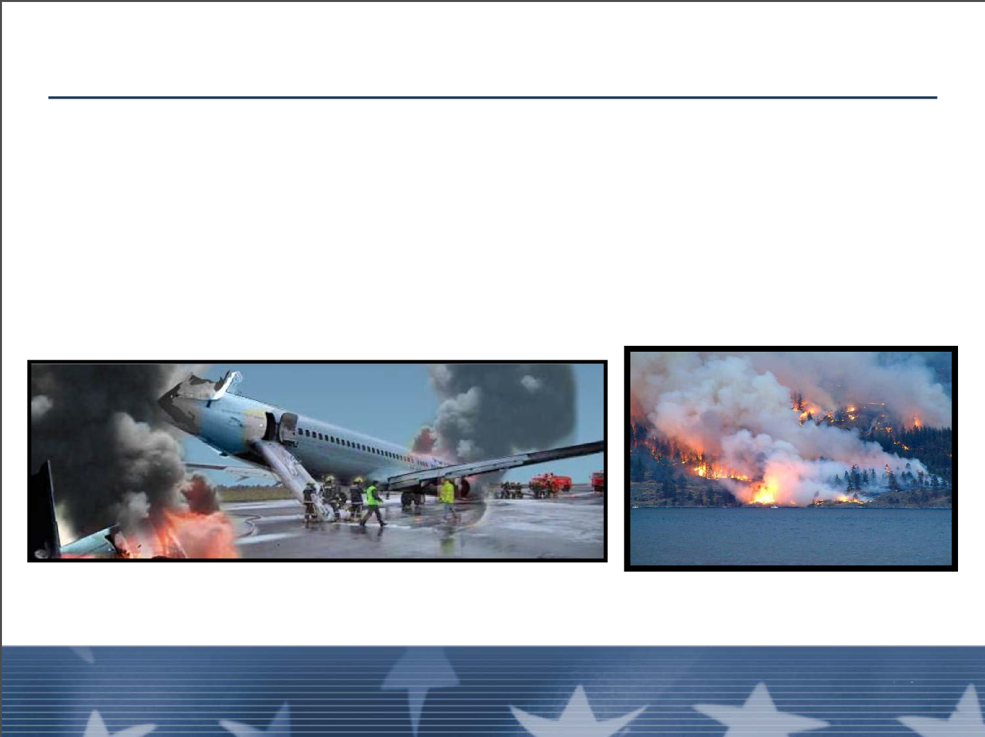
Incidents with Only Divisions or Only Groups
■ Just groups: If incident is small geographically
■ Just divisions: Larger geographical area, but less
complex activities and tasks
What is Written Above Makes No Sense!!!!!
Let’s Discuss when or why incidents may have
Just groups or Just divisions
Unit 2:
Overview of the Operations Section
Visual 2-27

Slide 30

Information Communication
The most critical element of the Division/Group Supv.
Supervisor’s job is to clearly communicate assignments
and incident activities to subordinates while maintaining safety as the highest priority for assigned personnel.
Unit 2:
Unit 2:
Visual 2-27
Overview of the Operations Section
Visual 2-18
Overview of the Operations Section

Slide 31
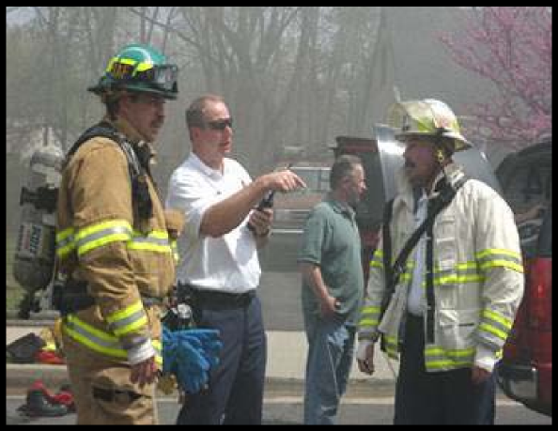
Management and Supervision
■ Understand tactics but have broader strategic
perspective
■ Monitor entire Division/Group
Unit 2:
Overview of the Operations Section
Visual 2-27

Slide 32
Management and Leadership skills
Has anyone ever had a bad DIVS?
Has anyone ever had a good DIVS?
What traits did these bad/good DIVS demonstrate?

Slide 33
Management and Leadership Skills
“As a commander, [they are] expected to choose command over action, working from strategic levels rather than the task level.”
  Alan Brunicini, Phoenix Fire Chief

Slide 34
Management and Supervision (cont.)
Management Skills:
■ Division/Group Supervisor are frontline managers
■ Manage by walking around
■ Be proactive
■ Take control
■ Demonstrate leadership
■ Know your duties
■ Maintain personnel accountability
Unit 2:
Unit 2:
Visual 2-27
Overview of the Operations Section
Visual 2-20
Overview of the Operations Section

Slide 35
Pre-Course Work Discussion
Instructors and students will now participate in a group discussion based on the concepts found in the pre-work:
  The Mission, the Men and Me.

Slide 36
Leadership
A DIVS must be very comfortable as a TFLD/STLD prior to initiating a DIVS task book.
A good many resources are relying on you to lead.
Trust and respect must be earned and cultivated.
It is crucial that DIVS obtain leadership training, attend staff rides and obtain multiple mentors for continued career development. Walk the Talk!

Slide 37
Wildfire Leadership Program Website

Slide 38
Review Unit 1 Objectives
Define Division/Group Supervisor positions and describe the differences between the two positions.
Describe the differences and similarities between the Division/Group supervisor, Strike team/Task force leader, and Incident Commander Type 3 (ICT3).

Slide 39
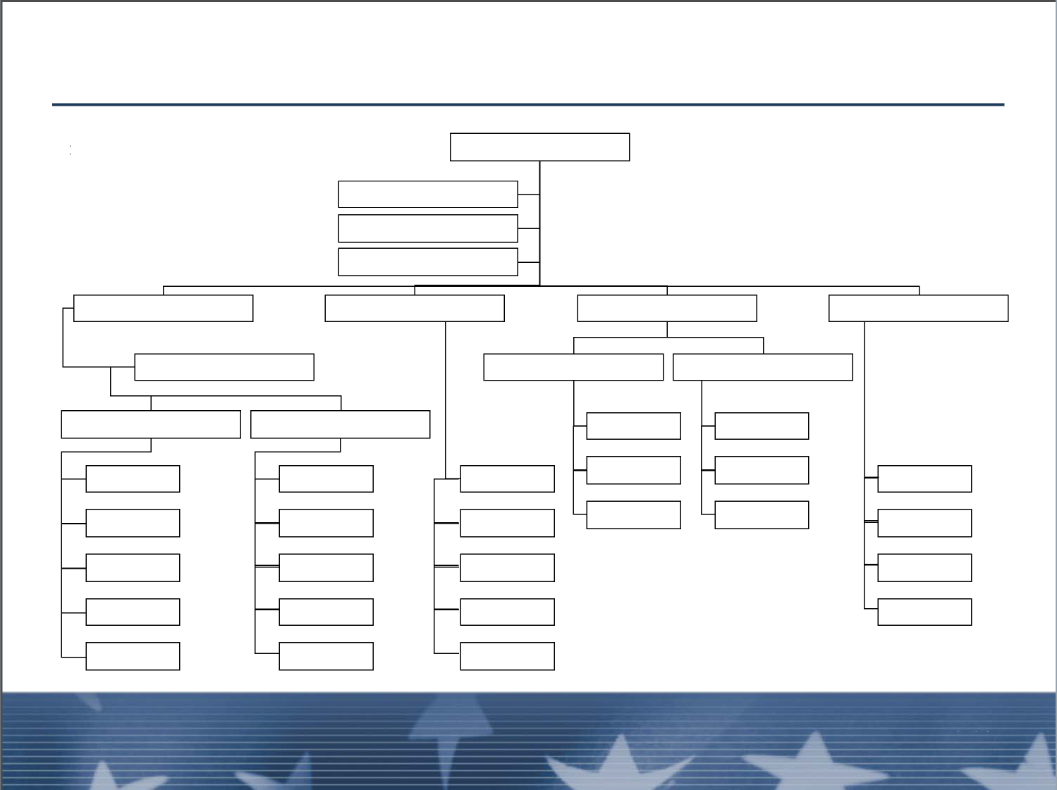
Organizational Development
INITIAL RESPONSE ORGANIZATION
INCIDENT COMMANDER
ENGINE
ENGINE
ENGINE
TRUCK
Unit 2:
Unit 2:
Visual 2-27
Overview of the Operations Section
Visual 2-22
Overview of the Operations Section

Slide 40
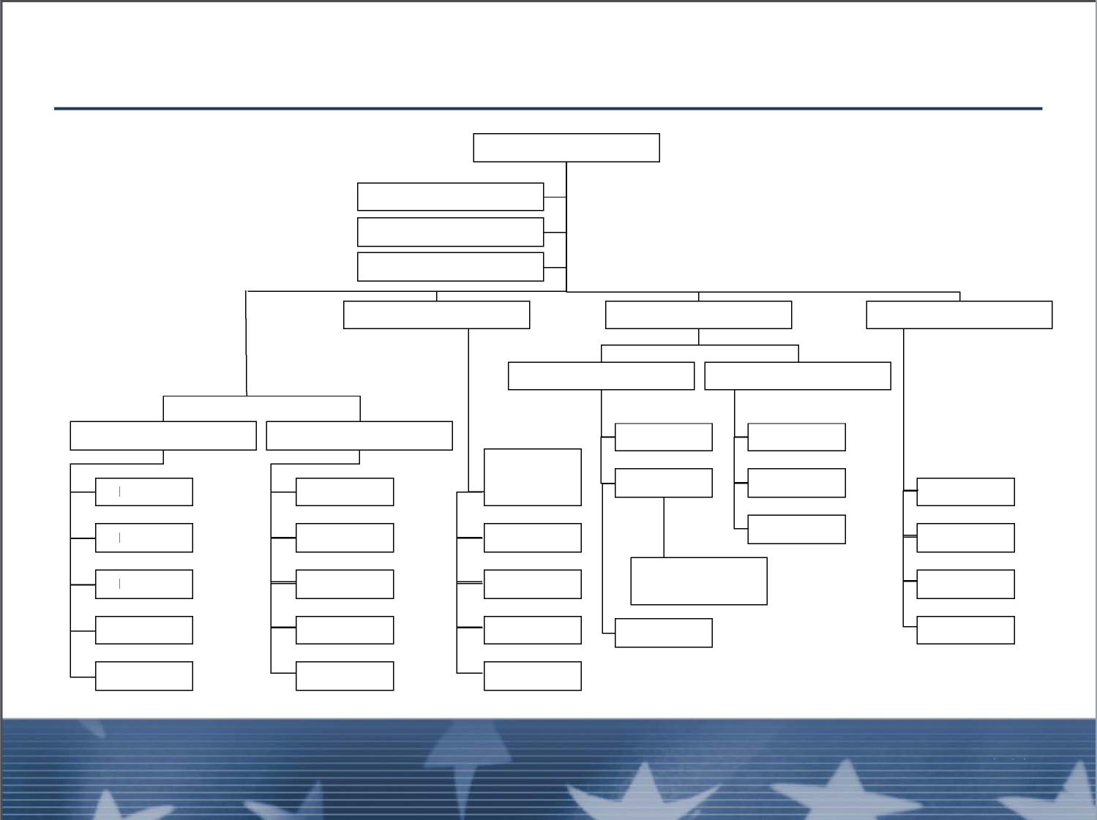
Organizational Development (cont.)
REINFORCED RESPONSE ORGANIZATION
INCIDENT COMMANDER
SAFETY OFFICER
DIVISION or GROUP
DIVISION or GROUP
RESOURCES
UNIT
ENGINE
ENGINE
ENGINE
ENGINE
ENGINE
ENGINE
RESPONDER
REHABILITATION
TRUCK
TRUCK
AMBULANCE
Unit 2:
Overview of the Operations Section
Visual 2-27

Slide 41
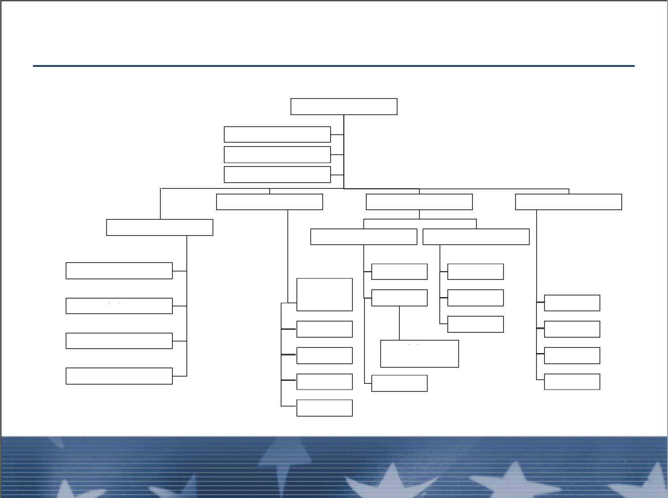
Organizational Development (cont.)
REINFORCED RESPONSE ORGANIZATION (cont.)
INCIDENT COMMANDER
SAFETY OFFICER
OPERATIONS SECTION
DIVISION
RESOURCES
UNIT
GROUP
GROUP
RESPONDER
REHABILITATION
GROUP
Unit 2:
Unit 2:
Visual 2-27
Overview of the Operations Section
Visual 2-24
Overview of the Operations Section

Slide 42
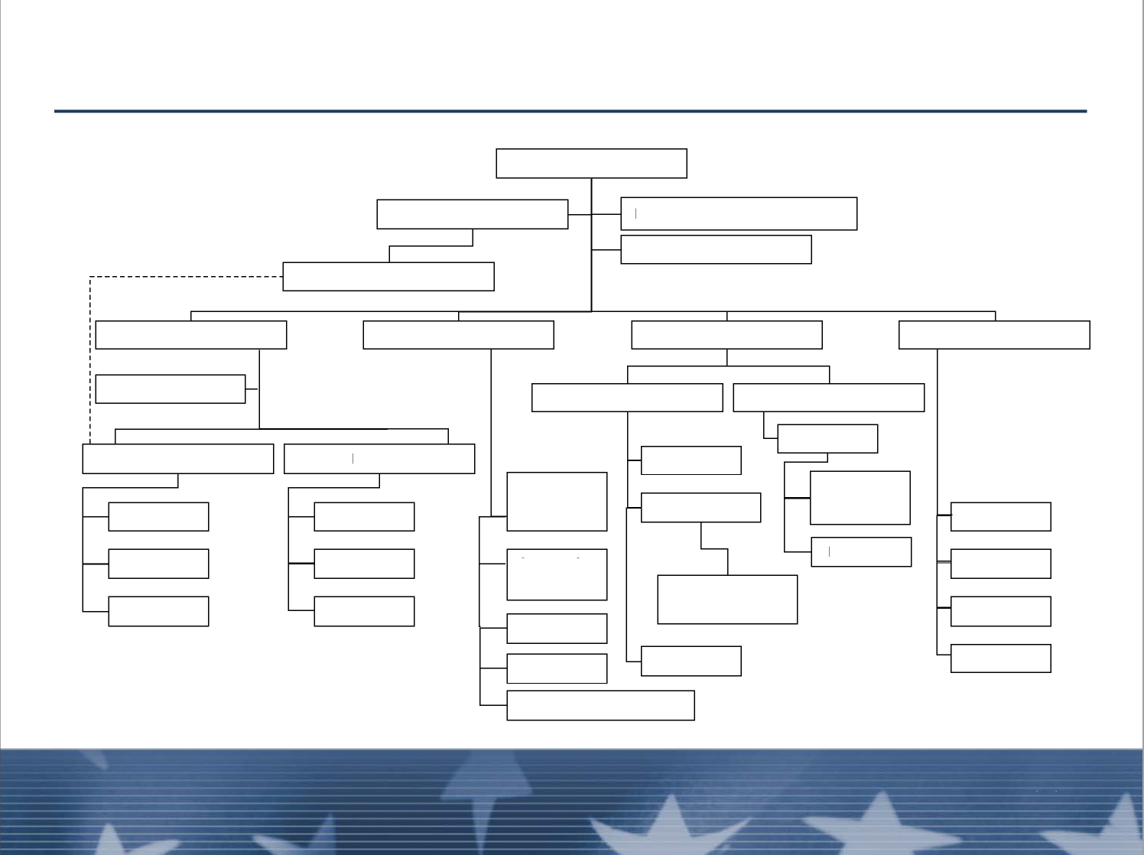
Organizational Development (cont.)
MULTI-BRANCH RESPONSE ORGANIZATION
INCIDENT COMMANDER
SAFETY OFFICER
PUBLIC INFORMATION OFFICER
ASSISTANT SAFETY OFFICER
OPERATIONS SECTION
PLANNING SECTION
LOGISTICS SECTION
STAGING AREA(S)
BRANCH
BRANCH
RESOURCES
UNIT
SUPPLY UNIT
DIVISION
DIVISION
MEDICAL UNIT
DIVISION
GROUP
SITUATION
UNIT
FACILITIES UNIT
RESPONDER
REHABILITATION
GROUP
GROUP
FOOD UNIT
TECHNICAL SPECIALIST
Unit 2:
Overview of the Operations Section
Visual 2-27

Slide 43
Objectives Review
What is the purpose of the Operations Section?
What are the responsibilities of the Operations
Section Chief?
What are the responsibilities of the Branch Director?
What are the key elements of the Division/Group
Supervisor position?
Unit 2:
Unit 2:
Visual 2-27
Overview of the Operations Section
Visual 2-26
Overview of the Operations Section

Slide 44
Objectives Review (cont.)
What are the differences between the Division
Supervisor and Group Supervisor positions?
What are some management skills and supervision
concepts relevant to the position of Division/Group
Supervisor?
Unit 2:
Overview of the Operations Section
Visual 2-27

