Slide 1
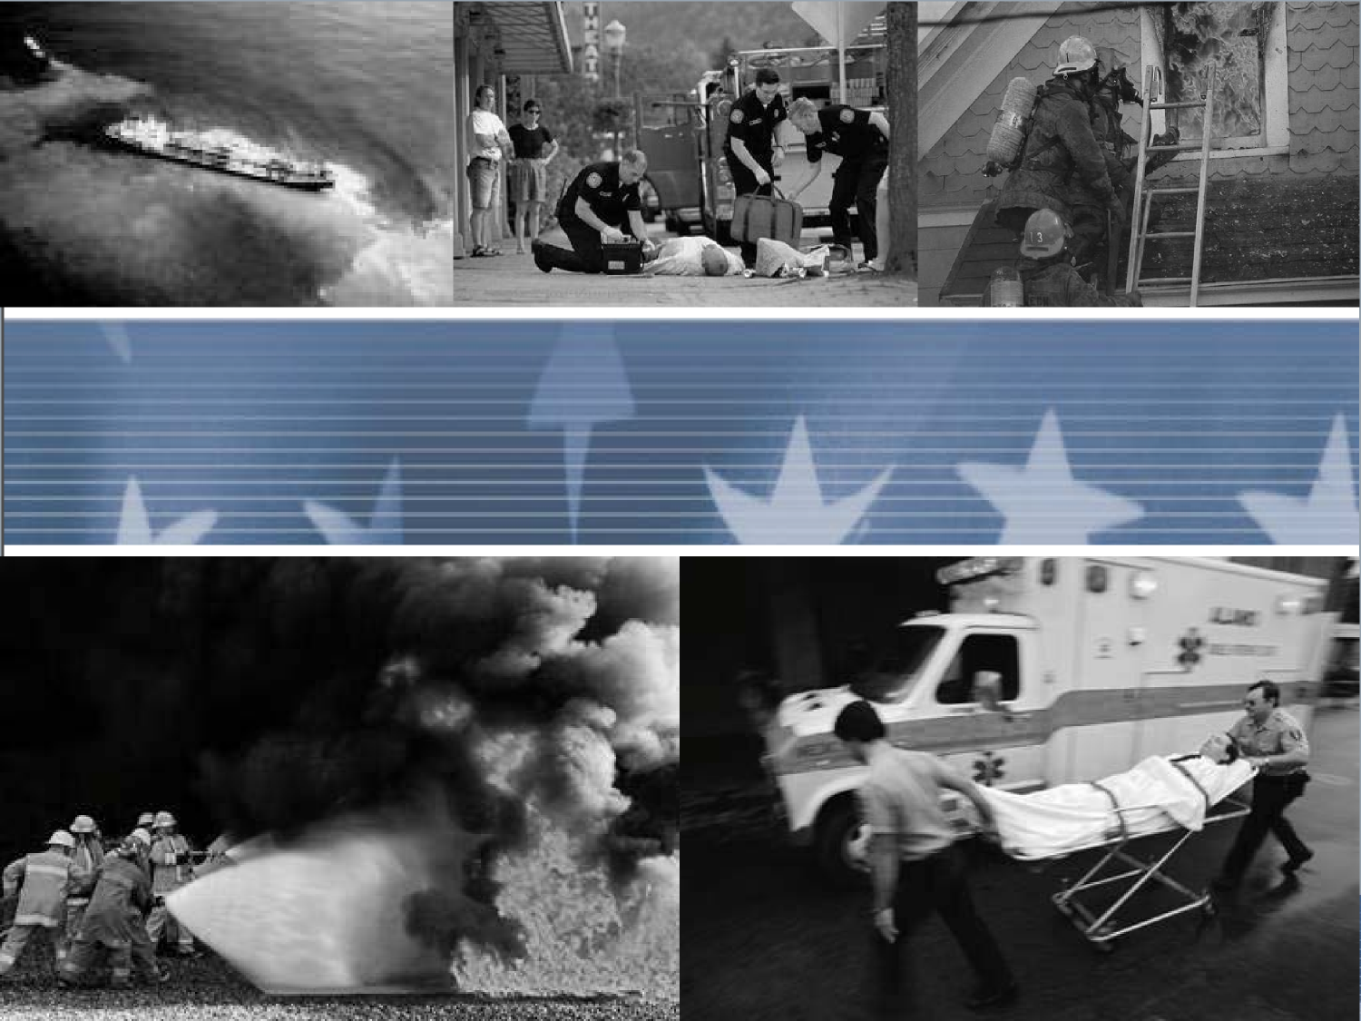
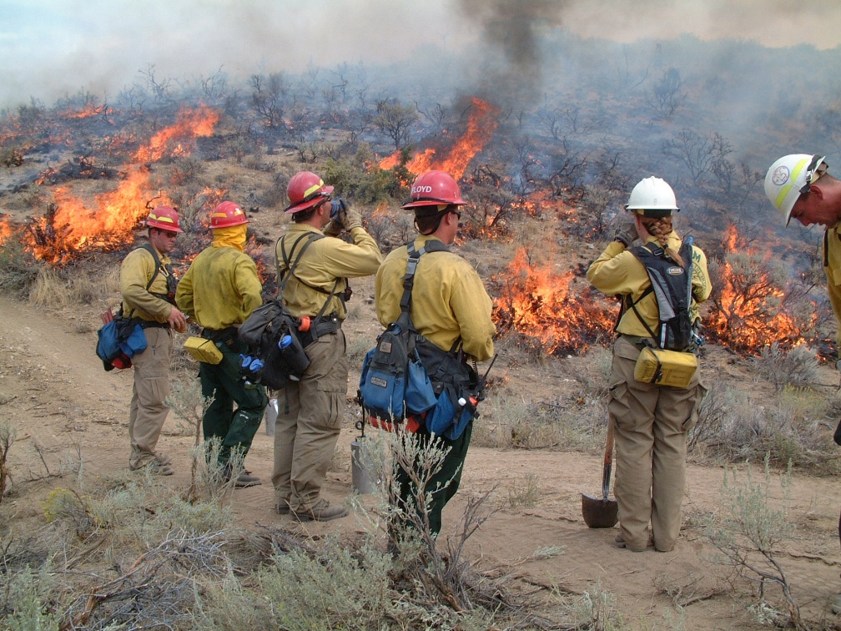
ALL-HAZARDS
DIVISION/GROUP SUPERVISOR
FEMA L960
Introduction
DIVISION SUPERVISOR
NWCG S339
NY-SPTC
January 2018

Slide 2
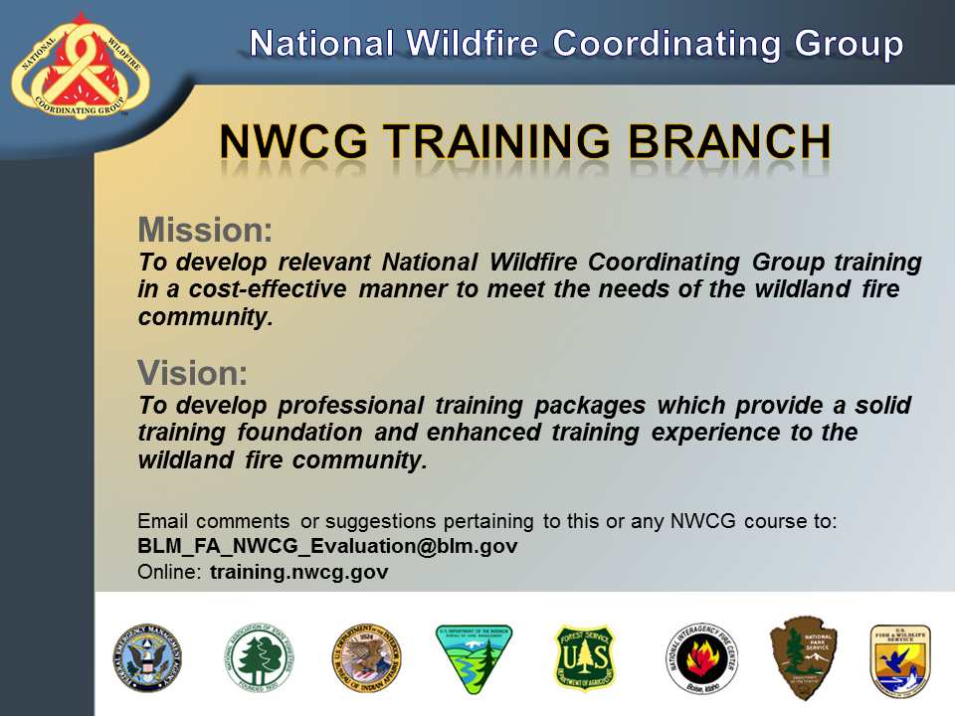

Slide 3
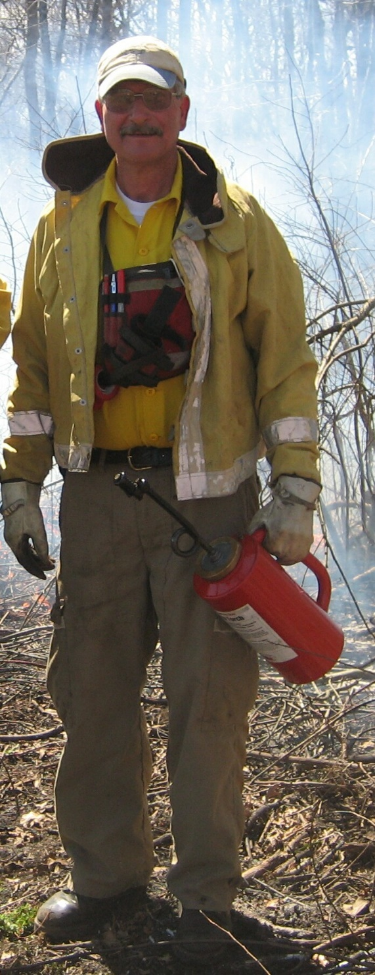
Lead Instructor- Bob Panko
36 years with USNPS – retired Nov 2007
Ranger (25 years) and then Fire Management Officer Everglades NP (11 years)
Qualification progression: FFT2-1974 Crew Boss-1982(8) STLD-1990(8) TFLD-1994 ICT3-1994 (4) DIVS-1995(1) OSC2-2002 (7) ICT2-2006 (4)
ICT2 / OSC2 / LOFR – USNPS Eastern All Hazard IMT, Southern Area IMT2, SA Red Team, and NYSIMT
Have worked on Incidents/Events/Wildfires in 23 states; Virgin Islands, Puerto Rico and DC.
Deputy IC & Instructor at NYWIMA
Risky Business Incident Management LLC “sole member” living in Voluntown, CT

Slide 4
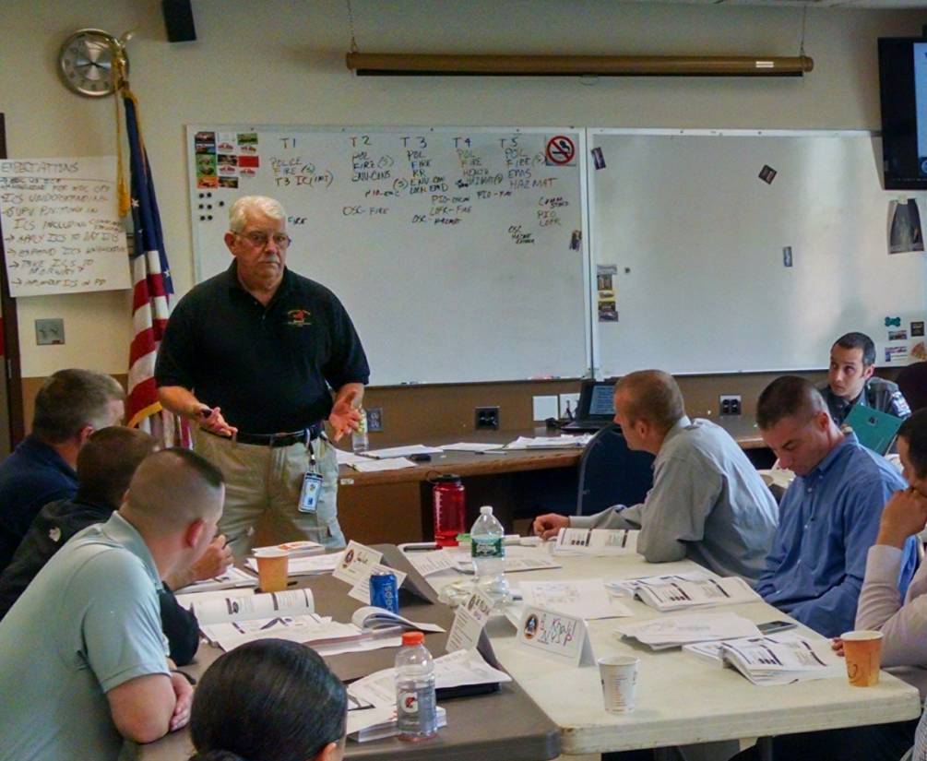
Instructor Introductions
  Frank Messar
  Retired Police Captain Yonkers NY PD
  Member of NYS-IMT2 as Operations SC with multiple in state and out of state assignments
  Instructor- Westchester County NY Police Academy
  Instructor – NYSOEM teaching I300/400 courses and FEMA Operations SC and DIVS
  Instructor NYWIMA

Slide 5
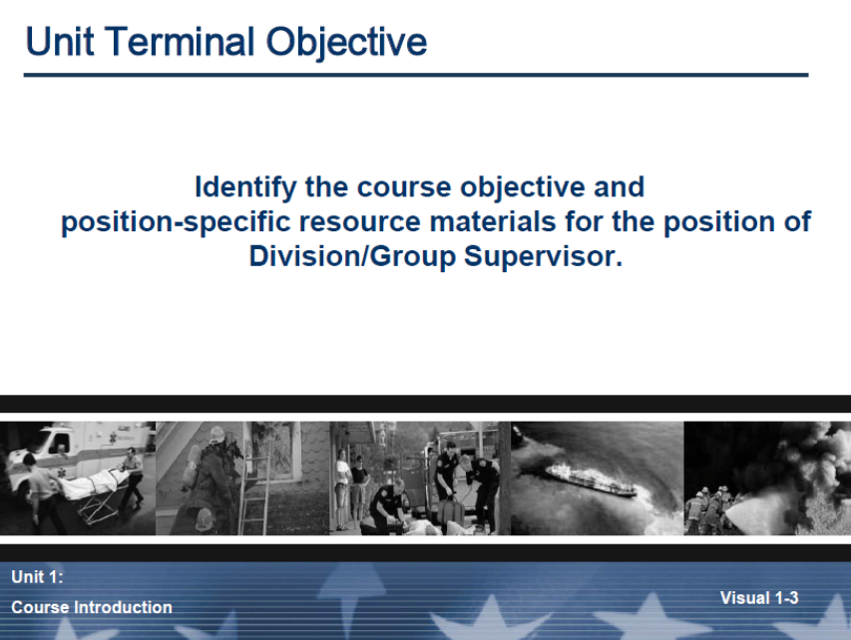
Unit Objectives
Introduce the instructors and students.
Discuss course logistics.
Provide a course overview.
Discuss course expectations.
Identify course reference material.
Discuss position responsibilities.
Notes:
Needs to match IG

Slide 6
Student Questions
DIVISION/GROUP SUPERVISOR
I have completed Task Book(s) and requisite training as a Strike Team Leader or Task Force Leader and have had multiple assignments in those positions.
I’ve had All Hazard training and/or experience as an Operations Section Chief or Division Supervisor(DIVS) but have never had the DIVS course in the past.
I have had little formal training leading to Strike Team/Task Force leader, but have been performing as ST/TF or DIVS on All Hazard or Wildfire assignments.
I have had I300 & I400 training, and most of my ICS incident/event assignments have been as Single Resource Boss or Single Resource.
Unit 0 – Introduction
Slide 0-6

Slide 7
Student Introductions
Please present:
Your name.
Where you work (agency, station, etc.)
What brought you to this training? eg: membership on a Team, building Home Unit capability, etc.
Your experience with incident management and what ICS positions you have worked in.
Your Expectations in attending this course.

Slide 8
Operational Period Briefing / Division Breakout Briefing Agenda
Current Situation
Objectives
Predictive Information
Assignments
Safety
Logistics
Finance
Planning
Information
Liaison
Agency Reps / Agency Administrator
Close Out

Slide 9
Course Objective
At the successful completion of this course the student will be able to demonstrate an understanding of the duties required of a division/group supervisor in preparation for completing the position task book.

Slide 10
Some Course Caveats
You are in for a unique experience
This is the 5th time RBIM LLC is offering this combined curriculum of FEMA L960 / NWCG S339 & no one else is doing it this way. (past courses NYWIMA-(2012 / 2014 / 2016, Massachusetts Fire Academy 2017)
Blend of Wildland Fire & All Hazard first responders and mangers = huge opportunity for networking and sharing

Slide 11
Some Course Caveats – With the Good Comes the Challenge
You have two Student Reference Manuals (FEMA AH/NWCG)…some presentations will follow strictly along with one SRG. Some will reference both manuals simultaneously.
Both FEMA AH & NWCG curriculums have the same core training competencies but their units vary where these training elements appear.
NWCG is better in some units / FEMA AH is better in some units.

Slide 12
Curriculum Crosswalk Chart
The “Crosswalk” Handout describes how these 2 courses were blended.
The FEMA L960 was based on NWCG S339.
The “core competency's” in both curriculum are identical; they just appear in different order of presentation.

Slide 13
Some Course Caveats – With the Good Comes the Challenge
You can whine all you want…but….
Bottom line is that being a DIVS is a front line management job that requires some serious “multi-tasking” capabilities.
As a DIVS you will have to face far more complex challenges than having two Student Reference Guides and slide presentations that don’t marry exactly with either.

Slide 14
Lead Instructor Advice…
The class agenda General Message indicates which units are straight from one curriculum or the other and which are combined. You can:
  Stick with one SRG and just take notes in it
  Take notes in both SRG’s depending on the Unit
  Forget about the SRG’s entirely for note taking. Absorb mentally and just take notes on paper for future transcription to a field notebook (concept: you create a pocket notebook that has these notes about your DIVS duties that you carry on DIVS assignments).

Slide 15
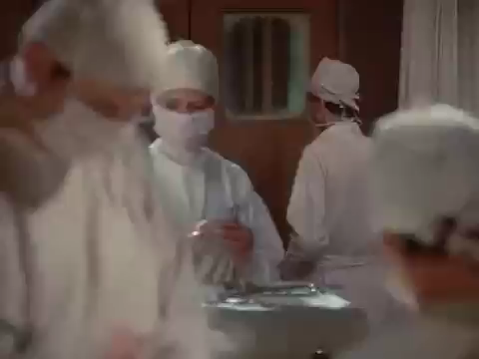
Lead Instructor Advice…

Slide 16
Evaluating Student Performance
-Students must achieve 70% or higher on the final examination in order to receive credit for attending the course.
-We will give you both final exams if you desire. It is your option.
-NWCG test in 2015 revision took out “the smoke” - it is more aligned with FEMA test on leadership and management than tactics (Lead Instructor Advice-if you pass one you can pass both)
-The Tests/course Certificates only mean you passed either or both of these courses. Passing this course doesn’t make you “Qualified” in the DIVS position. The Certificate only “certifies” you passed the Course.

Slide 17
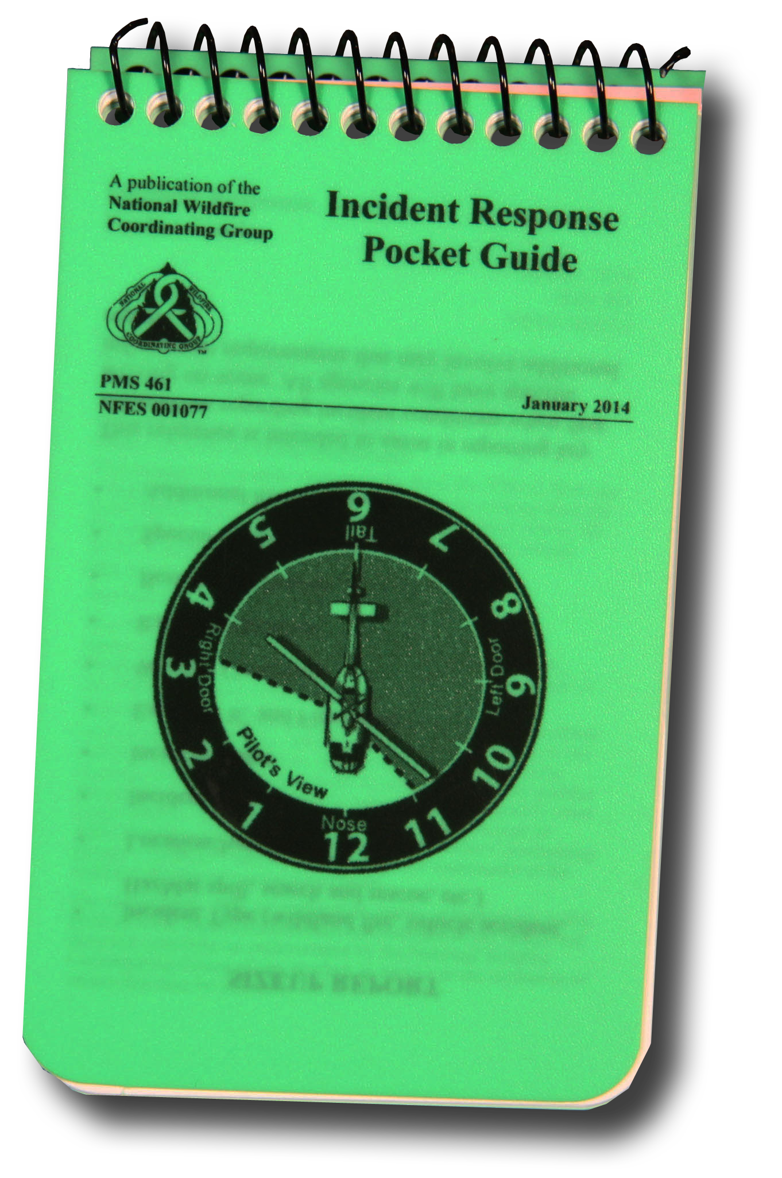
Course
Materials
Notes:
Add new covers for these

Slide 18
ALL HAZARD PRE-TEST REVIEW

Slide 19
Position Task Book
In the current performance based system, trainees must complete the tasking in the PTB to become qualified as a DIVS. The PTB can only be initiated by the home unit, not at this course.

Slide 20
Exercise

Slide 21
Any Questions?

