Slide 1

Unit 6:
Planning Process

Slide 2
Unit Objectives (1 of 3)
  Identify the importance of planning for incidents/events.
  Explain the differences between planning for incidents and events.
  Discuss major planning steps including logistical concerns, cost-benefit analysis, understanding the situation, developing and implementing the plan, and evaluating the plan.
  Explain the criteria for determining when the Incident Action Plan (IAP) should be prepared in writing.

Slide 3
Unit Objectives (2 of 3)
  Describe the role and use of ICS forms and supporting materials included in an IAP for effective incident/event management.
  Describe the strategy meeting, tactics meeting, planning meeting, operational period briefing, and team meeting.
  Given a scenario, describe appropriate strategies and tactics to meet incident objectives.
  Conduct a tactics meeting and complete an ICS 215, Operational Planning Worksheet, and ICS 215A, Incident Action Plan Safety Analysis, using the strategies and tactics from the scenario.

Slide 4
Unit Objectives (3 of 3)
  Describe how ICS 215A is used with ICS 215 to mitigate hazards in tactical operations.
  Recognize agency-specific aviation policies and procedures as they relate to safety.
  Participate in a planning meeting using the planning process and develop a written IAP for an incident/event using the appropriate ICS forms and supporting materials.
  Using the IAP, conduct an operational period briefing.

Slide 5
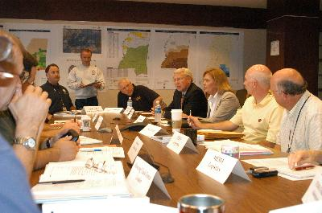
Benefits of the Planning Process
What are
the benefits of the incident planning process?

Slide 6
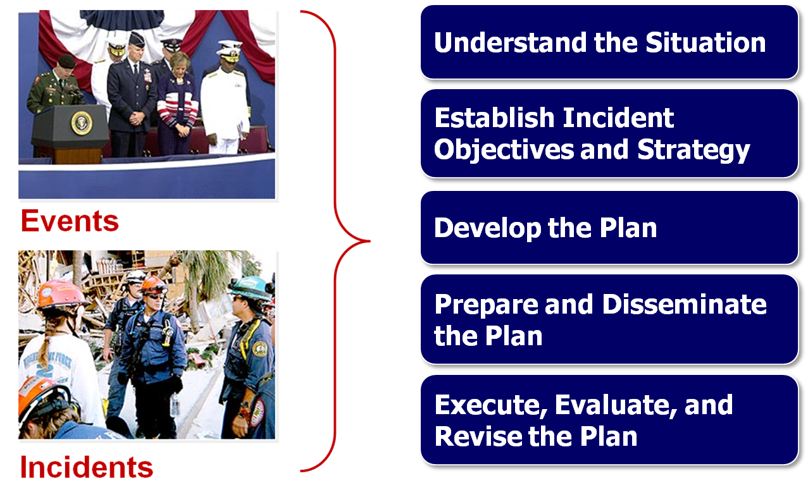
ICS Planning Process

Slide 7
Written IAP Considered
What are the situations when you would consider developing a written Incident Action Plan?

Slide 8
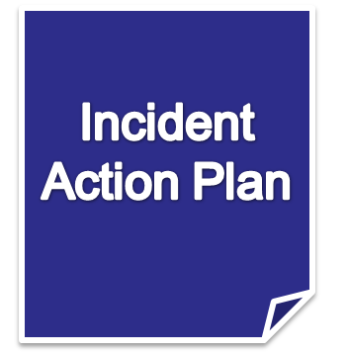
When a Written IAP Is Considered
  Two or more jurisdictions are involved in the response.
  The incident continues into the next operational period.
  A number of ICS organizational elements are activated (typically when General Staff Sections are staffed).
  It is required by agency policy.
  It is a hazmat incident.

Slide 9
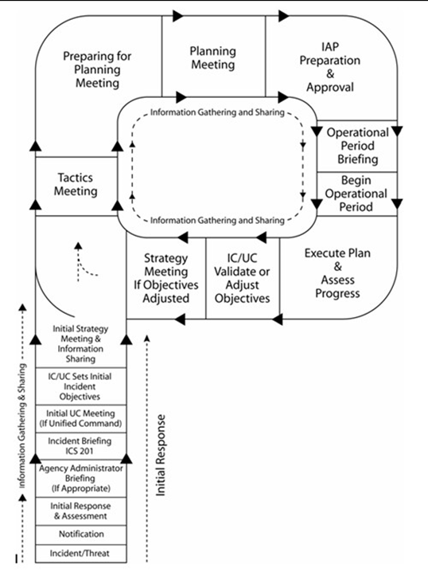
What’s an Operational Period?
  The designated time period in which tactical objectives are to be accomplished and reevaluated.
  Length depends on:
    Nature of incident
    Complexity

Slide 10
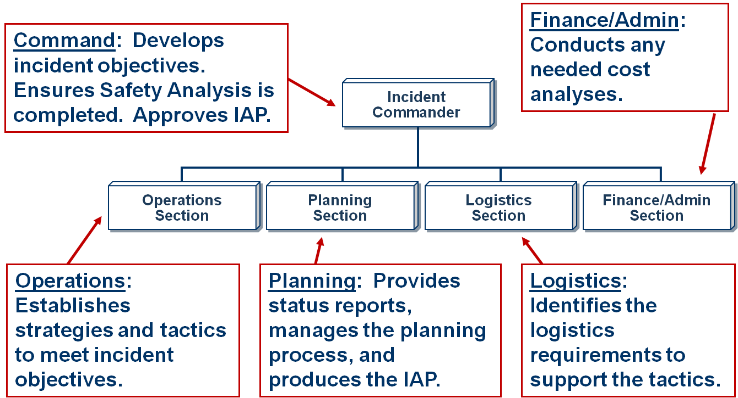
Who Does What?

Slide 11
The Start of Each Planning Cycle
Planning for each operational period begins with the Incident Commander or Unified Command developing/ updating incident objectives.
Objectives are based on the continued assessment of the situation and the progress made.

Slide 12
Assessing Current Objectives
  Is the incident stable, or is it increasing in size and complexity?
  What are the current incident objectives, strategy, and tactics?
    Are there any safety issues?
    Are the objectives effective? Is a change of course needed?
    How long will it be until the objectives are completed?
  What is the current status of resources? Are resources in good condition? Are there sufficient resources?

Slide 13
The Tactics Meeting: Overview
  Purpose
  Preparation
  Who Attends
  Who Leads

Slide 14
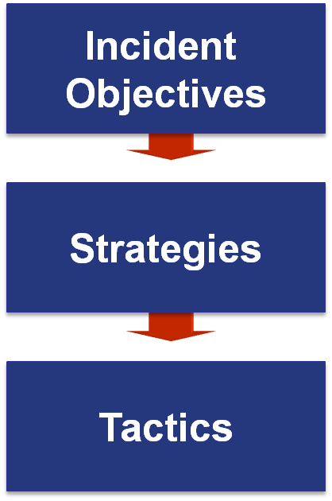
Objectives, Strategies, and Tactics
State what will be accomplished.
Establish the general plan or direction for accomplishing the incident objectives.
Specify how the strategies will be executed.

Slide 15
Developing Appropriate Strategy
  Generate a list of alternative strategies.
  Select the strategy that:
    Is within acceptable safety norms.
    Makes good sense (is feasible, practical, and suitable).
    Is cost effective.
    Is consistent with sound environmental practices.
    Meets political considerations.

Slide 16
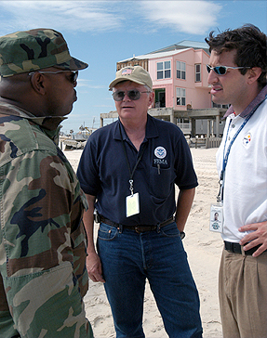
Executing Tactical Direction
  Establish Tactics: Describe what must be done.
  Assign Resources: Determine and assign the kind and type of resources needed for the selected tactics.
  Monitor Performance: Determine if the tactics and resources selected for the various strategies are both valid and adequate.

Slide 17
Sample Strategy and Tactics
Objective: Reduce reservoir level to 35 feet by 0800 on 2/10.
Strategy #1: Reduce/divert inflow.
Strategy #2: Release water from spillways.
Selected Strategy: Pump water from reservoir.
Tactics: Use truck-mounted pumps working from the road into spillway, and portable pumps on the east side discharging into Murkey Creek.
Resources: 5 crews with (3) 1,500-gpm truck-mounted pumps &
(2) 500-gpm portable pumps

Slide 18
Logistics Support Factors
Why must personnel
and logistical support factors be considered in determining tactical operations?

Slide 19
Cost-Benefit Analysis
What are some factors that you consider when assessing the costs and benefits of proposed tactical assignments?

Slide 20
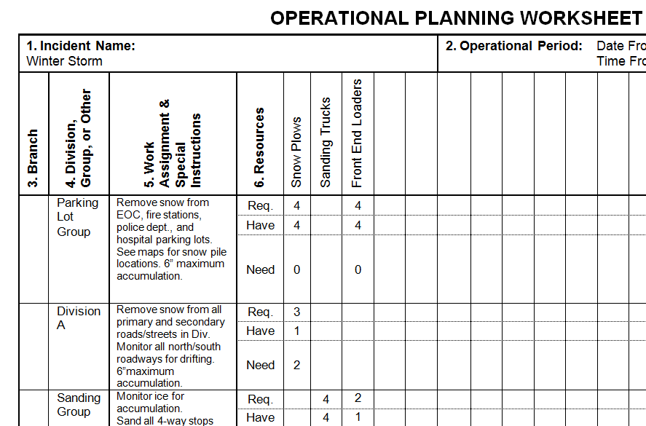
Tactics Meeting Documentation
Operational Planning Worksheet,
ICS Form 215

Slide 21
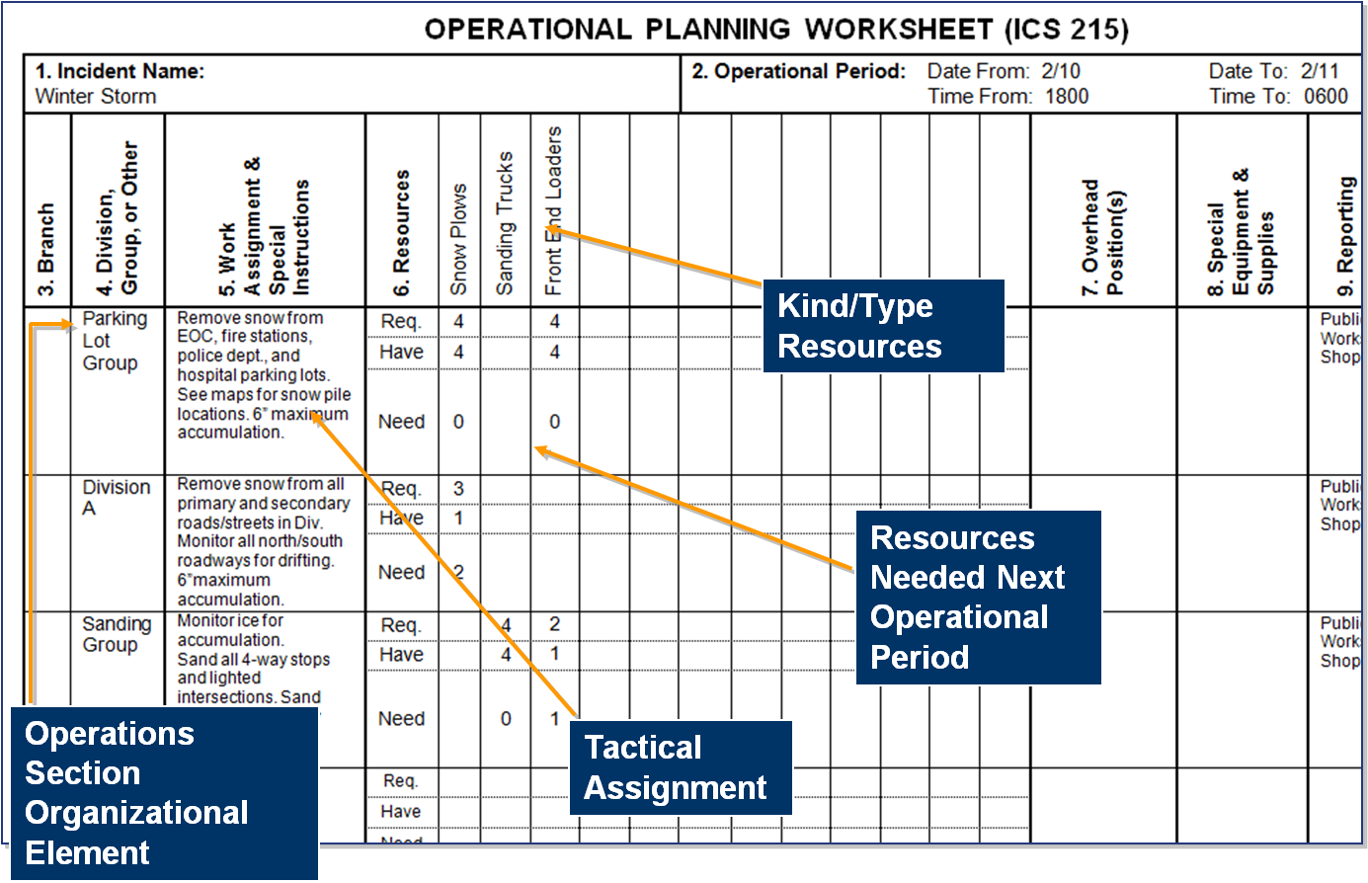

Slide 22
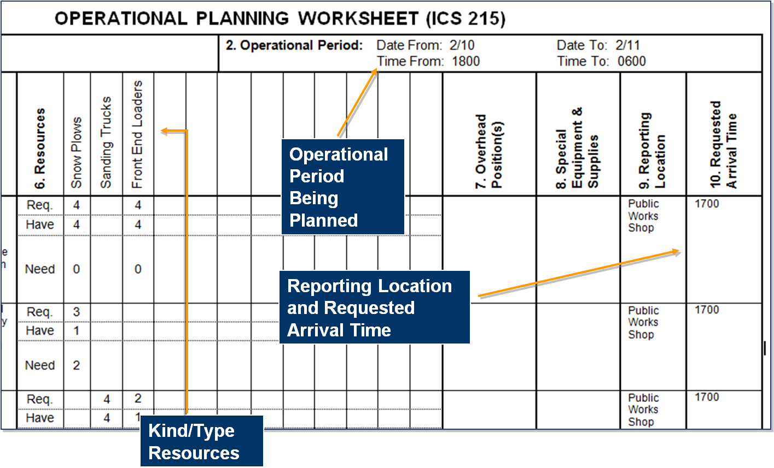

Slide 23
Preparing for the Planning Meeting
  Analyze the ICS 215 developed in the tactics meeting.
  Finalize the Incident Action Plan Safety Analysis (ICS 215A) completed by the Safety Officer.
  Assess current operations effectiveness and resource efficiency.
  Gather information to support incident management decisions.

Slide 24

Incident Safety
Incident management must ensure the safety of:
  Responders to the incident.
  Persons injured or threatened by the incident.
  Volunteers assisting at the incident.
  News media and the general public who are on scene observing the incident.

Slide 25
Aviation Safety
Does your agency have aviation safety policies and procedures?

Slide 26
Incident Safety Analysis
The Incident Safety Analysis is used to:
  Identify, prioritize, and mitigate the hazards and risks of each incident work location by operational period.
  Identify hazardous tactics so that alternatives may be considered.
  Determine the safety implications for the types of resources required.

Slide 27
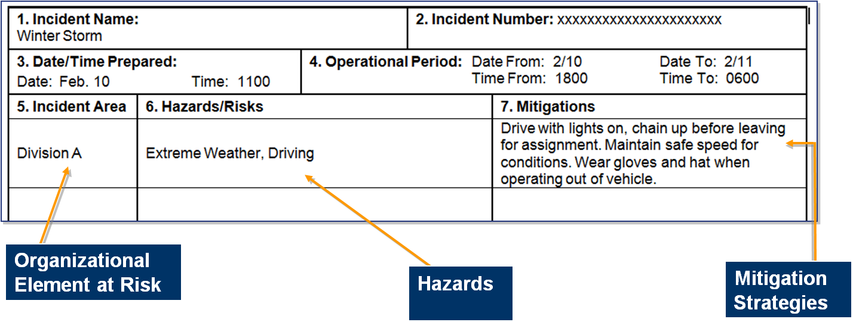
ICS Form 215A, Incident Action Plan Safety Analysis
The Safety Officer and Operations Section Chief complete the Safety Analysis using ICS 215A for . . .

Slide 28
The Planning Meeting
  Purposes: Review/validate the operational plan; identify resource requirements
  Who Attends: Command and General Staffs, other incident management personnel, Agency Administrator, and cooperating/assisting agency personnel
  Who Leads: Planning Section Chief

Slide 29
Planning Meeting Activities | Responsibility
Give situation & resources briefing; conduct planning meeting | Planning Section Chief
State incident objectives & policy issues | Incident Commander
State primary & alternative strategies to meet objectives | Operations Section Chief; Planning/Logistics Section Chiefs contribute
Specify reporting locations & additional facilities needed | Operations Section Chief; Logistics Section Chief assists
Develop the resources, support, & overhead orders | Planning/Logistics Section Chiefs; Logistics Section Chief places orders
Consider additional support requirements needed because of communications, traffic, safety, medical, etc. | Logistics Section Chief; Operations and Planning Section Chiefs and Safety Officer contribute
Finalize, approve, & implement the IAP | Planning Section Chief finalizes IAP; Incident Commander approves IAP; General Staff implements IAP

Slide 30
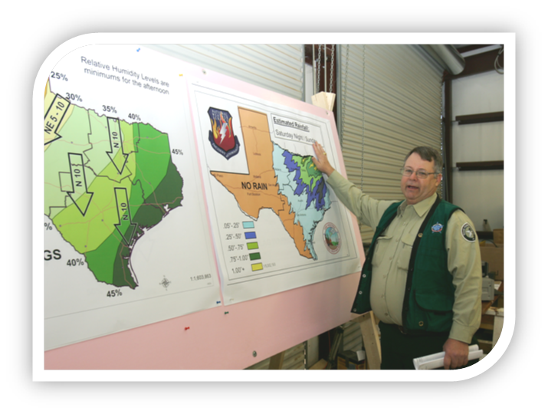
Planning Meeting Displays
Incident Objectives
Maps
ICS Form 215
Agenda
ICS Form 215A

Slide 31
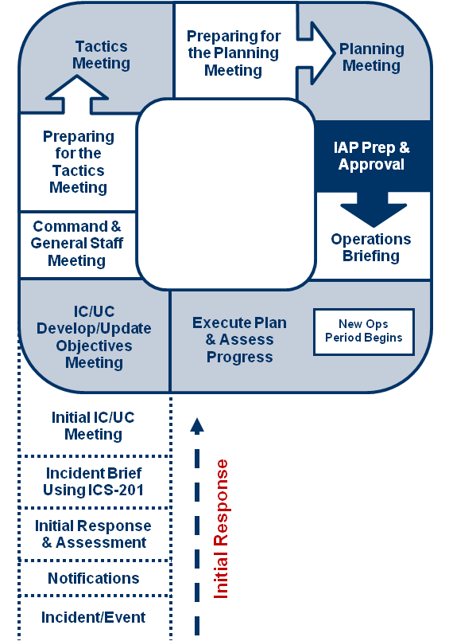
IAP Preparation and Approval
  Following the planning meeting:
  Organizational elements prepare IAP assignments and submit them to the Planning Section.
  Planning Section collates, prepares, and duplicates the IAP document for the operational period briefing.
  Resources Unit coordinates with the Logistics Section to acquire the amount and type of resources.
  Incident Commander approves the IAP.

Slide 32
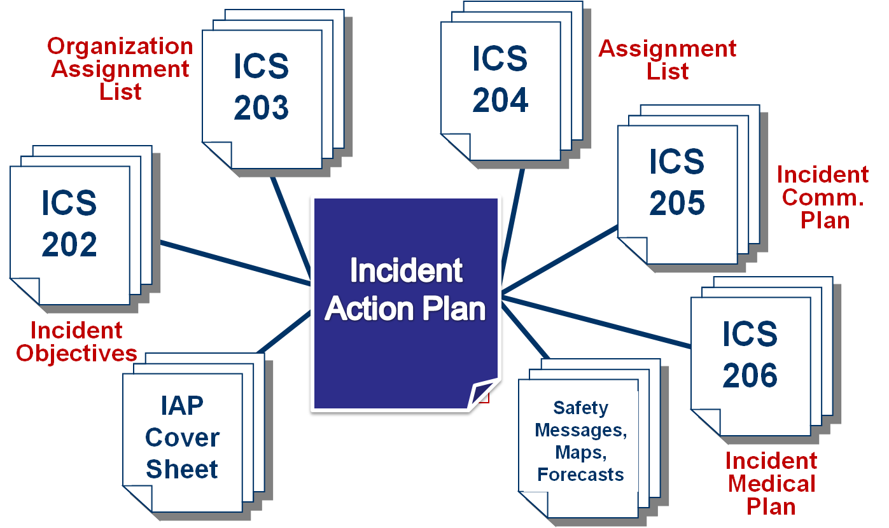
Forms and Supporting Documents: Overview

Slide 33
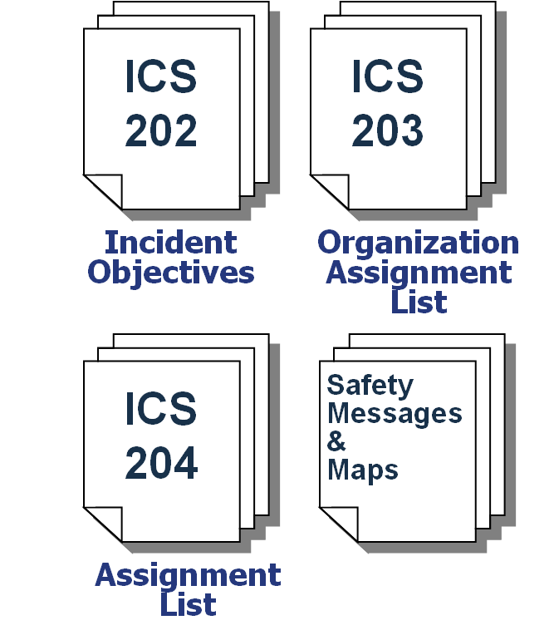
Are All Forms Used?
The Incident Commander determines which ICS forms and attachments are included in the IAP.
For less complex incidents, the Incident Commander may only require the Incident Objectives (ICS 202), Organization Assignment List (ICS 203), Assignment List (ICS 204), a Safety Message, and a map of the incident area.

Slide 34
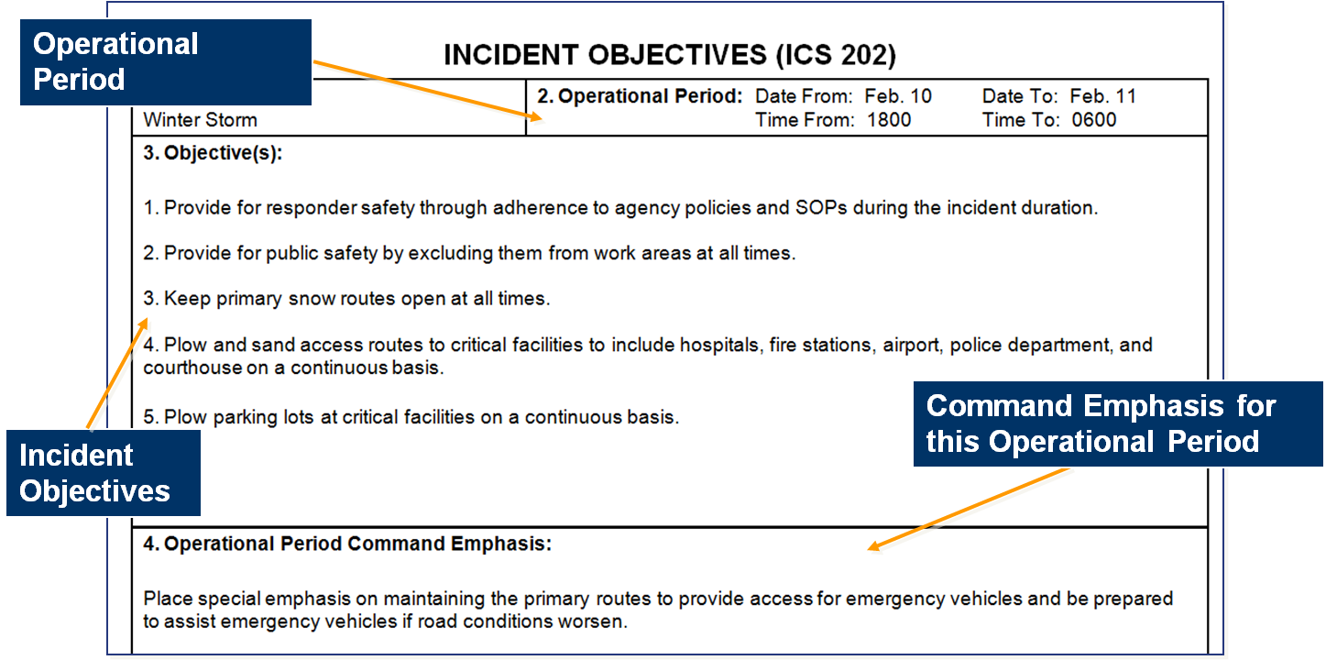
ICS Form 202, Incident Objectives (1 of 2)

Slide 35
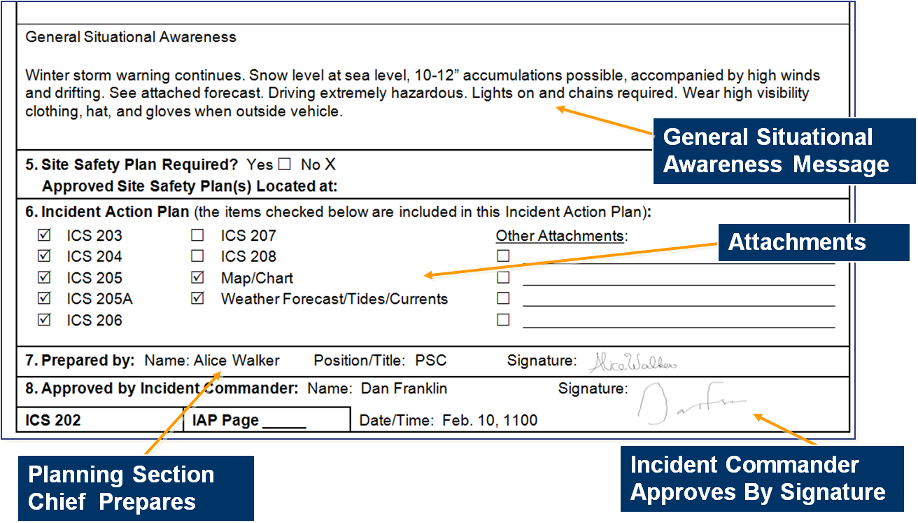
ICS Form 202, Incident Objectives (2 of 2)

Slide 36
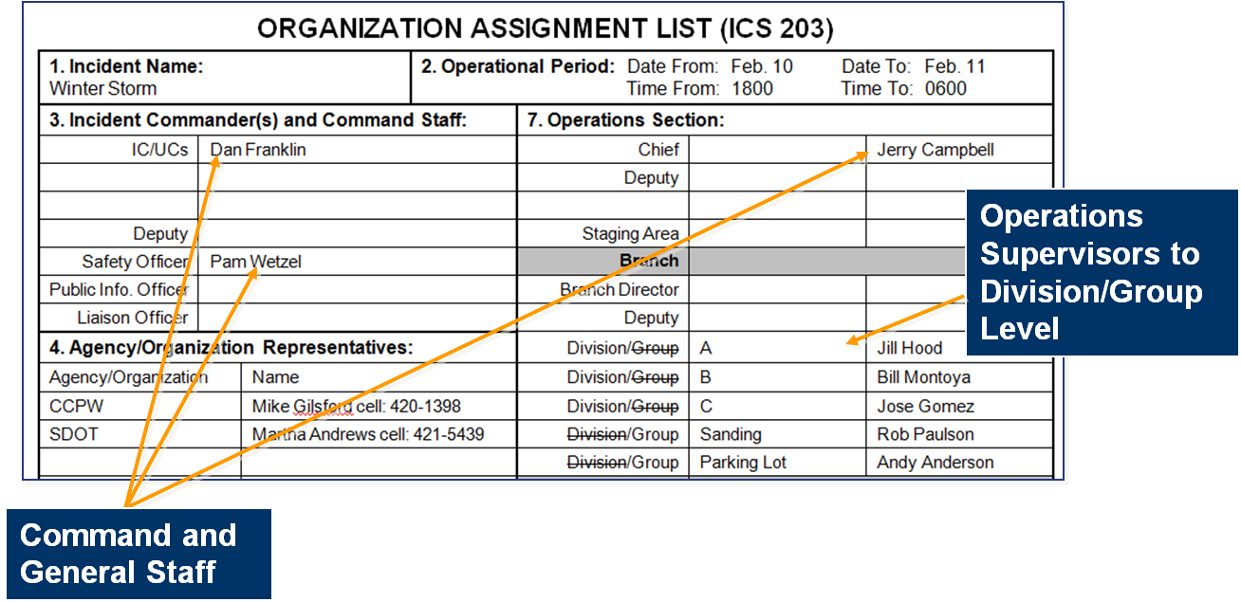
ICS Form 203, Organization Assignment List
ICS Form 203 provides a full accounting of incident management and supervisory staff for the operational period:

Slide 37
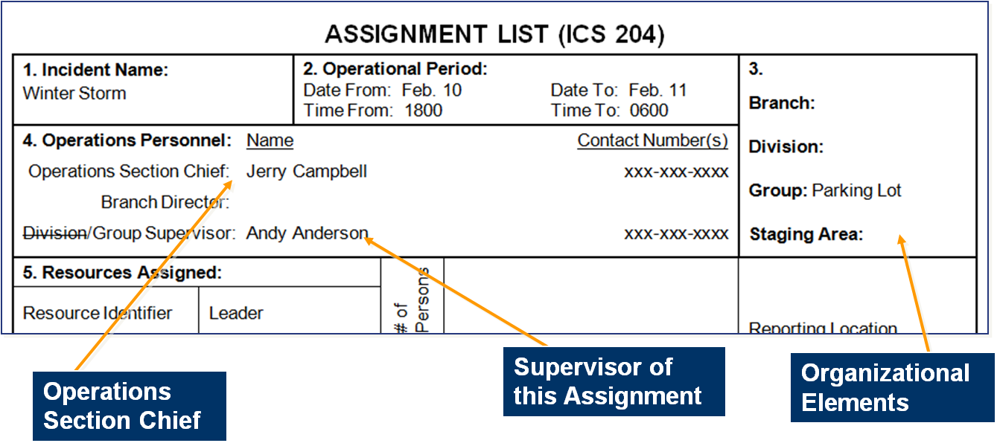
ICS Form 204, Assignment List (1 of 4)
ICS Form 204 specifies the Operations Section structure for the operational period:

Slide 38
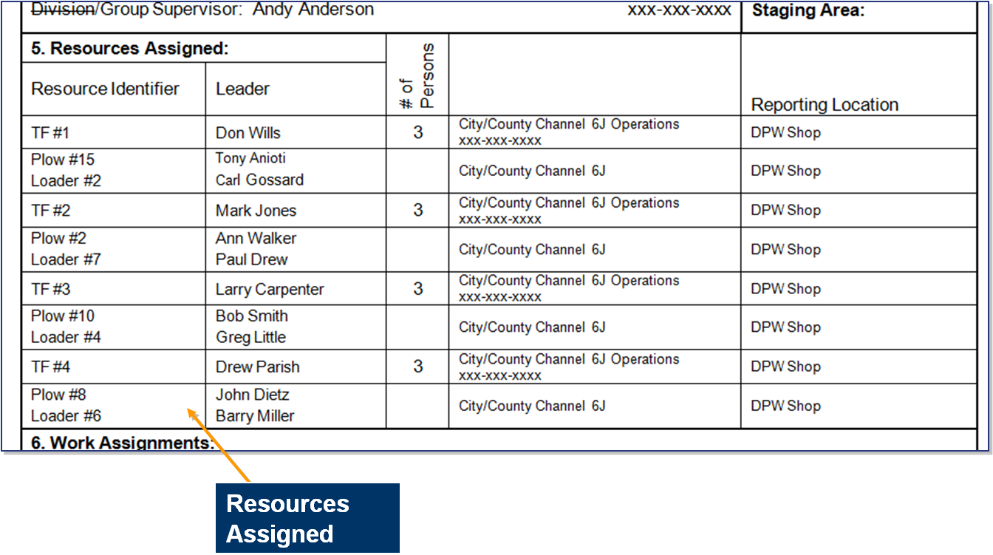
ICS Form 204, Assignment List (2 of 4)

Slide 39
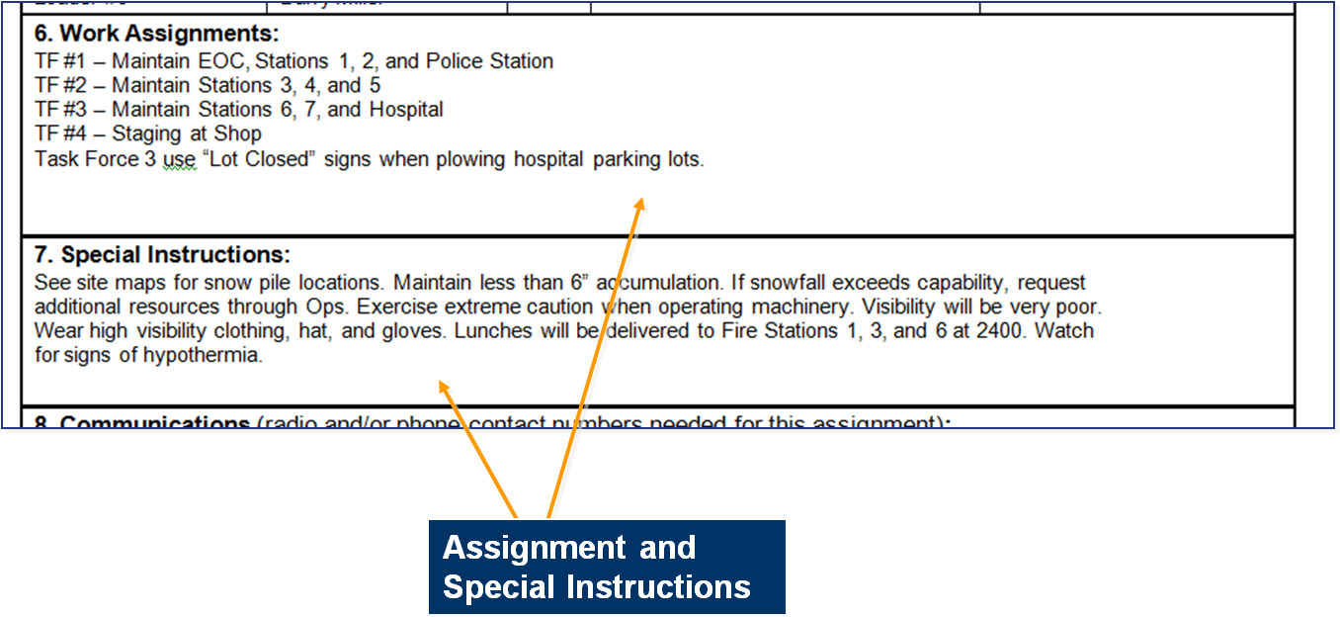
ICS Form 204, Assignment List (3 of 4)

Slide 40
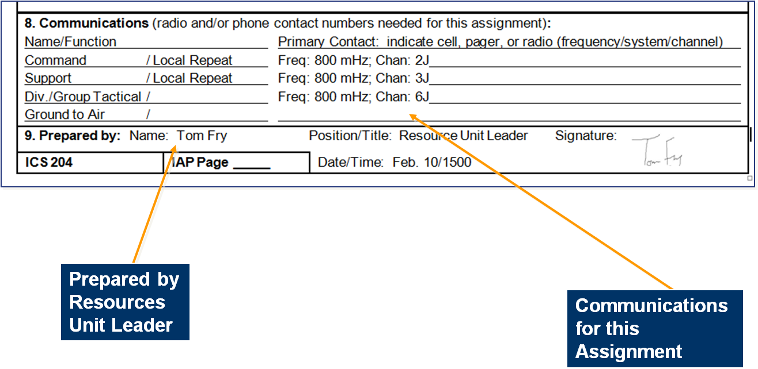
ICS Form 204, Assignment List (4 of 4)

Slide 41
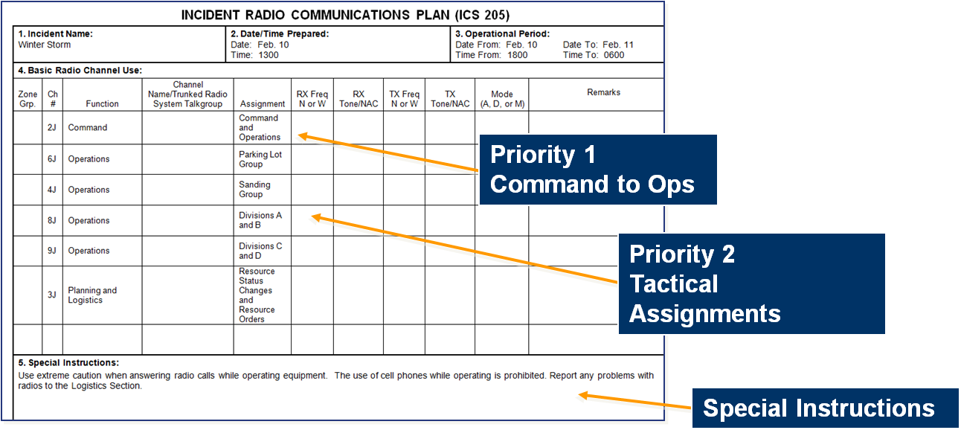
ICS Form 205, Incident Communications Plan
ICS Form 205 presents the communications plan for the entire incident:

Slide 42
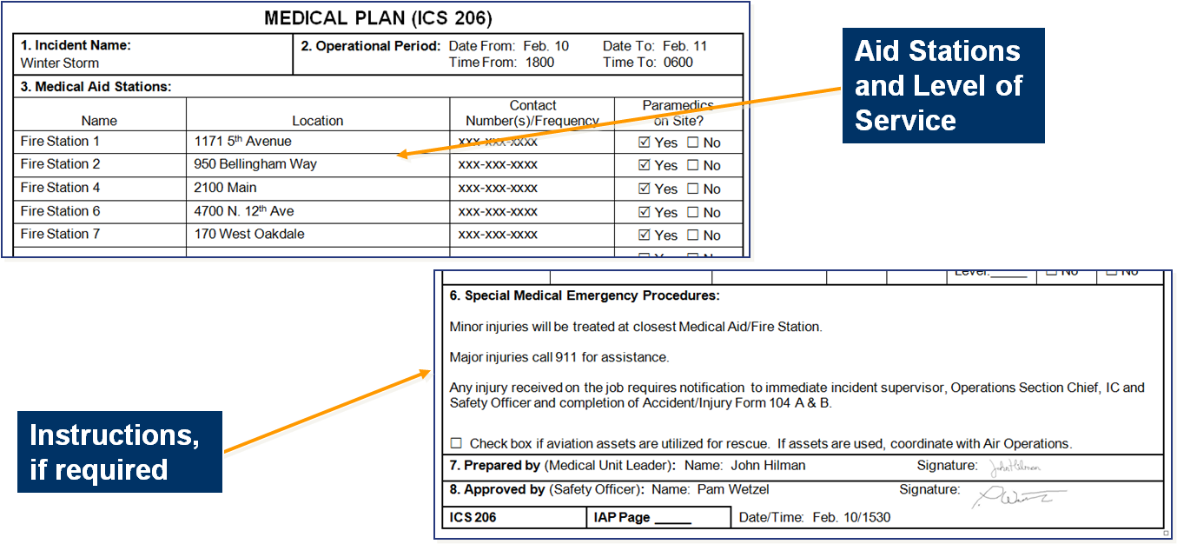
ICS Form 206, Medical Plan
ICS Form 206, describes the medical care to be provided in case of responder medical emergencies:

Slide 43
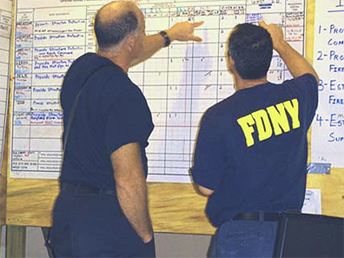

Additional Supporting Documents
  Safety messages
  Detailed weather forecasts
  Incident traffic plan
  Other important information for operational supervisors

Slide 44
Activity: Analyzing an IAP
Instructions:
  The purpose of this activity is to help you prepare for developing an IAP. Working as a team, review the sample Incident Action Plan in your Student Manual.
Complete the following steps:
  Independently read the sample IAP for a cruise ship accident. Make notes about the format and contents. Use the information presented in this unit to help you critique the plan.
  As a team, discuss the strengths and weaknesses of the sample plan.
  On chart paper, record your comments on the strengths and weaknesses of the plan.
  3. Select a spokesperson and be prepared to present your work in
  30 minutes.

Slide 45
Operations Briefing
The operations briefing:
  Is conducted at the beginning of each operational period.
  Presents the IAP to supervisors of tactical resources.
  Should be concise.

Slide 46
Sample Operations Briefing Agenda (1 of 2)
Agenda Item | Who
Introduction and Welcome | Planning Section Chief
Review of Incident Objectives | Incident Commander
Review of Current Incident/ Objective Status | Operations Section Chief Technical Specialists (as necessary)
Incident Boundaries, Branch/Division Locations, and Group Assignments | Operations Section Chief

Slide 47
Sample Operations Briefing Agenda (2 of 2)
Agenda Item | Who
Review of Division/Group Assignments (ICS 204) | Operations Section Chief
Review of Safety Issues, Safety Message | Safety Officer
Logistics (Communications and Medical Plans) | Logistics Section Chief (Communications Unit Leader/Medical Unit Leader)
Closing Remarks | Incident Commander
Conclusion | Planning Section Chief

Slide 48
Executing and Assessing the Plan
  Supervisors conduct team briefings with their assigned resources in order to implement operational assignments.
  Operations Section Chief assesses the IAP implementation, incident objectives, strategies, and tactics prior to the next operational period.

Slide 49
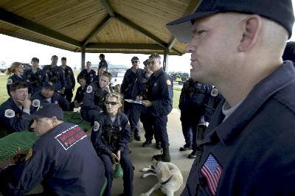
Other Types of Meetings
  Strategy Meetings
  Team Meetings
  Section Meetings
  Team Closeout
  Public Meetings
  Special Planning Meetings
  Transition Meetings

Slide 50

Applied Activity
Follow instructions . . .
  Presented by instructors.
  Outlined on handouts.

Slide 51
Summary (1 of 3)
  Are you now able to:
  Identify the importance of planning for incidents/events?
  Explain the differences between planning for incidents and events?
  Discuss major planning steps including logistical concerns, cost-benefit analysis, understanding the situation, developing and implementing the plan, and evaluating the plan?
  Explain the criteria for determining when the Incident Action Plan (IAP) should be prepared in writing?

Slide 52
Summary (2 of 3)
  Are you now able to:
  Describe the role and use of ICS forms and supporting materials included in an IAP for effective incident/event management?
  Describe the strategy meeting, tactics meeting, planning meeting, operational period briefing, and team meeting?
  Given a scenario, describe appropriate strategies and tactics to meet incident objectives?
  Conduct a tactics meeting and complete an ICS 215, Operational Planning Worksheet, and ICS 215A, Incident Action Plan Safety Analysis, using the strategies and tactics from the scenario?

Slide 53
Summary (3 of 3)
  Are you now able to:
  Describe how ICS 215A is used with ICS 215 to mitigate hazards in tactical operations?
  Recognize agency-specific aviation policies and procedures as they relate to safety?
  Participate in a planning meeting using the planning process and develop a written IAP for an incident/event using the appropriate ICS forms and supporting materials?
  Using the IAP, conduct an operational period briefing?

