Slide 1
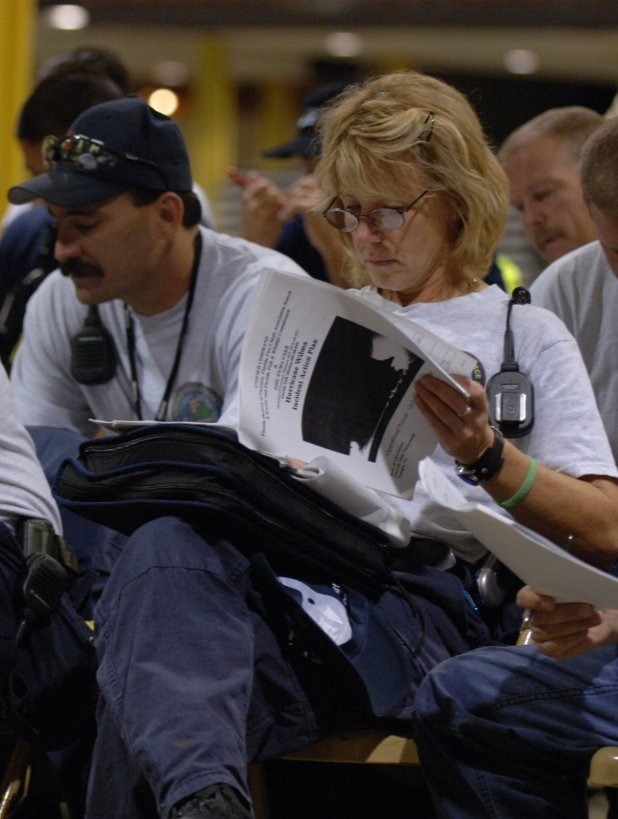
Unit 5:
Incident Resource Management

Slide 2
Unit Objectives (1 of 2)
  Identify and describe basic principles of resource management.
  Identify the basic steps involved in managing incident resources.
  Identify key considerations associated with resource management and the reasons for each.
  Describe how ICS Form 215, Operational Planning Worksheet, is used to manage incident or event resources.

Slide 3
Unit Objectives (2 of 2)
  Identify the organizational elements at the incident that can order resources.
  Describe the differences between single-point and multipoint resource ordering and the reasons for each.

Slide 4
NIMS Resource Management Principles
  Planning: Preparedness organizations should work together before an incident to develop plans for managing and using resources.
  Use of Agreements: Mutual aid agreements should be established for resource sharing.
  Categorizing Resources: Resources should be categorized by size, capacity, capability, skill, or other characteristics to make resource ordering and dispatch more efficient.
  Resource Identification and Ordering: Standard processes and methods to identify, order, mobilize, dispatch, and track resources should be used.
  Effective Management of Resources: Validated practices should be used to perform key resource management tasks.

Slide 5
Resource Management Practices
  Safety: Resource actions at all levels of the organization must be conducted in a safe manner.
  Personnel Accountability: All resources will be fully accounted for at all times.
  Managerial Control: Performance and adequacy of the current Incident Action Plan must be assessed and adjusted continually. Direction is always through the chain of command.
  Adequate Reserves: Adequate reserves must be maintained to meet anticipated demands.
  Cost: Objectives must be achieved through cost-effective strategy selection, and selection of the right kind, type, and quantity of resources.

Slide 6
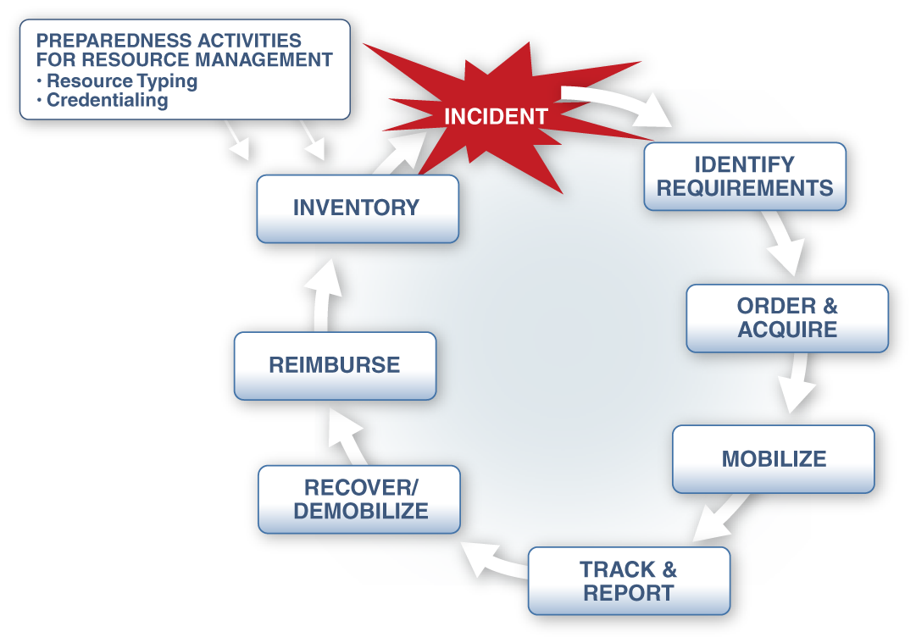
Incident Resource Management Process

Slide 7
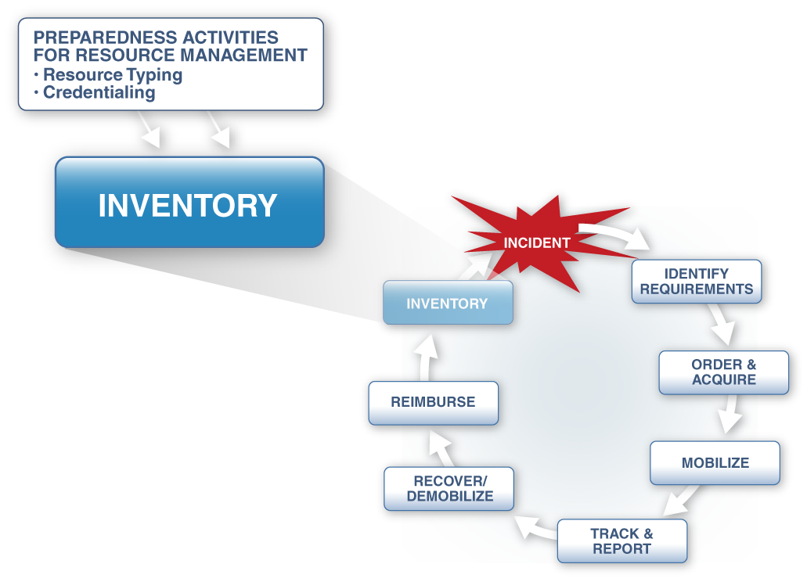
Inventory

Slide 8
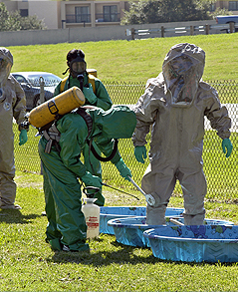
Credentialing
  An objective evaluation of a person’s qualifications to meet nationally accepted minimum standards.
  A separate process from badging, which takes place at an incident scene.

Slide 9
Review: Resource Typing
To ensure that responders get the right personnel and equipment, ICS resources are categorized by:
  Kinds of Resources: Describe what the resource is (for example: medic, firefighter, Planning Section Chief, helicopters, ambulances, combustible gas indicators, bulldozers).
  Types of Resources: Describe the size, capability, and staffing qualifications of a specific kind of resource.

Slide 10
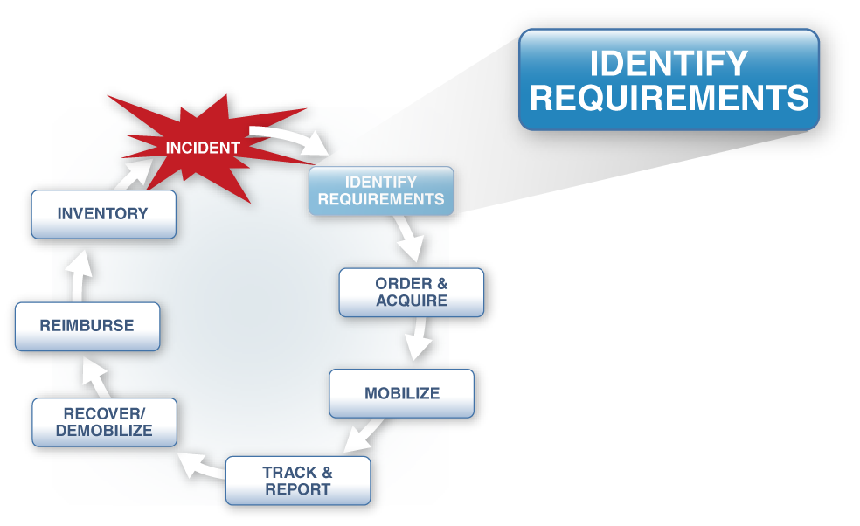
Identify Requirements

Slide 11
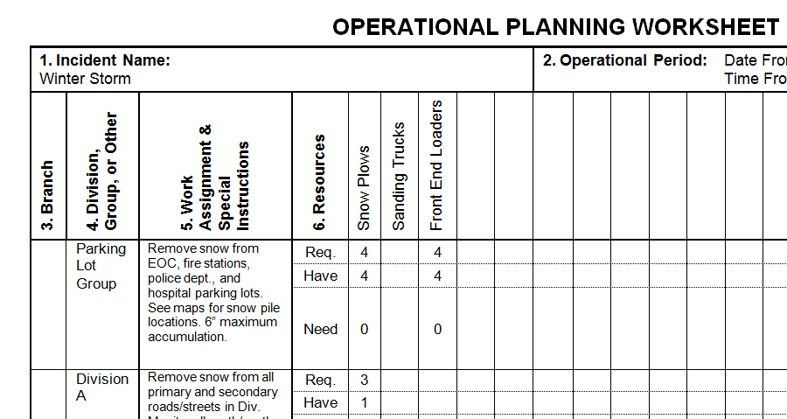
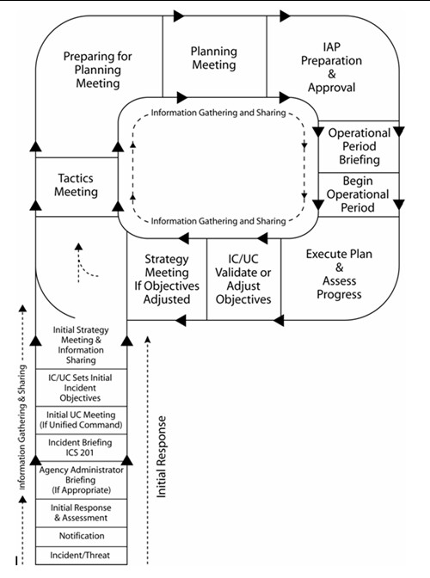
Identifying Requirements: Tactics Meeting
The Operational Planning Worksheet (ICS Form 215) identifies the resources needed to achieve the incident objectives and tactics.

Slide 12
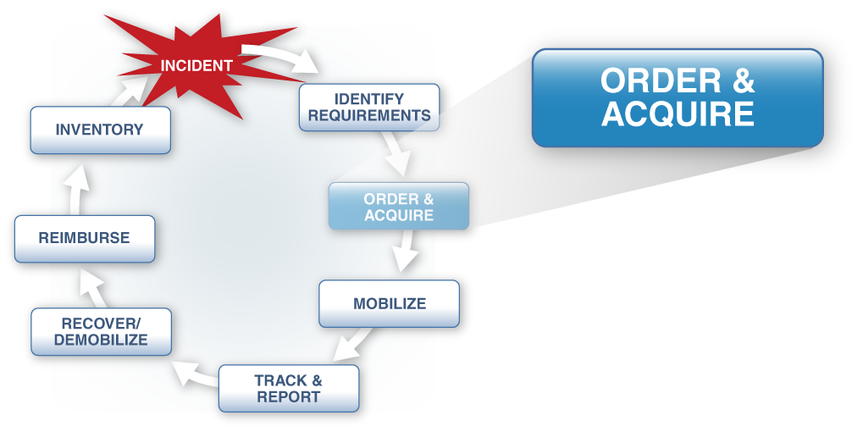
Order and Acquire

Slide 13
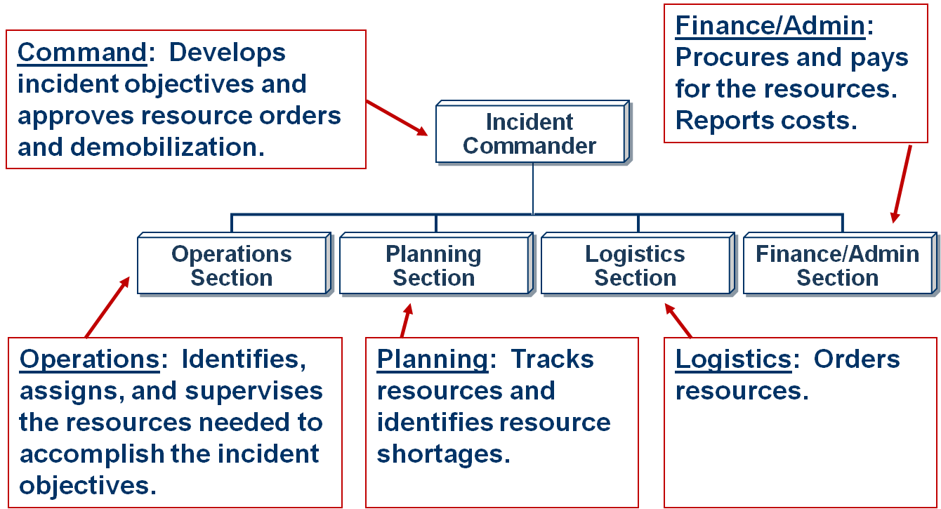
Who Does What?

Slide 14


Authority To Order Resources
  Approving Orders: The Incident Commander approves all resource orders.
  Placing Orders: The Incident Commander, Logistics Section Chief, and Supply Unit Leader are authorized to place orders.

Slide 15

Resource Ordering: Small Incidents
On smaller incidents, where only one jurisdiction or agency is primarily involved, the resource order is typically:
  Prepared at the incident,
  Approved by the Incident Commander, and
  Transmitted from the incident to the jurisdiction or agency ordering point.
Incident Site

Slide 16
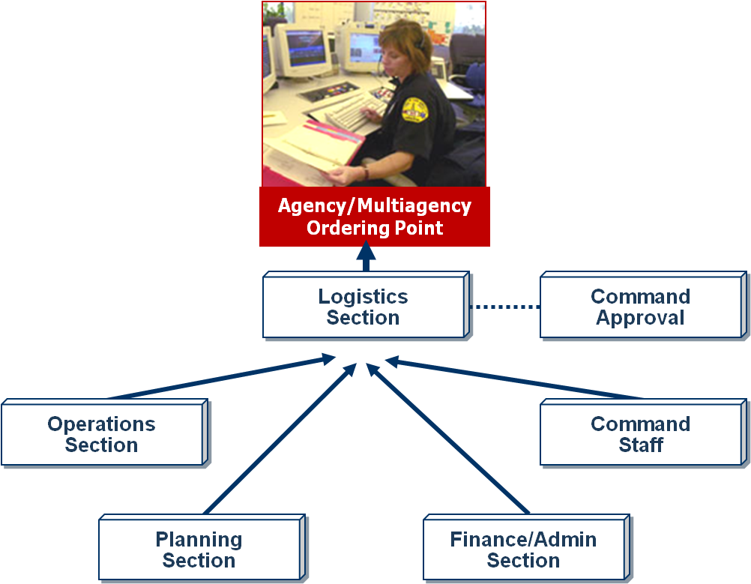
Single-Point Ordering
In single-point ordering,
the burden of finding the requested resources is placed on the responsible ordering point and not on the incident organization.

Slide 17
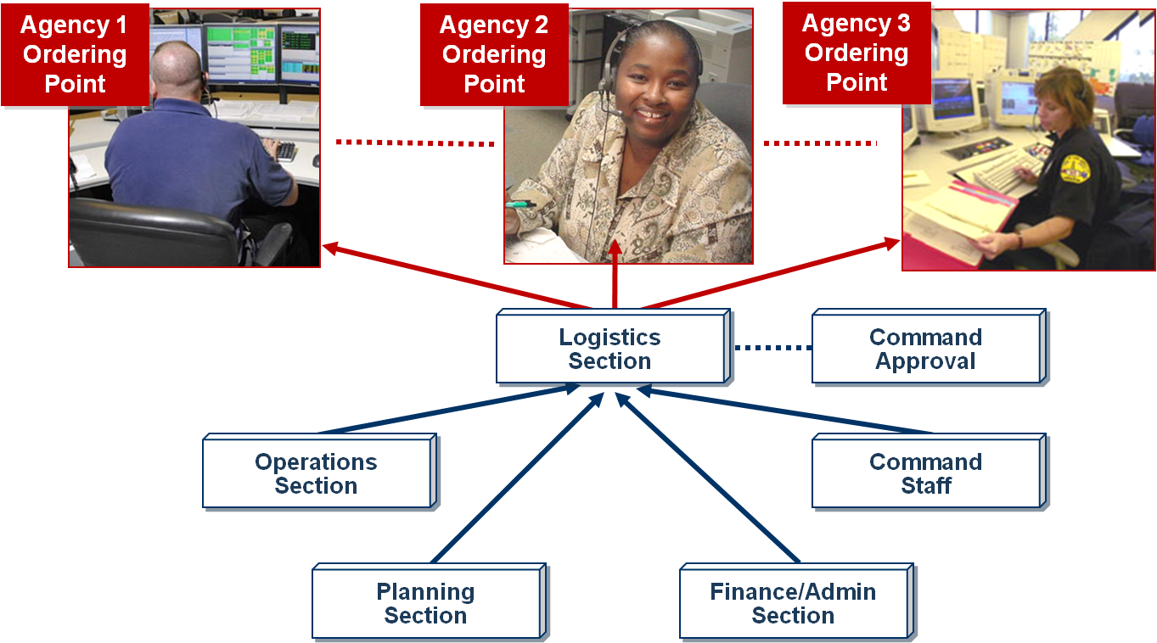
Multipoint Ordering

Slide 18
Review: Single-Point vs. Multipoint Ordering
What are the advantages of single-point ordering?
Under what circumstances would you use multipoint ordering?

Slide 19

Resource Orders: Information Elements (1 of 2)
  Incident name
  Order and/or request number (if known or assigned)
  Date and time of order
  Quantity, kind, and type
  Special support needs
  (as appropriate)

Slide 20

Resource Orders: Information Elements (2 of 2)
  Reporting location (specific)
  Requested time of delivery
  (specific, immediate vs. planned, not ASAP)
  Radio frequency to be used
  Person/title placing request
  Callback phone number
  or radio designation

Slide 21
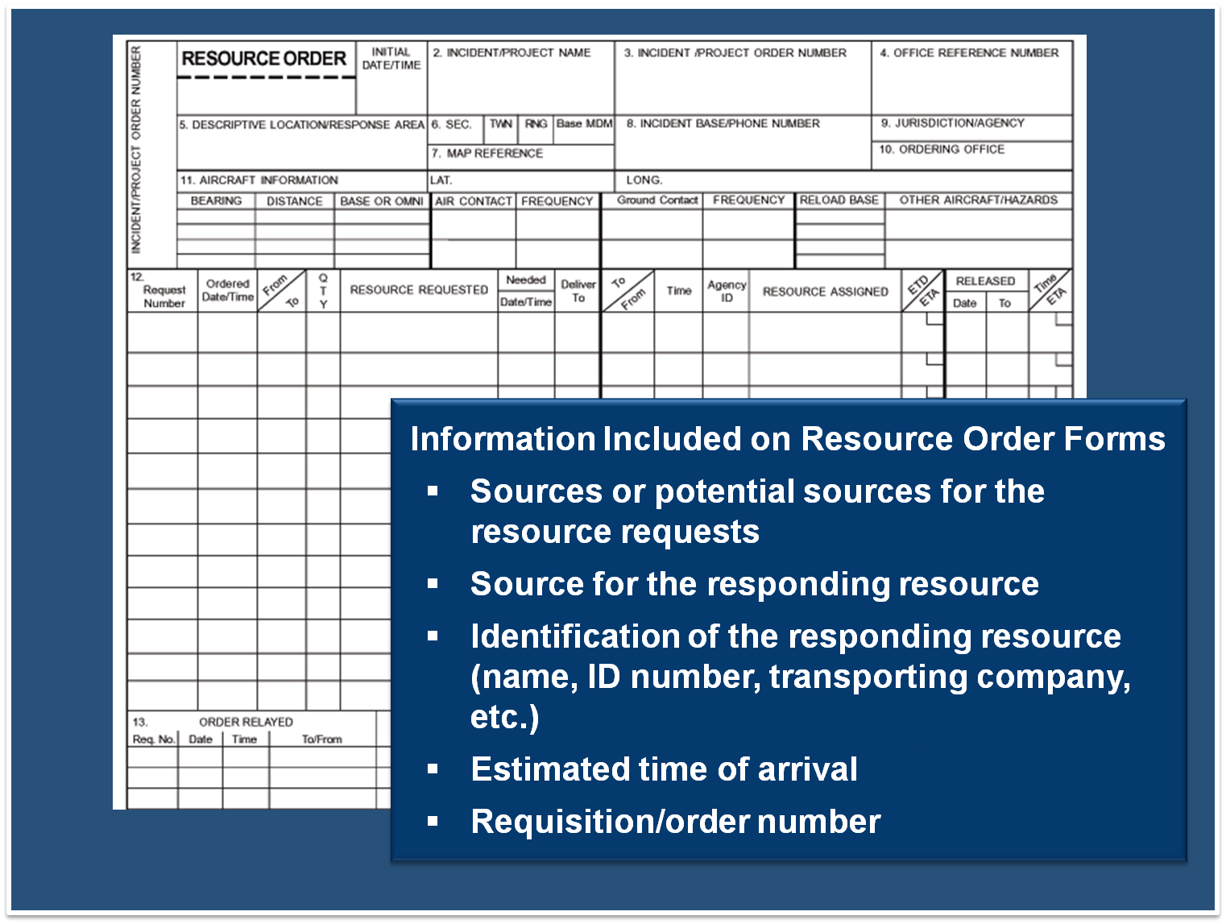

Slide 22
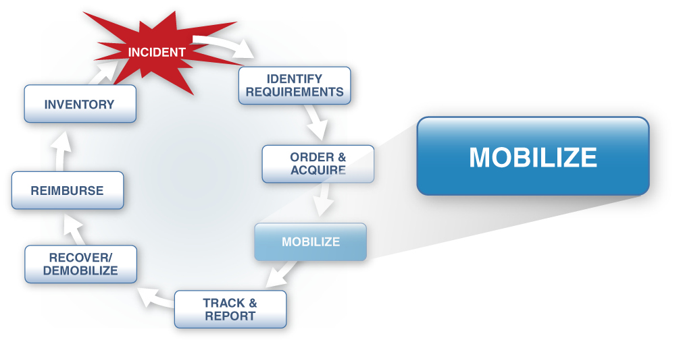
Mobilize

Slide 23
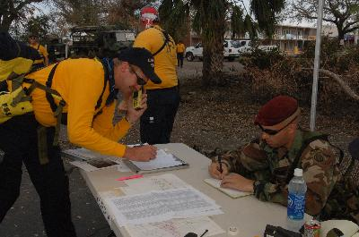
Check-In Process (1 of 2)
Where and how do you check in to an incident?

Slide 24
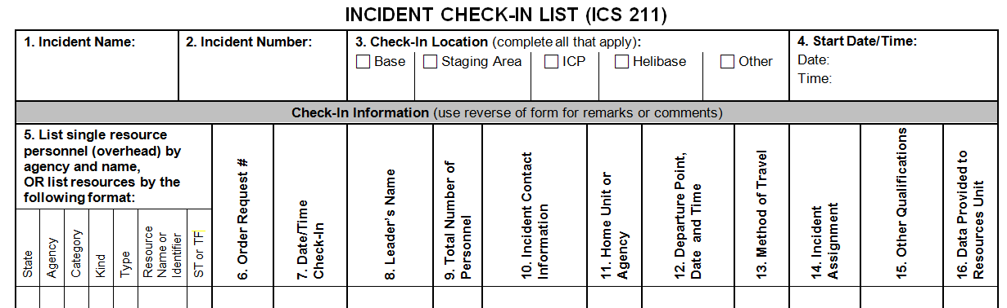
Check-In Process (2 of 2)
  ICS Form 211, Check-In List, is used to document the check-in process.
  Check-in recorders report check-in information to the Resources Unit.

Slide 25
Check-In Information
The following check-in information is used for tracking, resource assignment, and financial purposes:
Date and time of
check-in
Name of the resource
Home unit or agency
Departure point, date,
and time
Order request number
Crew Leader name and number of personnel
Other qualifications
Travel method
Incident assignment

Slide 26
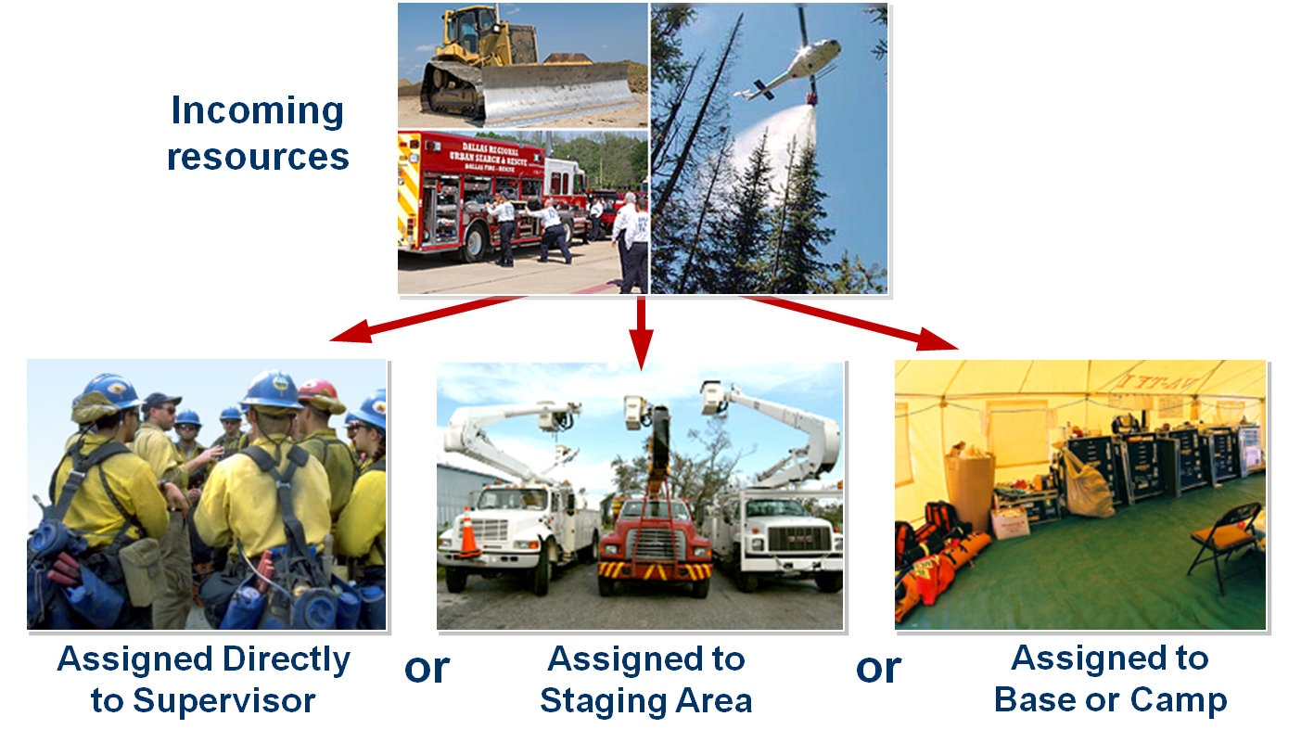
Assignment of Resources

Slide 27
Direct Assignment to Supervisor
  On fast-moving or rapidly expanding incidents, tactical resources may report immediately to Divisions or Groups.
  In direct assignments, tactical resources report in with a designated Supervisor.
  Formal check-in must take
  place when the resources
  are in the Staging Areas
  or are out-of-service.

Slide 28
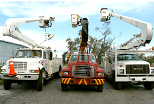
Assignment to Staging Area
Assignments to Staging Areas occur when:
  Resources are to be assigned during the current operational period.
  Resources are needed to provide a reserve force for contingencies.
  Single resources need to
  be formed into Task
  Forces and/or Strike
  Teams prior to
  assignment.

Slide 29
Staging Area Managers
The Operations Section Chief must brief the Staging Area Manager(s) about:
  Expected number, kind, and type of resources.
  Communications to be used.
  Minimum resource levels that should be maintained.
  Procedures for obtaining additional resources.
  Expected duration for use of the Staging Area.
  Procedures for obtaining logistical support.

Slide 30
Resources in Staging Areas
What are some concerns that the Operations Section Chief must be aware of if resources are in the Staging Area for long periods?

Slide 31
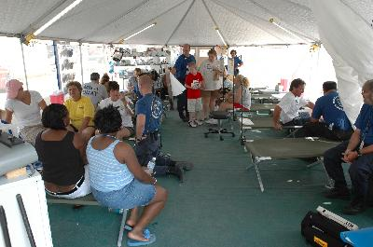
Assignment to Base or Camp
  Often done when the tactical resources are not scheduled for use during the current operational period.
  For resources that have traveled some distance, being in an out-of-service status allows briefings and a
  rest period.

Slide 32
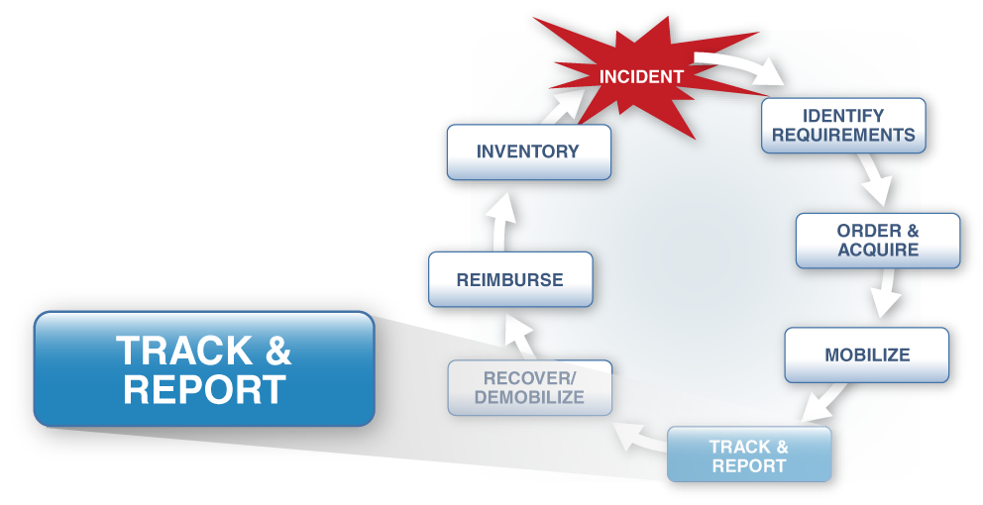
Incident Resource Management Process

Slide 33
Accounting for Responders
  As responders arrive, they must be separated from spectators, self-dispatched personnel, and victims by securing a perimeter around the incident.
  The perimeter allows the organization to:
    Establish personnel accountability.
    Control access.
    Ensure safety of the public.
    Establish a working environment for responders that is as safe and secure as possible.

Slide 34
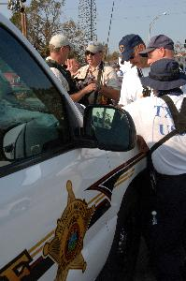
Incident Security
Incident security requires:
  Distinguishing agency personnel who have been dispatched from those who self-dispatched.
  Identifying and credentialing officially dispatched mutual aid resources.
  Establishing controlled points of access for authorized personnel.

Slide 35
Tracking Resources: Responsibilities
Resource tracking responsibilities are shared as follows:
  Planning Section is responsible for tracking all resources assigned to the incident and their status (assigned, available, out of service).
  Operations Section is responsible for tracking the movement of resources within the Operations Section itself.
  Finance/Administration Section is responsible for ensuring the cost-effectiveness of resources.

Slide 36
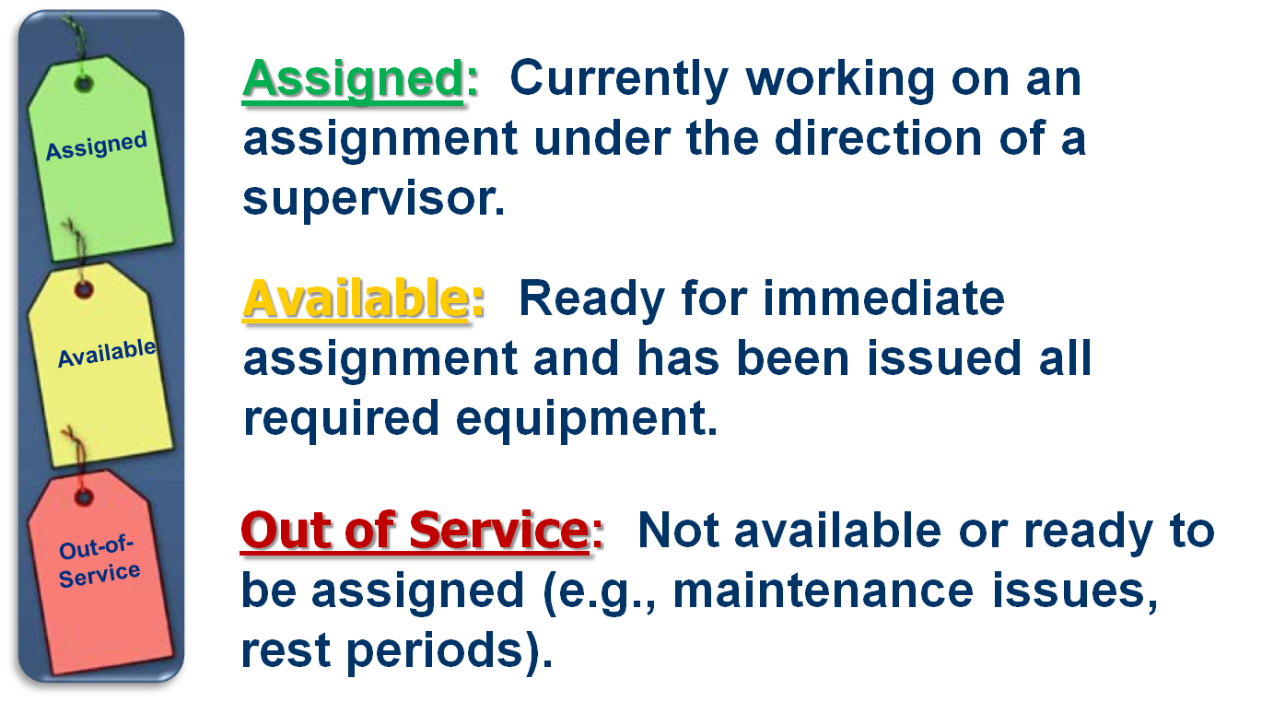
Review: Tactical Resources Status

Slide 37
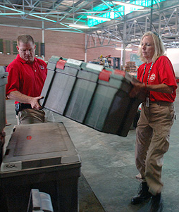
Resource Status
  Change in resource status:
  May be made by the Incident Commander, Operations Section Chief, Branch Director, or Division/Group Supervisor.
  Must be communicated to
  the Resources Unit or other appropriate element if the change lasts more than a few
  minutes.

Slide 38
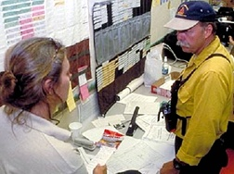
Resource Status-Keeping Systems
  Manual recordkeeping
  on ICS forms
  Card systems
  Magnetic symbols on
  maps or status boards
  Computer systems

Slide 39

Monitoring and Assessing Resources
Resource use is:
  Monitored on an ongoing basis.
  Assessed before objectives are set for the next operational period.

Slide 40

Resource Evaluation
Resources should be evaluated:
  On an ongoing basis as
  part of resource monitoring.
  At demobilization, upon the
  achievement of the assigned tactical objectives.
  During after-action reporting.

Slide 41
Management Actions & Poor Performance
Management practices may be the underlying cause of poor incident outcomes:
  Incident objectives, strategies, or tactics are unrealistic or poorly defined.
  The wrong resource was allocated for the assignment.
  There are inadequate tactical resources, logistical support, or communications.
  The resource is not trained or properly equipped for the assignment.
  Conflicting agency policies or procedures prevent the resource from carrying out the assignment.

Slide 42
Activity: Improving Performance Effectiveness
Instructions:
  Working as a team, review your assigned problem statement.
Answer the following questions:
  What is the cause of the performance problem?
  Who in the Command and General Staff need to address the problem?
  What are some strategies for preventing or solving this problem?
  Select a spokesperson and be prepared to present your work in 15 minutes.

Slide 43
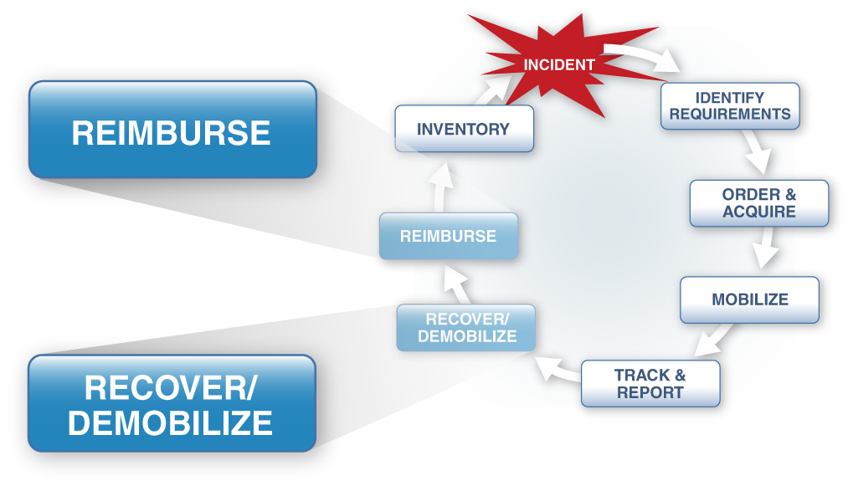
Recover, Demobilize, and Reimburse

Slide 44
Evaluating Resource Needs
  Initial incident needs exceed resources.
  Resources sufficient to control incident.
  Incident decline results in excess resources.
Resources
Incident Needs
Resources Mobilized
Time

Slide 45

Resource Demobilization
  Excess resources must be released in a timely manner to reduce costs, and to "free them up" for reassignments.
  Demobilization planning should begin almost immediately.
  Demobilization planning begins with the tactical resources assigned to the Operations Section. As tactical resources are released, support resources may also be reduced.

Slide 46

Applied Activity
Follow instructions . . .
  Presented by instructors.
  Outlined on handouts.

Slide 47
Summary (1 of 2)
Are you now able to:
  Identify and describe basic principles of resource management?
  Identify the basic steps involved in managing incident resources?
  Identify key considerations associated with resource management and the reasons for each?
  Describe how ICS Form 215, Operational Planning Worksheet, is used to manage incident or event resources?

Slide 48
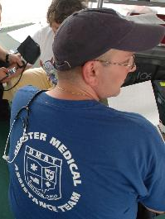
Summary (2 of 2)
Are you now able to:
  Identify the organizational elements at the incident that can order resources?
  Describe the differences between single-point and multipoint resource ordering and the reasons for each?

