Slide 1
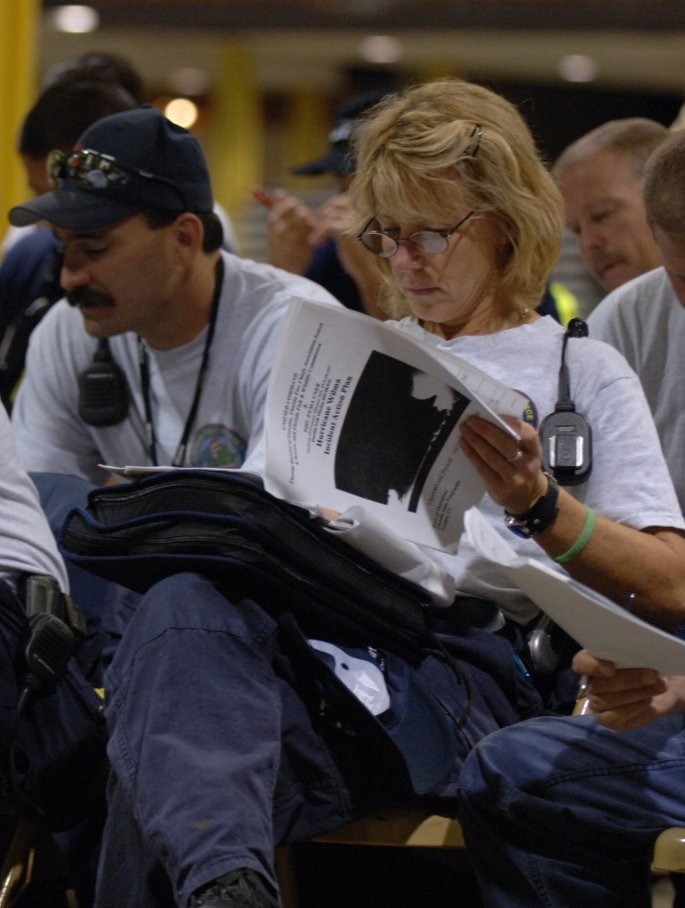
Unit 4:
Incident/Event Assessment & Agency Guidance
in Establishing Incident Objectives

Slide 2
Unit Objectives
  Describe methods and tools used to assess incident/event complexity.
  Describe types of agency(s) policies and guidelines that influence management of incident or event activities.
  Describe the process for developing incident objectives, strategies, and tactics.
  Describe the steps in transferring and assuming incident command.
  As part of an activity, develop incident objectives for a simulated incident.

Slide 3
Activity: Incidents vs. Events
Instructions:
Review the definitions below.
  Incident: An unexpected occurrence that requires immediate response actions through an ICS organization.
  Event: A scheduled nonemergency activity (sporting events, concerts, parades).
Working as a team, identify the differences and similarities between planning for incidents versus events. Record your answers on chart paper.
Choose a spokesperson and be ready to present your answers to the large group in 10 minutes.

Slide 4
Planning for Incidents
The incident planners must take into account the following factors:
  Time criticality
  Unstable, changing situation
  Potential rapid expansion of incident and response
  Incomplete communications and information
  Lack of experience managing expanding incidents

Slide 5
Planning for Events
The planners of an event should know
  Type of event
  Location, size, expected
  duration, history, and
  potential in order to project
  incident objectives
  Number of agencies
  involved
  Single or multijurisdiction
  Command Staff needs
  Kind, type, and number of
  resources required
  Projected aviation operations
  Staging Areas required
  Other facilities required
  Kind and type of logistical support needs
  Financial considerations
  Known limitations or restrictions
  Available communications

Slide 6
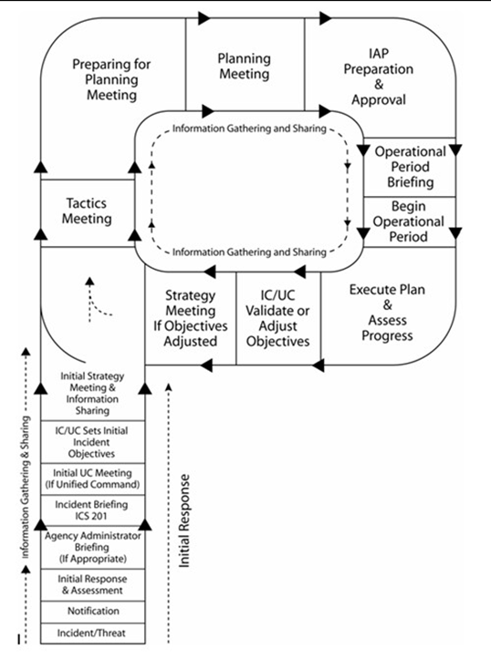
Planning “P” and Unified Command
This unit covers:
Initial response and assessment.
Incident briefing.
Setting initial objectives and strategies (during Initial UC Meeting).

Slide 7
Initial Actions
What actions must
the first responding units take to organize an incident?

Slide 8
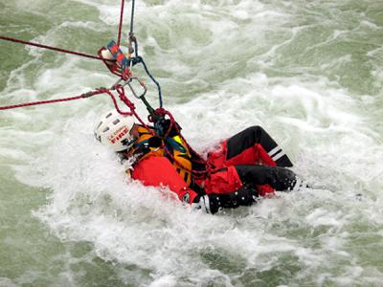
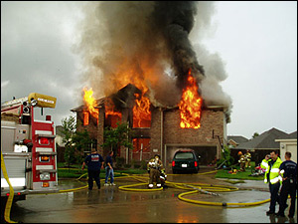
Overall Priorities
Initial decisions and
objectives are established
based on the following
priorities:
#1: Life Safety
#2: Incident Stabilization
#3: Property Conservation
Notes:
Initial decisions and objectives are established based on the following priorities:
First Priority: Life Safety
Second Priority: Incident Stabilization
Third Priority: Property Conservation
Ask the participants for examples of each type of priority. Present examples based on your experience.

Slide 9
Initial Response Actions
  Assessment and Safety
  Size up the situation.
  Determine if life is at risk.
  Ensure personnel safety.
  Identify environmental issues to address.
  Planning and Resource Management
  Assume command and establish Incident Command Post.
  Establish immediate incident objectives, strategies, and tactics.
  Determine resource needs.
  Establish initial organization that maintains span of control.

Slide 10
Initial Response: Conduct a Sizeup
The first responder to arrive must assume command and size up the situation by determining:
  Nature and magnitude of the incident
  Hazards and safety concerns
    Hazards facing response personnel and the public
    Evacuation and warnings
    Injuries and casualties
    Need to secure and isolate the area
  Initial priorities and immediate resource requirements
  Location of Incident Command Post and Staging Area(s)
  Entrance and exit routes for responders

Slide 11
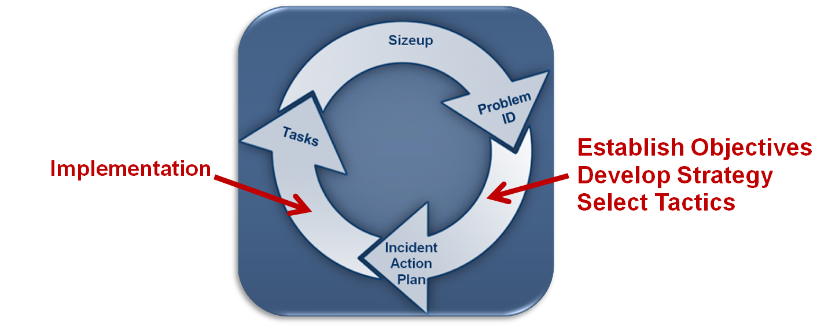
Initial Management Decisions
A thorough sizeup provides information needed to make initial management decisions.

Slide 12
Situational Awareness
Situational awareness is the perception of:
  What the incident is doing, and
  What you are doing in relation to the incident and your objectives.
Situational awareness involves the ability to predict:
  Changes in the incident, and
  Your future actions.

Slide 13
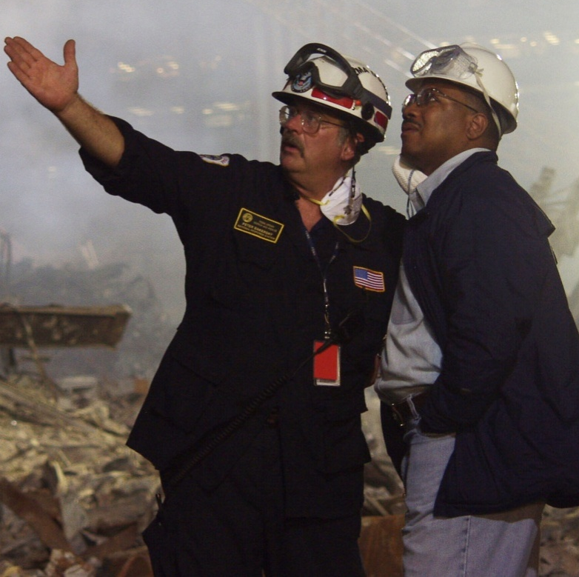
Situational Awareness Skills (1 of 2)
  Identify problems/potential problems.
  Recognize the need for action (atypical situations).
  Do NOT ignore information discrepancies; rather, analyze discrepancies before proceeding.
  Seek and provide information before acting.

Slide 14
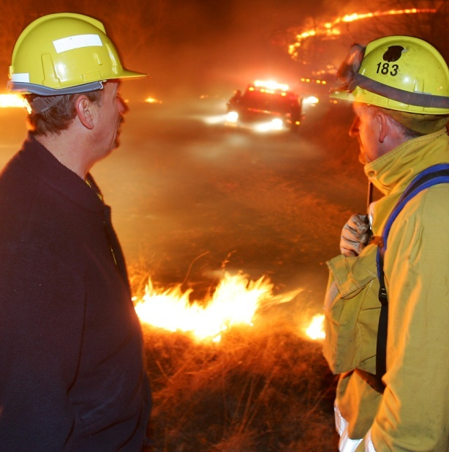
Situational Awareness Skills (2 of 2)
  Continue collecting information about the incident and assignments made.
  Assess your own task performance.
  Identify deviations from the expected.
  Communicate your situational awareness to all team members!

Slide 15
Loss of Situational Awareness
Tunnel vision is an indicator of losing situational awareness.
How might you know if you are experiencing tunnel vision?
What causes tunnel vision? How can it be avoided?

Slide 16
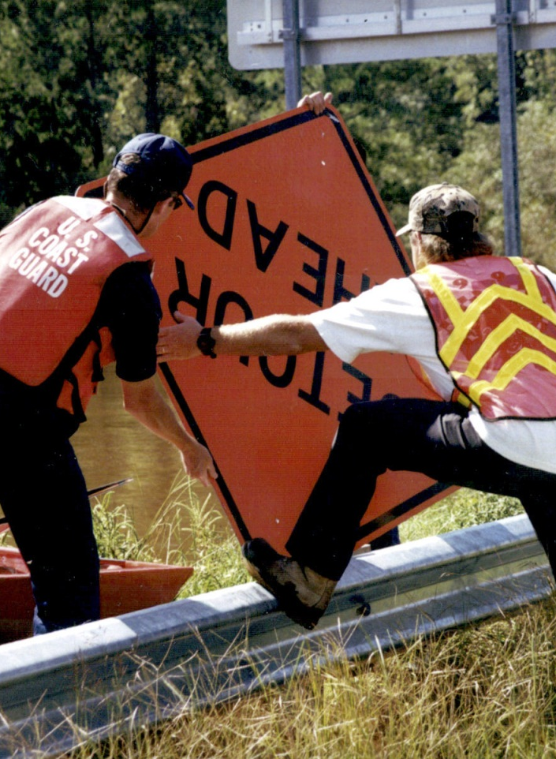
Complexity Analysis Factors (1 of 2)
  Impacts to life, property, and the economy
  Community and responder safety
  Expected duration
  Number of resources involved
  Potential hazardous materials
  Weather and other environmental influences
  Likelihood of cascading events or incidents

Slide 17
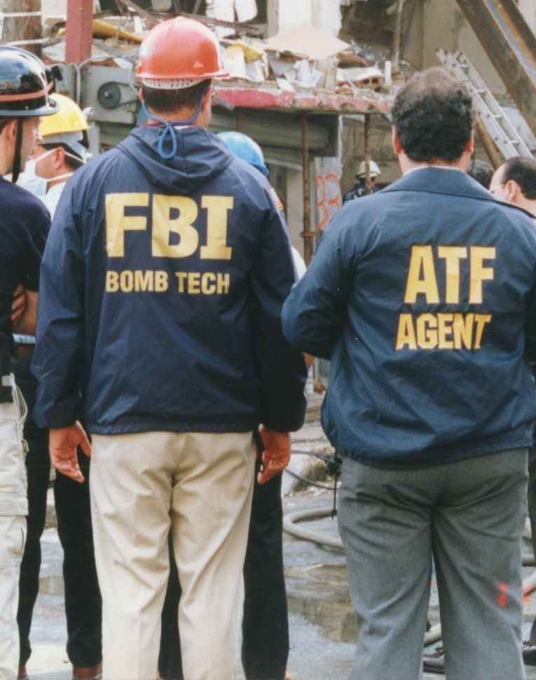
Complexity Analysis Factors (2 of 2)
  Potential crime scene (including terrorism)
  Political sensitivity, external influences, and media relations
  Area involved, jurisdictional boundaries
  Availability of resources

Slide 18
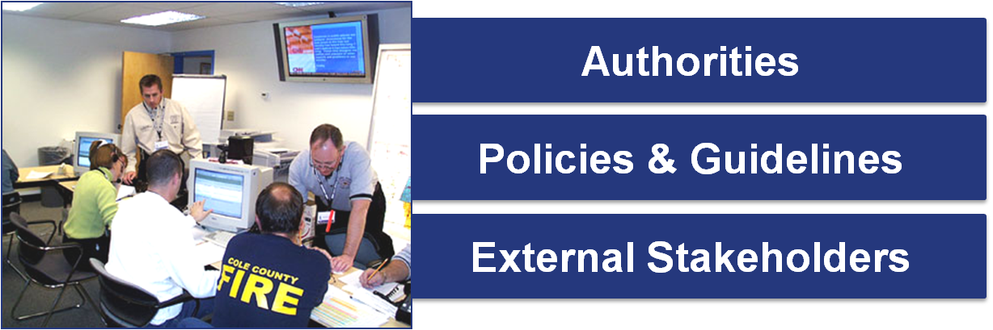
Authorities, Policies, and External Stakeholders
In addition to the information collected during the sizeup, the Incident Commander must take into account:

Slide 19
Agency Policies and Guidelines
What are some examples of agency policies and guidelines that can affect your management of an incident?

Slide 20
Policies and Guidelines: Examples
  Pre-incident plans
  Standard operating procedures
  Emergency operations plans
  Continuity of operations plans
  Community preparedness plans
  Mutual aid and assistance agreements
  Wildland Fire Situation Analysis (WFSA)
  Wildland Fire Implementation Plan (WFIP)
  Corrective action plans
  Mitigation plans
  Recovery plans
  Tribal, State, regional, and national mobilization guides
  Field operations guides
  Delegations of authority

Slide 21
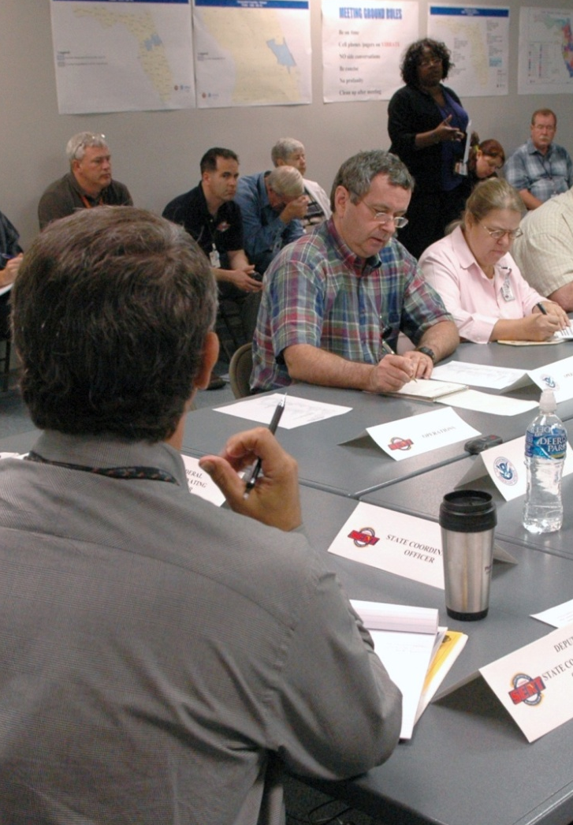
Responsibility for Developing Objectives
  On small incidents, the Incident Commander is solely responsible for developing incident objectives.
  On larger incidents, Command and General Staff contribute to the development of incident objectives.

Slide 22
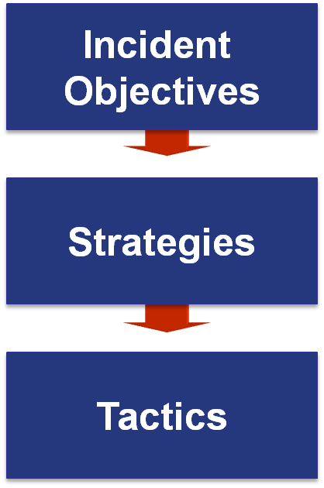
Objectives, Strategies, and Tactics
State what will be accomplished.
Establish the general plan or direction for accomplishing the incident objectives.
Specify how the strategies will be executed.

Slide 23
Writing “SMART” Objectives
  Specific – Is the wording precise and unambiguous?
  Measurable – How will achievements be measured?
  Action Oriented – Is an action verb used to describe expected accomplishments?
  Realistic – Is the outcome achievable with given available resources?
  Time Sensitive – What is the timeframe (if applicable)?

Slide 24
Sample Objectives
  Residents in Division A will be evacuated to the Walnford High School reception center by 1700 hours.
  Complete Preliminary Damage Assessments of all damaged residential structures in Anytown by 0800 hours on 3/21.
  Restore water to the business district by 0900 hours on 3/21.
  Contain fire within existing structures (during the current operational period).

Slide 25
Activity: SMART Objectives? (1 of 2)
Situation: It’s midnight and heavy rains have caused localized flooding. In one neighborhood, residents are becoming trapped in their homes.
Incident Objective: As needed, provide assistance to those who might have localized flooding problems.
Is this objective SMART?

Slide 26
Activity: SMART Objectives? (2 of 2)
Situation: Blocked storm drains are causing standing water on major roadways.
Incident Objective: Notify public works of storm drain blockages causing standing water, or clear the drains to prevent traffic accidents.
How would you improve this objective?

Slide 27
Planning “P” and Incident Briefing
Following the
Initial Assessment, an Incident Briefing
is conducted.

Slide 28
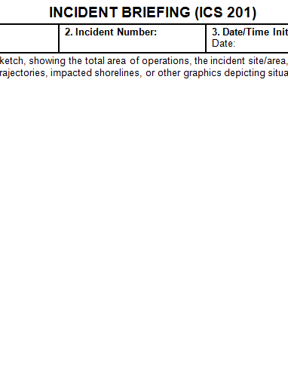
Incident Briefing (ICS Form 201)
  Provides staff with information about the incident situation and the resources allocated to the incident.
  Serves as a permanent record of the initial response to the incident.
  Can be used for transfer of command.
  Incident situation (maps, significant events)
  Incident objectives
  Summary of current actions
  Status of resources assigned or ordered

Slide 29
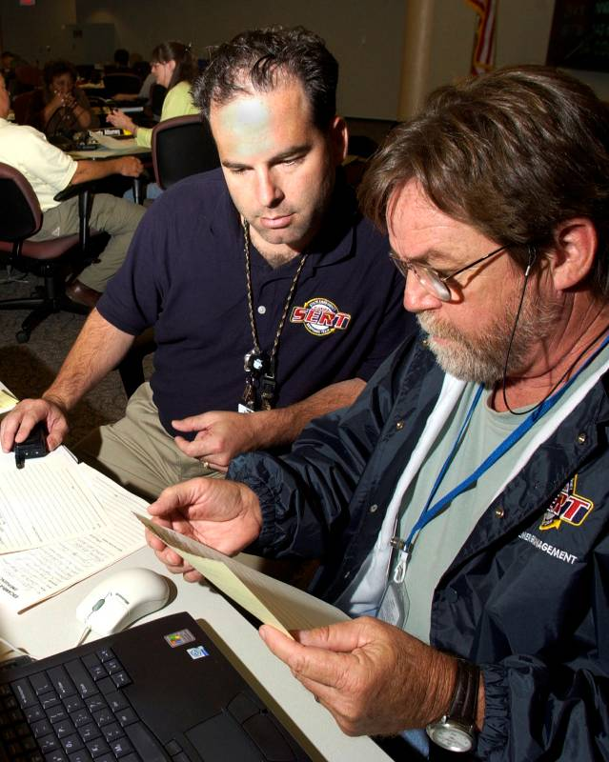
Transfer of Command
You have been serving as the initial Incident Commander.
A more qualified staff member has just arrived at the scene and will assume command of the incident.

Slide 30
Steps in Assuming Command
  Assess the situation with the current Incident Commander.
  Receive a briefing from the current Incident Commander.
  Determine an appropriate time for the transfer of command and document the transfer (ICS Form 201).
Notify others of the change in incident command.
  Assign the current Incident Commander to another position in the incident organization.
Refer to the next page in your Student Manual for more information about transfer of command briefings.

Slide 31
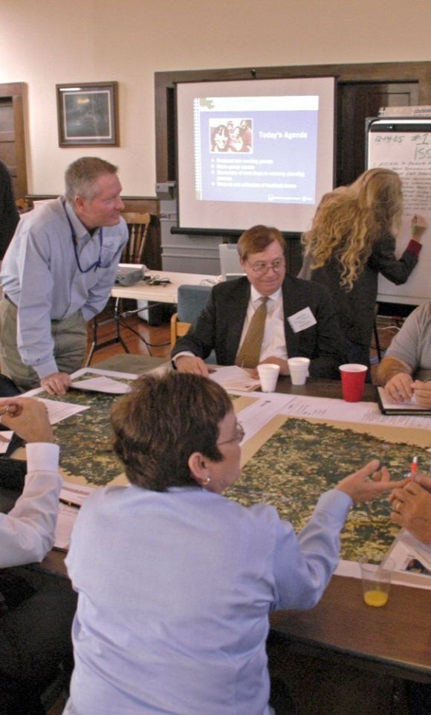
Applied Activity
Follow instructions . . .
  Presented by instructors.
  Outlined on handouts.

Slide 32
Summary
Are you now able to:
  Describe methods and tools used to assess incident/event complexity?
  Describe types of agency(s) policies and guidelines that influence management of incident or event activities?
  Describe the process for developing incident objectives, strategies, and tactics?
  Describe the steps in transferring and assuming incident command?
  As part of an activity, develop incident objectives for a simulated incident?

