Slide 1
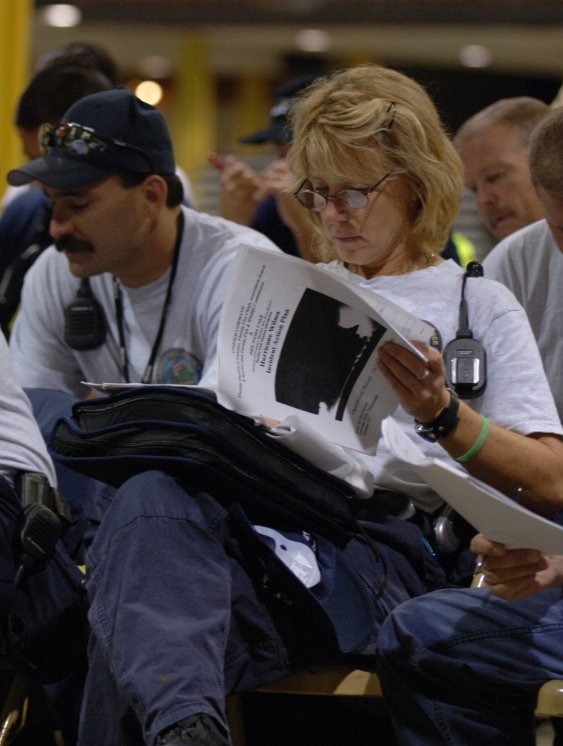
Unit 3:
Unified Command

Slide 2
Unit Objectives
  Define and identify the primary features of Unified Command.
  Describe how Unified Command functions on a multijurisdiction or multiagency incident.
  List the advantages of Unified Command.
  Given a simulated situation, demonstrate roles and reporting relationships under a Unified Command that involves agencies within the same jurisdiction and under multijurisdiction conditions.

Slide 3
Background on Unified Command
How can you organize
for incidents that cross jurisdictional boundaries or exceed individual agency responsibility?

Slide 4
Two Solutions
Options include:
  Dividing the incident geographically or functionally so that each jurisdiction or agency can establish its own ICS organization.
  Creating a single ICS incident structure
  and process that has an effective and responsible multijurisdictional or multiagency approach.

Slide 5
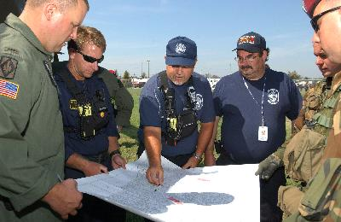
Definition of Unified Command
  As a team effort, Unified Command allows
  all agencies with jurisdictional authority or functional responsibility for the incident to jointly provide management direction to an incident through a common set of incident objectives and strategies and a single
  Incident Action Plan (IAP).
Each participating agency maintains its individual authority, responsibility, and accountability.

Slide 6
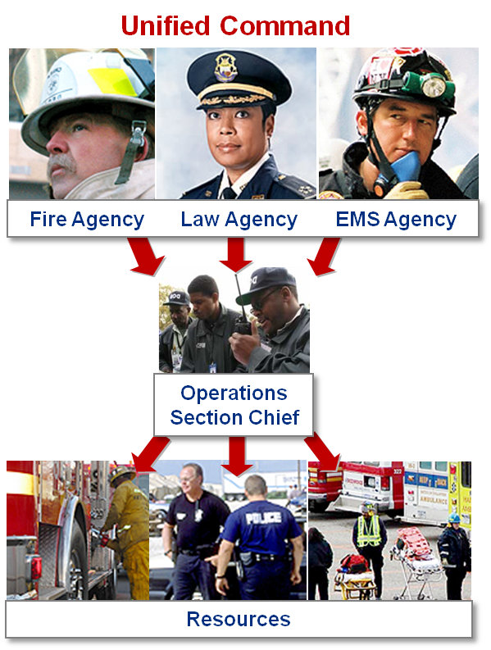
Unified Command
  Enables all agencies with responsibility to manage an incident together by establishing a common set
  of incident objectives and strategies.
  Allows Incident Commanders to make joint decisions by establishing a single command structure.
  Maintains unity of command. Each employee reports to only one supervisor.

Slide 7
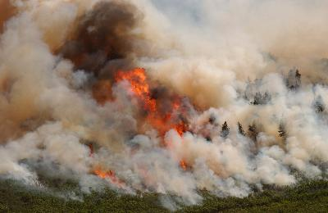
Unified Command: Multiple Jurisdictions
Incidents That Impact More Than One Political Jurisdiction
Example: A wildland fire starts in one jurisdiction and burns into another jurisdiction. Responding agencies from each jurisdiction have the same mission (fire suppression), and it is the political and/or geographical boundaries that mandate multiagency cooperation and involvement.

Slide 8
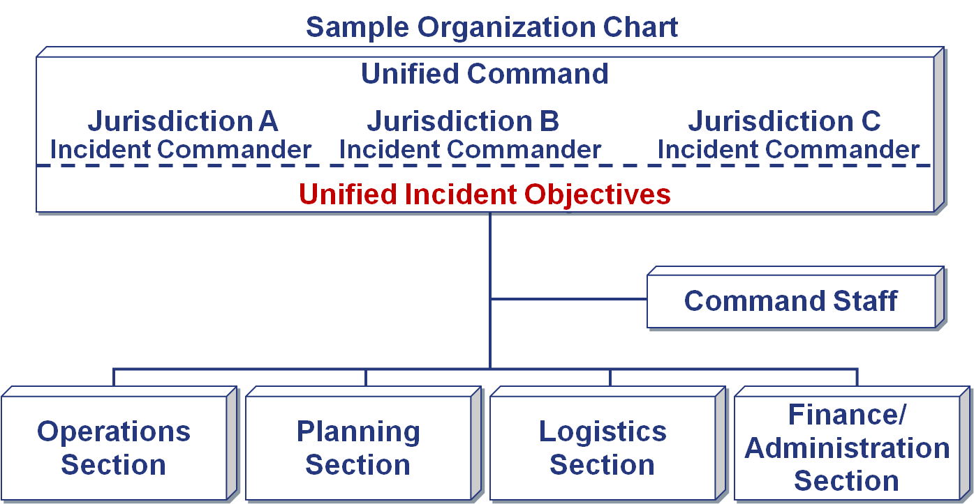
Multijurisdictional Incident

Slide 9
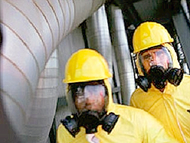
Unified Command: Multiple Agencies/Single Jurisdiction
Incidents Involving Multiple Agencies/Departments Within the Same Political Jurisdiction
Example: During a hazardous materials incident, the fire department has responsibility for fire suppression and rescue, the police department has responsibility for evacuation and area security, and public health agencies and others have responsibility for site cleanup.

Slide 10
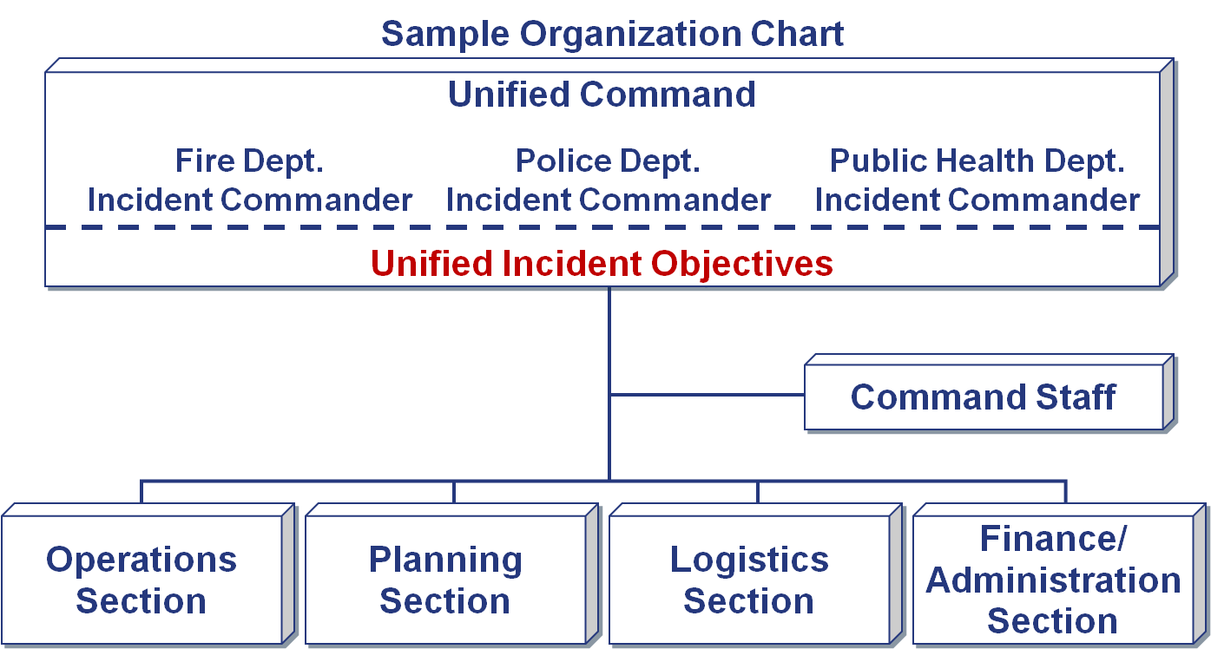
Multiagency/Single Jurisdiction Incident

Slide 11
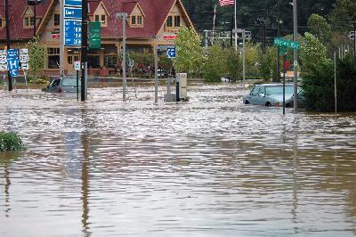
Unified Command: Multiagency/Multijurisdiction
Incidents That Impact on (or Involve) Several Political and Functional Agencies
Example: Severe weather, earthquakes, wildland fires, some special events, and terrorist threats involve large numbers of local, State, and Federal agencies. These incidents cross political boundaries and involve multiple
functional authorities.

Slide 12
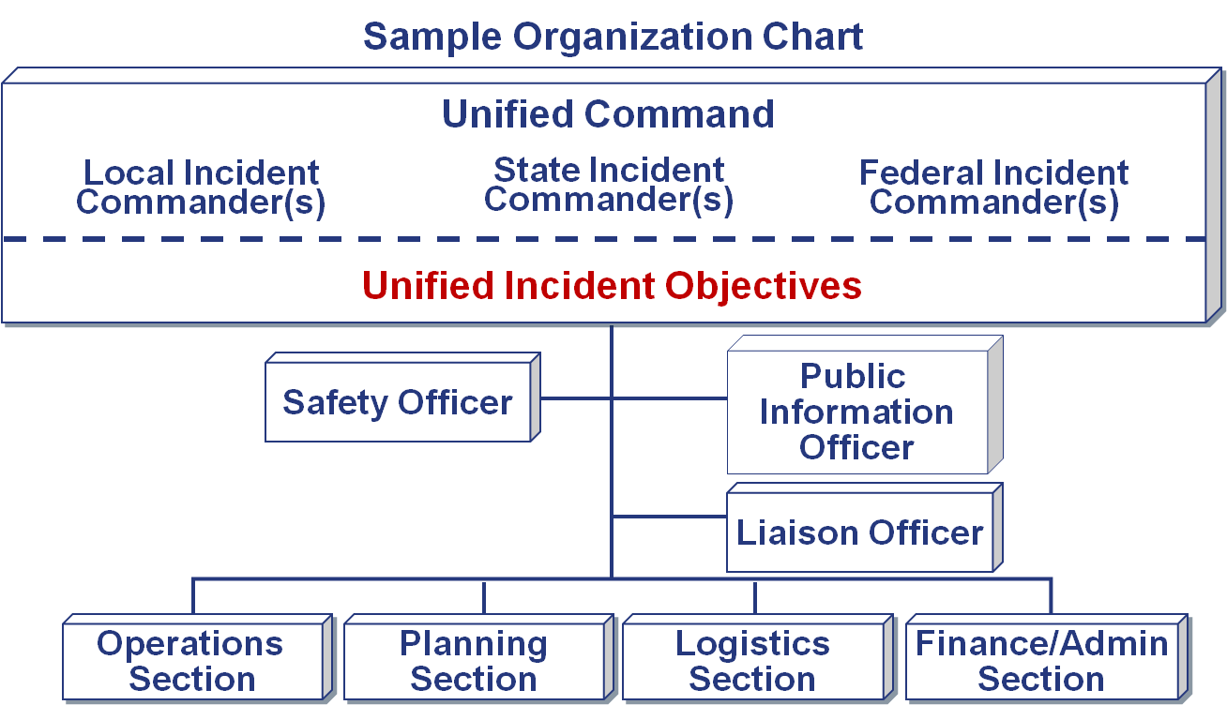
Multiagency/Multijurisdiction Incident

Slide 13
Unified Command Elements (1 of 2)
Policies, Objectives, Strategies: Are established jointly by each jurisdiction/agency authority in advance of tactical operations.
Organization: Consists of the various jurisdictional or agency on-scene senior representatives (agency Incident Commanders) operating within a Unified Command structure.
Resources: Are supplied by the jurisdictions and agencies that have functional or jurisdictional, legal, and financial responsibility.

Slide 14
Unified Command Elements (2 of 2)
  Operations: Are directed by one person, the Operations Section Chief, who controls tactical resources. There is still unity of command.
  Resources (personnel and equipment) stay under the administrative and policy control of their agencies. Operationally, they respond to tactical assignments under the coordination and direction of the Operations Section Chief.

Slide 15
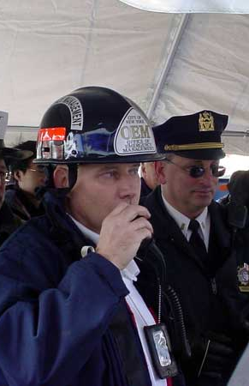
Unified Command Features: Overview
  A single integrated incident organization
  Collocated (shared) facilities
  One set of incident objectives, single planning process, and Incident Action Plan
  Integrated General Staff
  Coordinated process for resource ordering

Slide 16

Single Integrated Incident Organization
In a Unified Command:
  Jurisdictions and/or agencies blend into an integrated, unified team.
  The mix of participants depends on location of the incident and kind of incident.
  The members must function together as a team.

Slide 17
Building Teamwork
How can you build the teamwork necessary for Unified Command?

Slide 18
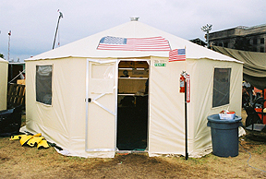
Collocated (Shared) Facilities
A single Incident Command Post allows the Unified Command to maintain a coordinated effort.

Slide 19
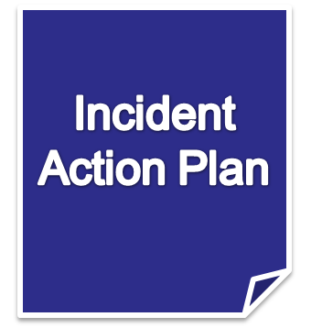
Single Planning Process and IAP
  Joint planning must be initiated as
  soon as two or more agencies form
  a Unified Command.
  This planning process results in a
  single Incident Action Plan (IAP)
  that addresses multijurisdiction or
  multiagency priorities and specifies tactical operations and resource assignments.
  The planning process will be covered in Unit 5.

Slide 20
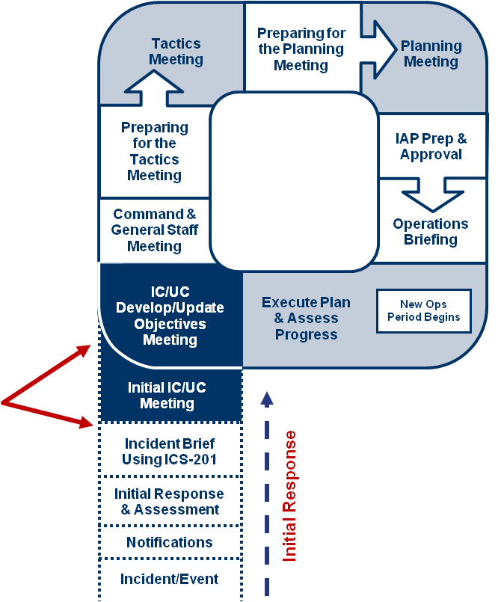
Planning “P” and Unified Command
The Unified Command meets:
Initially to assess the situation, set priorities, discuss authorities, determine strategies, and establish the organization.
At the onset of each operational period to develop or update objectives.

Slide 21
Initial Unified Command Meeting
The Initial Unified Command Meeting:
  Includes all members of the Unified Command.
  Takes place before the first operational period planning meeting.
  Provides the responsible agency officials with an opportunity to discuss and concur on important issues prior to joint incident planning.

Slide 22
Shared General Staff Sections
Integrating multijurisdictional and/or multiagency personnel into various other functional areas may be beneficial. For example:
  In Operations and Planning, Deputy Section Chiefs can be designated from an adjacent jurisdiction.
  In Logistics, a Deputy Logistics Section Chief from another agency or jurisdiction can help to coordinate incident support.
Are there more
examples?

Slide 23
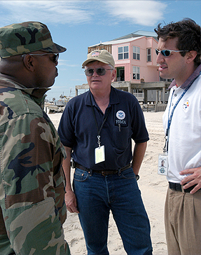
Integrated General Staff
  Incident Commanders within the Unified Command must concur on the selection of the General Staff Section Chiefs.
  The Operations Section Chief must have full authority to implement the tactics within the IAP.

Slide 24
Selection of the Ops Section Chief
What should be considered when selecting the Ops Section Chief in a Unified Command?

Slide 25
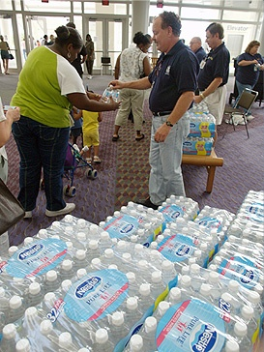
Coordinated Resource Ordering
The Incident Commanders within the Unified Command work together to establish resource ordering procedures that allow for:
  Deployment of scarce resources to meet high-priority objectives.
  Potential cost savings through agreements on cost sharing for essential services.

Slide 26
Incident Commander Responsibilities
Each designated agency Incident Commander functioning in a Unified Command must:
  Act within his/her jurisdictional or agency limitations.
  Inform the other Commanders of any legal, political, jurisdictional, or safety restrictions.
  Be authorized to perform certain activities and actions on behalf of the jurisdiction or agency he/she represents.
  Manage the incident to the best of his/her abilities.

Slide 27
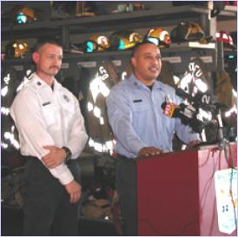
Spokesperson Designation
One of the Incident Commanders may be designated as the spokesperson to:
  Serve as a designated channel of communications from Command and General Staff members.
  Provide a point of contact as necessary for the Command and General Staffs.
The spokesperson does NOT make independent command decisions!

Slide 28
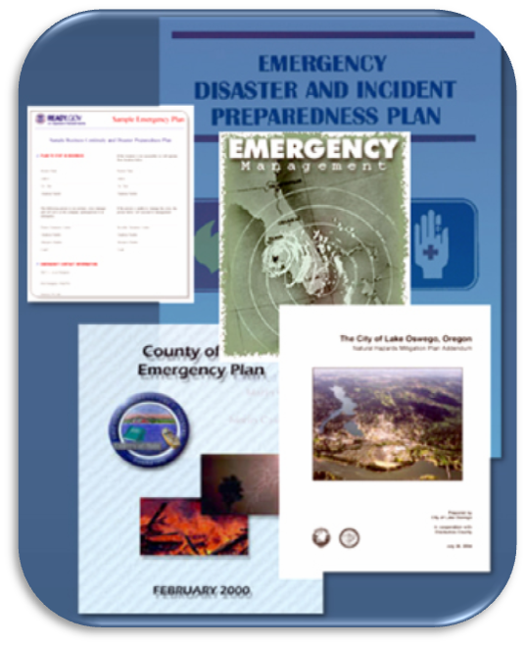
Unified Command and Preparedness
  Include Unified Command delegations in local emergency operations plans and interagency/ mutual-aid agreements.
  Conduct training exercises using Unified Command with adjacent jurisdictions and functional agencies.

Slide 29
Advantages of Unified Command
Now that you’ve learned more about Unified Command . . .
What are the advantages of using Unified Command?

Slide 30
Summary: Advantages of Using Unified Command
  A single set of objectives is developed for the entire incident.
  A collective approach is used to develop strategies to achieve incident objectives.
  Information flow and coordination are improved between all jurisdictions and agencies involved in the incident.
  All agencies with responsibility for the incident have an understanding of joint priorities and restrictions.
  No agency’s legal authorities will be compromised or neglected.
  The combined efforts of all agencies are optimized as they perform their respective assignments under a single Incident Action Plan.

Slide 31

Applied Activity
Follow instructions . . .
  Presented by instructors.
  Outlined on handouts.

Slide 32
Summary
Are you now able to:
  Define and identify the primary features of Unified Command?
  Describe how Unified Command functions on a multijurisdiction or multiagency incident?
  List the advantages of Unified Command?
  Given a simulated situation, demonstrate roles and reporting relationships under a Unified Command that involves agencies within the same jurisdiction and under multijurisdiction conditions?

