Slide 1
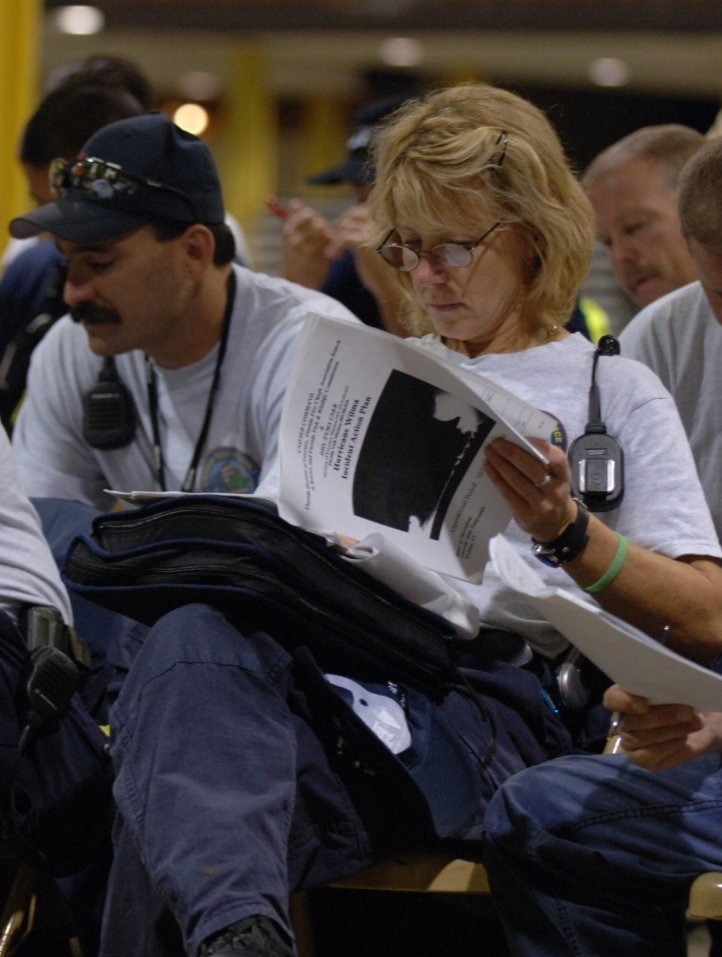
Unit 2:
ICS
Fundamentals Review

Slide 2
Unit Objectives (1 of 2)
  Describe how ICS fits into the Command and Management component of NIMS.
  Describe ICS reporting and working relationships for Technical Specialists and Agency Representatives.
  Describe reporting relationships and information flow within the organization.
  Match responsibility statements to each ICS organizational element.
  List the ICS positions that may include Deputies and describe Deputy roles and responsibilities.

Slide 3
Unit Objectives (2 of 2)
  Describe differences between Deputies and Assistants.
  Describe how incidents can best be managed by appropriate and early designation of primary staff members and by delegating authority to the lowest practical level.
  List the minimum staffing requirements within each organizational element for at least two incidents of different sizes.
  Describe the importance of establishing proper span of control for aviation resources and facilities.

Slide 4
Activity: Defining ICS
Instructions:
Working as a team, answer the questions below:
    What is ICS?
    What are the benefits and features of ICS?
    What is a nonemergency situation in which ICS could be used?
Record your answers on chart paper.
Choose a spokesperson and be ready to present your answers to the group in 10 minutes.

Slide 5
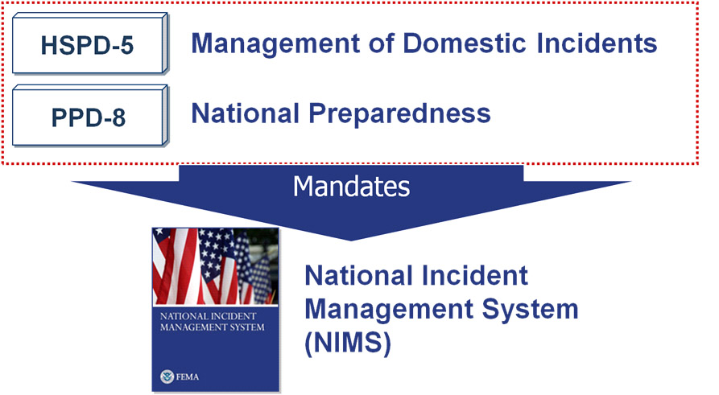
Presidential Directives

Slide 6
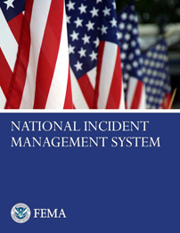
NIMS
What ? . . . NIMS provides a consistent nationwide template . . .
Who? . . . to enable Federal, State, tribal, and local governments, the private sector, and nongovernmental organizations to work together . . .
How? . . . to prepare for, prevent, respond to, recover from, and mitigate the effects of incidents regardless of cause, size, location, or complexity . . .
Why? . . . in order to reduce the loss of life and property, and harm to the environment.

Slide 7
NIMS Components & ICS
Preparedness
Communications and
Information Management
Incident Command System
Resource Management
Multiagency Coordination Systems
Command and Management
Ongoing Management and
Maintenance
Public Information

Slide 8
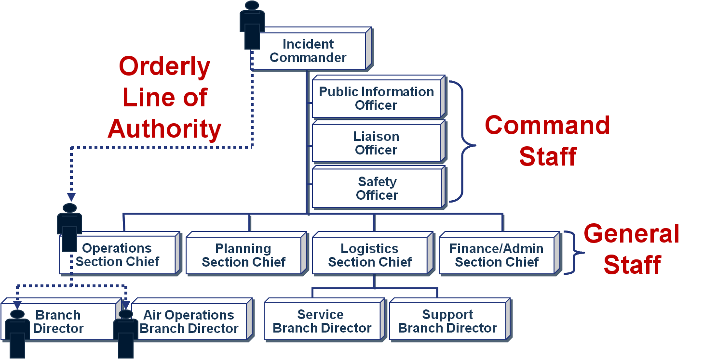
Chain of Command

Slide 9
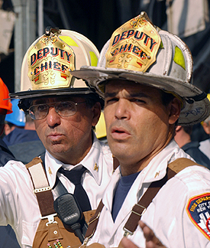
Unity of Command
Under unity of command, personnel:
  Report to only one supervisor.
  Receive work assignments only from their supervisors.
Don’t confuse unity of command
with Unified Command!

Slide 10
“Unity” vs. “Unified”
What’s the difference between unity of command and Unified Command?

Slide 11
Activity: Incident Commander Qualities
Instructions:
Working as a team, answer the questions below:
    What are the major duties of an Incident Commander?
    What are the qualities of an effective Incident Commander?
Record your answers on chart paper.
Choose a spokesperson and be ready to present your answers to the large group in 10 minutes.
You may want to refer to the review materials in your Student Manuals!

Slide 12
Incident Management Roles
Incident Commander’s
Role
The Incident Commander:
Manages the incident at
the scene.
Keeps the EOC informed
on all important matters
pertaining to the incident.
Agency Executives’/Senior Officials’ Role
These officials provide the following to the Incident Commander:
Policy
Mission
Strategic direction
Authority
To maintain unity of command and safety of responders, the chain of command must NOT be bypassed.

Slide 13
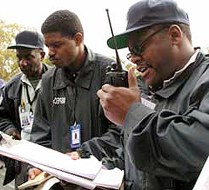
Common Terminology
Using common terminology helps to define:
  Organizational functions.
  Incident facilities.
  Resource descriptions.
  Position titles.

Slide 14
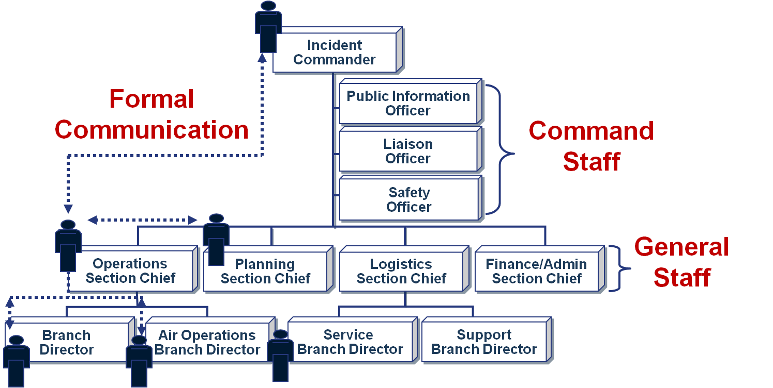
Formal Communication (1 of 2)

Slide 15
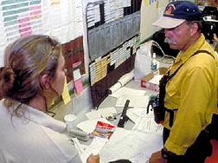
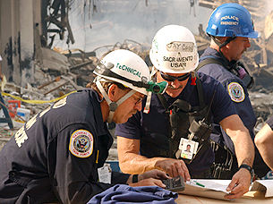
Formal Communication (2 of 2)
Use formal communication when:
  Receiving and giving work assignments.
  Requesting support or additional resources.
  Reporting progress of assigned tasks.

Slide 16
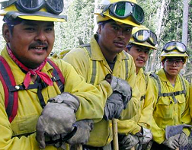
Informal Communication
  Is used to exchange incident or event information only.
  Is NOT used for:
    Formal requests for additional resources.
    Tasking work assignments.
Within the ICS organization, critical information must flow freely!

Slide 17
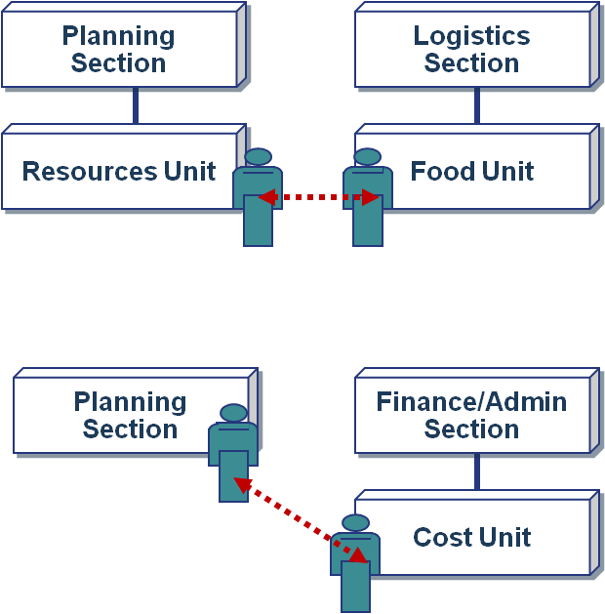
Informal Communication: Examples
  The Food Unit Leader may directly contact the Resources Unit Leader to determine the number of persons requiring feeding.
  The Cost Unit Leader may directly discuss and share information on alternative strategies with the Planning Section Chief.

Slide 18
Modular Organization
Incident command organizational structure is based on:
  Size, type, and complexity of
  the incident.
  Specifics of the hazard
  environment created by
  the incident.
  Incident planning process
  and incident objectives.

Slide 19
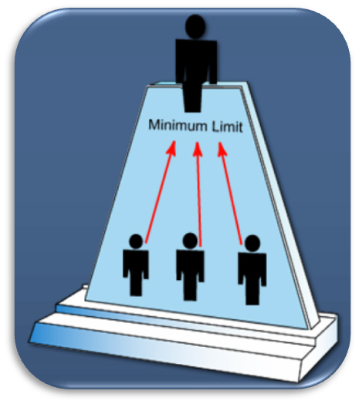
ICS Expansion and Contraction
Although there are no hard-and-fast rules, remember that:
  Only functions/positions that are necessary are filled.
  Each activated element must
  have a person in charge.
  An effective span of control
  must be maintained.

Slide 20
Delegation
Delegating to the lowest level possible allows ICS supervisors to:
  Assign responsibilities to subordinates. Until a task is delegated, the supervisor must assume responsibility for completing it.
  Maintain a manageable span of
  control for the supervisor.

Slide 21
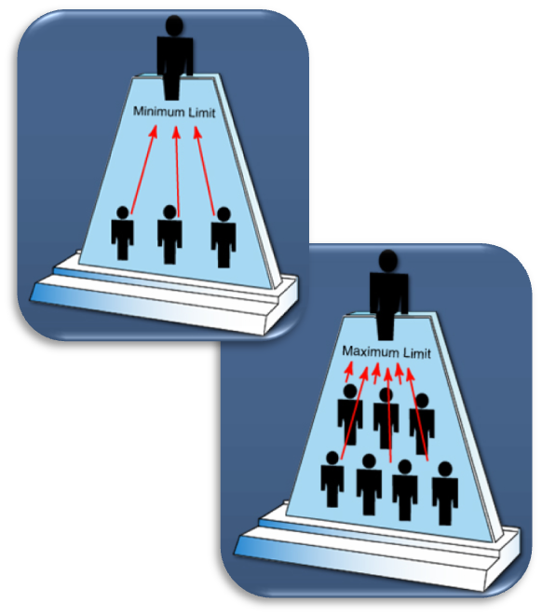
ICS Management: Span of Control
ICS span of control for any supervisor:
  Is between 3 and 7 subordinates.
  Optimally does not exceed 5 subordinates.

Slide 22
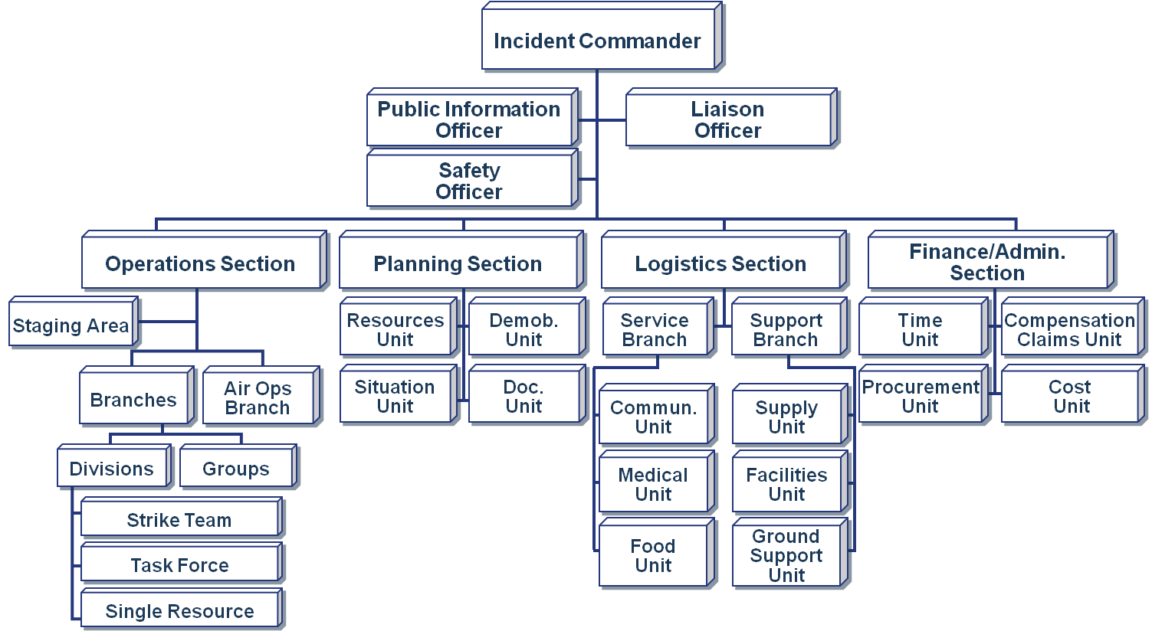
ICS Organizational Components

Slide 23
Air Operations Branch
An Air Operations Branch can be established if:
  Tactical and logistical air support activity is needed.
  Helicopters and fixed-wing aircraft are involved within the incident airspace.
  Safety, environmental, weather, or temporary flight restriction issues arise.
  A helibase or several helispots are required.
  Agency policy and/or flight operations SOPs require it.
  The Incident Commander and/or Operations Section Chief are unfamiliar with aviation resources, their uses, and safety procedures.

Slide 24
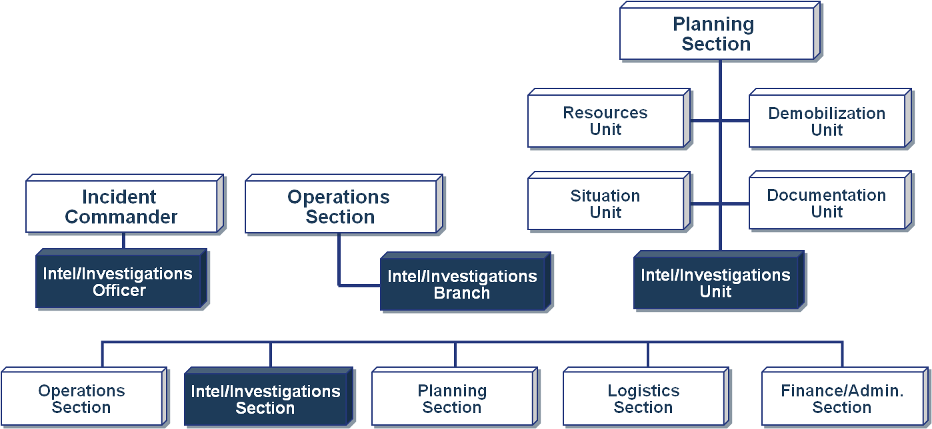
Intelligence/Investigations Function
Based on the incident needs, the Intelligence and Investigations Function may be activated as a fifth Section, as an element within the Operations or Planning Sections, or as part of the Command Staff.

Slide 25

Organizational Review Questions
I serve as the point of contact for representatives of other governmental agencies, nongovernmental organizations, and/or private entities.
Who am I?

Slide 26

Organizational Review Questions
My Section is responsible for all support requirements needed to facilitate effective and efficient incident management, including ordering resources from off-incident locations.
Who am I?

Slide 27

Organizational Review Questions
I monitor incident operations and advise the Incident Commander on all matters relating to the health and safety of emergency responder personnel.
Who am I?

Slide 28

Organizational Review Questions
As Chief of my Section, I manage all tactical operations at an incident.
Who am I?

Slide 29
Organizational Review Questions
Although I may be at the scene, I coordinate closely with the Joint Information Center.
Who am I?

Slide 30

Organizational Review Questions
My Section collects situation and resources status information, evaluates it, and processes the information for use in developing action plans.
Who am I?

Slide 31
ICS Supervisory Position Titles
Titles for all ICS supervisory levels are shown in the table below.
Organizational Level | Title | Support Position
Incident Command | Incident Commander | Deputy
Command Staff | Officer | Assistant
General Staff (Sections) | Chief | Deputy
Branch | Director | Deputy
Division /Group | Supervisor | n/a
Unit | Leader | Manager
Strike Team/Task Force | Leader | Single Resource Boss

Slide 32

Organizational Review Questions
Two Supervisors have been dispatched with resources (personnel and equipment) to evacuate homes within the potential hazard zone.
One Supervisor has responsibility for the east side of the community and the other has responsibility for the west side.
What type of ICS organizational structure is being described?

Slide 33
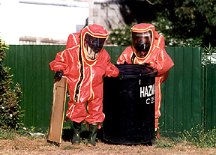
Organizational Review Questions
HazMat specialists, sanitation workers, and disposal equipment are grouped together, under the direct supervision of a Leader, to handle the removal of hazardous waste.
What type of ICS organizational structure is being described?

Slide 34
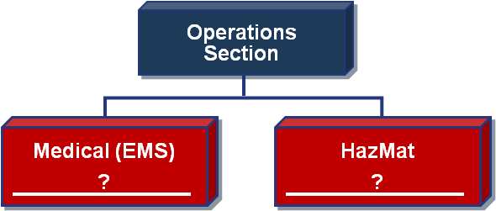
Organizational Review Questions
As incident objectives and resources expand, the Operations Section Chief begins organizing
resources into functional areas that are managed by
a Supervisor.
On the organizational chart, the title of each component would be a _________________.

Slide 35
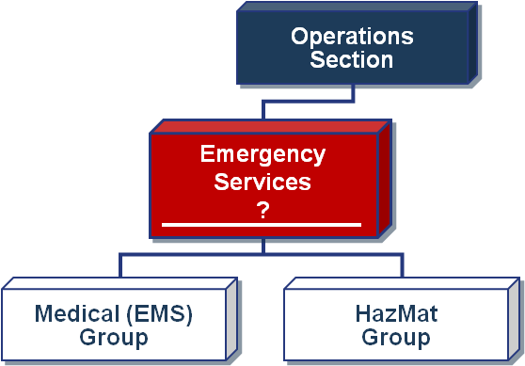
Organizational Review Questions
As the operation expands even further, the Operations Section Chief appoints a Director to manage the Groups.
On the organizational chart, the title of the organizational component managed by a Director would be called the Emergency Services _________________.

Slide 36
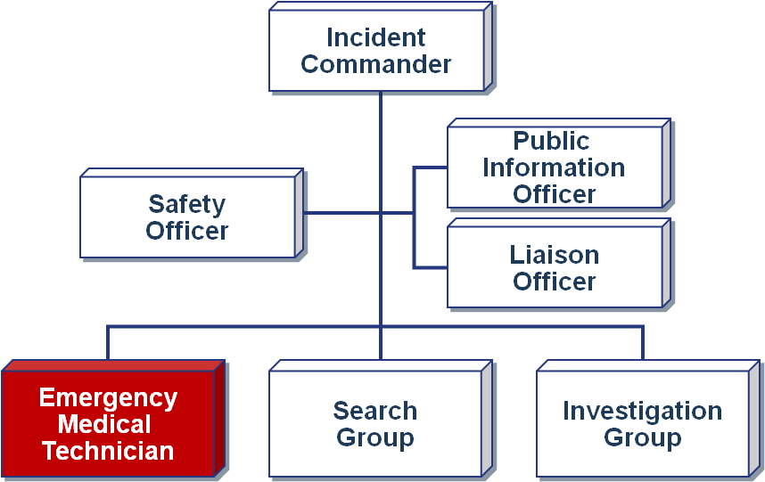
Organizational Review Questions
What ICS term
is used to describe the Emergency Medical Technician?

Slide 37
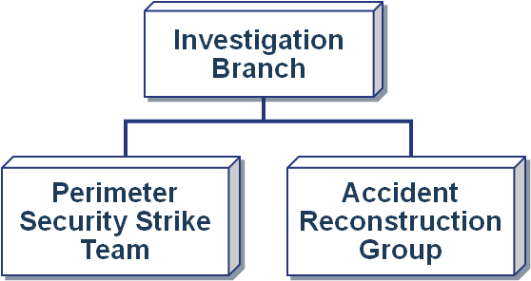
Organizational Review Questions
What is the supervisor’s title for each organizational element shown?

Slide 38
Deputies, Assistants, Tech Specialists, & Agency Reps
Review the materials in your Student Manuals and then answer the following questions:
  Deputies
    Where can Deputies be assigned?
    What are the requirements for Deputies?
  Assistants
    Where can Assistants be assigned?
    What is an example of a duty assumed by an Assistant?
  Technical Specialists
    Where can Technical Specialists be assigned?
    What types of Technical Specialists have you worked with on past incidents?
  Agency Representatives
    Where can Agency Representatives be assigned?
    What does an Agency Representative do?

Slide 39
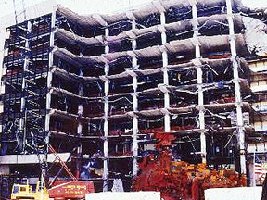
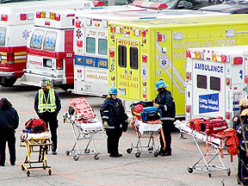
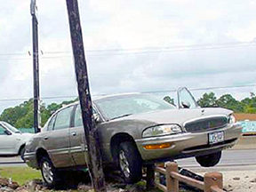
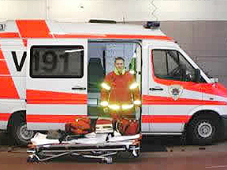
Incident Complexity and Resource Needs
Incident Complexity Resource Needs ICS Structure
Complexity

Slide 40

Applied Activity
Follow instructions . . .
  Presented by instructors.
  Outlined on handouts.

Slide 41
Summary (1 of 2)
Are you now able to:
  Describe how ICS fits into the Command and Management component of NIMS?
  Describe ICS reporting and working relationships for Technical Specialists and Agency Representatives?
  Describe reporting relationships and information flow within the organization?
  Match responsibility statements to each ICS organizational element?
  List the ICS positions that may include Deputies and describe Deputy roles and responsibilities?

Slide 42
Summary (2 of 2)
Are you now able to:
  Describe differences between Deputies and Assistants?
  Describe how incidents can best be managed by appropriate and early designation of primary staff members and by delegating authority to the lowest practical level?
  List the minimum staffing requirements within each organizational element for at least two incidents of different sizes?
  Describe the importance of establishing proper span of control for aviation resources and facilities?

