Slide 1
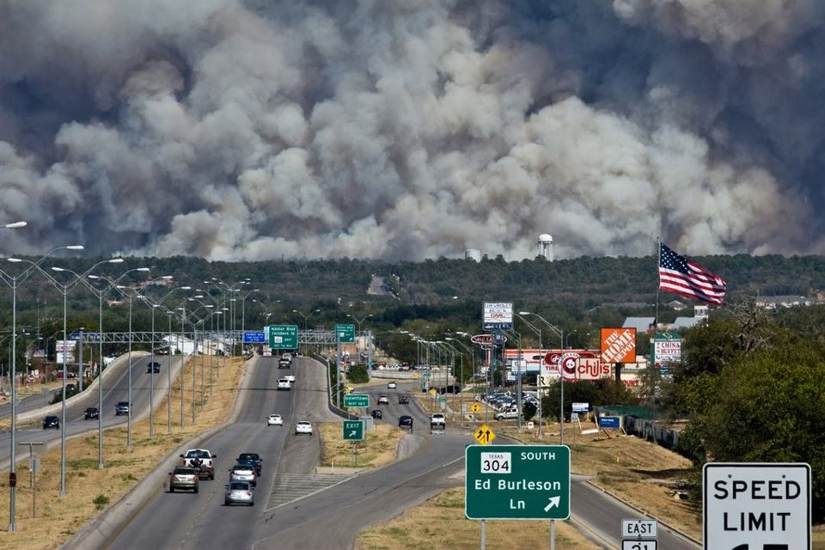
Bastrop County Complex
Bastrop, Texas Sept 2011

Slide 2
Bastrop County Complex
“An All Hazard Incident That Was Caused by a Wildfire”
Two civilian fatalities
1594 homes destroyed in 72 hours
First assignment of one of the national FEMA USAR teams to a wildland fire incident?
Caused by extreme drought, driven by the winds created as Hurricane Lee was squeezed by a high pressure ridge to its west
Unified Command under Bastrop County EMD, Texas Forest Service and Southern Area Red Team Incident commander
Major amounts of law enforcement, non fire emergency services, and private utility companies involved and coordinated under a single IAP
First expanded incident management team in Command was a Texas State trained All Hazard IMT3

Slide 3
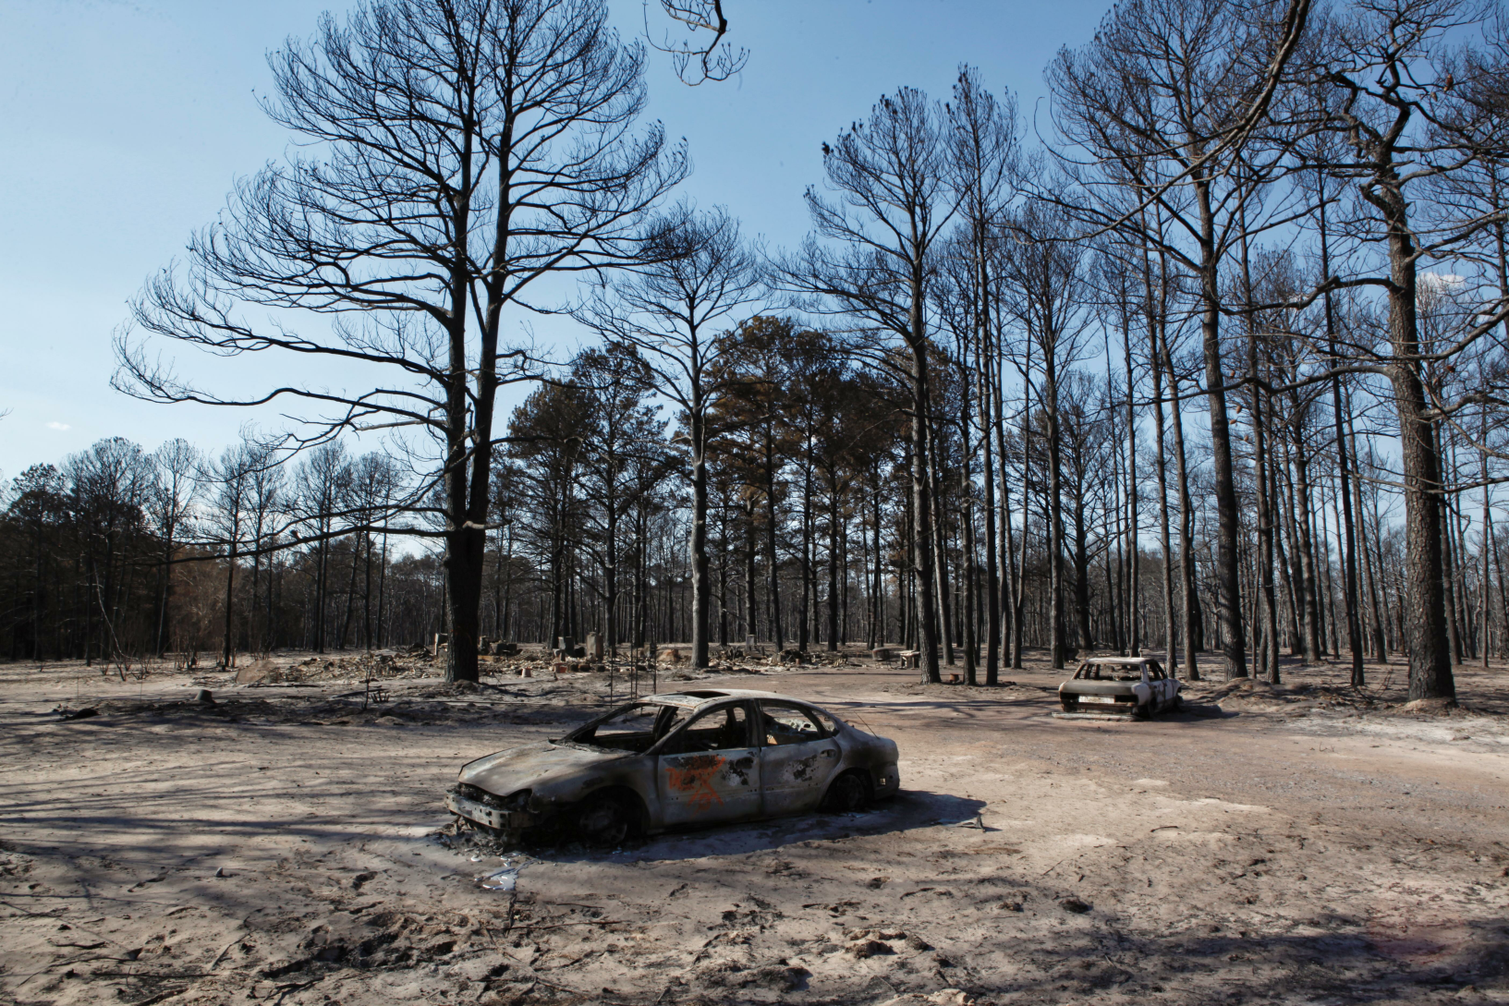

Slide 4
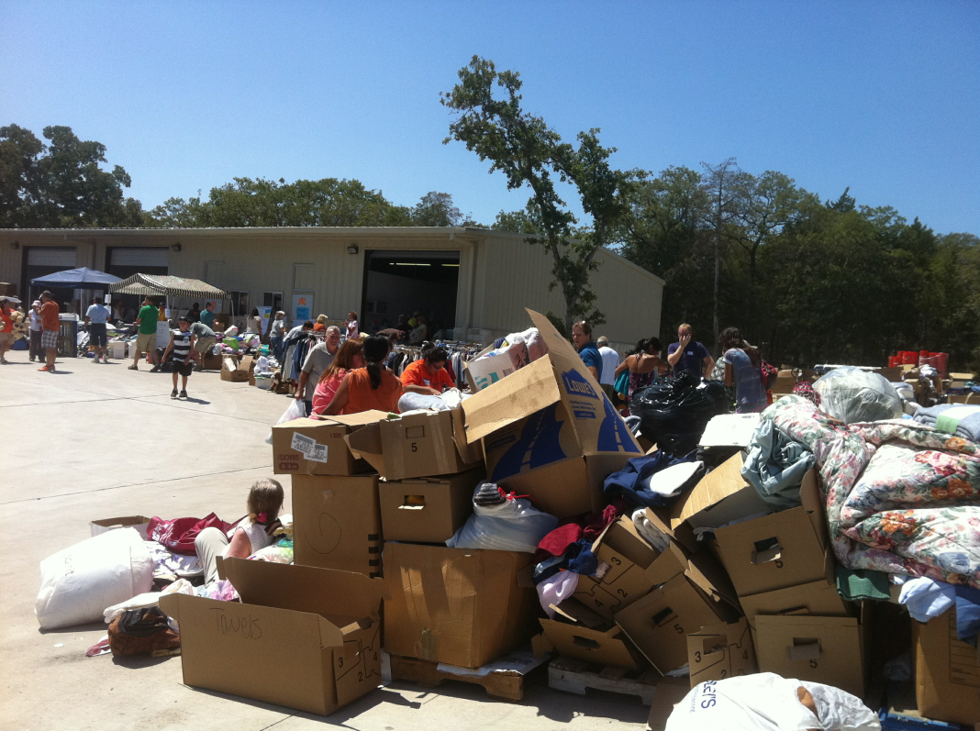
Branch Tactical Planning Used in Three Ways
Bastrop County Office of Emergency Management began Recovery Branch by about day 5

Slide 5
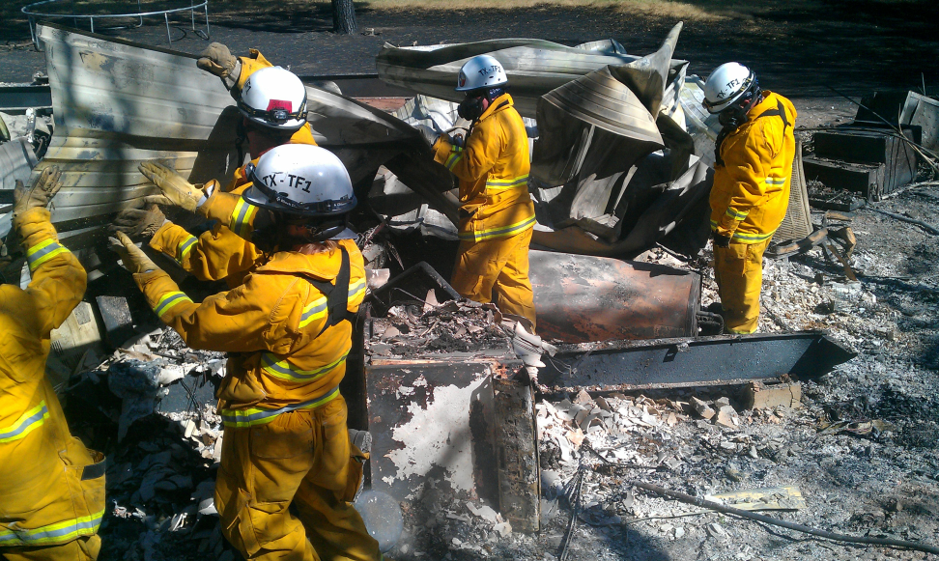
USAR Group (Texas TF1) used Branch Tactical Planning for their detailed work assignments

Slide 6
Texas Department of Public Safety used Branch Tactical Planning for specific law enforcement assignments. 204’s were incorporated into the single IAP

Slide 7
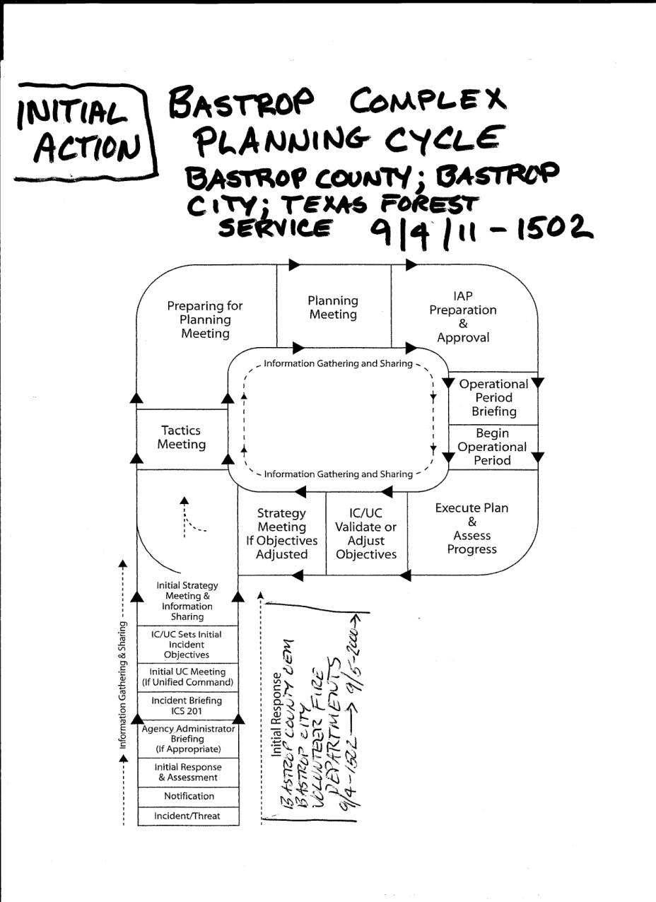
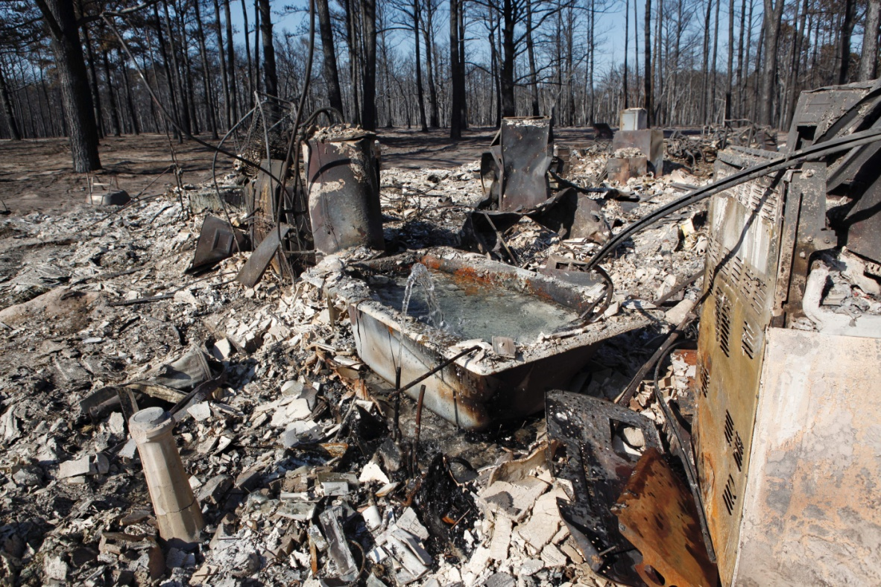

Slide 8


Slide 9


Slide 10
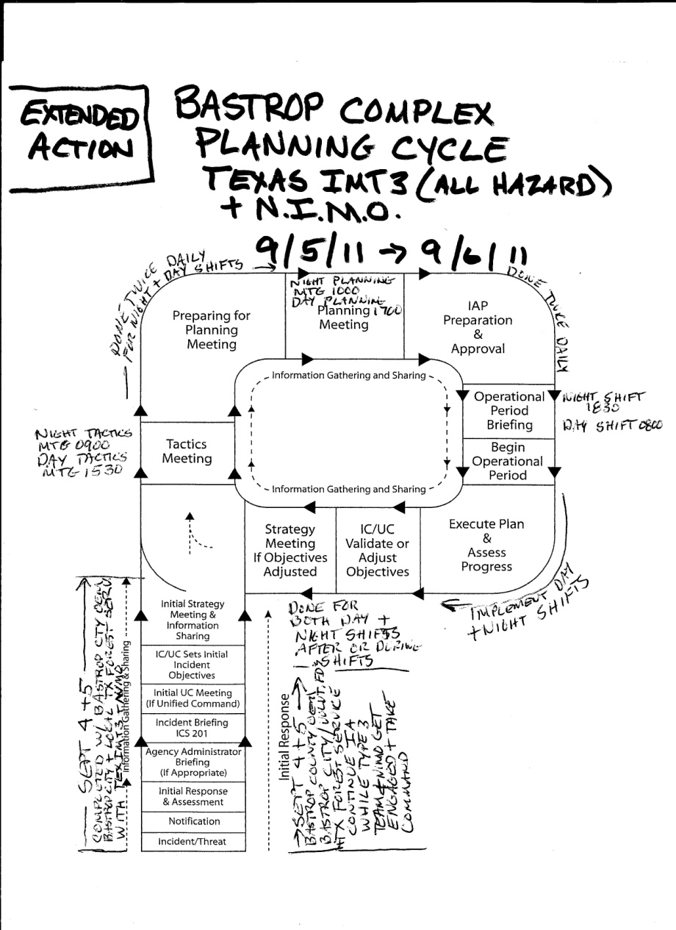
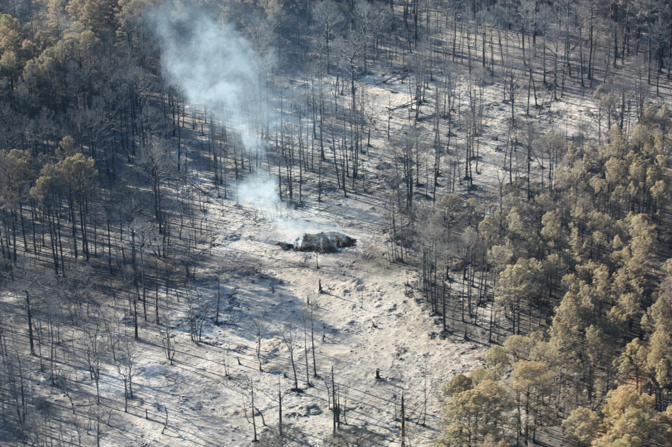

Slide 11


Slide 12
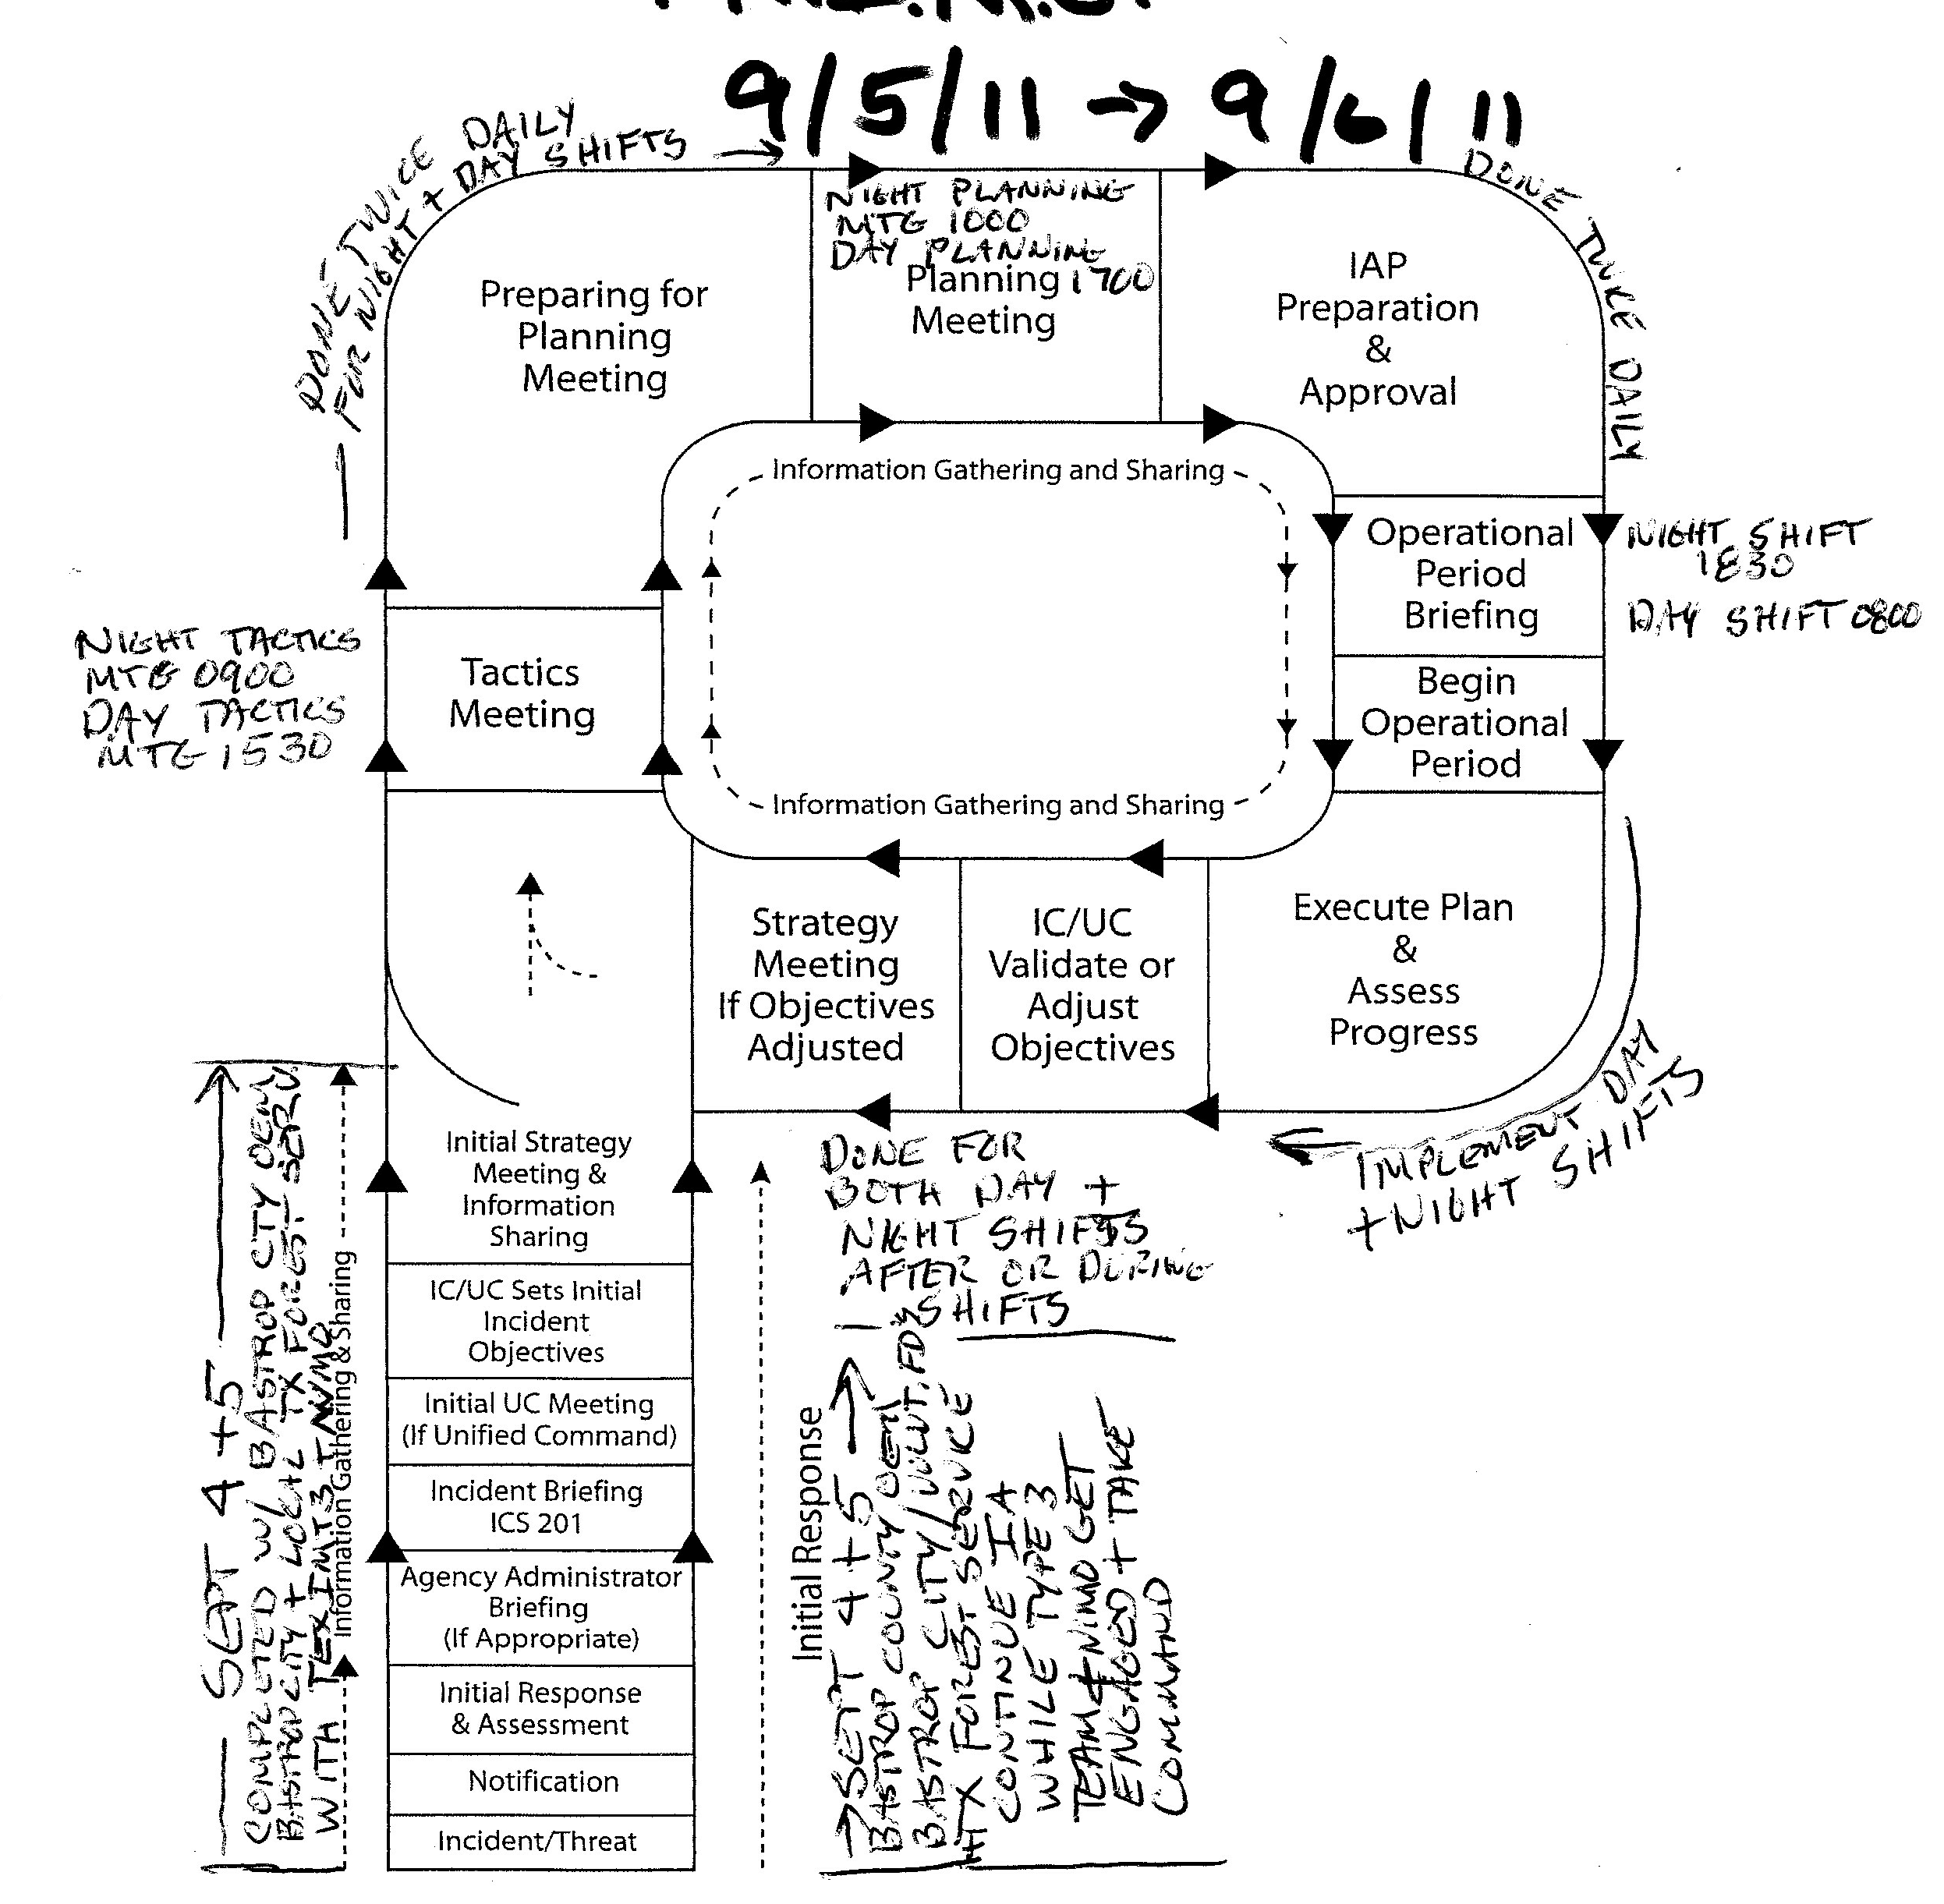

Slide 13
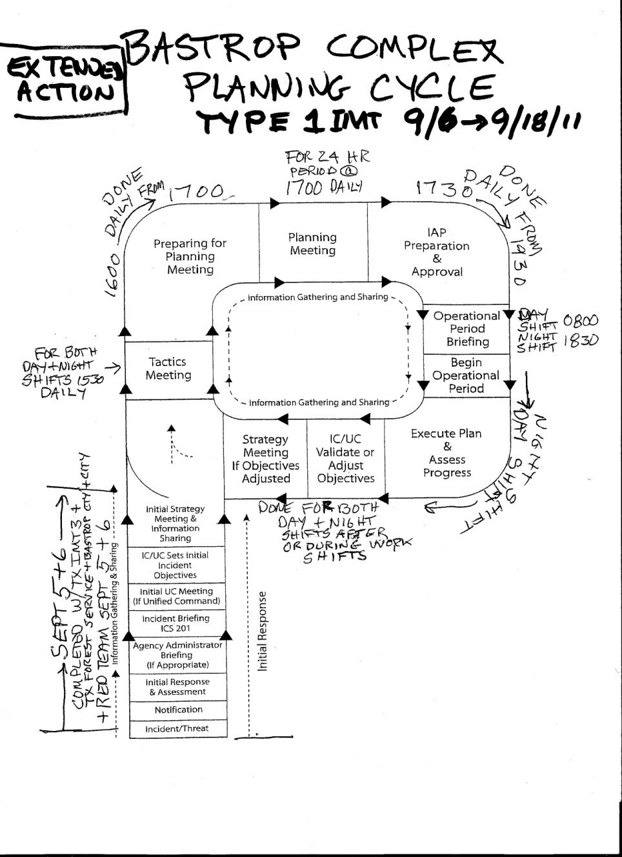

Slide 14


Slide 15
